Slide 1


Introduction to GoLang VMWare 19 November – 21 November 2018 by Fernando Pombeiro

Slide 2
Module Five: Deployment and DevOps in GO

Slide 3
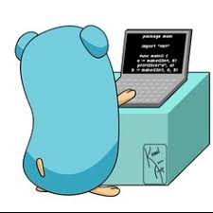
Why GO to build Command line apps?
So one of the most powerful things about golang is that it’s super easy to create binary files.
This offers several huge advantages- for example- if you need to deploy an application you simply run the built in go command line command “go build <my app name>” and, assuming no compling errors- you get a binary fine in your home directory of that application!!

Slide 4

Why is the binary file so powerful?
Ever try to deploy an especially large directory structure for a complex application? Especially one that needs to be compiled down? It’s painful- and you can see the difference immediately when deploying, for example, docker containers.
The simple go build command is all you need to create the binary. After that, to deploy (assuming you are doing it with docker)- simply wrap the binary file.

Slide 5

Go install
GO also comes with a simple command line application that will install into a binary folder that you can set with the $GOBIN environment variable.
If there is no $GOBIN environment variable set then the binary file will go to $GOPATH/bin
You can also create a similar system using go build –o /somepath/to/yourbinary

Slide 6
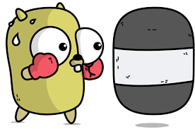
Creating Command Line Applications
So in this next section we’re going to go through creating command line applications in GOLANG. A large part of this will hearken back to the first module!
Sign into your virtual machine (whatever that virtual machine is- if you want to use Docker then by all means go with docker!)
Let’s START by creating a command line application on our HOST machine (we’ll do docker containers later!)

Slide 7
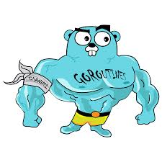
The Deathstalker Command line app
Obviously no host machine is complete without a Deathstalker command line application (thanks Roger Corman!).
(If you’re curious- it’s a 1982 Conan the Barbarian film and it’s about as good as you think it is (meaning awful)).
The application will seek an input of ”magical-amulet” as it’s input.

Slide 8
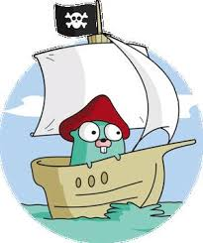
Moving on to Module 5….
AND WE’RE DONE!
ANY QUESTIONS?!?

