Slide 1


Introduction to GoLang VMWare 19 November – 21 November 2018 by Fernando Pombeiro

Slide 2
Module THREE: Control Flow, States, Methods

Slide 3
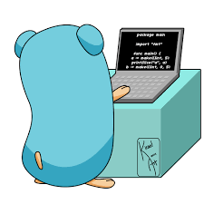
The Go Control Flow
Go has three basic control flow patterns that we’ll be reviewing:
If/else
for (looping)
switch
We’ll be going through each of these in detail. GO is heavily dedicated to simplicity and has pretty much limited to these methods.

Slide 4
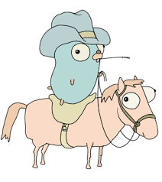
IF statement
Similar construct to C:
if answer != 42 {
return "Wrong answer"
}
There is an option for the shortened statement:
Set the variable then
Evaluate the truth or falsehood of the variable
NOTE that parentheses are not required
if err := foo(); err != nil { panic(err) }

Slide 5
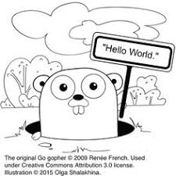
IF statement
One more thing…
There is no ternary if in GO– so none of this:
isittrue = a < 0 ? true : false
You have to spell it out…every time
You DON’T need parentheses- you DO need braces

Slide 6
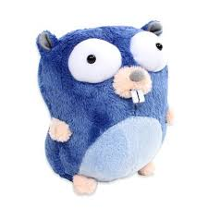
Logical Operators with IF statements
Pretty standard logical operators here:
“&&” is “AND”
“||” is “OR”
“!” is the logical NOT operator
The usual applies:
if ( a && b ) = a and b must be true to evaluate to true
if (a || b) = a can be true or b can be true or both
if ( !(a && b) ) = a and b must both be false to evaluate to true

Slide 7
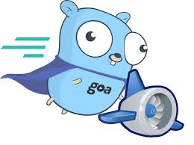
The GO “for” loop
The GO FOR loop has three basic components; we separate them by semi-colons:
The init statement (to be executed before execution):
i := 0
The condition expression- evaluated before every iteration:
i < 10
The post statement: executed at the end of every iteration:
i ++
Note: Unlike other languages like C, Java, or JavaScript there are no parentheses surrounding the three components of the for statement and the braces { } are always required.

Slide 8
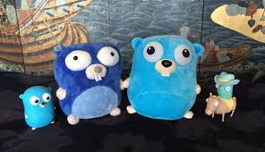
FOR loops in GO
When “FOR” looping through arrays (or slices) you can pull the index AND the value by using the range keyword.
For example:
nums := []int{2, 3, 4}
sum := 0
for _, num := range nums {
sum += num
}

Slide 9

SWITCH statements in GO
Again- similar to C– the switch statement here is mainly to avoid making us create a long series of really ugly if-then statements.:
myRanking := 7
switch myRanking {
case 1:
fmt.Println(“Terrible”)
case 2:
fmt.Println(“Really Bad”)

Slide 10
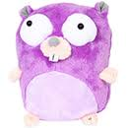
Switch Statements in GO (continued)
Switch statements can have “default” values if nothing matches:
a := ”superman”
switch a {
case “batman”:
fmt.Println(“Bruce Wayne”)
case “spiderman”:
fmt.Println(“Peter Parker”)
default:
fmt.Println(“Clark Kent”)

Slide 11

Switch statements continued
Switch Statements can have multiple cases on a single line:
score := 7
switch score {
case 0, 1, 3:
fmt.Println("Terrible")
case 4, 5:
fmt.Println("Mediocre")
case 6, 7:
fmt.Println("Not bad") }

Slide 12
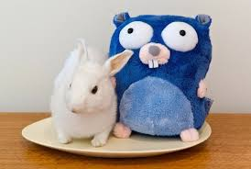
Switch Statements
break will break you out of the loop while fallthrough will evaluate the rest of the statement:
n := 1
switch n {
case 0:
fmt.Println("is zero")
fallthrough
case 1:
fmt.Println("<= 1")
fallthrough
case 2:
fmt.Println("<= 2")
break
}

Slide 13
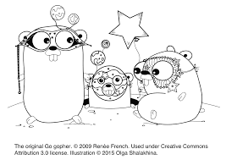
Switch Statements
You can evaluate statements IN the case section:
num := 3
v := num % 2
switch v {
case 0:
fmt.Println("even")
case 3 - 2:
fmt.Println("odd")

Slide 15
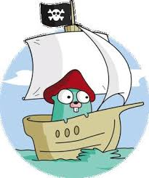
DATA TYPES!!
AND WE’RE DONE!
ANY QUESTIONS?!?

