Slide 1


Introduction to GoLang VMWare 19 November – 21 November 2018 by Fernando Pombeiro

Slide 2
Module Four: Concurrency and Routines

Slide 3
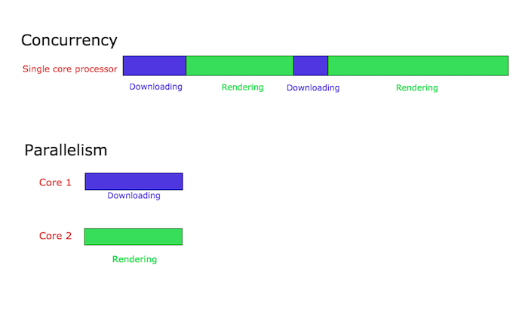
Concurrency vs Parallelism in GO
So let’s talk Parallelism vs Concurrency. A quick example:
Concurrency:
I’m out jogging. I look down and my shoelace is untied. I stop and tie my shoelace. I go back to jogging. Concurrency
This is in a single processor when I am doing a thing, I stop and do another thing, then I go back to doing the first thing.
In programmer language- I have a browser that does two things: renders HTML and downloads a file from the internets. The browser is running on a single core processor. This is what concurrency might look like:

Slide 4
Parallelism in GO
Basically two things happening at once. You can do this in multi-core systems by having things operate on different cores. So in the jogging example:
As you are jogging you are simultaneously listening to your ipod. You are now operating your jogging and ipod in parallel.

Slide 5
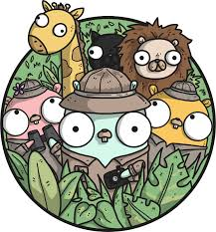
Concurrency vs Parallelism
Parallelism is not always faster- especially when one of the processes running in parallel must communicate with the other.
So to go back to our browser example- when the process to download the item has finished it must communicate back to the render process that the download is complete (which you see if you download anything). That takes some overhead.

Slide 6
How Go Handles Multi-threading
GoRoutines are methods that run concurrently with other methods (or functions) in GO. They are basically threads (NOT threads- but similar!)- but much more lightweight than threading in Python or C.
Advantages of goroutines:
Only a few KB of stack size (they grow and shrink by needs of the application)
They are multiplexed to a few OS threads. Check this out- you might have 100 goroutines running on very few threads CONCURRENTLY
IF an activity blocks a thread the routine can “jump” threads- like switching lanes in a traffic jam!

Slide 7

How do GoRoutines Communicate?
GoRoutines communicate via channels- which prevent race conditions from happening when multiple routines must access shared memory resources.
Think of channels as a pipe that GoRoutines use to communicate!

Slide 8

Running GoRoutines
Hop over to the lab and run the initial goroutine. What happened? ONLY the main function ran. Why?
First we started a new goRoutine (go troll2()) BUT- because we are running through main- the control flow did not wait for the go troll2 function to return it’s message
IF the main goRoutine is not running then no other goRoutines can run.

Slide 9
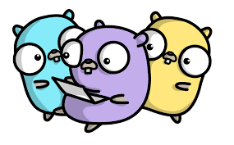
GoRoutines – managing them
Let’s look at multiple goRoutines running simultaneously (in the lab). Notice that they have different times. Here’s how this looks:

Slide 10
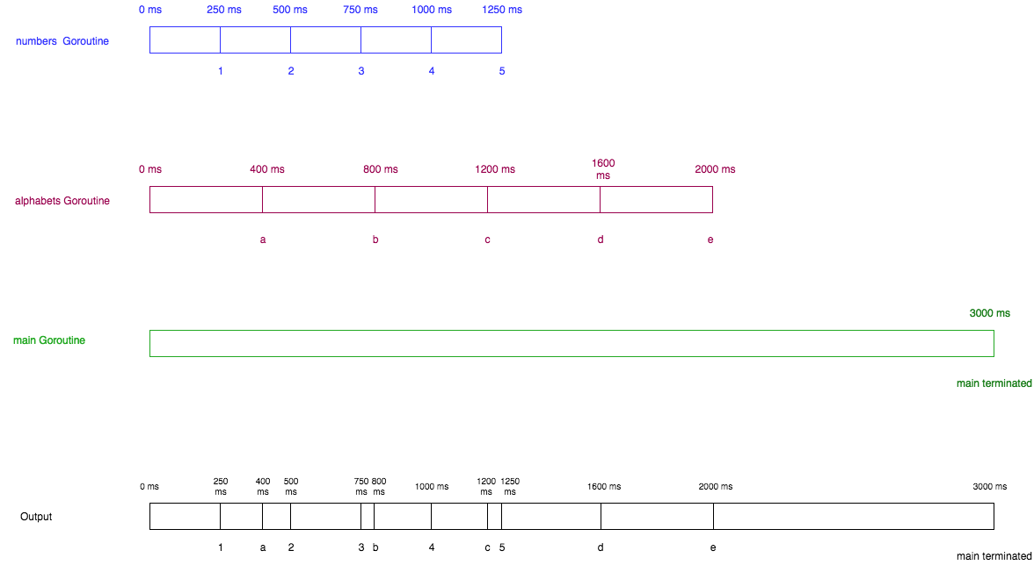
Concurrent GoRoutines

Slide 11

Channels and GoRoutines
So let’s assume that we want to have some shared resources between our goRoutines – we want to give the ability for GoRoutine A to talk to GoRoutine B
In order to do this effectively we need to make channels. The way we do this is with the make command:
make(chan <type>)
Then to CALL the channel we use the “->”

Slide 12
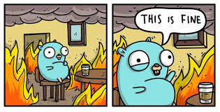
Channels- a couple of notes
We need to make channels with the chan keyword
Channel sends and receives automatically block- which is kind of an awesome feature because you don’t need explicit locks (or conditional variables) which are a PITA in other languages
newchan := make(chan int)
var rando := 2 + 19
newchan <- rando //write rando to newchan
total := <- newchan //read from newchan

Slide 13
Deadlocks and Channels
One issue with channels is that if you write to a channel but you never receive from that channel you end up with a panic/error resulting in deadlock

Slide 14

Buffer sizes in Channels
You can set the buffer size in a channel by setting the second argument when making the channel:
make(chan int, 10) //sets a buffer size of 10 bytes
So the channel will hold until it has 10 bytes of data then you can pull the data. If you overfill the buffer you will get a deadlock error.

Slide 16
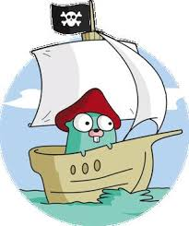
Moving on to Module 4….
AND WE’RE DONE!
ANY QUESTIONS?!?

