Slide 1


Introduction to GoLang VMWare 19 November – 21 November 2018 by Fernando Pombeiro

Slide 2
Module THREE: Control Flow, States, Methods

Slide 3
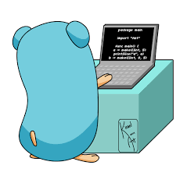
The Go Control Flow
Go has four basic control flow patterns that we’ll be reviewing:
If/else
for (looping)
switch
goto
We’ll be going through each of these in detail. GO is heavily dedicated to simplicity and has pretty much limited to these methods.

Slide 4
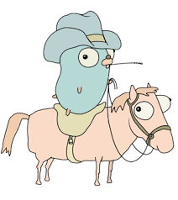
IF statement
Similar construct to C:
if answer != 42 {
return "Wrong answer"
}
There is an option for the shortened statement:
Set the variable then
Evaluate the truth or falsehood of the variable
NOTE that parentheses are not required
if err := foo(); err != nil { panic(err) }

Slide 5
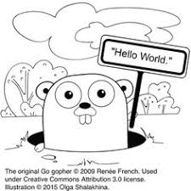
IF statement
One more thing…
There is no ternary if in GO– so none of this:
isittrue = a < 0 ? true : false
You have to spell it out…every time
You DON’T need parentheses- you DO need braces

Slide 6

Logical Operators with IF statements
Pretty standard logical operators here:
“&&” is “AND”
“||” is “OR”
“!” is the logical NOT operator
The usual applies:
if ( a && b ) = a and b must be true to evaluate to true
if (a || b) = a can be true or b can be true or both
if ( !(a && b) ) = a and b must both be false to evaluate to true

Slide 7
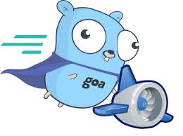
The GO “for” loop
The GO FOR loop has three basic components; we separate them by semi-colons:
The init statement (to be executed before execution):
i := 0
The condition expression- evaluated before every iteration:
i < 10
The post statement: executed at the end of every iteration:
i ++
Note: Unlike other languages like C, Java, or JavaScript there are no parentheses surrounding the three components of the for statement and the braces { } are always required.

Slide 8
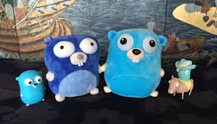
FOR loops in GO
When “FOR” looping through arrays (or slices) you can pull the index AND the value by using the range keyword.
For example:
nums := []int{2, 3, 4}
sum := 0
for _, num := range nums {
sum += num
}

Slide 9
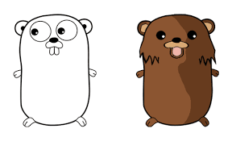
Quick note
So if you use Python/Ruby/Node you might be used to having a built-in “IF-IN” statement- i.e: “IF 3 in [1,2,3,4,5,6]”
This does not exist in GO (yet)…so there are a few ways around this: One is to iterate through the array with an IF….the other is to use a map.

Slide 10

SWITCH statements in GO
Again- similar to C– the switch statement here is mainly to avoid making us create a long series of really ugly if-then statements.:
myRanking := 7
switch myRanking {
case 1:
fmt.Println(“Terrible”)
case 2:
fmt.Println(“Really Bad”)

Slide 11

Switch Statements in GO (continued)
Switch statements can have “default” values if nothing matches:
a := ”superman”
switch a {
case “batman”:
fmt.Println(“Bruce Wayne”)
case “spiderman”:
fmt.Println(“Peter Parker”)
default:
fmt.Println(“Clark Kent”)

Slide 12

Switch statements continued
Switch Statements can have multiple cases on a single line:
score := 7
switch score {
case 0, 1, 3:
fmt.Println("Terrible")
case 4, 5:
fmt.Println("Mediocre")
case 6, 7:
fmt.Println("Not bad") }

Slide 13
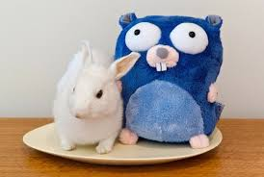
Switch Statements
break will break you out of the loop while fallthrough will evaluate the rest of the statement:
n := 1
switch n {
case 0:
fmt.Println("is zero")
fallthrough
case 1:
fmt.Println("<= 1")
fallthrough
case 2:
fmt.Println("<= 2")
break
}

Slide 14
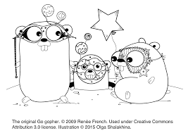
Switch Statements
You can evaluate statements IN the case section:
num := 3
v := num % 2
switch v {
case 0:
fmt.Println("even")
case 3 - 2:
fmt.Println("odd")

Slide 15

“Continue” vs ”Break”
IF you are in the midst of a loop, switch, or select statement you have the option to use the break or the continue statement:
For BREAK:
If there is a label, it must be that of an enclosing "for", "switch", or "select" statement, and that is the one whose execution terminates.
For CONTINUE:
If there is a label, it must be that of an enclosing "for" statement, and that is the one whose execution advances.

Slide 16

LABELS in GO
Go can also be used with Labels- which come in handy for defining sections of code that you want to call out separately.
You can use labels with continue or break statements to mark where they should go.
Used rarely but it’s a nice way to make your code readable:
Label:
for _, x in range someArray {
continue Label
}

Slide 17
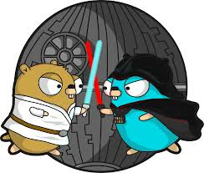
GOTO- brought to you by Satan
Now- goto has a bad reputation- mainly because it can create occluded and ugly code if misused.
If we’re going to learn it in GO you have to swear on bibles that if you use this methodology you use it carefully.
IT FREQUENTLY LEADS TO UNREADABLE, CRAPPY CODE if mishandled!!

Slide 18
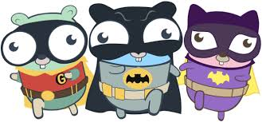
Goto In GO
Basically with GOTO- you can use a LABEL identifier and then use the goto keyword to go to that label.
Again- you can probably see where this can lead to very bad things if it is misused- so use sparingly and carefully (switch statements are a good place)

Slide 19

Pointers and References
GO uses pointers- which hold the memory address of a value.
The symbol for a pointer is *
The & operator generates a pointer to its operand

Slide 20
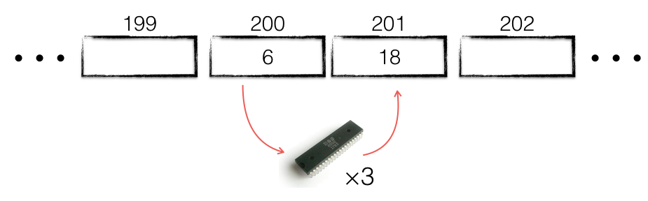
Pointers in GO- practically
So it’s important to remember that fundamentally what a pointer does is point to the memory address of a variable.
A variable in any language is just a nickname for a memory location where that value is stored.
Back in the day programmers had to remember memory locations. It sucked.

Slide 21
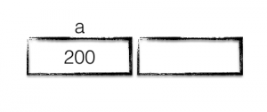
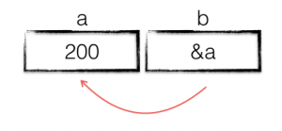
Pointers and receivers continued
So let’s take a look at a program fragment and go through how it changes based on pointers:
func main() {
a := 200
b := &a
*b++
fmt.Println(a)
}

Slide 22
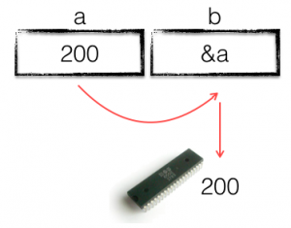
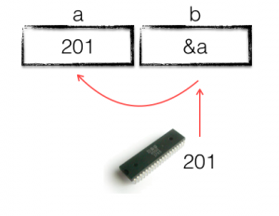
Pointers in GO (continued)
Okay- so in the third line there (“*b++”)- we want to INCREASE the value of “b”, right? But how can we increase the value of a via b?
We need to dereference b- which we do with the “*” value and point it back to a:

Slide 23
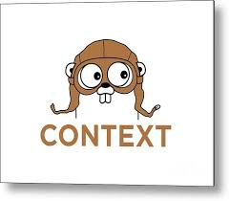
Pointers in GO
What usually confuses new folks with GO first using pointers is the concept of dereferencing.
You see- we can’t just change the “b” variable here- the “b” variable is an address…. But we can change the a variable via the b variable by dereferencing it with the * symbol.

Slide 24

Pass By Reference
There is no pass-by-reference in GO.
This can be confusing because in languages like C++ you can declare aliases to existing variables using eerily similar coding techniques to Go- specifically:
int a = 10;
int &b = a;
int &c = b;

Slide 25
Pass by reference
So as you can see from the C++ example there- a write to ”a” will alter the contents of b and c, right? BUT- in GO variables always have their own memory storage location- so although both point to “a”:
func main() {
var a int
var b, c = &a, &a
fmt.Println(b, c) // 0x1040a124 0x1040a124 //The same
fmt.Println(&b, &c) // 0x1040c108 0x1040c110 //Different
}

Slide 26
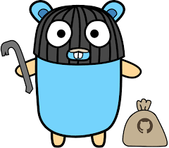
Pointers to Structs
Pointers usually come in *most* useful with structs.
IF the method is intended to modify the receiver (read: struct) then the receiver must be a pointer.
Here’s what to know- when you pass-by-value to a struct you are basically making a copy of the struct within the scope of that function- so you are *not* modifying the underlying struct.
To modify the struct- use a pointer.
Generally- try not to pass around pointers a lot

Slide 27

What’s better- value or pointer method?
Basically it comes down to this:
func (s *MyStruct) pointerMethod() { } // method on pointer
func (s MyStruct) valueMethod() { } // method on value
Pointer method is better for large structs because you aren’t making a copy of a struct.
Values work well for smaller data types- like slices, small structs, etc.

Slide 28

Embedding Structs in GO
…and while we’re on the subject of STRUCT manipulation…
If you want to get around issues of the lack of type hierarchy in GO (i.e: you want to use inheritance) you can use embedding of structs to accomplish something a LOT LIKE inheritance between structs.
type newStruct {
specificthingie string
}
type embedStruct {
newStruct
}

Slide 29

Anonymous Structs in GO
You can also create anonymous structs
These should be used for One-and-done
If you don’t need to re-use a struct- make an anonymous structure (see lab)

Slide 30
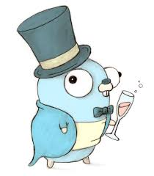
JSON package in GO
Most data in modern web applications is passed around in Javascript Object Notation (JSON).
GO comes with a built-in JSON package that allows you to marshal/unmarshal data between structs and JSON types.
This is one of the most commonly utilized packages in GO and understanding it is essential.

Slide 31

JSON in GO (continued)
Imagine a situation in which you are hitting an API that returns JSON but- you aren’t sure WHAT that JSON looks like.
In other words- sometimes the JSON returns a list. Sometimes an object. Sometimes a string.
WHAT SHOULD WE DO HERE?
(This is where generics would be nice, GOLANG!)

Slide 32

JSON in GO (continued)
Another option we should look at when marshalling or unmarshalling JSON is to look at MAPS and/or SLICES.
The lab has an example of this- but know that using type map[string]interface{} will allow you to put JSON into the map but- to actually access that JSON you will need to cast the values into the types you want.

Slide 33

BREAK TIME
Take 15 – we have completed another section!!!
Next up: TESTING!

Slide 34

TESTING in GOlang
Go has a built-in testing command called go test and a package testing which combine to give a minimal but complete testing experience.
You can run the tests from the command line with
go test –v

Slide 35

Testing (continued)
So every test is done utilizing a pointer to the Testing type
package main
import "testing"
func TestSum(t *testing.T) {}
Also note that the function name begins with (capital-T) Test- followed by the name of the function that we are testing.

Slide 36

Testing (continued)
For errors you can use any of the following (all embedded in the “testing” package):
t.Error or t.Fail to indicate errors
t.Log if you need non-failing debug information
As you saw in the lab: t.Errorf prints out to the command line

Slide 37

Testing (continued)
Test files must be saved in a file called something_test.go to run effectively:
something like badmoviedatabase_test.go to theoretically test a package like badmoviedatabase
Do not keep your tests and your programs in the same directory location- otherwise you can’t use go run *.go (will fail)

Slide 38

Testing (continued)
Go does not use the Assert patterns in testing.
Justifications for not going with assert patterns are as follows:
When using assert:
tests can feel like they're written in a different language (RSpec/Mocha for instance)
errors can be cryptic "assert: 0 == 1"
pages of stack traces can be generated
tests stop executing after the first assert fails - masking patterns of failure

Slide 39
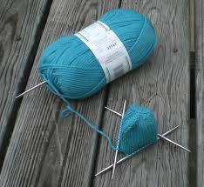
Testing (continued)
For large scale tests where you really want to put a function through the ringer you can utilize test tables- which is a slice that runs through numerous possibilities in the test. Go test will run through these.

Slide 40

Testing (continued)
Provided that you ended your test file with the appropriate _test.go nomenclature- the go compiler will not ship your tests
SO- if you are building binaries to run- do not worry that your tests will end up in a binary- the go compiler is smart enough to know to skip those.

Slide 41
Testing continued
To get your test coverage you can run the command go test –cover to get a handy coverage report.
Another neat function- you can generate an html rendering of your coverage report (nice if you have a public web server) with the following:
go test -cover -coverprofile=c.out
go tool cover -html=c.out -o coverage.html

Slide 42
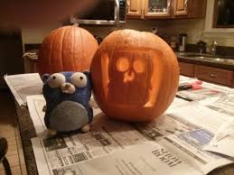
Testing advice
Table tests are your best friends; even if you have only a single instance to test- use a table test. Why? They are easy to extend for other people that use your code.
Mocking db connections can be painful- but you can utilize fake interfaces (not going to go too deeply into that here.

Slide 43

Benchmarking
So along with tests we can benchmark functions in GO using a similar setup:
If we begin the function name with capital “B” Benchmark keyword AND
We need to add the command line option bench= to our go test command on the command line.

Slide 44

Benchmarking (continued)
Benchmarking uses regex with the bench= command in the CLI…so keep that in mind: just passing go test bench= will fail!
If you want to just check everything just pass go test -bench=.
If you only want to run the bench marks and skip the actual tests- simply pass a bad regex to the run= command line option in test- for example:
go test –run=doesnotexist –bench=.

Slide 45
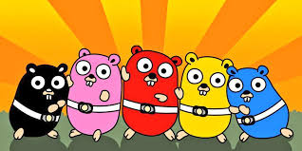
Dependency Management
So now that we’ve been through unit testing and bench marking we should talk about dependency management in GO.
Here’s kind of a nasty fact of life with GO: unlike python (requirements.txt) or node (package.json)- GO doesn’t have a fully fleshed out dependency management system installed….yet.

Slide 46
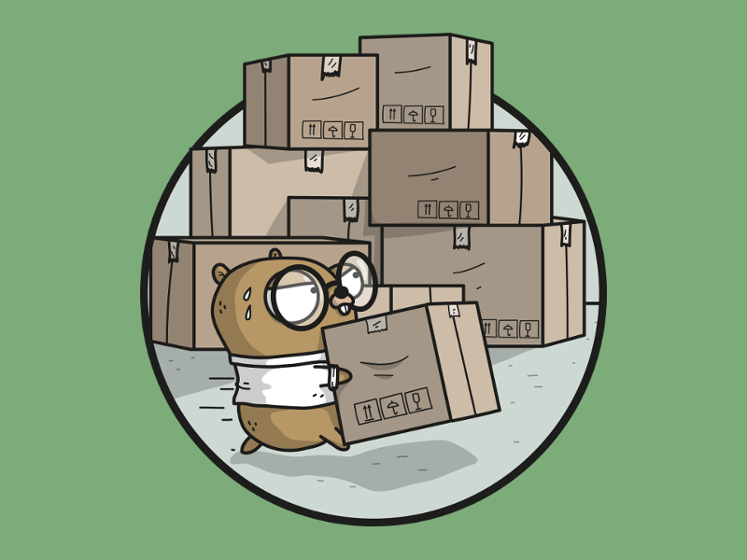
Dependency management
Obviously lacking mature dependency management can make exporting your completed packages a real PITA. Fortunately there are packages out there to handle this for you…and the top one right now seems to be dep

Slide 47

Dep for dependency management
dep- written by the GO team, has been released as of February of this year (2018). It utilizes two files for dependency management:
Gopkg.toml – think of it like the package.json in node
Gopkg.lock – auto-generated- like package-lock.json in node
You can initialize these files with a dep init command line entry.

Slide 48
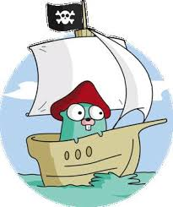
Moving on to Module 4….
AND WE’RE DONE!
ANY QUESTIONS?!?

