Slide 1
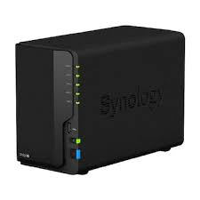

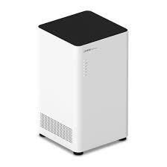
















/api
/grafana
/user
Deploy
/api, /socket
/admin
Deploy
/api,
/socket
Mapping
/api
/jenkins
Deploy
Deploy
Connect
/socket
Connect
Connect
Connect
Sync
/rabbit
Mapping
/kibana
PR&Merge
/kafkaui
push

