Slide 1
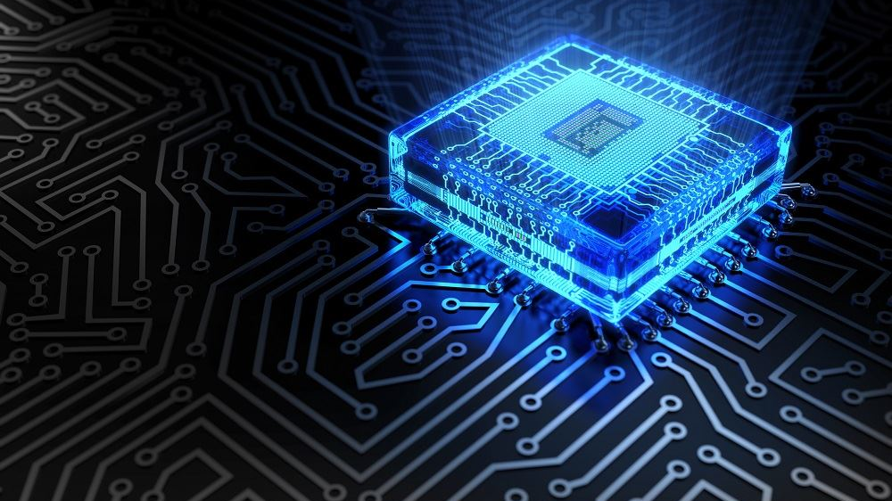


Haptic Glove Development Project – Semester 1 Final Presentation
The Two Stooges
This Photo by Unknown author is licensed under CC BY-SA-NC.

Slide 2
Slides overlook
General Overview
Team Members
Project
Sprint 1
Sprint 2
Sprint 3
Sprint 4
Sprint 5
Sprint 6
Attempting Bluetooth
Demo
Unity
Going Forward

Slide 3
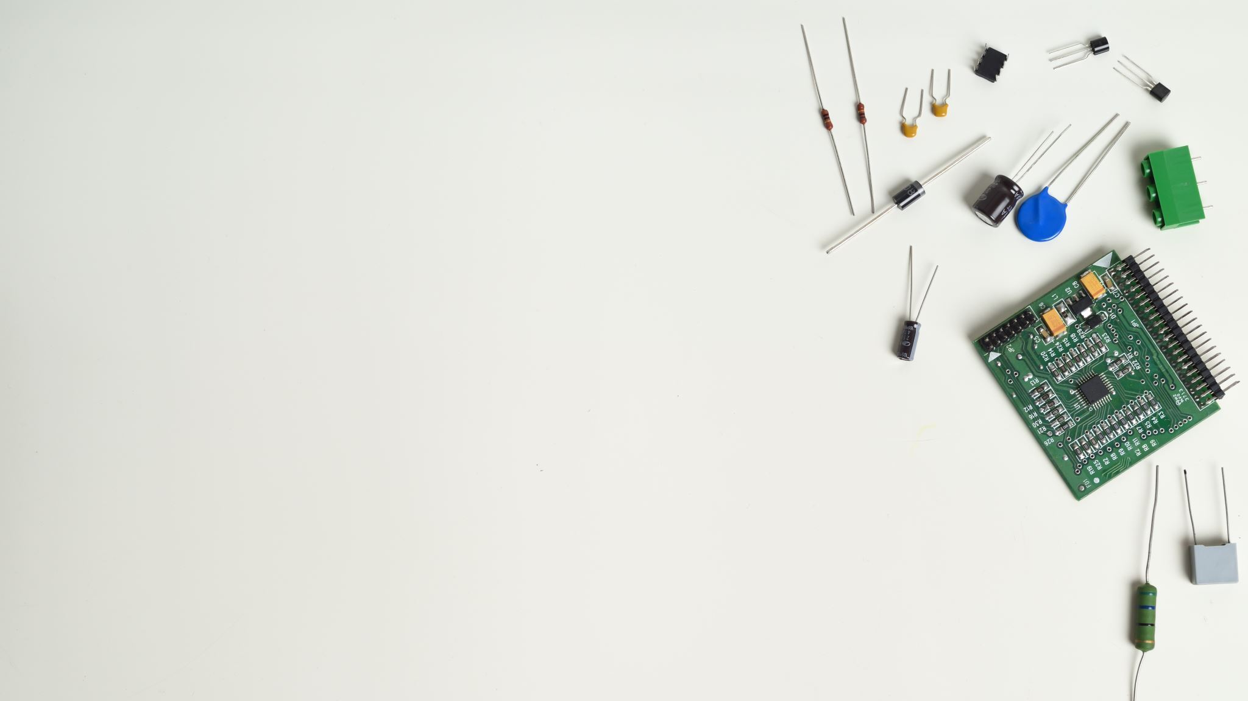
The Team
Levi Graham
Scrum Coach
Technical Lead (Software)
Riley Nichols
Technical Product Manager
Technical Lead (Hardware)

Slide 4
The Project
Build Haptic Glove to use as input device into a computer.
Build a working simulation to demonstrate the glove as an input.

Slide 5
Sprint 1 (Project Research)
Hinge Finger Joint
The bending of the fingers when opening and closing the Hand. This movement can be captured using a Flex Sensor.
Wrist inflection
The bending of the hand in 3-d space from vertical to horizontal with spin. This movement can be captured by an IMU sensor device.
Hand Position
How and where the hand sits in 3-d Virtual space. This movement can be captured with an IMU sensor device.
Hand Movement
Movement of the hand in comparison to the body. This can be measured by using the IMU's accelerometer data.

Slide 6
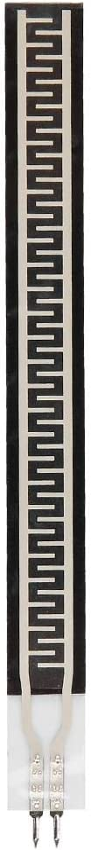
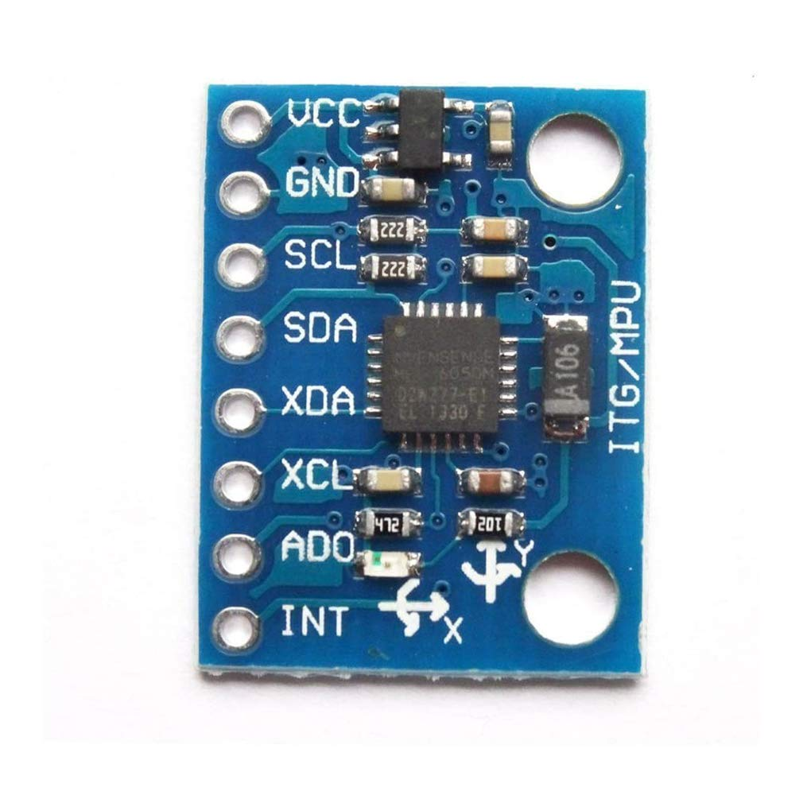
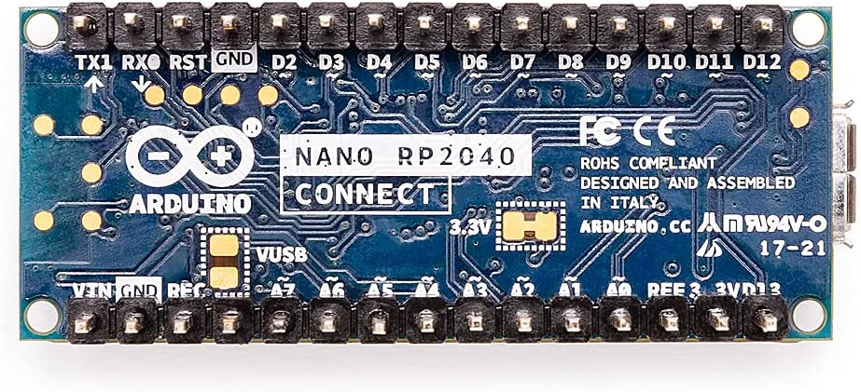
Sprint 1 - Continued
Flex Sensor – A flex Sensor is a sensory module that can measure the bend of an object through resistance. We originally used the ZD10-100 500g Resistance Type FSR Sensor however, we have then switched over to the ADA182
IMU - The Inertial Measurement Unit is a sensor that acts as a Gyroscope, Accelerometer and Magnetometer to help us find object location in 3-D space. We are using the HiLetgo GY-521 MPU-6050 MPU6050
Arduino - The Arduino we will be using to communicate for our device is going to be the Arduino Nano RP2040 Connect. This small device is equipped with an IMU of its own and allows Bluetooth and Wi-Fi connections.

Slide 7


Sprint 2 (Software Research)
Program for Hardware
Arduino IDE - The open-source Arduino Software (IDE) makes it easy to write code and upload it to the board. This software can be used with any Arduino board.
Program for Software
Unity - Unity is a cross-platform game engine developed by Unity Technologies, first announced and released in June 2005 at Apple Worldwide Developers Conference as a Mac OS X game engine.

Slide 8
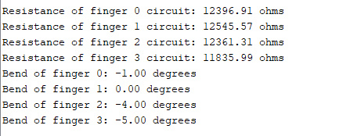
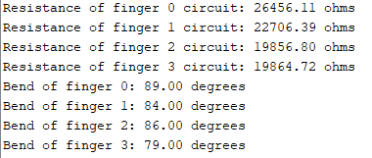
Sprint 3 (Start of Circuit building)
Flex Sensor Building
During the process of building the first circuit to incorporate just the base flex sensor, we ran into the issues with the Original ZD10-100 Flex sensors and had to reorder the current ones we have now. Below are the readings of the flex sensor at 0 degrees and 90 degrees.
Start of Bluetooth Research Into Libraries

Slide 9
Sprint 4 (Circuit Building)
Success with External IMU
Receive Sensor Data as Serial Data through non-Arduino software
This step is important because it helped us learn how to take serial data straight from the Arduino and convert it into readable data
Gyroscope, Accelerometer and Magnetometer are initialized and read continously.

Slide 10
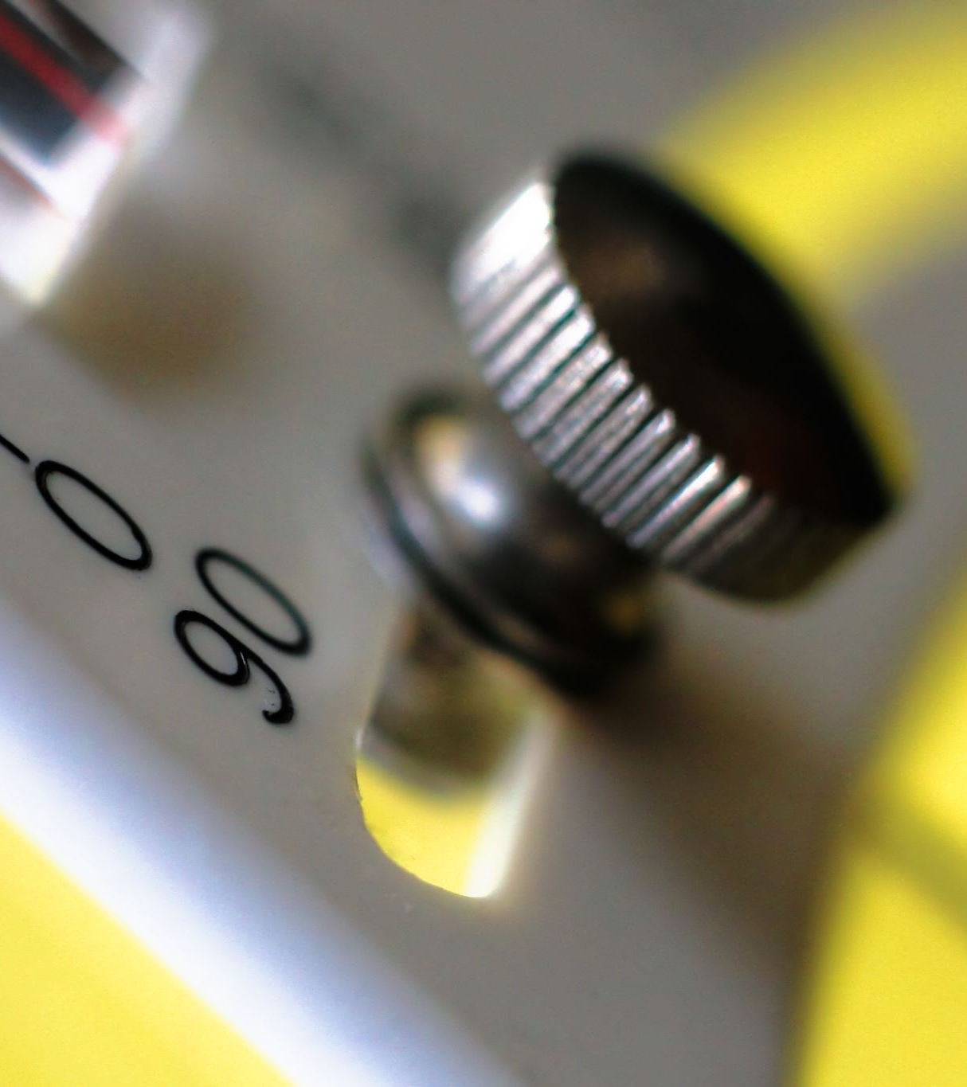
Sprint 5 (RP2040 Connect)
Issues with Nina Pins on RP2040
Analog Pins A6 and A7 use the Nina system and are limited to only sending Simple "On" or "Off" data
Because of the loss of pins A6 and A7, only 4 flex sensors can be read.
Access of Internal IMU system on
The internal IMU gives Accelerometer and Gyroscope technologies to read the position of the arm while the external IMU gives hand positioning.
Start of Unity Working

Slide 11
Sprint 6 (Attempted Bluetooth)
RP2040 Bluetooth
Ran into issues with how the RP2040 Bluetooth works. The RP2040 can only send and receive Boolean data between another Bluetooth module. Because we cannot send serial data through this Bluetooth, we had to look for alternatives.
HC-05 Bluetooth Module
Turning to an independent Module, we could not use the RP2040 because the library used to operate this Module only works on boards with 8,16 or 20 MHz processors and the RP2040 has a 133MHz processor. We also counldn't use this personal Module because it only worked up to a baud rate of 57600 and we needed at least 115200.

Slide 12
Sprint 6 Hardware Demo
Check Wiki

Slide 13
Sprint 6 Unity Demo
Check Wiki

Slide 14
Future Goals
Research Bluetooth Modules or possible replacement Arduino Boards to help us work with the baud rate we need .
Once finished with Bluetooth, soldering the Circuit and fitting it into a glove.
Finishing the Unity sandbox demo
Configuring the computer to read serial data as hand motion in the Unity Sandbox

Slide 15

Questions?

