Slide 1


Midterm Presentation
HAPTIC GLOVE DEVELOPMENT PROJECT
Levi Graham
Riley Nichols

Slide 2
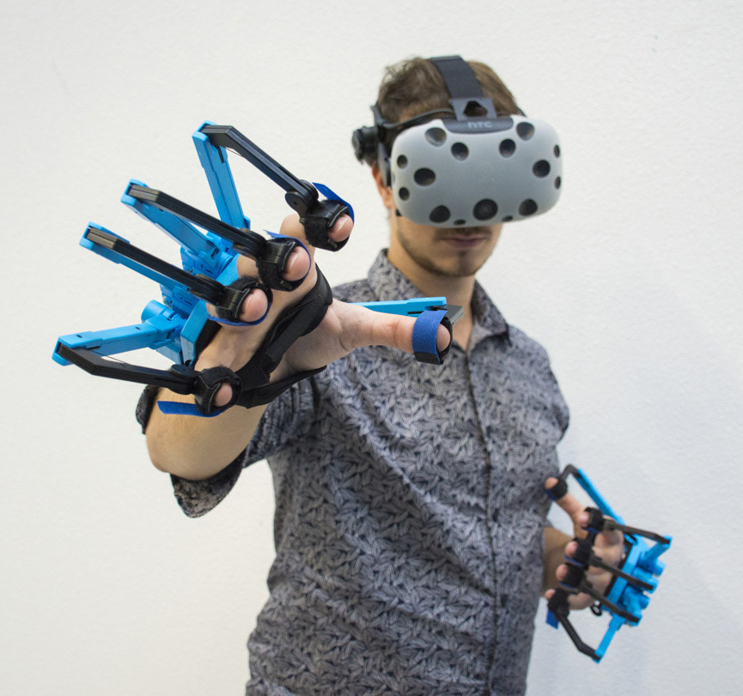
Project overview
Research and Develop a haptic glove for use as an input device for a computer.
The glove will read the user’s hand movements and translate them to meaningful input for the computer.
Develop the glove so that it will be able to be used in a sandbox simulation built with a game engine.

Slide 3
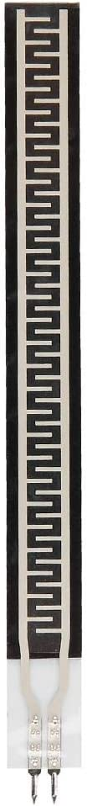
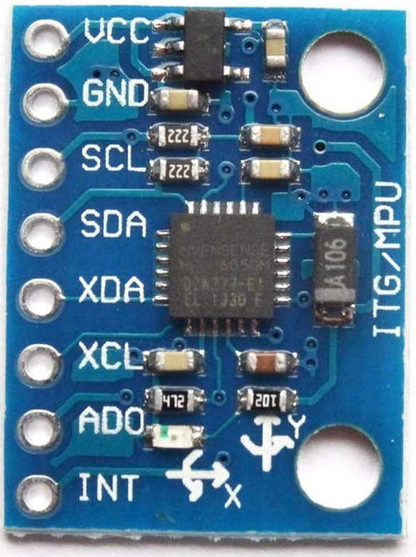
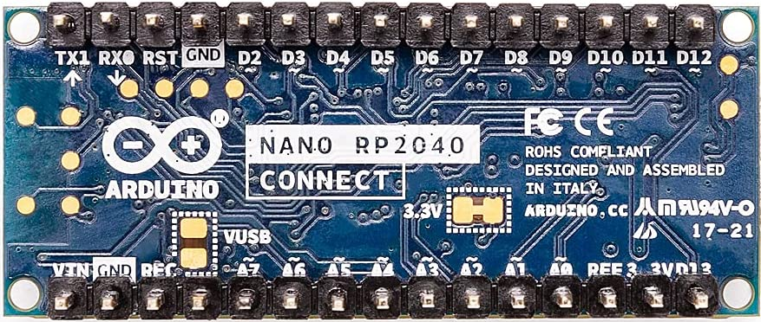
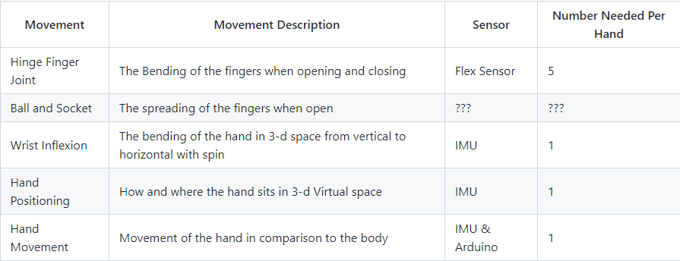
Sprint 1

Slide 4


SPRINT 2
Working with Arduino
Could have used Arduino IDE, but wanted source control
Could have coded in Python, but running Python on the microcontroller has downsides
Decided to go with the Arduino extension for VSCode and coding in C++

Slide 5

Sprint 2 continued
Game engine – Unity
Choices : Unity, SteamVR, Unreal (Thanks Professor Branton)
Reason for choosing Unity easy beginner usability and easy connection to outside communication, i.e., handmade input devices such as the glove

Slide 6
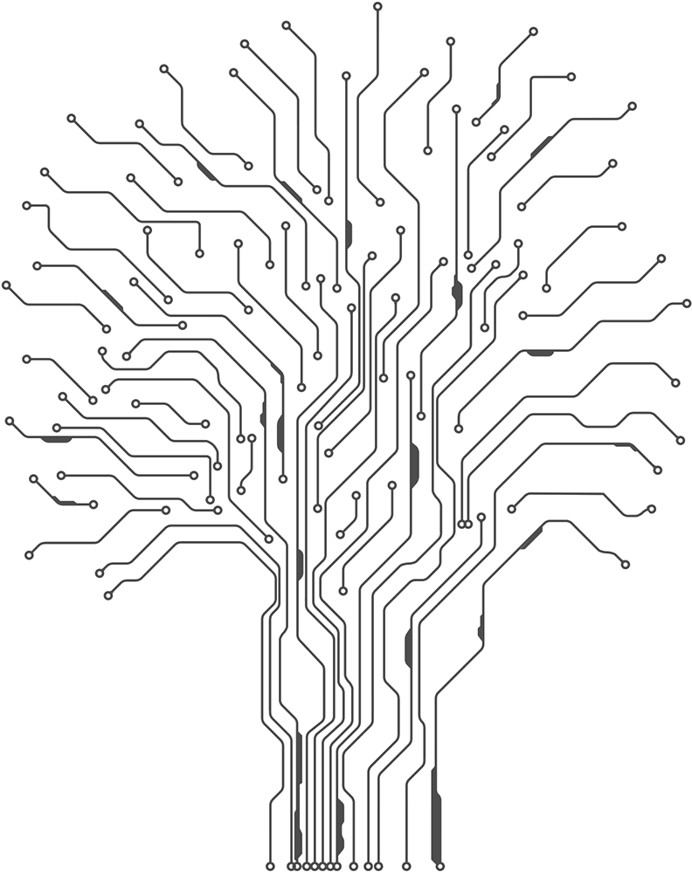
Plans for Sprint 3
Test and build base circuits with individual parts
Build a test circuit with all sensors working together
Communicate via wired communications between circuit and Computer
Stretch Goal: Communicate over Bluetooth with same results

Slide 7
What's next?
Build a simulated Sandbox with Unity with hand-based activities for interaction
Build Prototype Glove with temporary circuits
Hook Prototype Glove to Sandbox to test mobility and fine-tune
Build final protype of glove with soldered connections

Slide 8
Questions?

