Slide 1


Haptic Glove Development Project-Sprint 3
Riley Nichols
Levi Graham

Slide 2
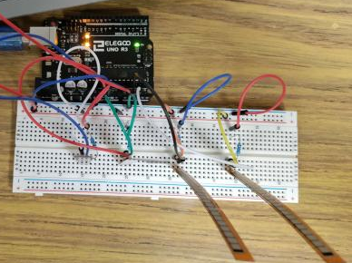
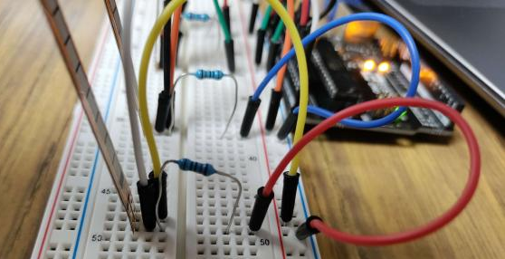
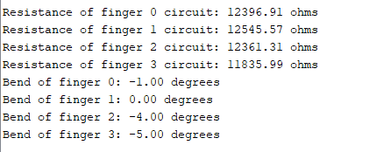
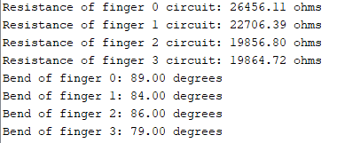
Circuits

Slide 3

Bluetooth
Arduino includes Bluetooth library
Easiest way to communicate is using serial connection
Can write Python app to receive inputs on computer

Slide 4
What’s Next
Finish Sprint 3 Goals
1
Complete Test Circuit Communication Over Bluetooth
2
Get started with writing in Unity
3

