Slide 1

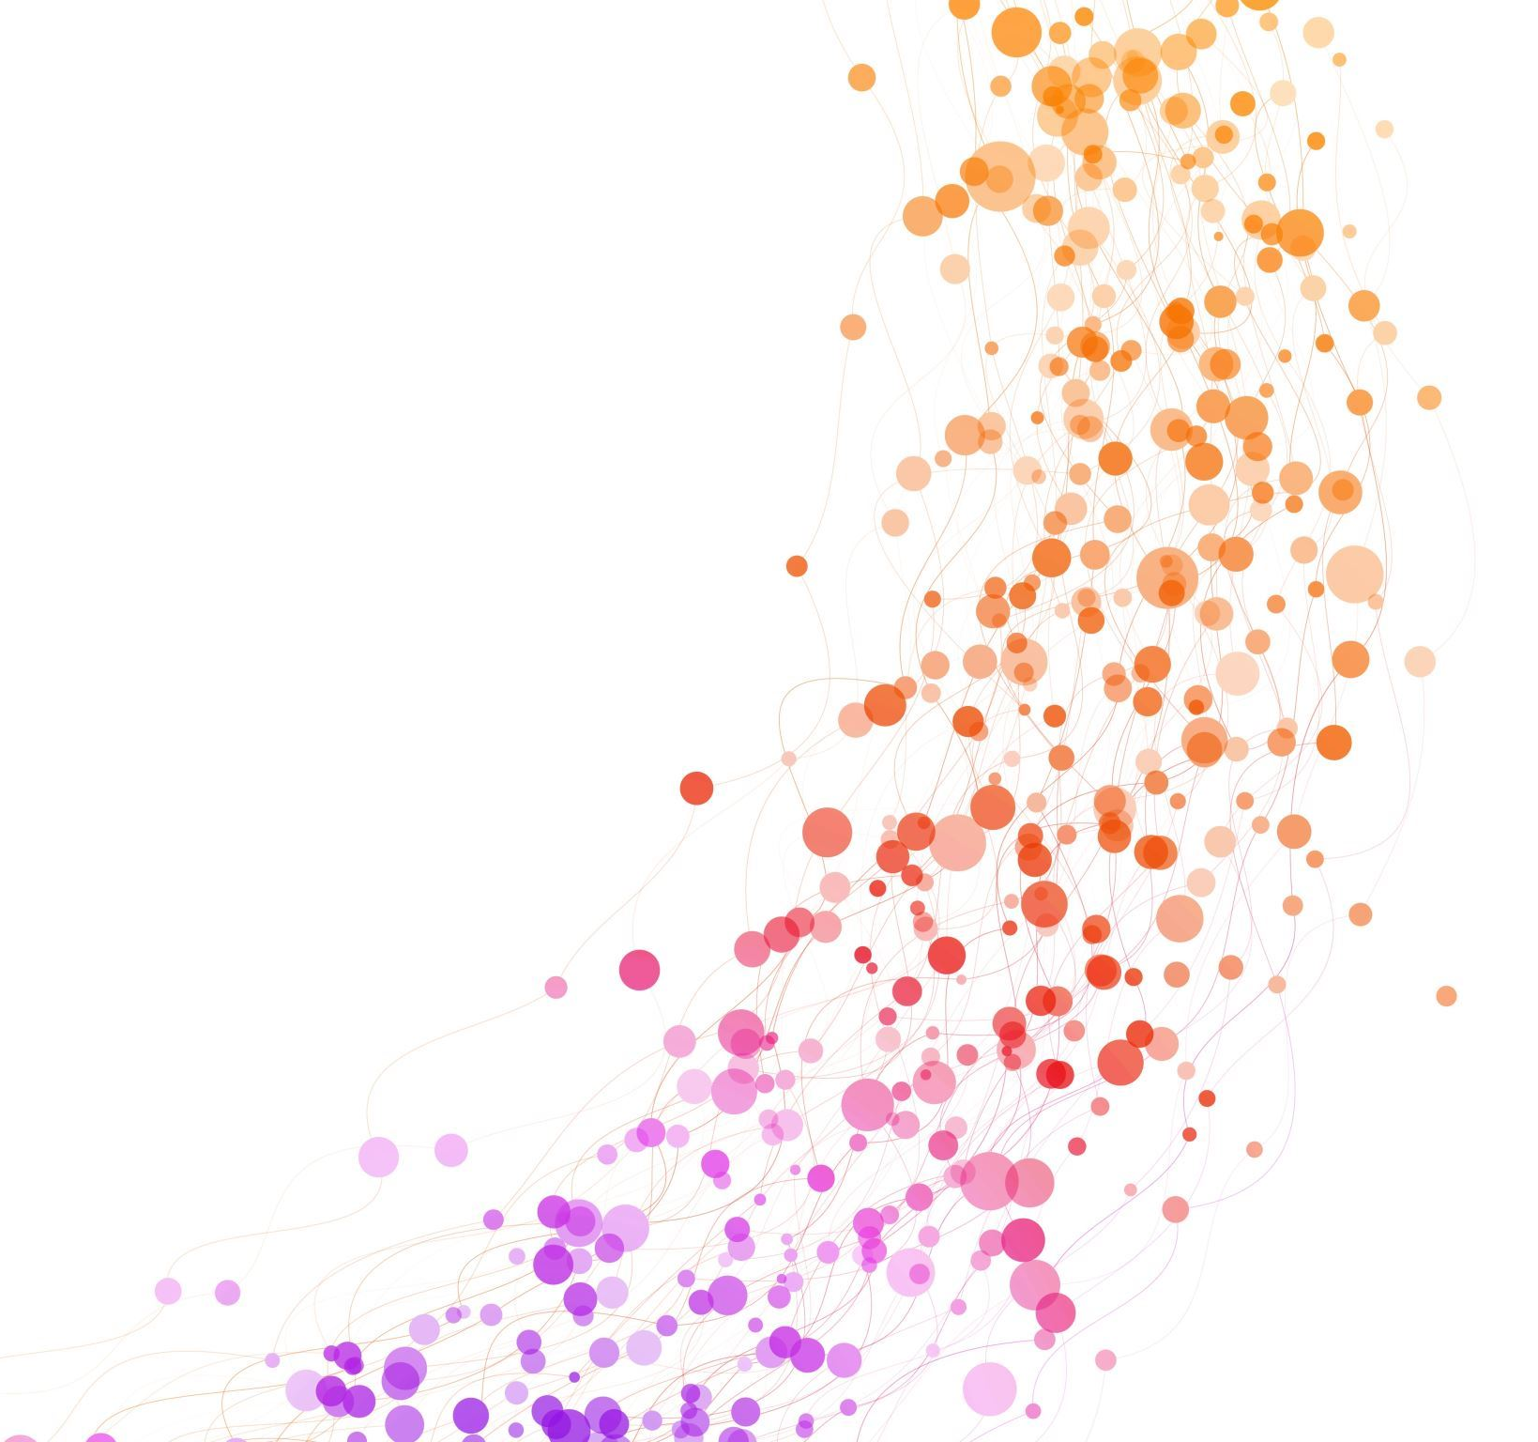

Haptic Glove Development Project Sprint 5
Levi Graham
Riley Nichols

Slide 2
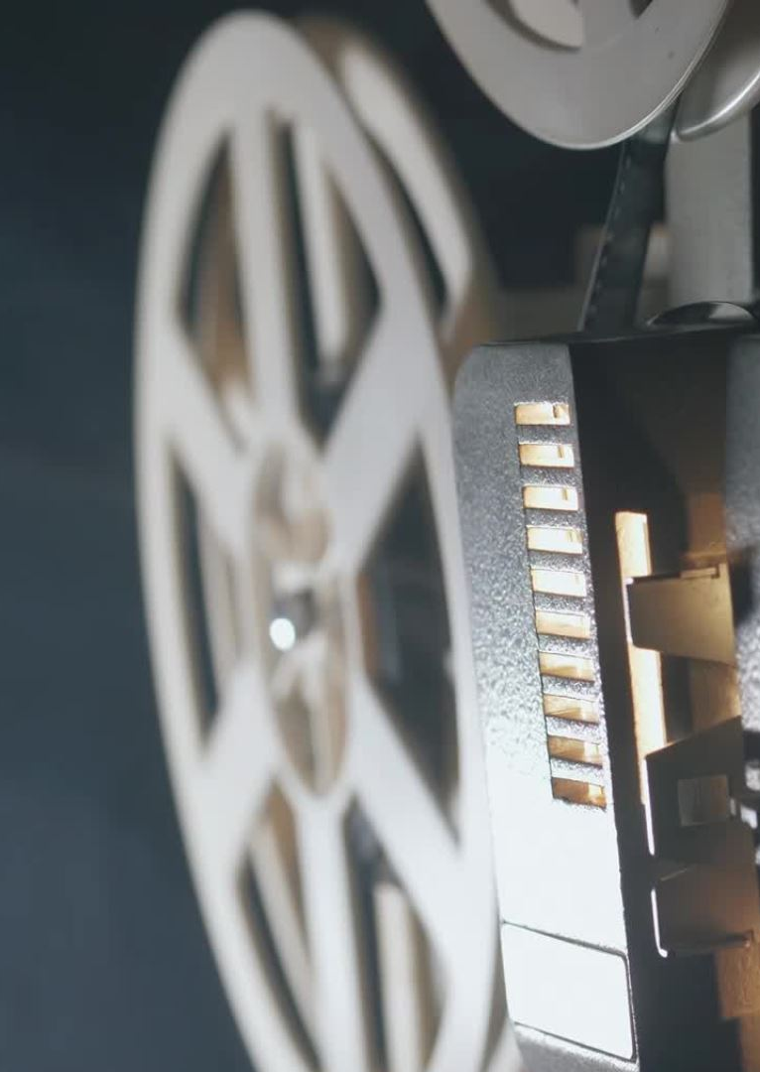
RECAP
The goal of our project is to
Create a glove/hand-based input device to read hand-based inputs into a machine
Create a sandbox environment to demonstrate and show off this device
Last sprint we used wired communication to read the serial values of the full circuit device to a GUI.

Slide 3
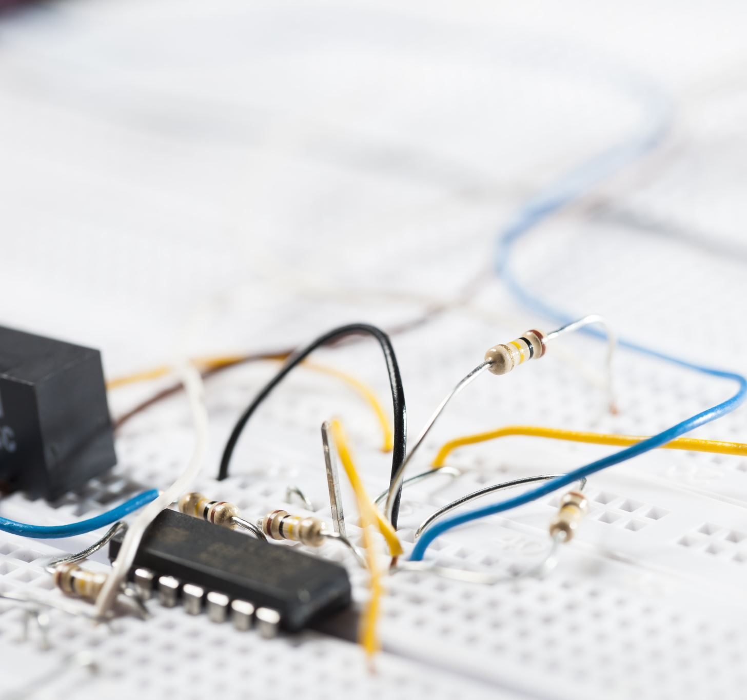
SPRINT 5 - Arduino
Issues we had with the 5th flex sensor:
The last two analog pins on the RP2040 Connect are WifiNINA pins (pins to be used as signal pins)
This signal is more of a Boolean system than a constant data source, so parts are read as On or Off values

Slide 4

Sprint 5 - Arduino Cont.
Accessed RP2040 Connect internal IMU
Last Sprint, we had 500ms in response times between Serial outputs, we were able to improve that to 100ms stably, and 60ms unstably.

Slide 5
Sprint 5 - Unity
Add to GitHub by manually coping files in and out of the repository.
Write code in C#
Unity Editor has assets and scenes that we can use to start the project.

Slide 6
This Week & Sprint 6
This week we plan to research more into using the A6 and A7 pins without WifiNINA and writing documentation.
For Sprint 6, we will be finishing with our circuit and working on Unity so we can come back from winter break ready to move forward to soldering the glove and using it as an input device for our simulation.

Slide 7

Questions?

Slide 8
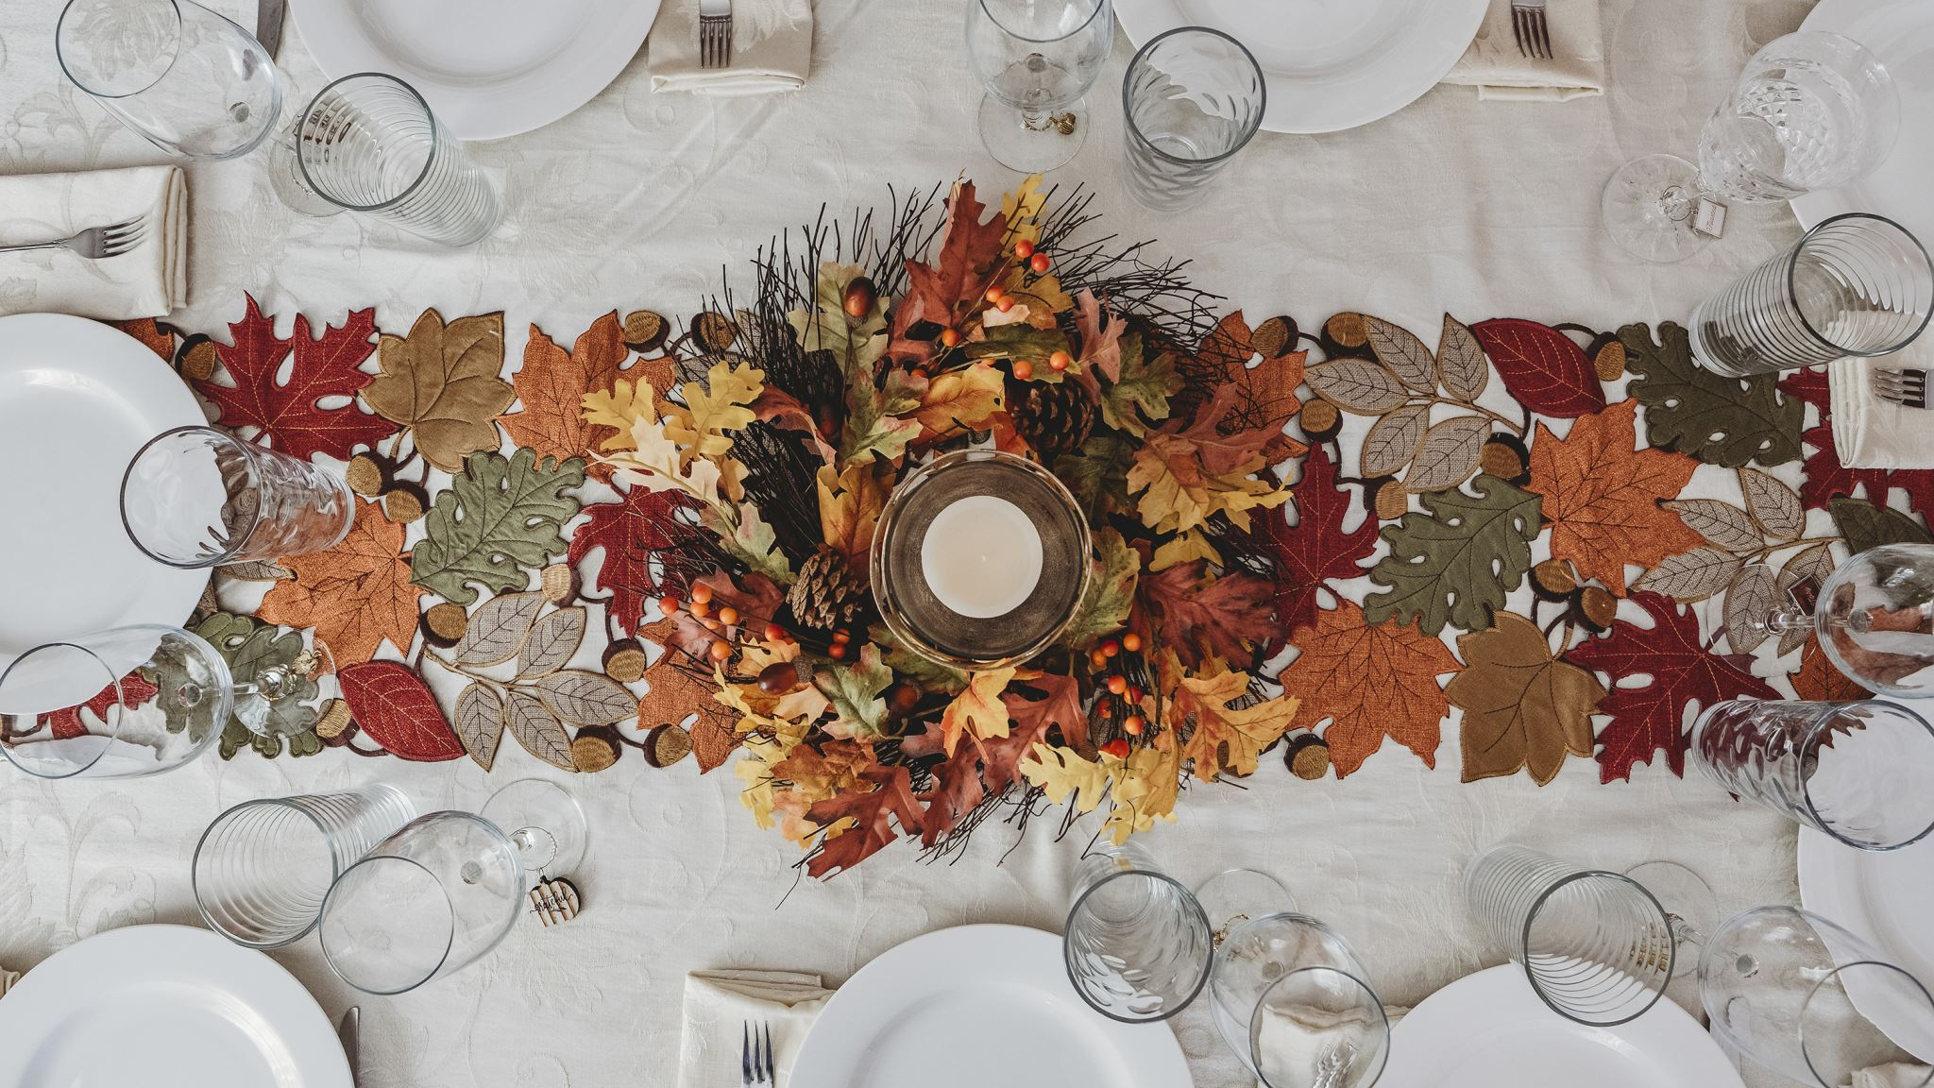
Happy thanksgiving

