Slide 1
Draw Boxes around Traffic Lights in an image.
Using Python and OpenCV

Slide 2
Step 1.
Using given Images and their respective xml files .I’ve extracted the state of traffic light and the coordinates of the rectangular box.
For extraction of data I’ve used following function in the code i.e,
extract_info() - Gives all the data into a list form.
chunks() - Divide the data into given by extract_info() into equal parts.

Slide 3
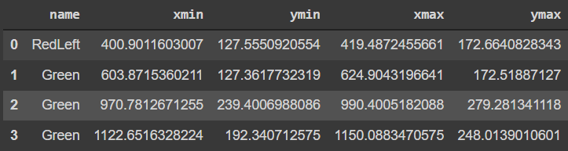
Step 2.
Using all the data we will create a DataFrame that will look something like this.
To do this we will take the use of preprocess_data() function.

Slide 4
Step 3.
Using the DataFrame we will store all the values of xmin, ymin, xmax & ymax in the list format.
We will also store the state of traffic light using the DataFrame.
To achieve this we have used the min_max_values() function.

Slide 5
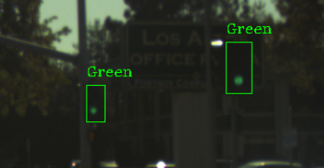
Step 4.
This is the final step where we are taking the xml file path and image path as input and simply using the OpenCV library we are displaying the image which contain
State of the light as text, that can be green,red,yellow or off as well.
A rectangular box around the light.

Slide 6
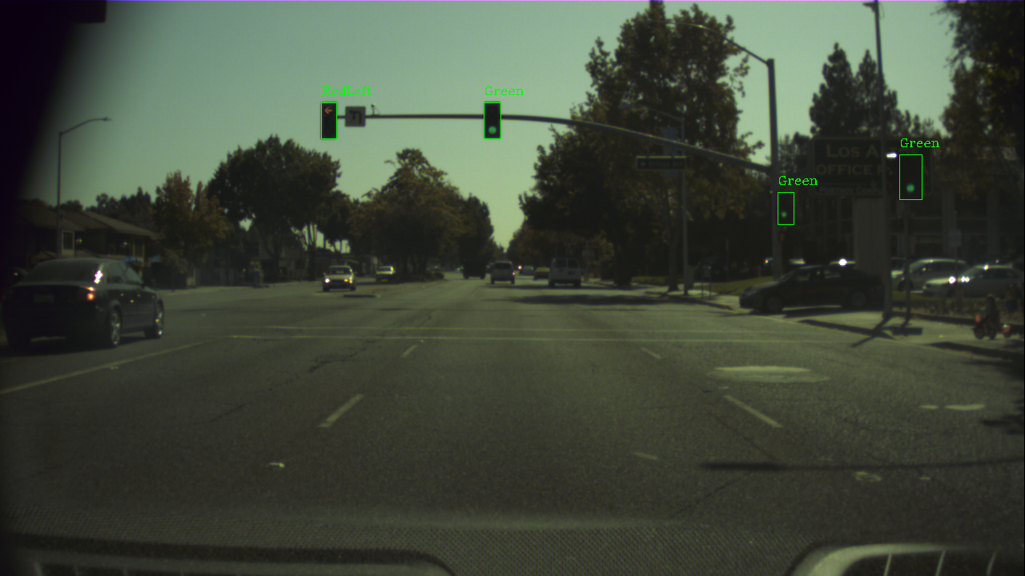
Sample Output

Slide 7
Thank You

