Slide 1
Python course
Dictionary in Python
Submitted by :Mahdi Jafari

Slide 2
contents
1-Dictionary
2-Accessing Items
3-Change Values
4-Adding Items:
5-Removing Items:
6-Copy a Dictionary:
7-Nested Dictionaries
8-Dictionary Methods:

Slide 3
Dictionary
A dictionary is a collection which is unordered, changeable and indexed. In Python dictionaries are written with curly brackets, and they have keys and values.
EX:
thisdict = {
"brand": "Ford",
"model": "Mustang",
"year": 1964
}
print(thisdict)

Slide 4
Accessing Items:
You can access the items of a dictionary by referring to its key name, inside square brackets
EX:
thisdict = {
"brand": "Ford",
"model": "Mustang",
"year": 1964
}
x = thisdict["model"]
print(x)

Slide 5
There is also a method called get() that will give you the same result:
EX:
thisdict = {
"brand": "Ford",
"model": "Mustang",
"year": 1964
}
x = thisdict.get("model")
print(x)

Slide 6
Change Values:
You can change the value of a specific item by referring to its key name
EX:
thisdict = {
"brand": "Ford",
"model": "Mustang",
"year": 1964
}
thisdict["year"] = 2018
print(thisdict)

Slide 7
Adding Items:
Adding an item to the dictionary is done by using a new index key and assigning a value to it
EX:
thisdict = {
"brand": "Ford",
"model": "Mustang",
"year": 1964
}
thisdict["color"] = "red"
print(thisdict)
Answar: {'brand': 'Ford', 'model': 'Mustang', 'year': 1964, 'color': 'red'}

Slide 8
Removing Items:
There are several methods to remove items from a dictionary:
EX:
thisdict = {
"brand": "Ford",
"model": "Mustang",
"year": 1964
}
thisdict.pop("model")
print(thisdict)
Thisdist=={'brand': 'Ford', 'year': 1964}
Notes:
Sbmated by mahdi jafari

Slide 9
Example
The popitem() method removes the last inserted item (in versions before 3.7, a random item is removed instead):
thisdict = { "brand": "Ford", "model": "Mustang",qa "year": 1964 } thisdict.popitem() print(thisdict)

Slide 10
Example:
The del keyword removes the item with the specified key name:
thisdict = { "brand": "Ford", "model": "Mustang", "year": 1964 } del thisdict["model"] print(thisdict)

Slide 11
Copy a Dictionary:
You cannot copy a dictionary simply by typing dict2 = dict1, because: dict2 will only be a reference to dict1, and changes made in dict1 will automatically also be made in dict2.
There are ways to make a copy, one way is to use the built-in Dictionary method copy()
EX
Make a copy of a dictionary with the copy() method
thisdict = { "brand": "Ford", "model": "Mustang", "year": 1964 } mydict = thisdict.copy() print(mydict)

Slide 12
Nested Dictionaries
A dictionary can also contain many dictionaries, this is called nested dictionaries
EX:
Create a dictionary that contain three dictionaries:
myfamily = { "child1" : { "name" : "Emil", "year" : 2004 }, "child2" : { "name" : "Tobias", "year" : 2007 }, "child3" : { "name" : "Linus", "year" : 2011 } }

Slide 13
The dict() Constructor
It is also possible to use the dict() constructor to make a new dictionary
EX:
thisdict = dict(brand="Ford", model="Mustang", year=1964) # note that keywords are not string literals # note the use of equals rather than colon for the assignment print(thisdict)

Slide 14
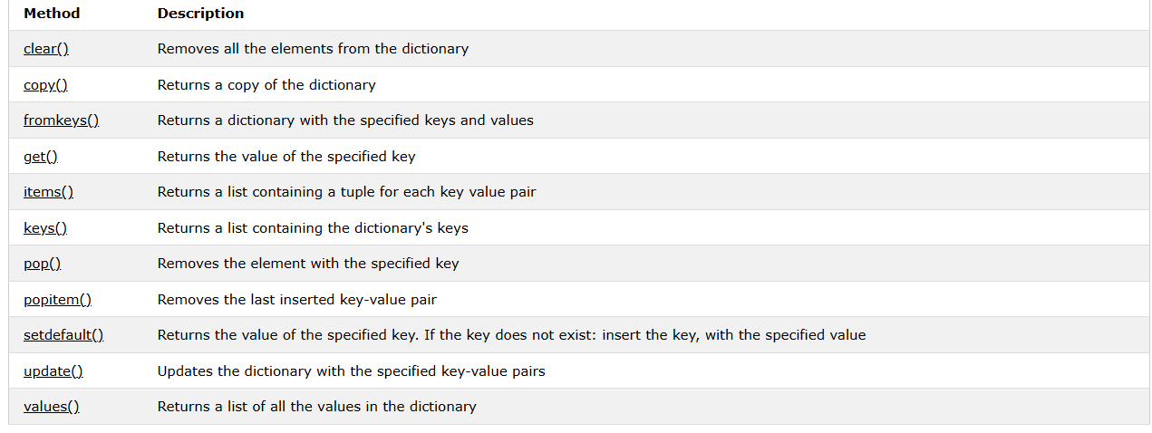
Dictionary Methods:
Python has a set of built-in methods that you can use on dictionaries

Slide 15
Any Question?

