Slide 1
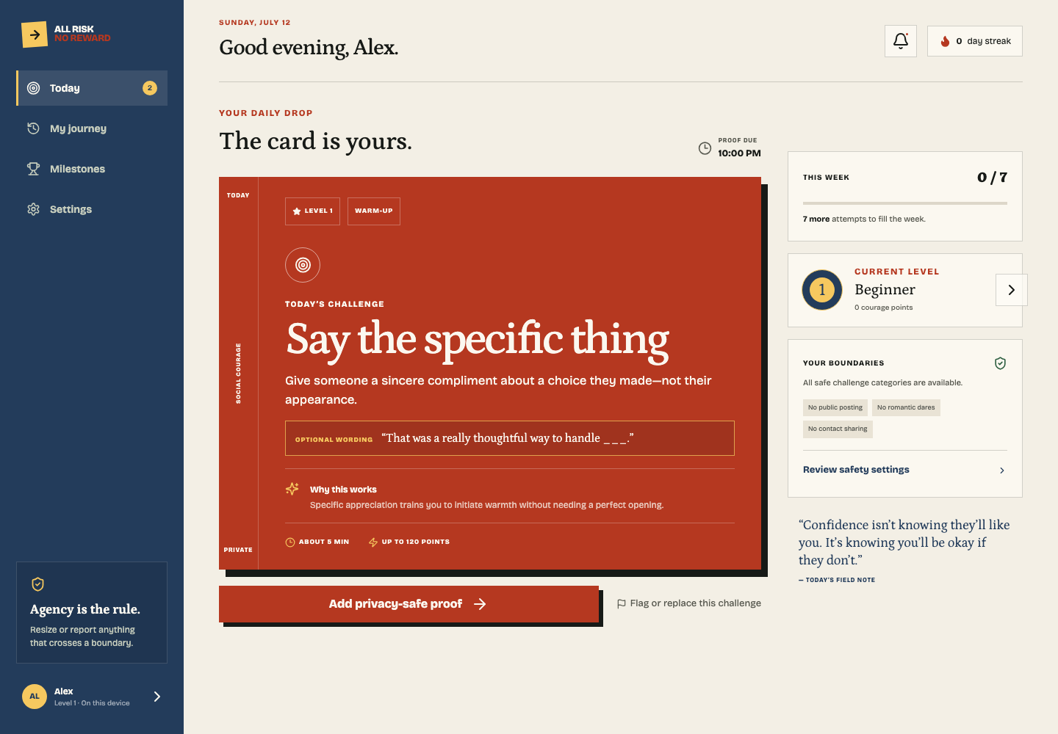
HACKATHON DEMO · 2026
ALL RISK,
NO REWARD.
Social courage, gamified—with guardrails.
AWKWARD
IS ALLOWED
ONE DAILY DROP. ZERO PUBLIC SHAME.
Notes:
All Risk, No Reward is a consent-first social courage app. It turns one healthy, uncomfortable action into a daily game—without public shame, forced posting, or reckless dares.

Slide 2
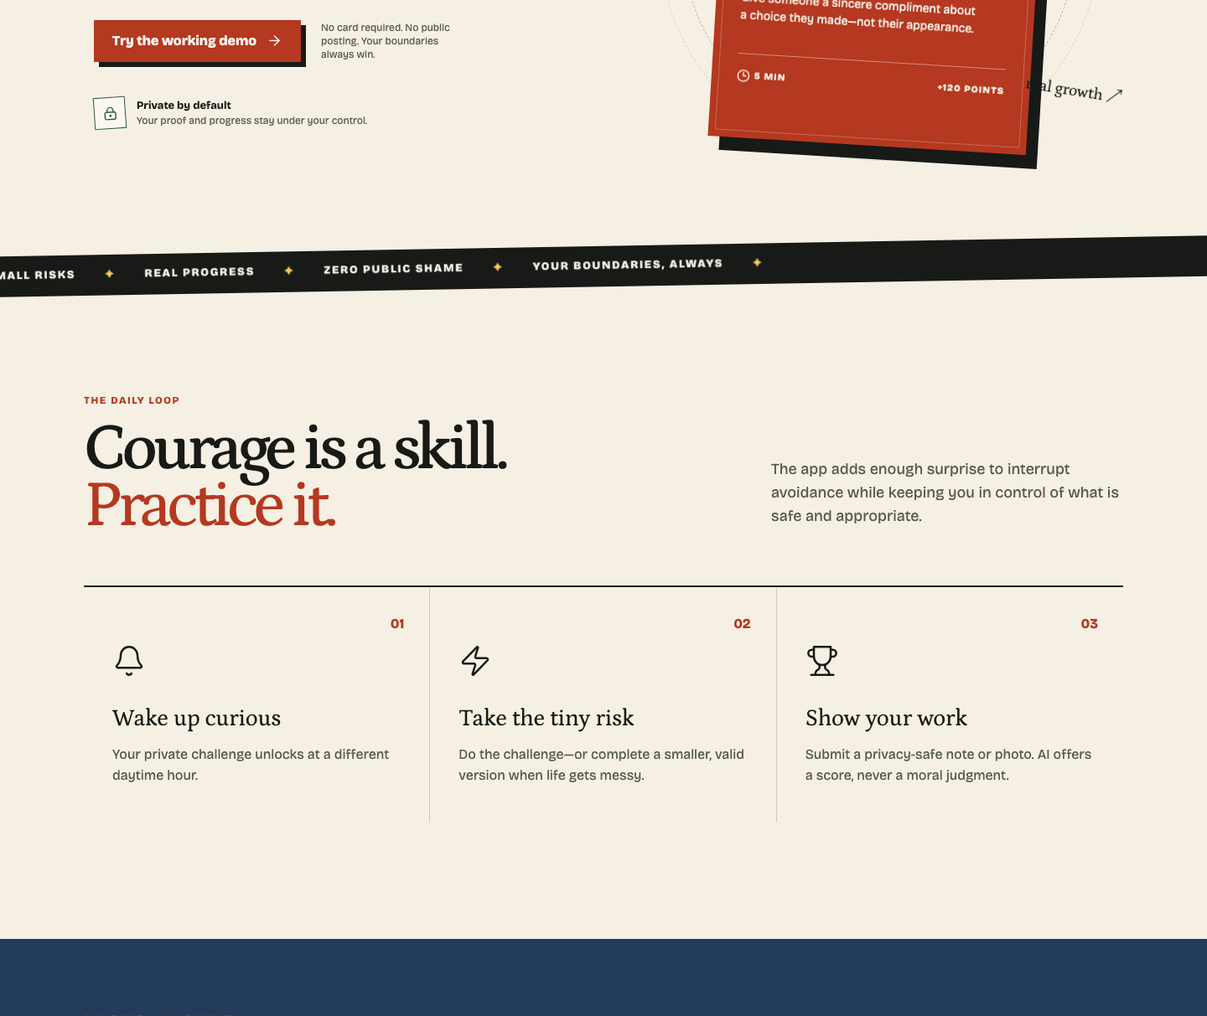
THE ACTUAL PROBLEM
Fear is not the bug.
Delay is.
The gap between “I should” and “I did” eats every good intention.
RANDOM
UNLOCK
ONE SPECIFIC
ACTION
10 PM
DEADLINE
Surprise interrupts avoidance.
Small enough to attempt today.
The loophole closes on schedule.
YOUR COMFORT ZONE
CALLED. WE DECLINED.
ALL RISK, NO REWARD
02
Notes:
The problem is not a lack of advice. It is the infinite delay between intention and action. The app closes that gap with a randomized daytime unlock, one concrete task, and a real deadline.

Slide 3
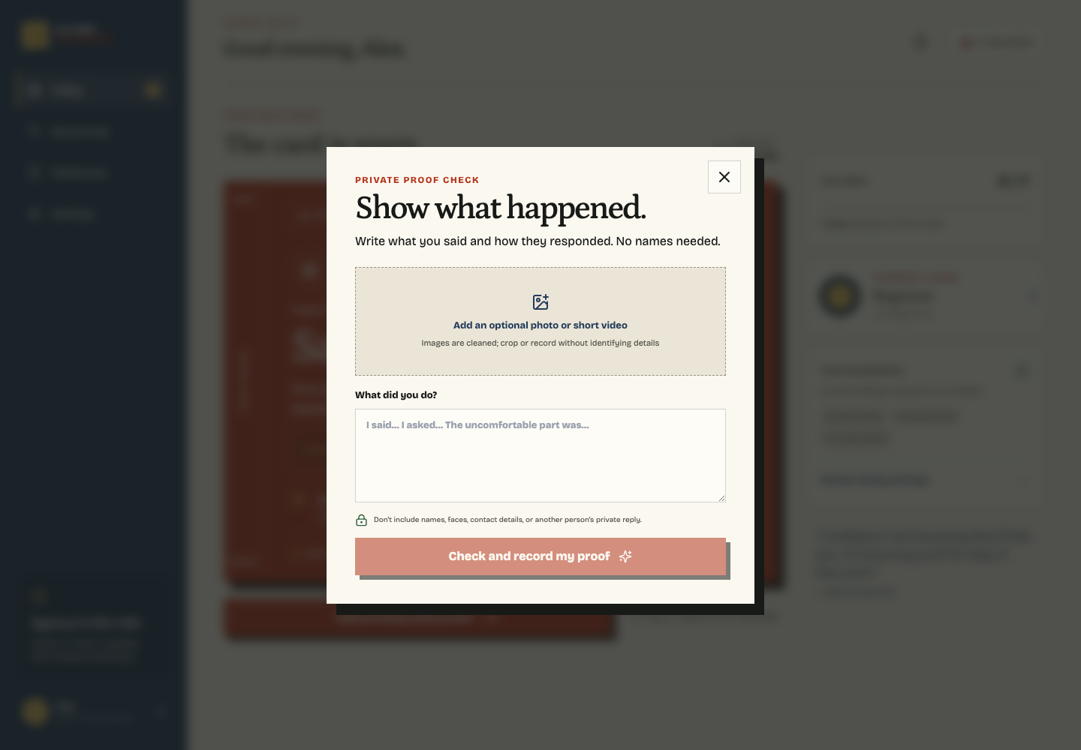
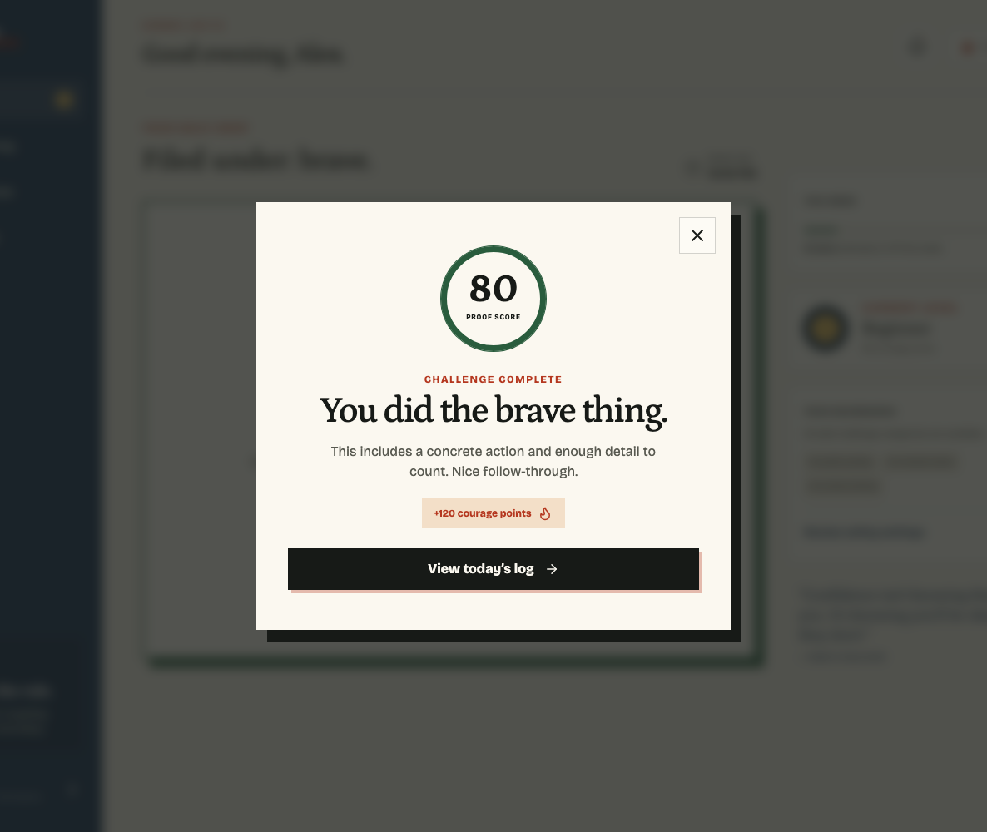
THE DAILY LOOP
One day. One card.
One honest receipt.
No feed. No doom-scroll. Just one rep.
01 · DEAL
02 · PROVE
03 · SCORE
A level-appropriate social challenge unlocks during the day.
Add a private note—and optional cleaned media—with concrete details.
Full, partial, or needs-more becomes points, streaks, levels, and history.
120 FULL CREDIT · 60 PARTIAL CREDIT · 0 NEEDS MORE DETAIL
ALL RISK, NO REWARD
03
Notes:
The entire product is one short loop: the app deals one challenge, the user records privacy-safe proof, and the system scores the evidence. The result feeds points, streaks, levels, milestones, and a private history—not a public social graph.

Slide 4
PROOF WITHOUT SURVEILLANCE
AI scores evidence—
not your worth.
The system asks: did a concrete action happen? It never asks whether you were charismatic enough.
01
CONCRETE > PERFORMATIVE
Specific actions and reflection earn the score.
02
IDENTIFYING DETAILS: NOPE
Names, faces, contacts, and private replies are never required.
03
CONSENT BEFORE GEMINI
Hosted mode asks explicitly before automated assessment.
AI OFFERS A SCORE.
NEVER A MORAL JUDGMENT.
ALL RISK, NO REWARD
04
Notes:
Proof is designed to be useful without becoming surveillance. In local demo mode, a transparent concrete-detail heuristic runs in the browser. In hosted mode, the user must explicitly consent before Gemini receives the note or optional media through the secure backend proxy.

Slide 5
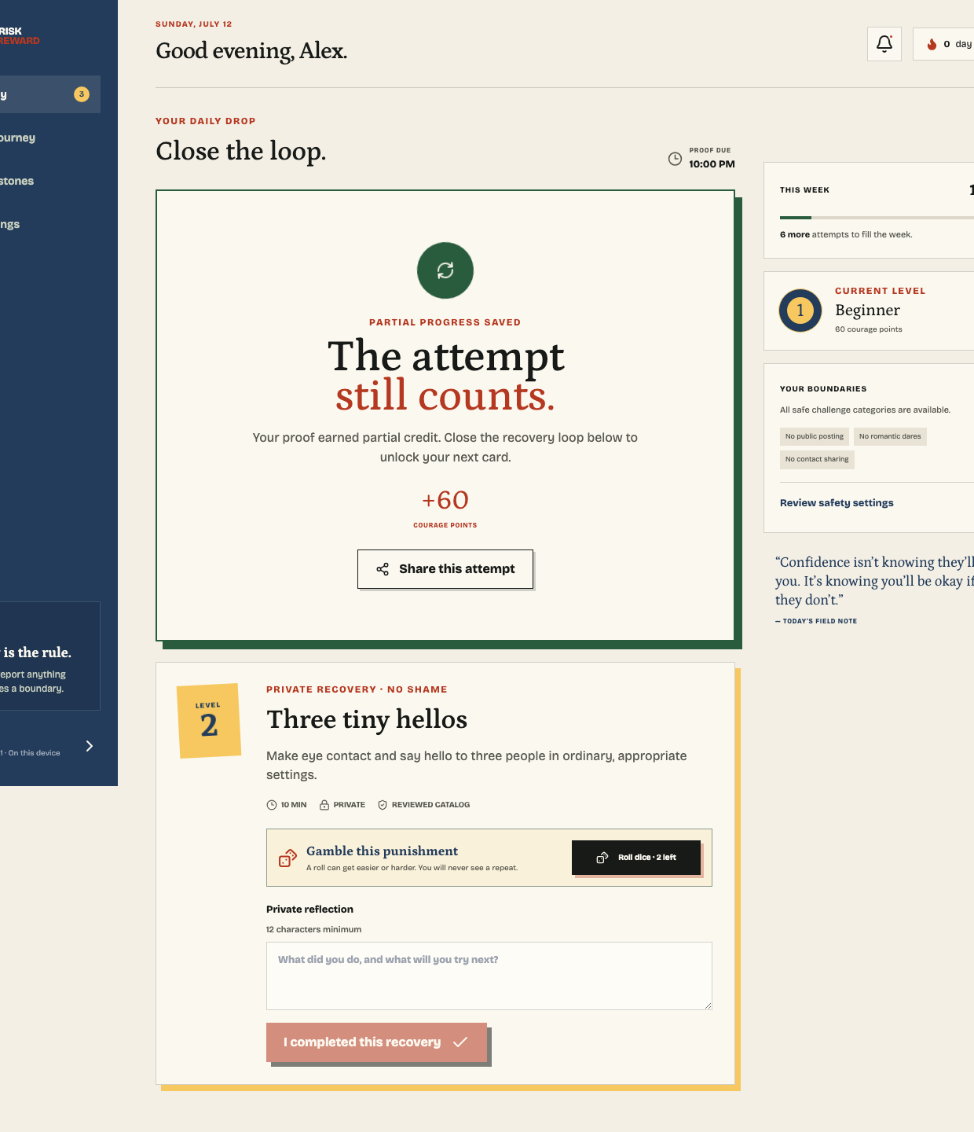
FAILURE IS A GAME STATE, NOT A CHARACTER FLAW
Missed it? The app
rolls dice. Literally.
A partial or missed challenge creates a bounded, private recovery task—then makes closing the loop weirdly compelling.
PRIVATE
No public penalty. No shame spiral.
2 IRREVERSIBLE ROLLS
Easier or harder. Never a repeat for that account.
CLOSE THE LOOP
Finish the task—or spend a banked lifeline—to unlock what comes next.
COULD GET WORSE.
THAT'S THE BIT.
ALL RISK, NO REWARD
05
Notes:
The app does not pretend every attempt is perfect. Partial or missed challenges create a private recovery task. Users get two irreversible, no-repeat dice rerolls that can get easier or harder. Completing the recovery—or spending a lifeline—closes the loop.

Slide 6
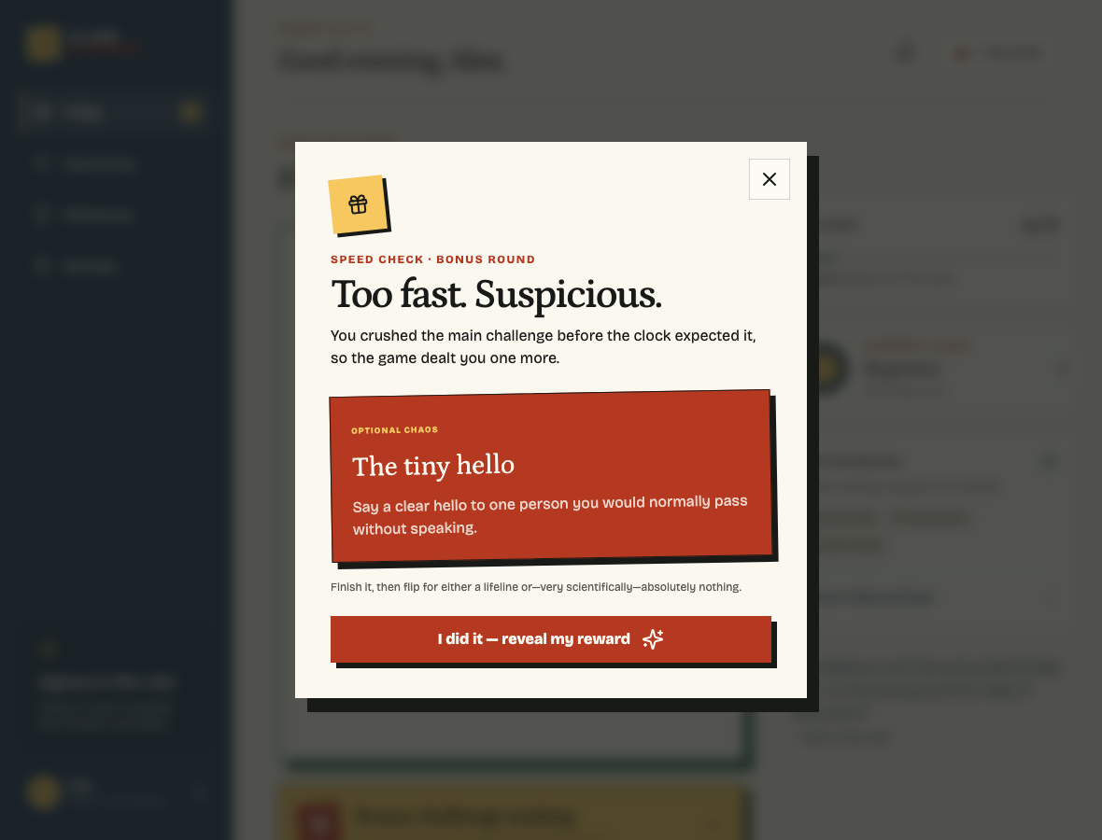
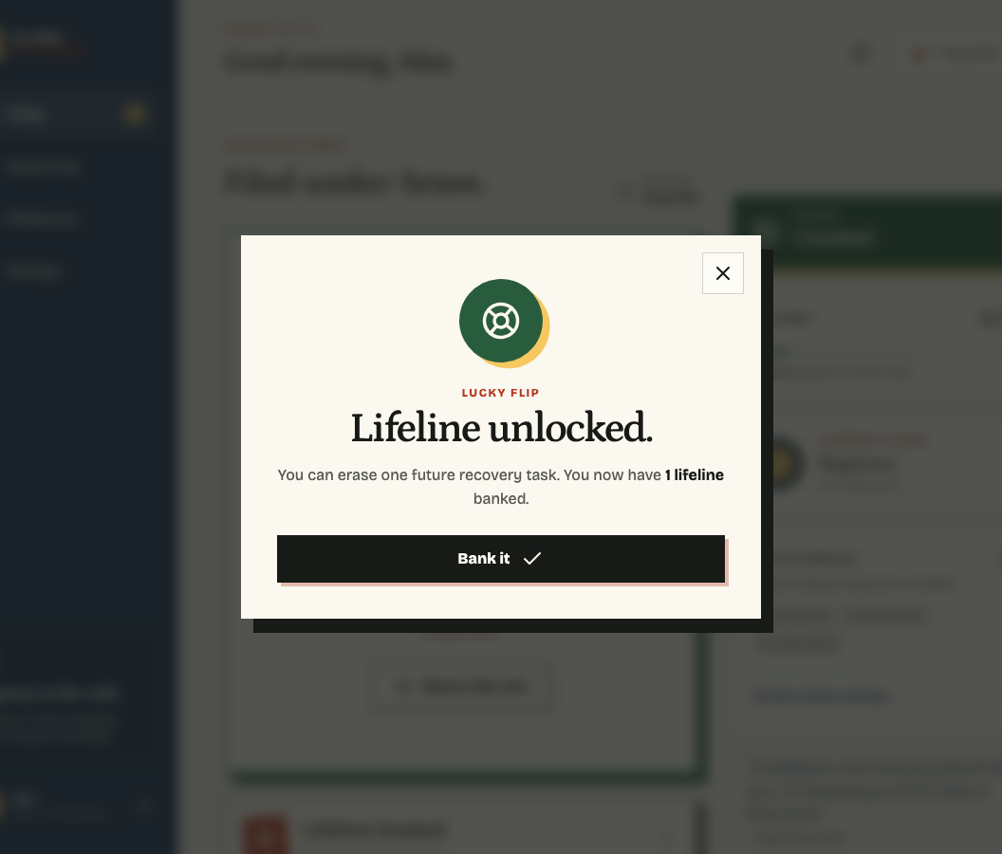
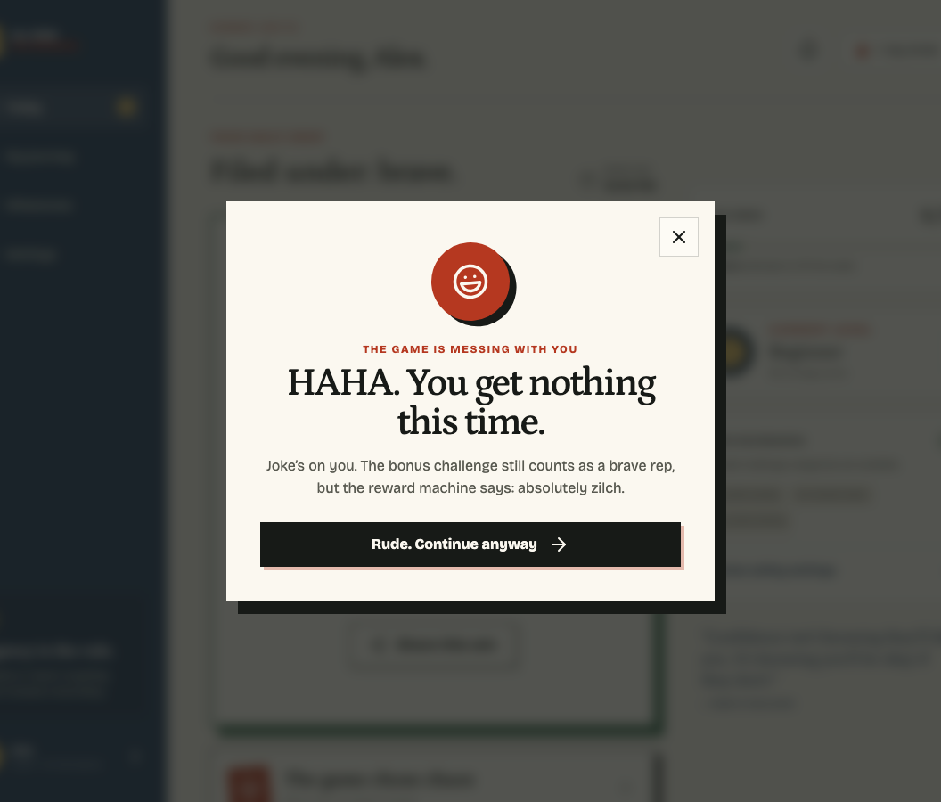
OPTIONAL CHAOS
Finish too fast and the
app gets suspicious.
Complete quickly and a bonus card may appear. Do one more tiny rep, then flip the reward machine.
THEN THE GAME CHOOSES:
BANK A LIFELINE
ABSOLUTELY NOTHING
DO THE BONUS
ALL RISK, NO REWARD
06
Notes:
This is the intentionally unhinged layer. A suspiciously fast completion can trigger one optional bonus challenge. Finish it, then the game awards either a banked recovery lifeline or—very scientifically—absolutely nothing. Either way, the brave rep still counts.

Slide 7
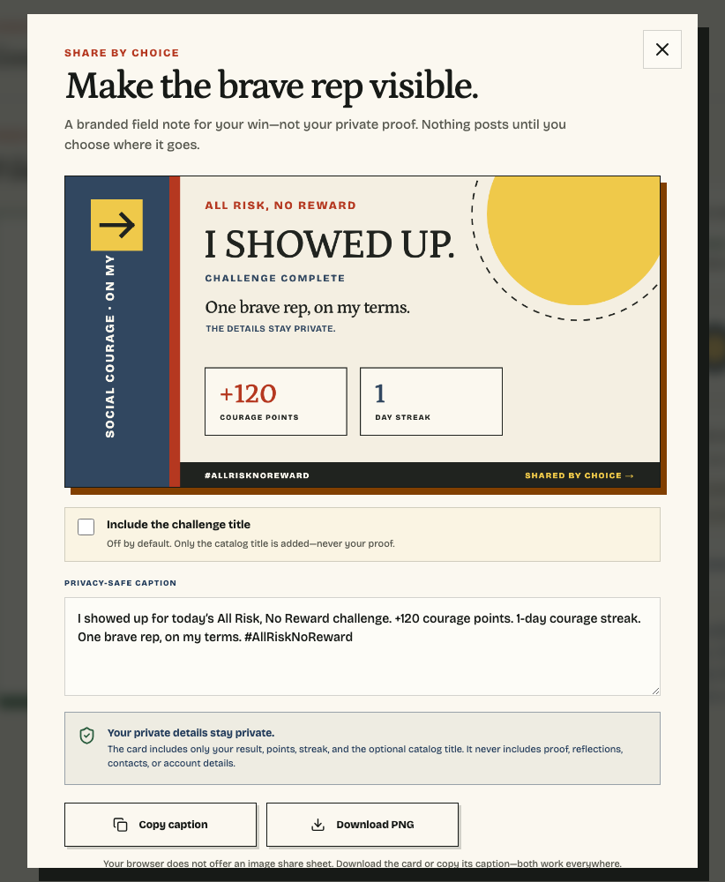
THE BACKBONE
Fun on top.
Serious underneath.
The hackathon demo works with no cloud keys—and has a real hosted path when the room gets serious.
OFFLINE-FIRST PWA
Local auth, 30-day sessions, deterministic daily assignments, cached offline reload.
LOCAL OR HOSTED
React + TypeScript + Vite; optional InsForge auth, RLS, schedules, and secure Gemini proxy.
AGENCY BUILT IN
Report or replace; filter categories and formats; nothing is auto-sent or auto-posted.
SHARE BY CHOICE
Generate a branded result card. Private proof, reflections, contacts, and account details stay out.
RESULTS OUT.
PRIVATE DETAILS IN.
ALL RISK, NO REWARD
07
Notes:
The demo is local-first and requires no backend or API key. Underneath, the same product supports InsForge authentication, row-level security, scheduled maintenance, and a secure Gemini verification proxy. The agency rules remain identical in both modes.

Slide 8
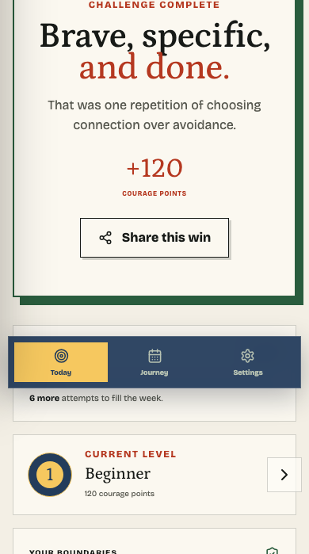
THE ASK
AVOIDANCE
HAS A
DEADLINE.
Open the demo. Do one brave thing.
No card. No public posting. No pretending this isn't a little scary.
LET'S DEMO IT →
ALL RISK, NO REWARD
Notes:
The close is simple: avoidance has a deadline. Now I would leave the deck, open the working demo, and complete the product loop live.

