Slide 1
CS223 Software engineering Book management system The learning hub | Facilitating education at fingertips
Anurag shah (B16cs034)
Chinmay garg (b16cs041)

Slide 2
Objective
The software, Book Management System is designed for the libraries of educational institutes.
It is meant to help the Library staff by easing out their work load and hence increasing the overall efficiency of the system.

Slide 3
Constraints
Each member registered in the system has an institute id.
Each resource (book or journal) has an id.
Only faculties and students of the institute can issue a book.
Only faculties and PhD students can issue a journal and renew a resource.
Only faculties can request for new resources.
Each member cannot issue multiple copies of a resource at a time.
Software is running 24/7.

Slide 4
Who are the actors?
Members: Everyone registered in the system. (librarian/ users)
Librarian/Staff: Library staff who operates the software and acts like the administrator for the software.
Users: Two types -
Faculty
Students –
PhD students
Non-PhD students
Bank: The bank actor is used to pay the fine by student.

Slide 5
Use cases
View Profile : Any member can view his/her own profile. (edit profile/ see your history)
Search : Any member can search the library for books/journals.
Issue Resource : A Librarian can issue resource to user.
Validity : This use case includes check limit and check availability of resource for issuing resource. (check limit, check availability)
Add User : A librarian can add user to the system.
Add Resource : A librarian can add resource to the system.
Get list of fine : The librarian can get list of all users who have fine to pay.

Slide 6
Update Record : The librarian can update the record of resource.
Order Book : A librarian can order any number of Resources.
Clear Dues : User can clear his/her dues.
Issue Journal : Any PhD student or faculty member can issue journal.
Issue Book : any member can issue book.
Return resource : Members have to return the resource issued.
Renew resource : A PhD student or Faculty member can renew the resource issued by them.

Slide 7
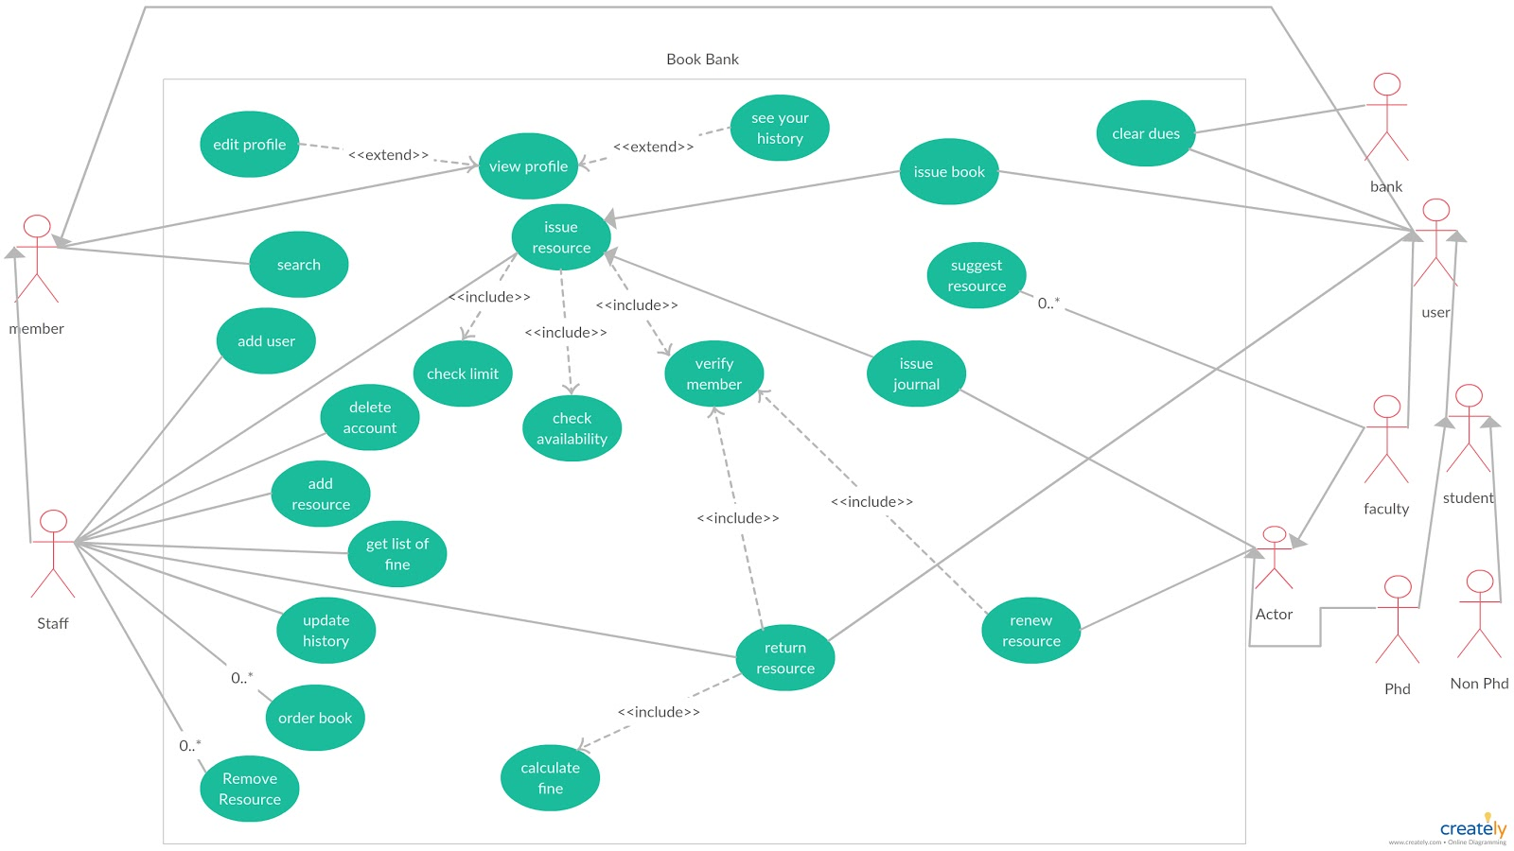
Use case diagram

Slide 8
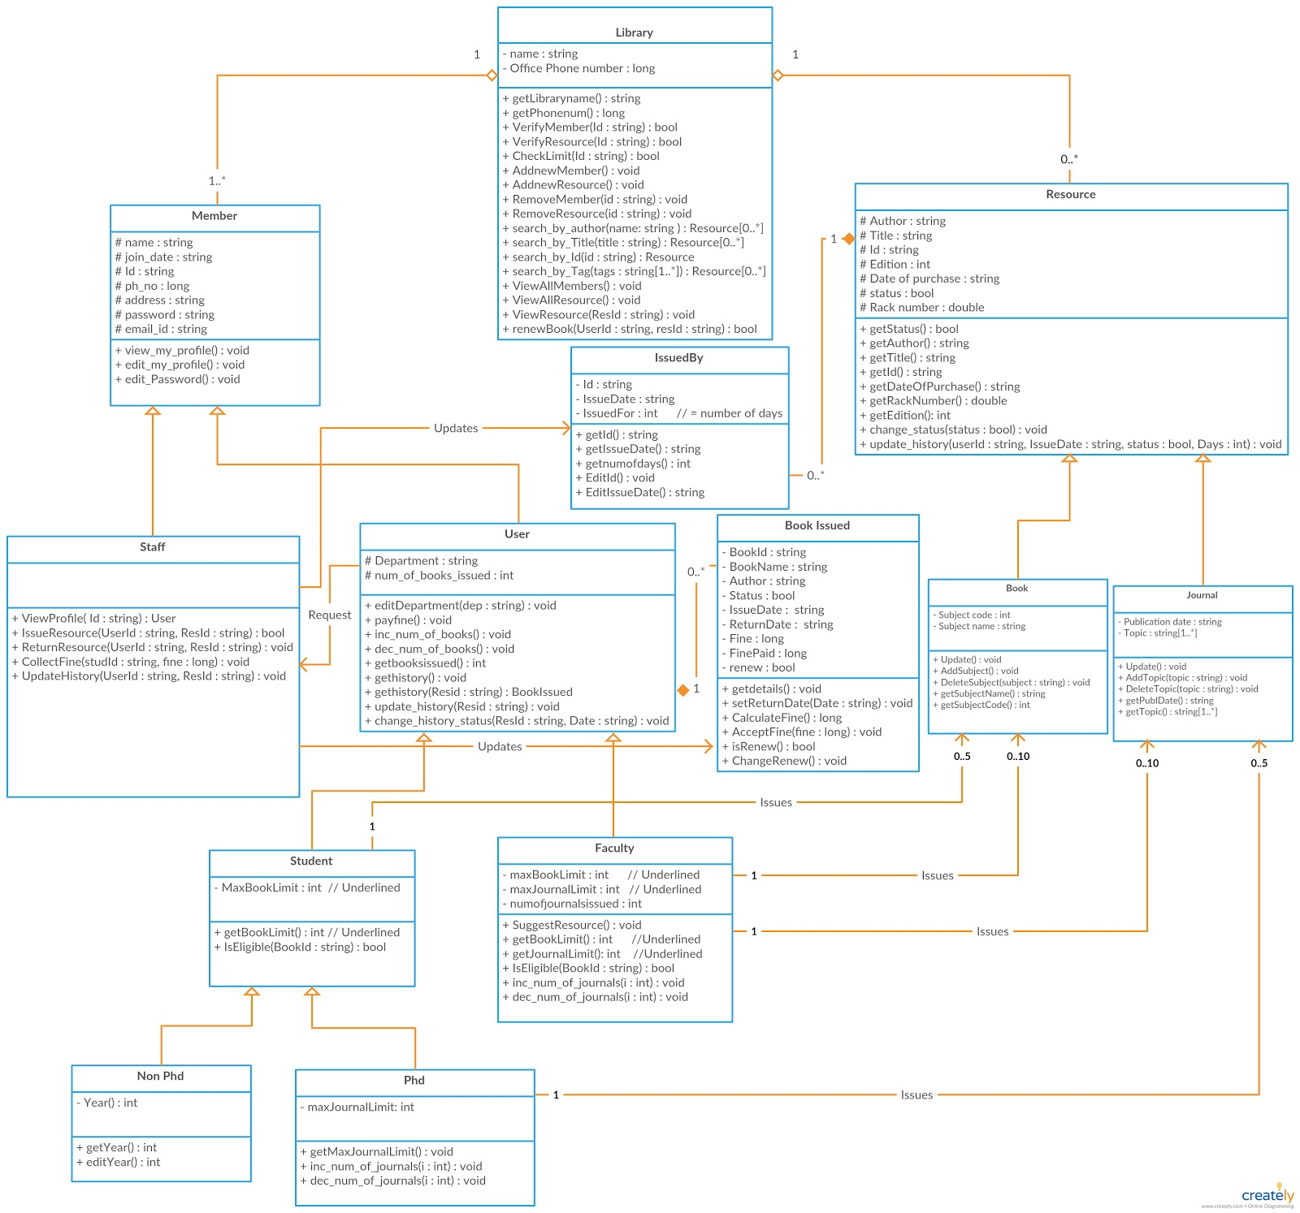
Class diagram

Slide 9
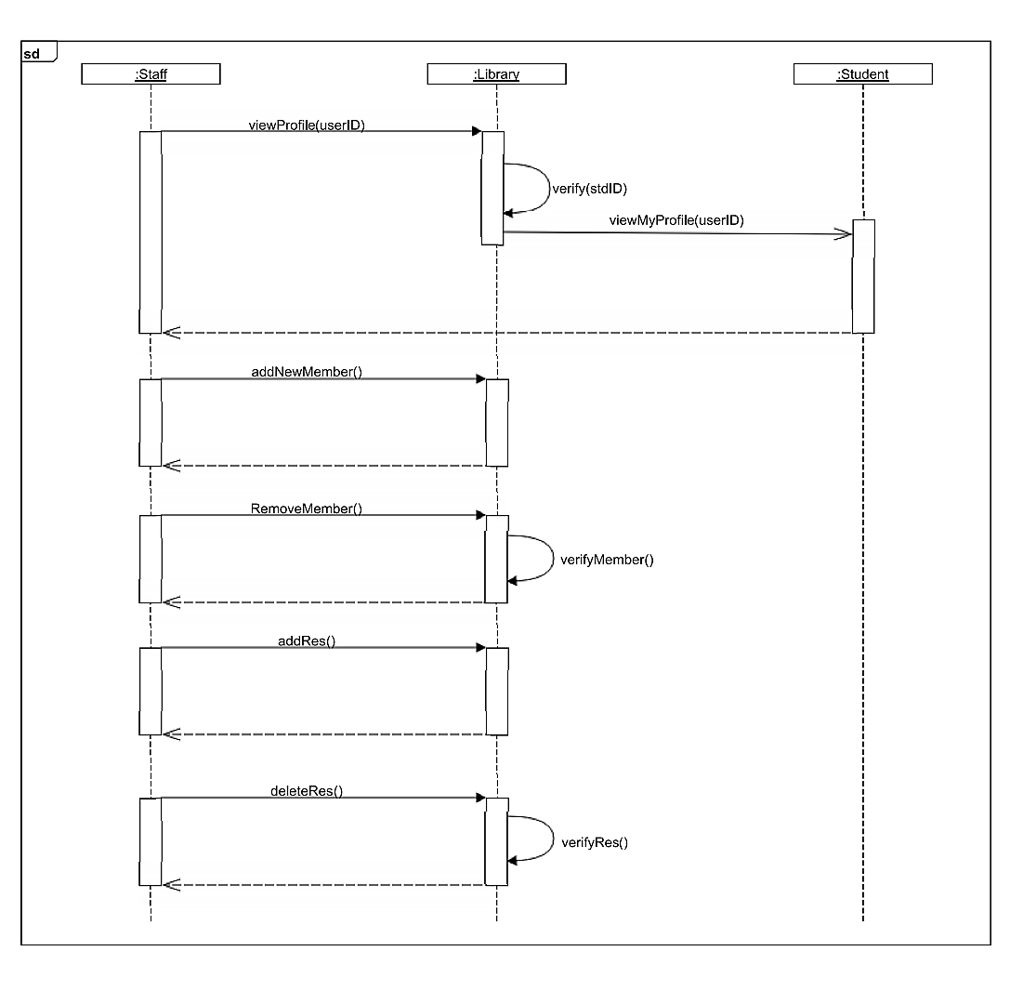
Sequence diagram

Slide 10
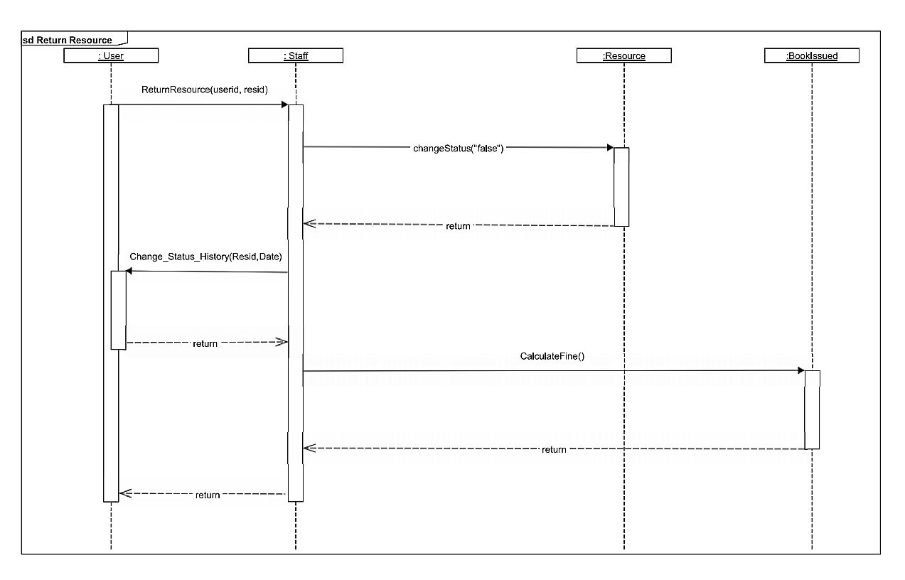

Slide 11
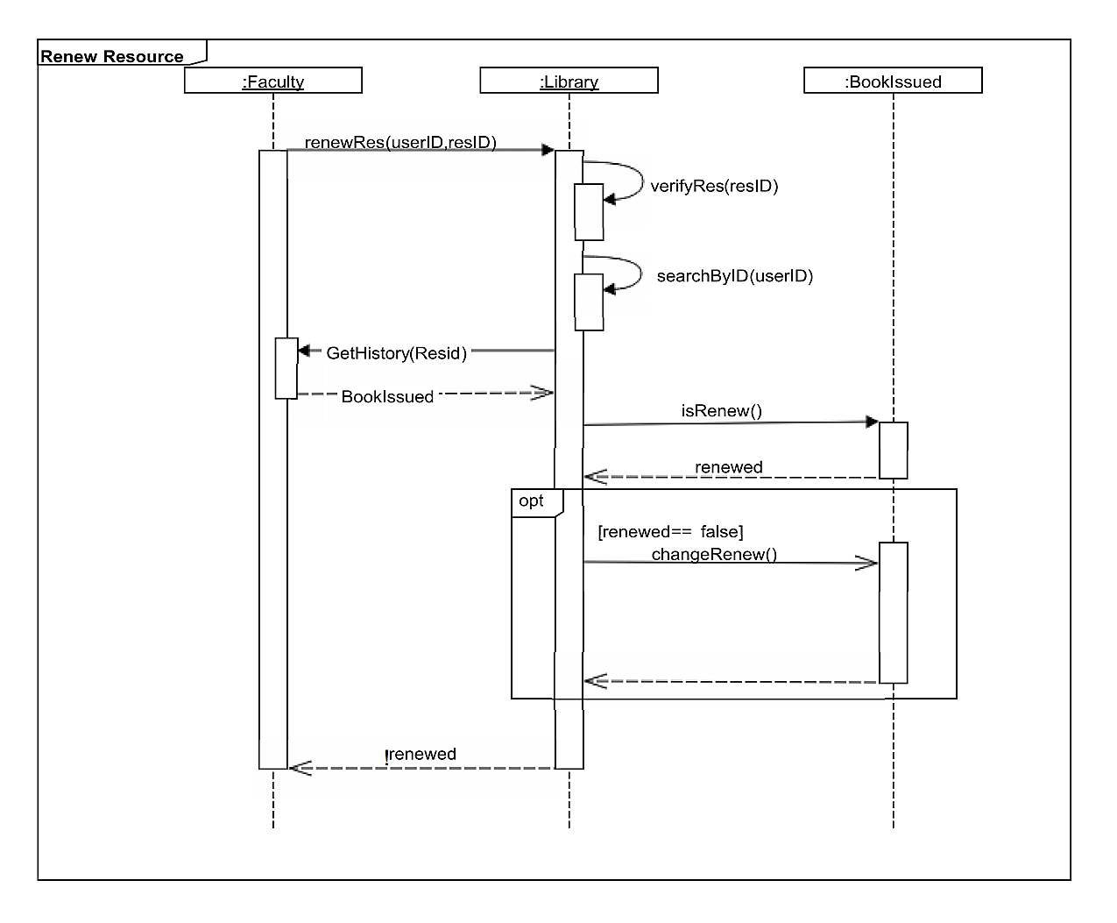

Slide 12
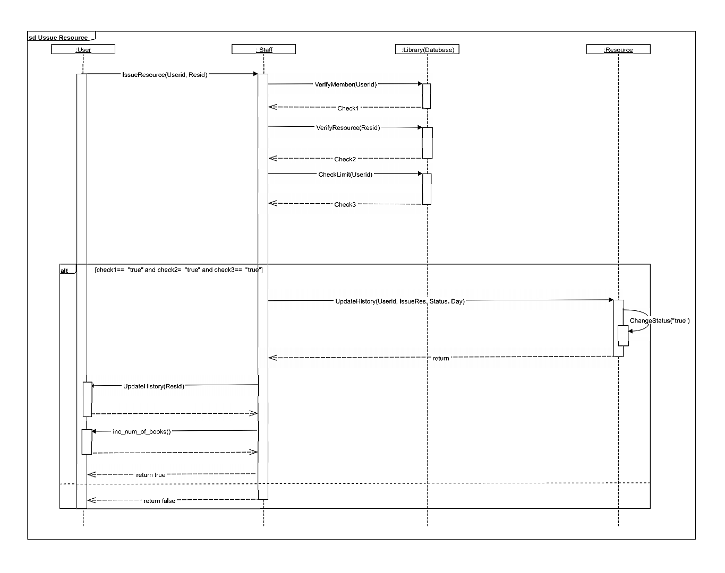

Slide 13
Thank you

