Slide 1
First-Order Logic

Slide 2
Preposition Logic(PL)
In the topic of Propositional logic, we have seen that how to represent statements using propositional logic. But unfortunately, in propositional logic, we can only represent the facts, which are either true or false.
PL is not sufficient to represent the complex sentences or natural language statements.
The propositional logic has very limited expressive power.
Consider the following sentence, which we cannot represent using PL logic.
"Some humans are intelligent",
"Sachin likes cricket."

Slide 3
First-Order Logic(FoL)
First-order logic is another way of knowledge representation in artificial intelligence. It is an extension to propositional logic.
FOL is sufficiently expressive to represent the natural language statements in a concise way.
First-order logic is also known as Predicate logic or First-order predicate logic.
First-order logic is a powerful language that develops information about the objects in a more easy way and can also express the relationship between those objects.

Slide 4
First-order logic (like natural language) does not only assume that the world contains facts like propositional logic but also assumes the following things in the world:
Objects: A, B, people, numbers, colors, wars, theories, squares, pits, wumpus, ......
Relations: It can be unary relation such as: red, round, is adjacent, or n-any relation such as: the sister of, brother of, has color, comes between
Function: Father of, best friend, third inning of, end of, ......
As a natural language, first-order logic also has two main parts:
Syntax
Semantics

Slide 5
Syntax of First-Order logic:
The syntax of FOL determines which collection of symbols is a logical expression in first-order logic. The basic syntactic elements of first-order logic are symbols. We write statements in short-hand notation in FOL.
Basic Elements of First-order logic:
Constant | 1, 2, A, John, Mumbai, cat,....
Variables | x, y, z, a, b,....
Predicates | Brother, Father, >,....
Function | sqrt, LeftLegOf, ....
Connectives | ∧, ∨, ¬, ⇒, ⇔
Equality | ==
Quantifier | ∀, ∃

Slide 6
Example:
Ravi and Ajay are brothers:
=> Brothers(Ravi, Ajay).
Chinky is a cat:
=> cat (Chinky).

Slide 7
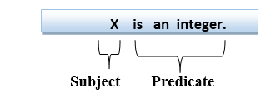
First-order logic statements can be divided into two parts:
Subject: Subject is the main part of the statement.
Predicate: A predicate can be defined as a relation, which binds two atoms together in a statement.

Slide 8
Quantifiers in First-order logic
A quantifier is a language element which generates quantification, and quantification specifies the quantity of specimen in the universe of discourse.
These are the symbols that permit to determine or identify the range and scope of the variable in the logical expression. There are two types of quantifier:
Universal Quantifier,
(for all, everyone, everything)
Existential quantifier,
(for some, at least one).

Slide 9
Universal Quantifier(∀)
Universal quantifier is a symbol of logical representation, which specifies that the statement within its range is true for everything or every instance of a particular thing.
The Universal quantifier is represented by a symbol ∀, which resembles an inverted A.
Note: In universal quantifier we use implication "→".
If x is a variable, then ∀x is read as:
For all x
For each x
For every x.

Slide 10
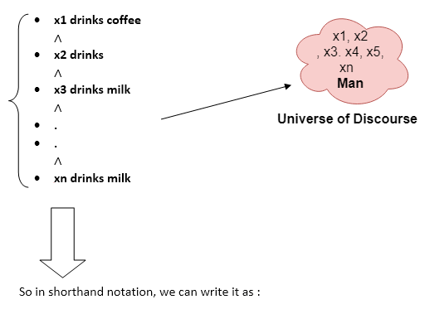
Example
All man drink coffee.
∀x man(x) → drink (x, coffee).
It will be read as: There are all x where x is a man who drink coffee.

Slide 11
Existential Quantifier(∃)
Existential quantifiers are the type of quantifiers, which express that the statement within its scope is true for at least one instance of something.
It is denoted by the logical operator ∃, which resembles as inverted E. When it is used with a predicate variable then it is called as an existential quantifier.
Note: In Existential quantifier we always use AND or Conjunction symbol (∧).
If x is a variable, then existential quantifier will be ∃x or ∃(x). And it will be read as:
There exists a 'x.'
For some 'x.'
For at least one 'x.'

Slide 12
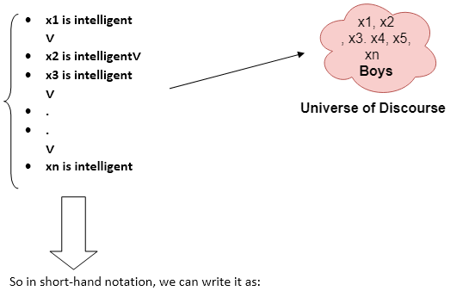
Example
Some boys are intelligent
∃x: boys(x) ∧ intelligent(x)
It will be read as: There are some x where x is a boy who is intelligent.

Slide 13
Points to remember:
The main connective for universal quantifier ∀ is implication →.
The main connective for existential quantifier ∃ is and ∧.
Properties of Quantifiers:
In universal quantifier, ∀x∀y is similar to ∀y∀x.
In Existential quantifier, ∃x∃y is similar to ∃y∃x.
∃x∀y is not similar to ∀y∃x.

Slide 14
Some Examples of FOL using quantifier
All birds fly.
In this question the predicate is "fly(bird)." ∀x bird(x) →fly(x).
Every man respects his parent.
Predicate is "respect(x, y)," where x=man, and y= parent. Since there is every man so will use ∀, and it will be represented as follows: ∀x man(x) → respects (x, parent).

Slide 15
Some Examples of FOL using quantifier
Some boys play cricket.
Predicate is "play(x, y)," where x= boys, and y= game.
Since there are some boys so we will use ∃, and it will be represented as: ∃x boys(x) ∧ play(x, cricket).

Slide 16
Only one student failed in Mathematics.
Predicate is "failed(x, y),"
where x=student, and y=subject. Since there is only one student who failed in Mathematics, so we will use following representation for this:
∃(x) [ student(x) → failed (x, Mathematics) ∧∀ (y) [¬(x==y) ∧ student(y) → ¬failed (x, Mathematics)].

Slide 17
Free and Bound Variables
The quantifiers interact with variables which appear in a suitable way. There are two types of variables in First-order logic which are given below:
Free Variable: A variable is said to be a free variable in a formula if it occurs outside the scope of the quantifier.
Example: ∀x ∃(y)[P (x, y, z)], where z is a free variable.
Bound Variable: A variable is said to be a bound variable in a formula if it occurs within the scope of the quantifier.
Example: ∀x [A (x)], here x and y are the bound variables.

Slide 18
Knowledge Engineering
What is knowledge-engineering?
The process of constructing a knowledge-base in first-order logic is called as knowledge- engineering.
In knowledge-engineering, someone who investigates a particular domain, learns important concept of that domain, and generates a formal representation of the objects, is known as knowledge engineer.

Slide 19
Knowledge engineering projects vary in content, scope, and difficulty, but all such projects include the following steps:
Identify the task.
Assemble the relevant knowledge
Decide on a vocabulary of predicates, functions, and constants
Encode general knowledge about the domain
Encode a description of the specific problem instance
Pose queries to the inference procedure and get answers
Debug the knowledge base.

Slide 20
FOL inference rules for quantifier
Inference in First-Order Logic is used to deduce new facts or sentences from existing sentences.
As propositional logic we also have inference rules in first-order logic, so following are some basic inference rules in FOL:
Universal Generalization
Universal Instantiation
Existential Instantiation
Existential introduction

Slide 21

Universal Generalization
Universal generalization is a valid inference rule which states that if premise P(c) is true for any arbitrary element c in the universe of discourse, then we can have a conclusion as ∀ x P(x).
It can be represented as: .
This rule can be used if we want to show that every element has a similar property.
In this rule, x must not appear as a free variable.

Slide 22
Example: Let's represent,
P(c): "A byte contains 8 bits",
so for ∀ x P(x) "All bytes contain 8 bits.",
it will also be true.

Slide 23

Universal Instantiation
Universal instantiation is also called as universal elimination or UI is a valid inference rule. It can be applied multiple times to add new sentences.
The new KB is logically equivalent to the previous KB.
As per UI, we can infer any sentence obtained by substituting a ground term for the variable.
The UI rule state that we can infer any sentence P(c) by substituting a ground term c (a constant within domain x) from ∀ x P(x) for any object in the universe of discourse.
It can be represented as: .

Slide 24
Example:
IF "Every person like ice-cream“
=> ∀x P(x) so we can infer that
"John likes ice-cream" => P(c)

Slide 25
"All kings who are greedy are Evil." So let our knowledge base contains this detail as in the form of FOL:
∀x king(x) ∧ greedy (x) → Evil (x),
So from this information, we can infer any of the following statements using Universal Instantiation:
King(John) ∧ Greedy (John) → Evil (John),
King(Richard) ∧ Greedy (Richard) → Evil (Richard),
King(Father(John)) ∧ Greedy (Father(John)) → Evil (Father(John)),

Slide 26

Existential Instantiation
Existential instantiation is also called as Existential Elimination, which is a valid inference rule in first-order logic.
It can be applied only once to replace the existential sentence.
The new KB is not logically equivalent to old KB, but it will be satisfiable if old KB was satisfiable.
This rule states that one can infer P(c) from the formula given in the form of ∃x P(x) for a new constant symbol c.
The restriction with this rule is that c used in the rule must be a new term for which P(c ) is true.
It can be represented as:

Slide 27
Example:
From the given sentence:
∃x Crown(x) ∧ OnHead(x, John),
So we can infer:
Crown(K) ∧ OnHead( K, John),
as long as K does not appear in the knowledge base.
The above used K is a constant symbol, which is called Skolem constant.

Slide 28

Existential introduction
An existential introduction is also known as an existential generalization, which is a valid inference rule in first-order logic.
This rule states that if there is some element c in the universe of discourse which has a property P, then we can infer that there exists something in the universe which has the property P.
It can be represented as:

Slide 29
Example: Let's say that, "Priyanka got good marks in English." Therefore,
someone got good marks in English."

Slide 30
What is Unification?
Unification is a process of making two different logical atomic expressions identical by finding a substitution. Unification depends on the substitution process.
It takes two literals as input and makes them identical using substitution.
Let Ψ₁ and Ψ₂ be two atomic sentences and 𝜎 be a unifier such that, Ψ₁𝜎 = Ψ₂𝜎, then it can be expressed as UNIFY(Ψ₁, Ψ₂).
Example: Find the Most General Unifier(MSG) for Unify{King(x), King(John)}

Slide 31
Let Ψ₁ = King(x), Ψ₂ = King(John),
Substitution θ = {John/x} is a unifier for these atoms and applying this substitution, and both expressions will be identical.
The UNIFY algorithm is used for unification, which takes two atomic sentences and returns a unifier for those sentences (If any exist).
Unification is a key component of all first-order inference algorithms.
It returns fail if the expressions do not match with each other.
The substitution variables are called Most General Unifier or MGU.

Slide 32
E.g. Let's say there are two different expressions, P(x, y), and P(a, f(z)).
In this example, we need to make both above statements identical to each other. For this, we will perform the substitution.
P(x, y)......... (i) P(a, f(z))......... (ii)
Substitute x with a, and y with f(z) in the first expression, and it will be represented as a/x and f(z)/y.
With both the substitutions, the first expression will be identical to the second expression and the substitution set will be: [a/x, f(z)/y].

Slide 33
Conditions for Unification
Following are some basic conditions for unification:
Predicate symbol must be same, atoms or expression with different predicate symbol can never be unified.
Number of Arguments in both expressions must be identical.
Unification will fail if there are two similar variables present in the same expression.

Slide 34
Resolution in FOL
Resolution is a theorem proving technique that proceeds by building refutation proofs, i.e., proofs by contradictions. It was invented by a Mathematician John Alan Robinson in the year 1965.
Resolution is used, if there are various statements are given, and we need to prove a conclusion of those statements. Unification is a key concept in proofs by resolutions.

Slide 35
Resolution in FOL
Resolution is a single inference rule which can efficiently operate on the conjunctive normal form or clausal form.
Clause: Disjunction of literals (an atomic sentence) is called a clause. It is also known as a unit clause.
Conjunctive Normal Form: A sentence represented as a conjunction of clauses is said to be conjunctive normal form or CNF.

Slide 36
Steps for Resolution
Conversion of facts into first-order logic.
Convert FOL statements into CNF
Negate the statement which needs to prove (proof by contradiction)
Draw resolution graph (unification).

Slide 37
Steps for Resolution
Conversion of facts into first-order logic.
Convert FOL statements into CNF
Eliminate all implication (→) and rewrite
Move negation (¬)inwards and rewrite
Rename variables or standardize variables
Eliminate existential instantiation quantifier by elimination.
Drop Universal quantifiers.
Negate the statement which needs to prove (proof by contradiction)
Draw resolution graph (unification).

Slide 38
Example
John likes all kind of food.
Apple and vegetable are food
Anything anyone eats and not killed is food.
Anil eats peanuts and still alive
Harry eats everything that Anil eats.
Prove by resolution that:
John likes peanuts.

Slide 39
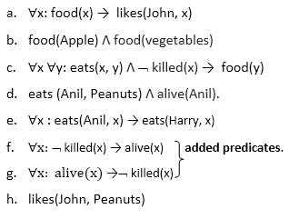
Step-1: Conversion of Facts into FOL
In the first step we will convert all the given statements into its first order logic.

Slide 40
Step-2: Conversion of FOL into CNF
In First order logic resolution, it is required to convert the FOL into CNF as CNF form makes easier for resolution proofs.
Eliminate all implication (→) and rewrite
Move negation (¬)inwards and rewrite
Rename variables or standardize variables
Eliminate existential instantiation quantifier by elimination.
Drop Universal quantifiers.

Slide 41
Step-2: Conversion of FOL into CNF
Eliminate all implication (→) and rewrite
∀x ¬ food(x) V likes(John, x)
food(Apple) Λ food(vegetables)
∀x ∀y ¬ [eats(x, y) Λ ¬ killed(x)] V food(y)
eats (Anil, Peanuts) Λ alive(Anil)
∀x ¬ eats(Anil, x) V eats(Harry, x)
∀x¬ [¬ killed(x) ] V alive(x)
∀x ¬ alive(x) V ¬ killed(x)
likes(John, Peanuts).

Slide 43
Step-2: Conversion of FOL into CNF
Move negation (¬)inwards and rewrite
∀x ¬ food(x) V likes(John, x)
food(Apple) Λ food(vegetables)
∀x ∀y ¬ eats(x, y) V killed(x) V food(y)
eats (Anil, Peanuts) Λ alive(Anil)
∀x ¬ eats(Anil, x) V eats(Harry, x)
∀x ¬killed(x) ] V alive(x)
∀x ¬ alive(x) V ¬ killed(x)
likes(John, Peanuts).

Slide 44
Eliminate all implication (→) and rewrite
∀x ¬ food(x) V likes(John, x)
food(Apple) Λ food(vegetables)
∀x ∀y ¬ [eats(x, y) Λ ¬ killed(x)] V food(y)
eats (Anil, Peanuts) Λ alive(Anil)
∀x ¬ eats(Anil, x) V eats(Harry, x)
∀x¬ [¬ killed(x) ] V alive(x)
∀x ¬ alive(x) V ¬ killed(x)
likes(John, Peanuts).

Slide 45
Step-2: Conversion of FOL into CNF
Rename variables or standardize variables
∀x ¬ food(x) V likes(John, x)
food(Apple) Λ food(vegetables)
∀y ∀z ¬ eats(y, z) V killed(y) V food(z)
eats (Anil, Peanuts) Λ alive(Anil)
∀w¬ eats(Anil, w) V eats(Harry, w)
∀g ¬killed(g) ] V alive(g)
∀k ¬ alive(k) V ¬ killed(k)
likes(John, Peanuts).

Slide 46
Move negation (¬)inwards and rewrite
∀x ¬ food(x) V likes(John, x)
food(Apple) Λ food(vegetables)
∀x ∀y ¬ eats(x, y) V killed(x) V food(y)
eats (Anil, Peanuts) Λ alive(Anil)
∀x ¬ eats(Anil, x) V eats(Harry, x)
∀x ¬killed(x) ] V alive(x)
∀x ¬ alive(x) V ¬ killed(x)
likes(John, Peanuts).

Slide 47
Step-2: Conversion of FOL into CNF
Eliminate existential instantiation quantifier by elimination. In this step, we will eliminate existential quantifier ∃, and this process is known as Skolemization. But in this example problem since there is no existential quantifier so all the statements will remain same in this step.

Slide 48
Step-2: Conversion of FOL into CNF
Drop Universal quantifiers. In this step we will drop all universal quantifier since all the statements are not implicitly quantified so we don't need it.
¬ food(x) V likes(John, x)
food(Apple)
food(vegetables)
¬ eats(y, z) V killed(y) V food(z)
eats (Anil, Peanuts)
alive(Anil)
¬ eats(Anil, w) V eats(Harry, w)
killed(g) V alive(g)
¬ alive(k) V ¬ killed(k)
likes(John, Peanuts).

Slide 49
Step-3: Negate the statement to be proved
In this statement, we will apply negation to the conclusion statements, which will be written as ¬likes(John, Peanuts)

Slide 50
Step-4: Draw Resolution graph
Now in this step, we will solve the problem by resolution tree using substitution. For the above problem, it will be given as follows:

Slide 51
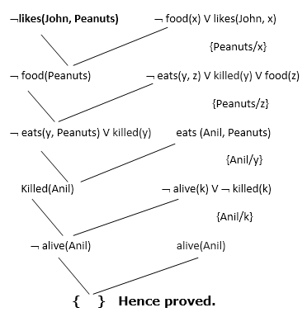
Hence the negation of the conclusion has been proved as a complete contradiction with the given set of statements.

Slide 52
Step-2: Conversion of FOL into CNF
Drop Universal quantifiers. In this step we will drop all universal quantifier since all the statements are not implicitly quantified so we don't need it.
¬ food(x) V likes(John, x)
food(Apple)
food(vegetables)
¬ eats(y, z) V killed(y) V food(z)
eats (Anil, Peanuts)
alive(Anil)
¬ eats(Anil, w) V eats(Harry, w)
killed(g) V alive(g)
¬ alive(k) V ¬ killed(k)
likes(John, Peanuts).

Slide 53
Resolution Proof Example.
(a) Marcus was a man.
(b) Marcus was a Roman.
(c) All men are people.
(d) Caesar was a ruler.
(e) All Romans were either loyal to Caesar or hated him (or both).
(f) Everyone is loyal to someone.
(g) People only try to assassinate rulers they are not loyal to.
(h) Marcus tried to assassinate Caesar.

Slide 54
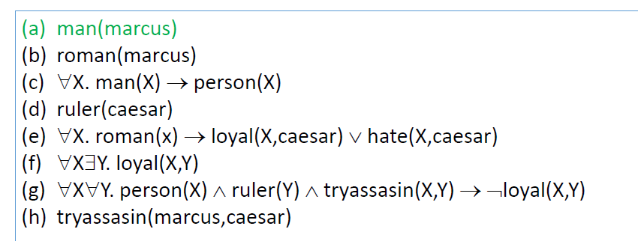

Slide 55
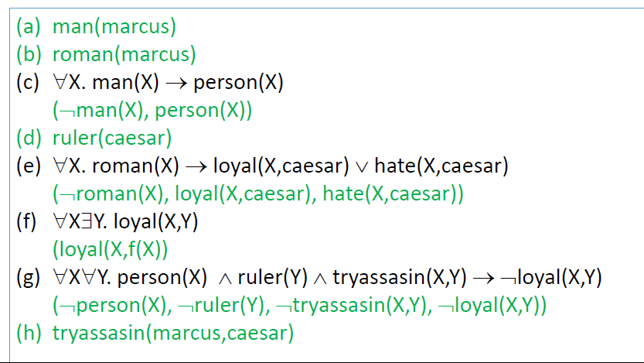

Slide 56
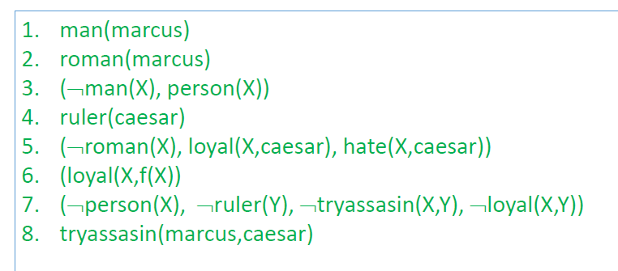

Slide 57
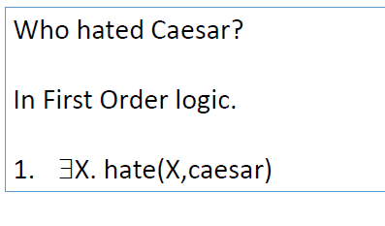

Slide 58
