Slide 1

Agenda
Introduction
Management Summary
Overall conclusions
Client Commitment Index®
RADAR® summaries
Word Cloud
One piece of advice
Animal personifications
Overall Indicated action
Detailed Client Viewpoint
Appendices
Quantitative highlights
© 2022 Relationship Audits & Management®

Slide 2
Introduction
© 2022 Relationship Audits & Management®

Slide 3
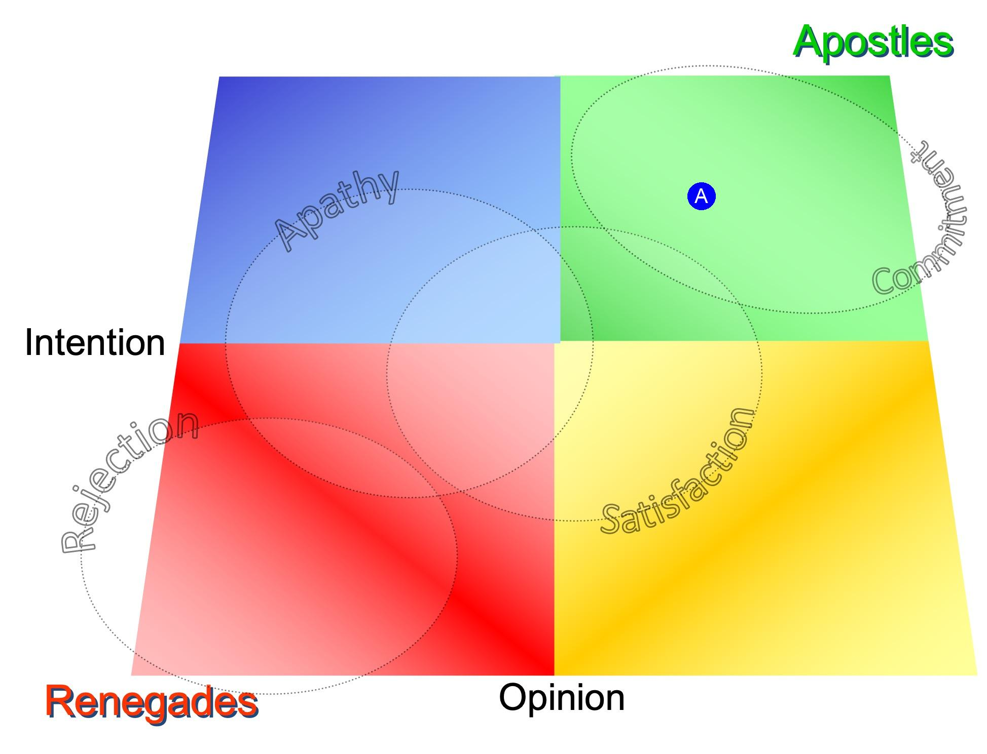
The Client Commitment Index® (RAM Overall)
(A) RAM Overall
© 2022 Relationship Audits & Management®

Slide 4
Test
Test

