Slide 1
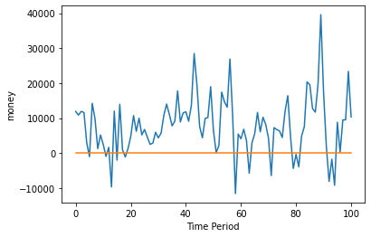
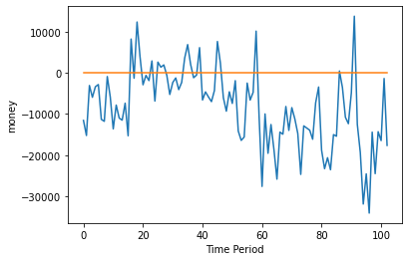
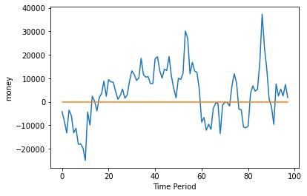
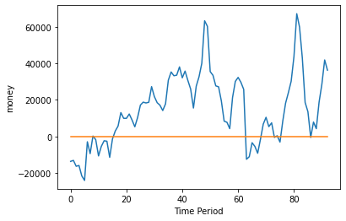
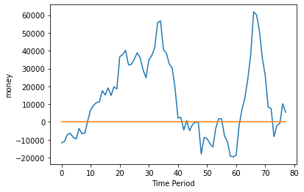
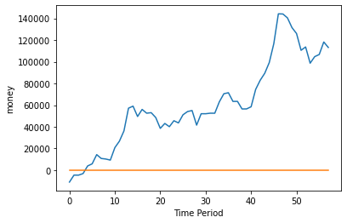
날짜별, 7일 / 5일 / 10일 / 15일 / 30일 / 50일 , (answer-result)값, 0에 가까울 수록 정확한 예측
7
10
5
loss: 0.0013 - accuracy: 0.0122
- val_loss: 0.0023 - val_accuracy: 0.0198
loss: 7.8135e-04 - accuracy: 0.0121
- val_loss: 0.0029 - val_accuracy: 0.0194
loss: 0.0013 - accuracy: 0.0124
- val_loss: 0.0024 - val_accuracy: 0.0204
15
30
50
loss: 0.0034 - accuracy: 0.0084
- val_loss: 0.0109 - val_accuracy: 0.0215
loss: 0.0063 - accuracy: 0.0090
- val_loss: 0.0112 - val_accuracy: 0.0256
loss: 0.0696 - accuracy: 0.0000e+00
- val_loss: 0.0974 - val_accuracy: 0.0000e+00

Slide 2
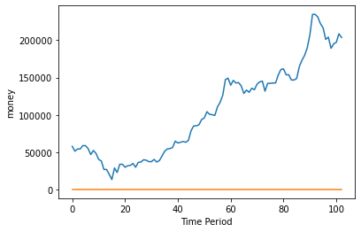
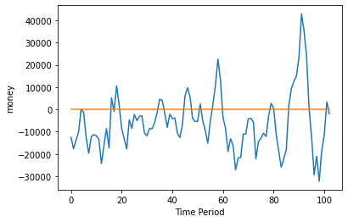
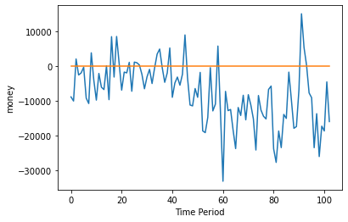
mean_absolute_percentage__error
sigmoid
Relu relu sigmoid

