Slide 1
APC, T-Cell Model v4
6/28/2016
Jose Perez

Slide 2
Cell Types
T-Cells
TREG – Naïve, Active, Anergic
TCONV – Naïve, Active, Anergic
Antigen Presenting Cells (APCs)

Slide 3
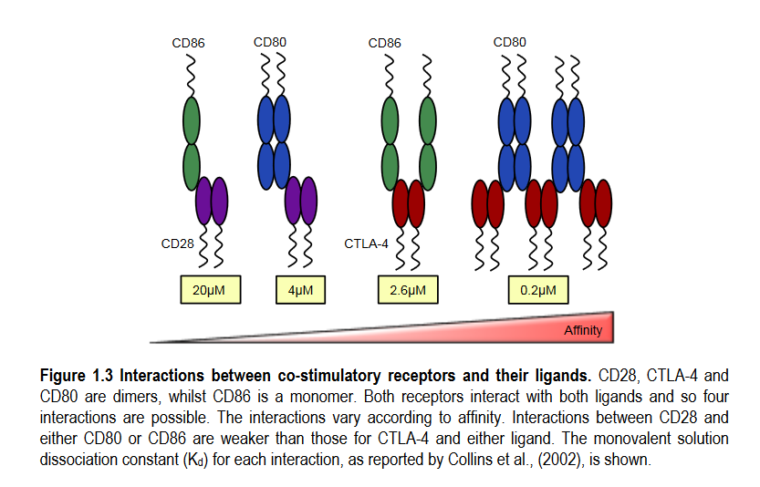
Binding Affinities
From “Role of the CTLA-4 terminus in regulating its intracellular trafficking”, PhD thesis by Satdip Kaur. (http://etheses.bham.ac.uk/4903/8/Kaur14PhD.pdf)

Slide 4
Amount of CD80 Downregulation

Slide 5
Amount of CD86 Downregulation

Slide 6
CTLA-4 and CD28 Receptor Engagement

Slide 7
Threshold

Slide 8
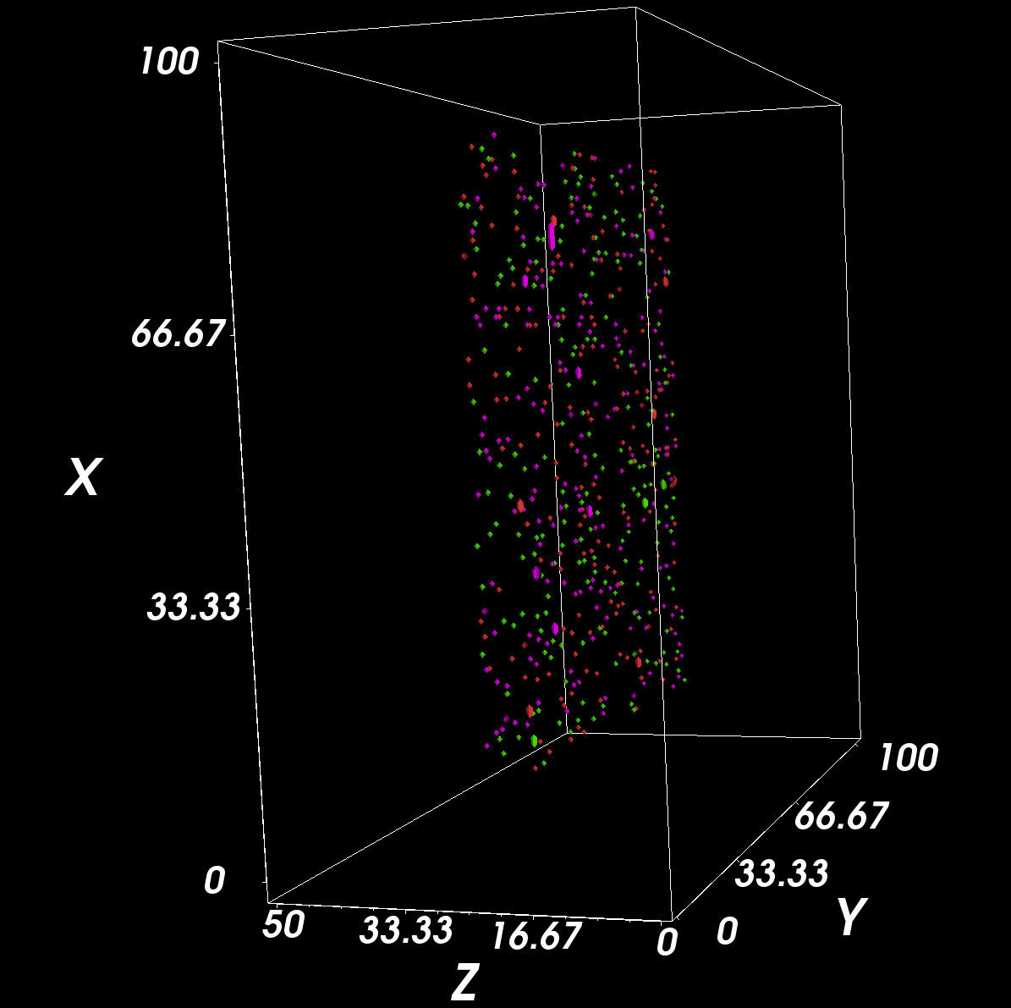
Start (MCS = 0)
Legend
APC
Naïve Treg
Active Treg
Anergic Treg
Naïve Tconv
Active Tconv
Anergic Tconv

Slide 9
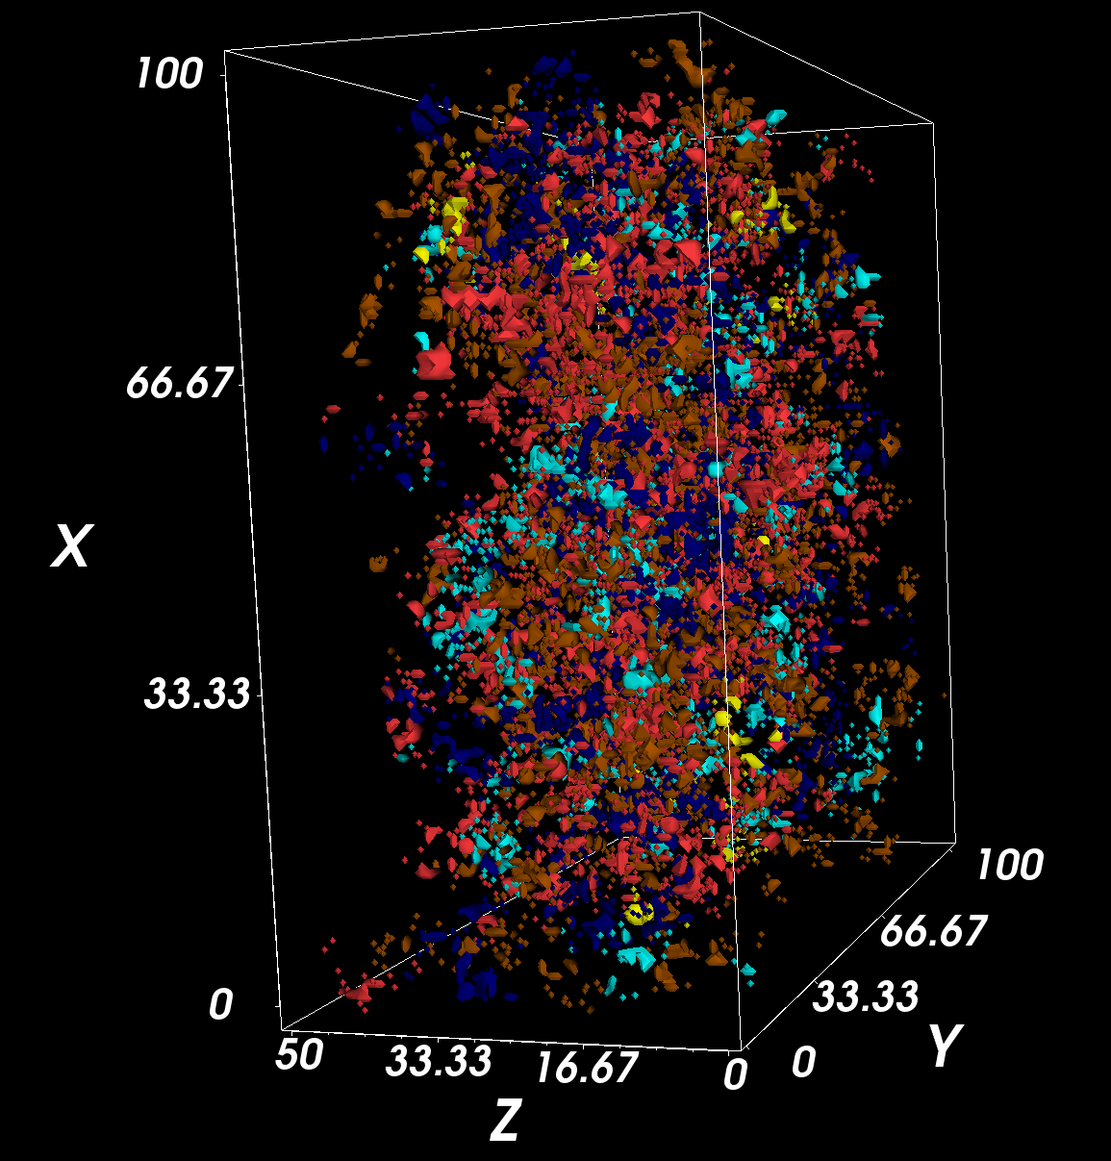
End (MCS = 300)
Legend
APC
Naïve Treg
Active Treg
Anergic Treg
Naïve Tconv
Active Tconv
Anergic Tconv

