Slide 1
APC, T-Cell Model v5
Ligand removal mechanism
6/28/2016
Jose Perez

Slide 2
Ligand Removal
Happens after T-Cell and APC stop interacting
Selects an available ligand at random (50% probability each)

Slide 3
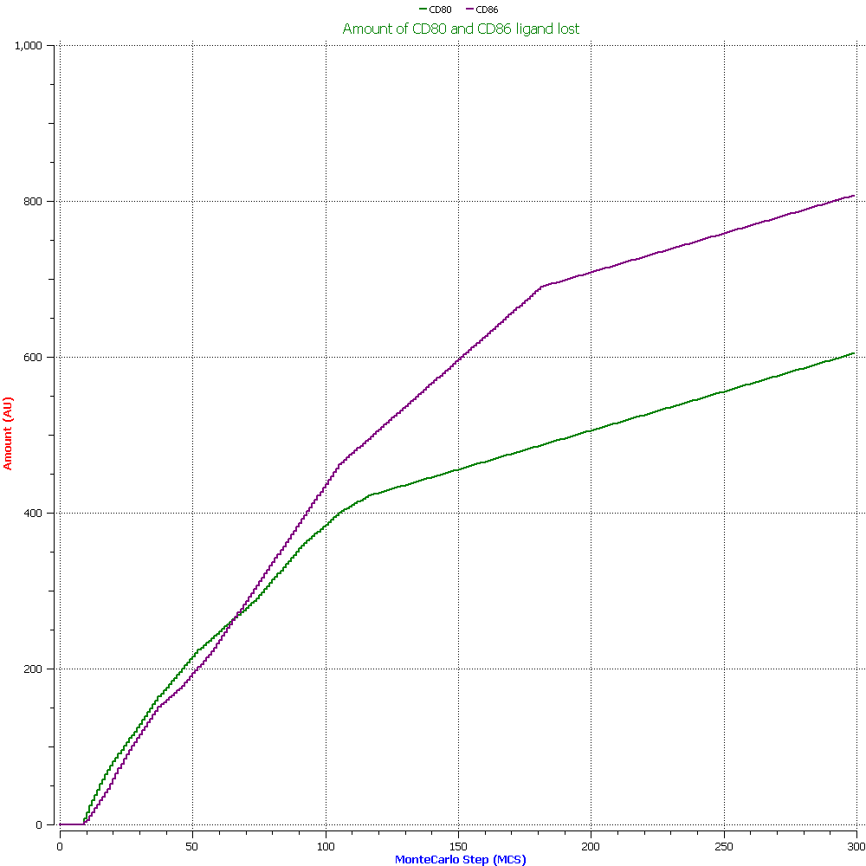
Graph

