Slide 1


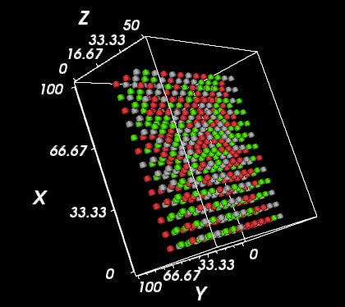
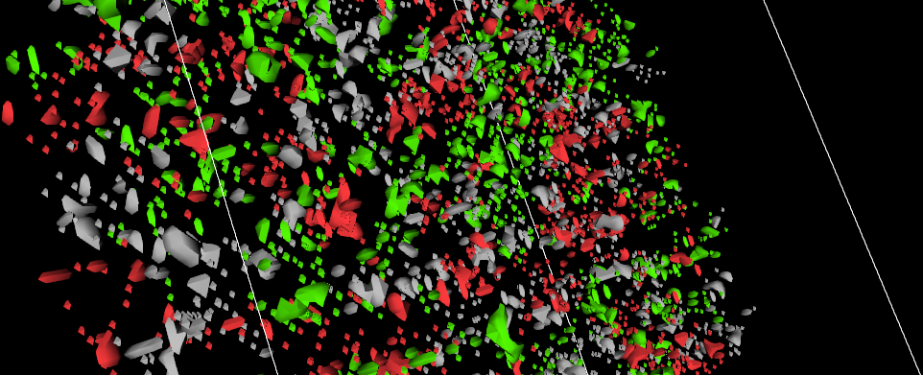
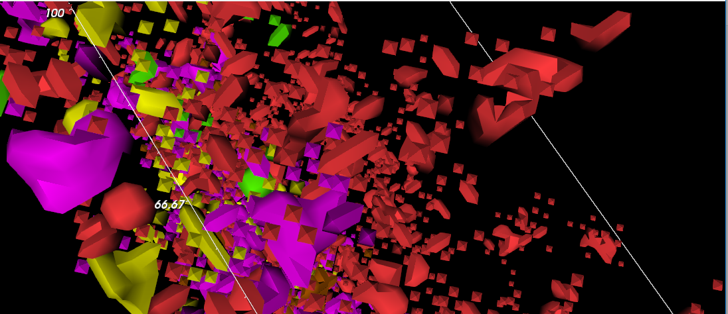
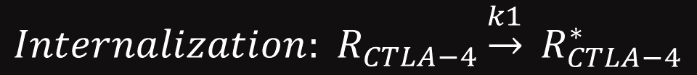

Multi-Scale Modeling of T Cell and Antigen Presenting Cell Interaction in the Tumor Microenvironment
Jose Perez¹, Meghan Bloom², Marcelo Behar²
¹ The University of Texas at El Paso
² Cellular Sensing and Communication Dynamics Research Group, Biomedical Engineering, The University of Texas at Austin
Abstract
Methodology
Results (Continued)
Multi-Scale Model Processes Selection
The impact cancer has on the world today is very significant and costly. Out of the current treatments for cancer one of particular promise is immunotherapy. However, a large fraction of cancer patients is still unresponsive to immunotherapies. This is partly due to the fact that every patient is different and tumor microenvironments are very diverse. There is therefore a need for predictive tools suitable for adjusting treatments to individual patient’s microenvironments.
To this end we implement a computational model of immune cell interactions including cell types and molecular processes relevant for cancer immunotherapy. Ultimately, the model will enable clinicians to test therapies and dosages to define optimal treatment plans for individual patients.
Multi-Scale Model Processes Selection
Extracellular
Movement
T Cell Activation
Intracellular
CTLA-4 Recycling
Modeling Approach
Extracellular
Agent-based approach
CompuCell3D modeling environment
Intracellular
Biochemical system simulated as systems of Ordinary Differential Equations
BioNetGen rule-based environment
Model Implementation
Figure 4. CTLA-4 recycling can be observed by the inverse relationship between internal and external CTLA-4 over time.
Movement
T Cells move at a rate of ~0.75um/min while APCs move at ~0.1um/min
Scale by 1 pixel = 1 um
Move cells pseudorandomly (APCs secrete chemical to attract T Cells)
CTLA-4 Recycling
Mass-action kinetics equations
Doctor gathers data from patient
Model is adjusted for individual patient
Treatment plans are selected
Model simulates treatments
Optimal treatment is proposed
Treatments are compared
$${Internalization: R}_{CTLA−4}\underset{→}{k1} R_{CTLA−4}^{∗}$$
$$Recycling: R_{CTLA−4}^{∗}\underset{→}{k2}R_{CTLA−4}$$
T Cell Activation
T Cell activated by co-activation process and by CD28 engagement passing a threshold
Regulatory T Cells (Tregs) and Conventional T Cells (Tconvs) simulated
Tregs have both CD28 and CTLA-4 surface expression
Tconvs only express surface CTLA-4 when activated
1
Model Integration
Run inter- and intra-cellular models sequentially
Biochemical model updated 10 times every Monte Carlo step
Simulations typically run for 200 model hours
Background
Figure 5. Simulation data which recapitulates CTLA-4 has a higher affinity to bind compared to CD28 and competes for ligand engagement^{2.}
Results
Cancer is a systemic disease that influences and is influenced by the immune system.
Immunotherapy is a type of cancer treatment that helps the immune system fight cancer. (National Cancer Institute).
One form of T Cell immunotherapy is checkpoint-blocking.¹
Immune checkpoint molecules are used by tumors to suppress and evade attacks from the immune system.¹
Checkpoint blocking therapies seek to prevent this suppression of immune activity.¹
Interactions between T Cells and Antigen Presenting Cells in the tumor microenvironment are relevant for this therapy.
Model begins by implementing some of these interactions.
Conclusions
Legend
APC
Naïve Treg
Active Treg
Anergic Treg
Naïve Tconv
Active Tconv
Anergic Tconv
Model recapitulates basic interactions between T Cells and APCs
Ligand competition between CTLA-4 and CD28 receptors
CTLA-4 recycling intracellular process
Cell movement and T Cell co-activation extracellular processes
Model sets a basis for development
More complex intracellular and extracellular processes required for immunotherapy design
Figure 2. Movement of cells from initial arrangement after 7 MCS. Cells have scattered around their origin and began interacting.
T Cell co-activation process (Intercellular)*
Receptors
CTLA-4 recycling process (Intracellular)
Naive Treg
References
APC
Ligands
CTLA-4
T Cell
CD80
TCR
CTLA-4 is internalized
CTLA-4*
Active Treg
Postow, M. A., Callahan, M. K. & Wolchok, J. D. Immune Checkpoint Blockade in Cancer Therapy. J. Clin. Oncol. JCO.2014.59.4358 (2015). doi:10.1200/JCO.2014.59.4358
Walker, L. S. K. & Sansom, D. M. Confusing signals: Recent progress in CTLA-4 biology. Trends Immunol. 36, 63–70 (2015).
Peptide-MHC
CD28
CTLA-4*
CD86
CTLA-4 is recycled
CTLA-4*
APC
CTLA-4
Inside of T cell
Active Tconv
Acknowledgments
Figure 1. Multi-scale interaction comprising intercellular and intracellular processes. CTLA-4 is a key player of immune checkpoint-blocking therapy.
*T cell activation involves at least two signals: one via engagement of the T cell receptor (TCR) and another through a co-receptor.
Figure 3. State of cells after a usual simulation of 200 MCS. Activated T Cells from the co-activation process are present.
Research reported in this poster was supported by the National Institute Of General Medical Sciences of the National Institutes of Health under linked Award Numbers RL5GM118969, TL4GM118971, and UL1GM118970. The content is solely the responsibility of the authors and does not necessarily represent the official views of the National Institutes of Health.

