Slide 1
HOVEL
A SOFTWARE APPROACH TO SLUM CLEARANCE PROJECT….

Slide 2

“ WE SHALL SEE GOD IN SMILE OF POOR”

Slide 3
INTRODUCTION TO SLUM
THE WORD SLUM IS OFTEN USED TO DESCRIBE THE INFORMAL SETTLEMENTS WITH CITIES THAT HAVE INADEQUATE HOUSING AND SQUALID, MISERABLE LIVING CONDITIONS.
THEY ARE OFTEN OVERCROWDED, WITH MANY PEOPLE CRAMMED INTO VERY SMALL LIVING SPACES.

Slide 4
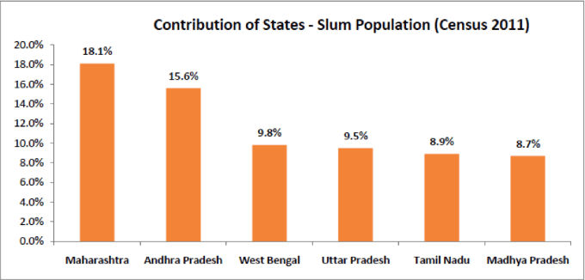
DATA ANALYSIS
ACCORDING TO THE 2011 CENSUS, AROUND 65 MILLION AMONG THE INDIAN CITIZENS WERE SLUM DWELLERS.

Slide 5
SLUMS IN MAJOR CITIES
DHARAVI IN MUMBAI.
NOCHIKUPPAM IN CHENNAI.
INDIRAMMA NAGAR IN HYDERABAD.
BHALSWA IN DELHI.
BASANTI IN KOLKATA.
SAROJ NAGAR IN NAGPUR.
MEHBULLAHPUR IN LUCKNOW
RAJENDRA NAGAR IN BANGLORE.
PARVARTAN IN AHMEDABAD.
SATNAMI NAGAR IN BHOPAL.

Slide 6
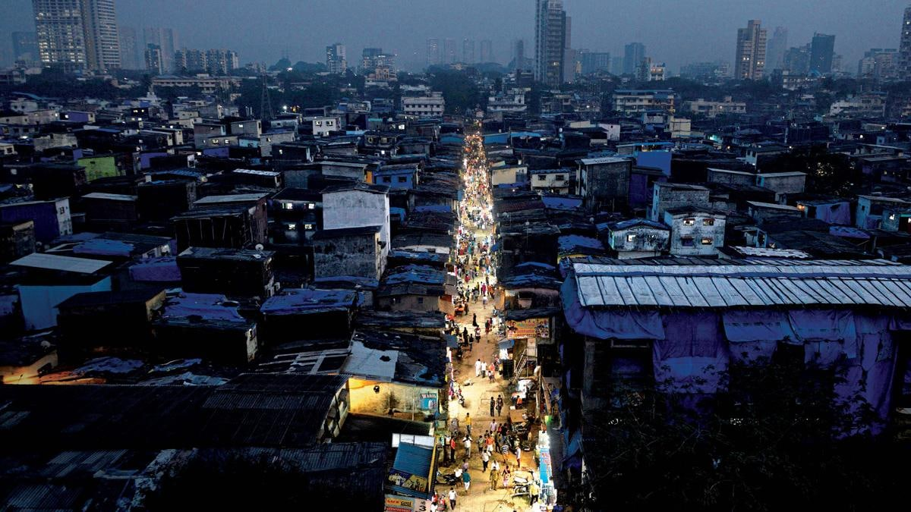
ACCORDING TO 2011 CENSUS, MAHARASTRA AND ANDHRA PRADESH SLUM DWELLERS ARE MOSTLY OCCUPIED.
BUT IN 2019, OF COURSE, THIS NUMBER HAS INCREASED. APPROXIMATELY 9.5% OF INDIA’S TOTAL POPULATION LIVES IN SLUMS.

Slide 7
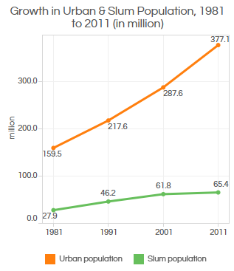
GRAPH ANALYSIS

Slide 8
PROBLEMS FACED BY SLUMS
LACK OF CLEANLINESS
OVERCROWDING AND HIGH DENSITY
SUBSTANDARD HOUSING OR ILLEGAL AND INADEQUATE BUILDING
UNHEALTHY LIVING CONDITIONS AND HAZARDOUS LOCATIONS
INSECURE TENURE, IRREGULAR OR INFORMAL SETTLEMENTS
POVERTY AND SOCIAL EXCLUSION
MINIMUM SETTLEMENT SIZE

Slide 9
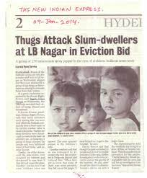
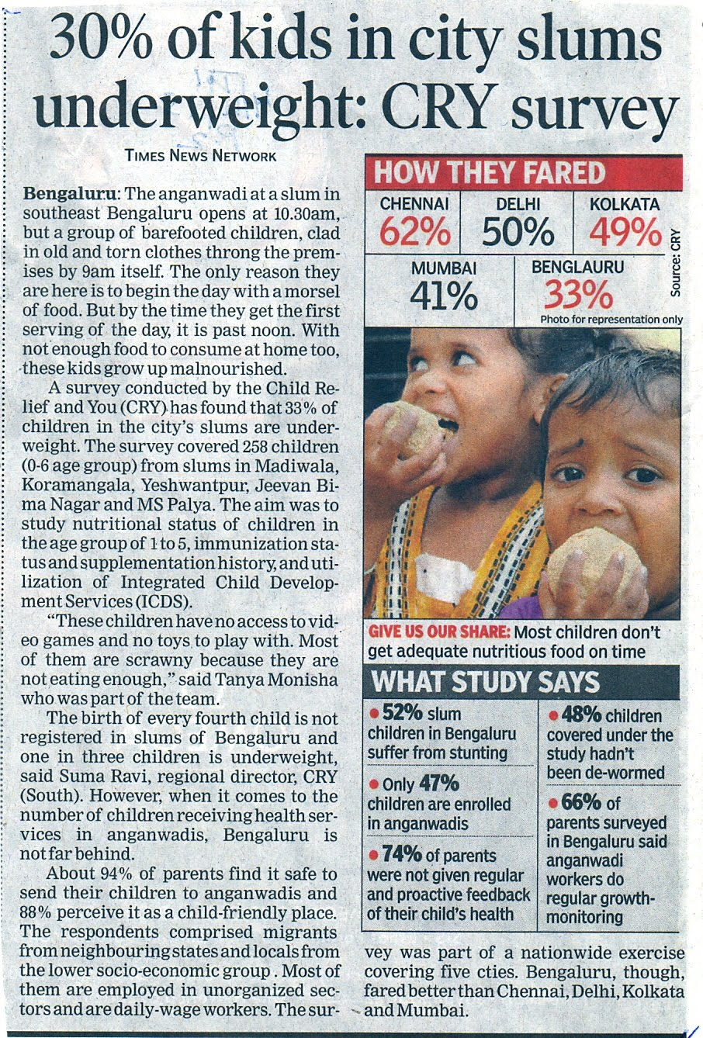
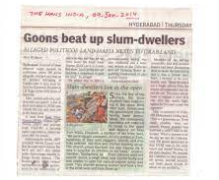
.

Slide 10
HOVEL :
HOVEL IS AN APPLICATION WHICH PROVIDES A INTERMEDIATE FLATFORM BETWEEN DIFFERENT COMMUNITY PEOPLE FOR THE REDEVELOPMENT OF SLUMS.

Slide 11
UNIQUENESS OF THE APP
FIRST APPLICATION TO DEVELOP THE SLUM AREAS IN THE METROPOLITIAN CITIES.
PROVIDING EMPLOYMENT WITHIN THE APP SERVICE.
SPECIAL team for SLUM MONITORING (SSM).
BUDGET PLAN.
PROVIDING EMPLOYMENT WITH RESPECTIVE THEIR EDUCATIONAL QUALIFICATION.
SATTELITE IMAGING.

Slide 12
FEATURES
LOGIN VERIFICATION
EASY UI/UX DESIGN.
FEED IN APP.
PHOTAG.
EMPLOYEMENT AND SCHEME DETAILS.
BUDGET PLANNING AND DONATION OPTION
NGO’s REQUISITION PAGE AND DONORS PAYMENT PORTAL
CHAT BOX.
SATELLITE IMAGING AND GEOLOCATION.
SHARING OPTION
PUBLICITY IN SOCIAL MEDIA

Slide 13
PHOTAG
IT IS A RAW PICTURE OF SLUM WHICH COULD BRING UP THE EXACT CONDITION OF THE SLUM.
THE NGO’s AND SOCIALISTS CAN UPLOAD THE PICTURE OF THE SLUM AND DESCRIBE ABOUT THE PROBLEM.

Slide 14
SATTELITE IMAGING.
THIS WILL PROVIDE A CLEAR IMAGE OF THE SLUM OBSERVED FROM THE SATTELITE AND CAN BE UPDATED AFTER EVERY RECREATION IN THE APPLICATION.
THIS WOULD ALSO HELP US IN MONITORING THE SLUM REDEVELOPMENT.

Slide 15
EMPLOYMENT
THE APPLICATION PROVIDES NECESSARY DETAILS ABOUT THE EMPLOYMENT OPPORTUNITIES PROVIDED BY THE GOVERNMENT OR SOME OTHER INSTITUTIONS AND ALSO THE PROCESS TO APPLY FOR IT TO THE EDUCATED SLUM PEOPLE WHO ARE IN NEED OF JOBS.
WE ALSO SELECT 40% PEOPLE OF TECHNICAL TEAM MEMBERS FROM THE SLUM ITSELF TO EXTEND JOB OPPURTUNITY AS WELL AS THE SLUM DEVELOPMENT PROCESS.

Slide 16
SHARING
WE HAVE ALSO ENABLED SHARING OPTION FOR THE PEOPLE THROUGH DIFFERENT SOCIAL MEDIA ABOUT THE INITIATIVES TAKEN FOR THE SLUM DEVELOPMENT.

Slide 17
BENIFITS
THIS LINKAGE BETWEEN DIFFERENT COMMUNITIES CAN PROVIDE A BOON FOR THE SLUM PEOPLE.
HELPING FOR IMPROVEMENT OF INFRASRUCTURE ,WATER FACILITY DRAINAGE FACILITY,STANDARD OF LIVING,etc…
A DOUBLE BENEFIT OF PROVIDING EMPLOYMENT AND ALSO DEVELOPING THE SLUMS CAN BE DONE SIMULTANEOUSLY.

Slide 18
FUTURISTIC ANALYSIS
THE CURRENT DATA HAS 35.2% SLUM AREAS IN INDIA AND
IF WE COULD REDUCE 1.8% PER YEAR WE WILL ACHIEVE SLUMLESS
INDIA BY 2040.

Slide 19
THANK YOU
LET THE CURSE OF THE SLUM
GETS EXTINCT FROM NOW !!!!

