Slide 1
BluetoothLeGatt
sample

Slide 2
BluetoothLeGatt – 구성요소
DeviceScanActivity
Scan 수행하여 ble device 를 리스트에 추가
Device 선택하여 제어화면으로 (DeviceControlActivity) 이동
DeviceControlActivity
BluetoothLeService 생성 및 연결
BroadcastReceiver 등록 - ACTION_GATT_CONNECTED - ACTION_GATT_DISCONNECTED - ACTION_GATT_SERVICES_DISCOVERED - ACTION_DATA_AVAILABLE
BluetoothLeService
GATT Servicer와 연결하면서 BluetoothGattCallback을 전달 - onConnectionStateChange() - onServicesDiscovered() - onCharacteristicRead() - onCharacteristicChanged()
SampleGattAttributes
Sample UUID 저장

Slide 3


BluetoothLeGatt – DeviceScanActivity (1)
DeviceScanActivity
Scan 시작
- BluetoothAdapter.LeScanCallback 전달
BT
Adapter
BluetoothAdapter.LeScanCallback 호출
BLE Device #1
BLE Device #2
BLE Device #3
BluetoothAdapter.LeScanCallback 호출
BluetoothAdapter.LeScanCallback 호출
SCANNING
BLE
Device #1
BLE Device #3
BLE
Device #2

Slide 4
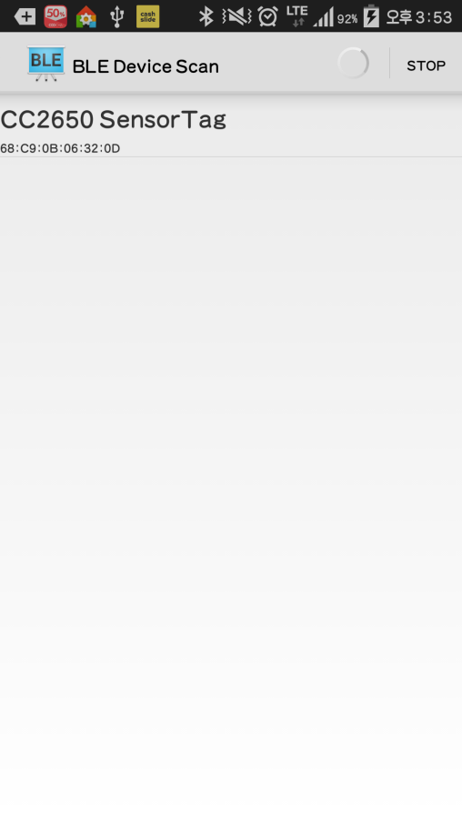

BluetoothLeGatt – DeviceScanActivity (2)
10초 후

Slide 5
BluetoothLeGatt – DeviceControlActivity (1)
DeviceControlActivity
2
BluetoothLeService
Service 생성 및 bind
1
bindService () 호출
– BIND_AUTO_CREATE 플래그 사용
- ServiceConnection 객체 전달
4
onBind() 호출 - mBinder 리턴
3
- BluetoothManager 객체획득
- BluetoothAdapter 객체획득
- BluetoothGatt 객체획득
BroadcastReceiver 등록
Device.connectGatt호출
- Gatt Server에 접속
- BluetoothGattCallback 전달
ServiceConnection
{
onServiceConnected()
- mBinder를 통해 Service객체를 획득
- Service.initialize() 호출
- Sercice.connect() 호출
onServiceDisconnected()
}
7
BluetoothGattCallback
{
onConnectionStateChange()
1.BluetoothProfile.STATE_CONNECTED
- ACTION_GATT_CONNECTED 방송
- BluetoothGatt.discoverServices()
2.BluetoothProfile.STATE_DISCONNECTED
- ACTION_GATT_DISCONNECTED 방송
onServicesDiscovered()
- ACTION_GATT_SERVICES_DISCOVERED방송
onCharacteristicRead()
- ACTION_DATA_AVAILABLE방송
onCharacteristicChanged()
- ACTION_DATA_AVAILABLE 방송
}
5
GATT Server
BLE
Device #1
6
8
9
10
11
BroadcastReceiver
{
onReceive()
{
1. ACTION_GATT_CONNECTED
2. ACTION_GATT_DISCONNECTED
3. ACTION_GATT_SERVICES_DISCOVERED
4. ACTION_DATA_AVAILABLE
}
}
12

Slide 6
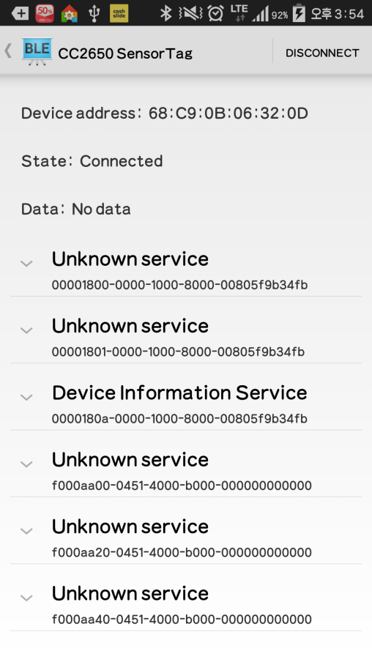
BluetoothLeGatt – DeviceControlActivity (2)

Slide 7
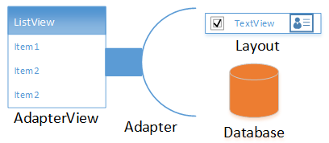
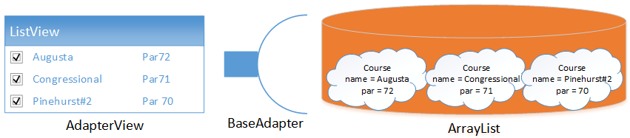
BluetoothLeGatt – View, Adapter, Dataset

Slide 8
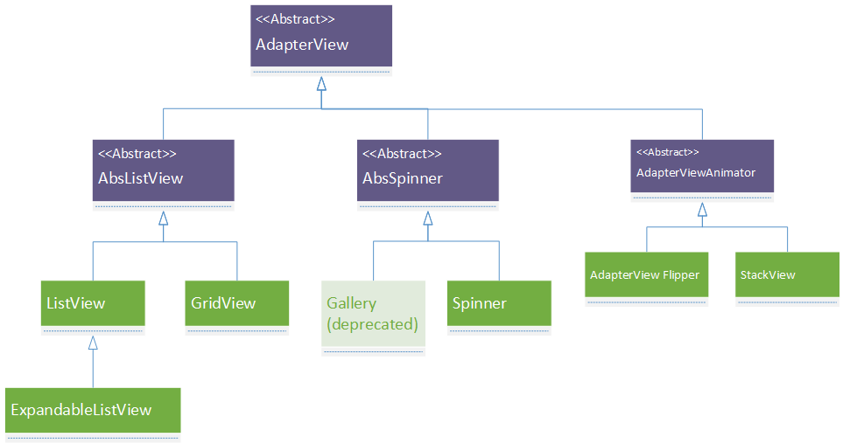
BluetoothLeGatt – View

Slide 9
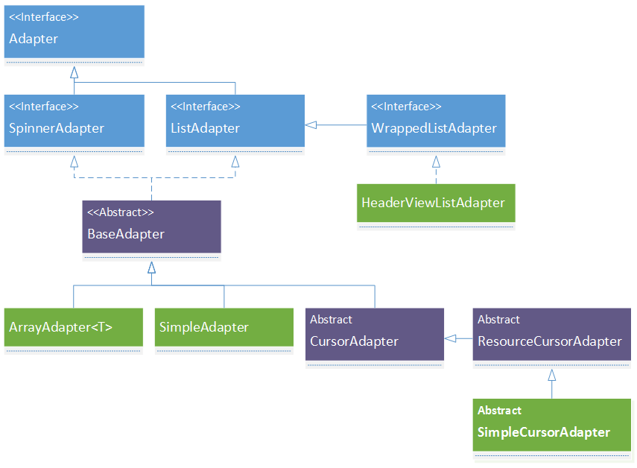
BluetoothLeGatt – Hierarchy of Adapter

Slide 10
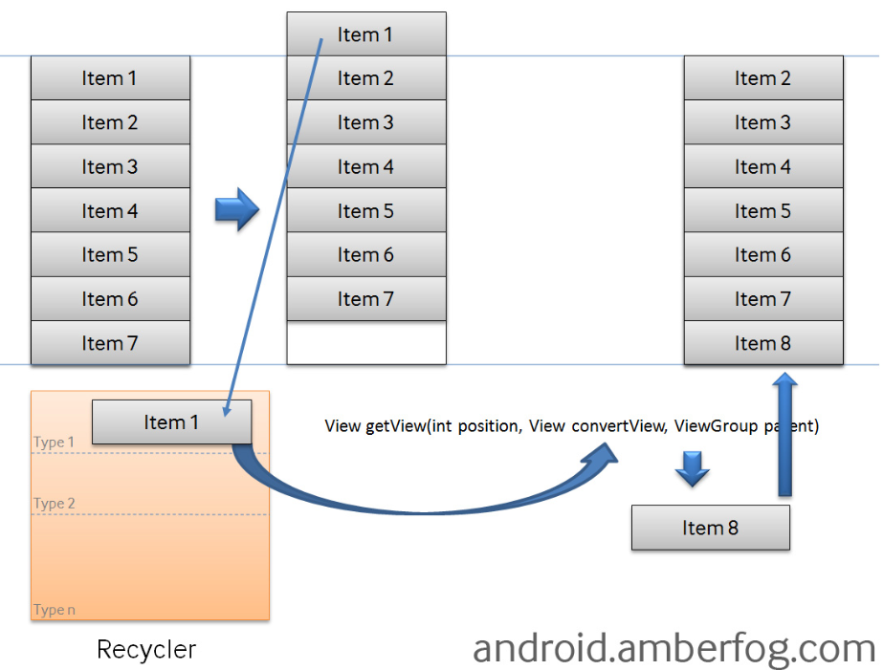
getView

