Slide 1
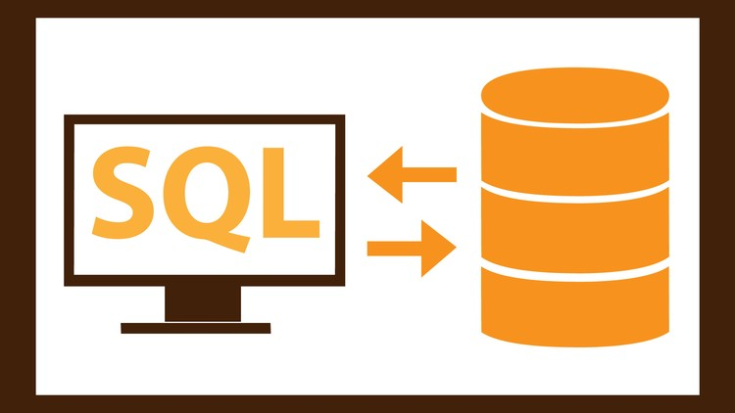
Chapter 1 : Database Concept (SQL)
Prepared By: Prof. Dipak Dabhi, CGPIT, UTU

Slide 2
Outline
Database
DBMS
RDBMS
SQL
SQL Component

Slide 3
Database
A database can be defined as a collection of coherent, meaningful data.
Ex. Postal address
Flat number
Flat name
Road name
Area name
City name
State name
Pincode
So many data stored in address book, so now address book is a database.
Each record in address book consider as data.

Slide 4
Database Management System (DBMS)
A database management system stores data in such a way that it becomes easier to retrieve, manipulate, and produce information.
Benefits of DBMS :
Data redundancy
no more data inconsistency
Stored data can be shared by a single and multiple user
Data integrity can be maintained. (assure database have only accurate data)
Security easily implemented
Data independence can be achived (for differenc data manupalation)

Slide 5
Database Management System (DBMS)
Examples of Popular Database Management Systems (DBMS)
Oracle Database
MySQL Database
MS- Access
Microsoft SQL Server
File Maker
NoSQL
Postgresql
MS Fox Pro
Red Brick
Etc……

Slide 6
Relational DBMS (RDBMS)
RDBMS stands for Relational Database Management System
A Relational database management system (RDBMS) is a database management system (DBMS) that is based on the relational model as introduced by E. F. Codd.
If a management system or software follows any of 5-6 rules proposed by E.F.Codd, it qualifies to be a Database Management System (DBMS).
If a management system or software follows any of 7-9 rules proposed by E.F.Codd, it qualifies to be a semi-Relational Database Management System (semi- RDBMS).
If a management system or software follows 9-12 rules proposed by E.F. Codd, it qualifies to be a complete Relational Database Management System (RDBMS).

Slide 7
Dr. E.F Codd’s Rules for RDBMS
Rule 1: Rule of Information
Rule 2: Rule of Guaranteed Access
Rule 3: Rule of Systematic Null Value Support
Rule 4: Rule of Active and online relational Catalog
Rule 5: Rule of Comprehensive Data Sub-language
Rule 6: Rule of Updating Views
Rule 7: Rule of Set level insertion, update and deletion
Rule 8: Rule of Physical Data Independence
Rule 9: Rule of Logical Data Independence
Rule 10: Rule of Integrity Independence
Rule 11: Rule of Distribution Independence
Rule 12: Rule of Non Subversion

Slide 8
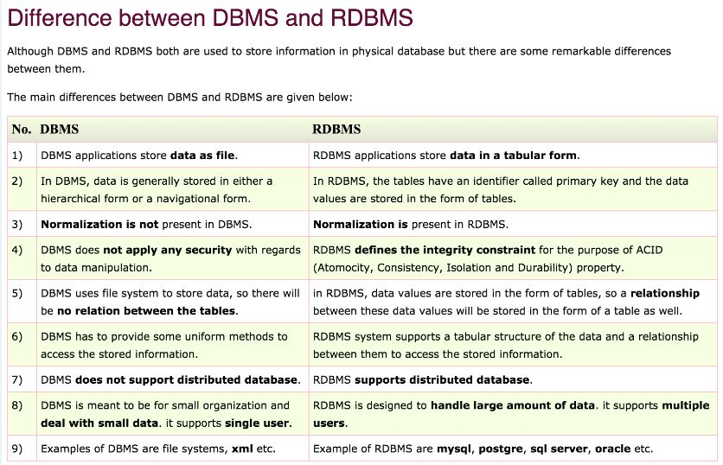

Slide 9
Normalization
Normalization is a database design technique which organizes tables in a manner that reduces redundancy and dependency of data.

Slide 10
Structured Query Language
SQL stands for Structured Query Language.
SQL is a database computer language designed for the retrieval and management of data in a relational database.
SQL is the standard language for Relational Database System.
All the Relational Database Management Systems (RDMS) like MySQL, MS Access, Oracle, Sybase, Informix, Postgres and SQL Server use SQL as their standard database language.
SQL is widely popular because of its functionality.

Slide 11
SQL Component
The main components of sql are :
Data Definition Language (DDL) : it is a set of SQL command used to create, modify and delete database structure but not data. (DBA)
Ex. CREATE, ALTER, DROP,TRUNCATE, COMMENT…
Data Manipulation Language (DML) : it is the area of SQL that allows changing data within the database.
Ex. INSERT, UPDATE, DELETE…
Data Control Language (DCL) : it is component of SQL that control access to data and to the database.
Ex. SAVEPOINT, COMMIT, REVOKE,GRANT….
Data Query Language (DQL) : it is component of SQL statement that allows getting data from the database.
Ex. SELECT

Slide 12
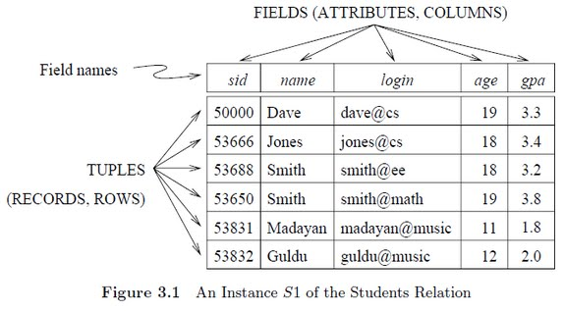
TABLE, TUPLE, ROW, COLUMN, FIELD

