Slide 1
JOIN, COUNT(*), GROUP_BY,ROLLUP,CUBE

Slide 2
Types of Join
Cross join, Cartesian join (Keyword : cross join)
Inner joins, Natural Join, Equ Join (Keyword Inner Join)
Outer joins
Left Outer Join (keyword : Left Join)
Right Outer Join (keyword : Right Join)
Full Outer Join (keyword : Full Join)
Self join

Slide 3
Cartesian Product
Table One
X | A
1 | a
4 | d
2 | b
Table Two
X | B
2 | x
3 | y
5 | v
3 rows
X
3 rows
Result Set
X | A | X | B
1 | a | 2 | x
1 | a | 3 | y
1 | a | 5 | v
4 | d | 2 | x
4 | d | 3 | y
4 | d | 5 | v
2 | b | 2 | x
2 | b | 3 | y
2 | b | 5 | v
select * from one,two;
9 rows

Slide 4
5.02 Quiz – Correct Answer
How many rows are returned from this query?
select * from three, four;
Table Three
X | A
1 | a1
1 | a2
2 | b1
2 | b2
4 | d
Table Four
X | B
2 | x1
2 | x2
3 | y
5 | v
Partial Results Set
X | A | X | B
1 | a1 | 2 | x1
1 | a1 | 2 | x2
1 | a1 | 3 | y
1 | a1 | 5 | v
1 | a2 | 2 | x1
1 | a2 | 2 | x2
1 | a2 | 3 | y
1 | a2 | 5 | v
2 | b1 | 2 | x1
2 | b1 | 2 | x2
5*4=20
s105a01
Notes:
Type answer here

Slide 5
Inner Joins
One method of displaying the X column only once is to use a table qualifier in the SELECT list.
Table One
X | A
1 | a
4 | d
2 | b
Table Two
X | B
2 | x
3 | y
5 | v
select one.x, a, b
from one, two
where one.x=two.x;
X | A | B
2 | b | x
s105d03
Notes:
s105d03

Slide 6
Inner Joins
Display all combinations of rows with matching keys, including duplicates.
Table Three
X | A
1 | a1
1 | a2
2 | b1
2 | b2
4 | d
Table Four
X | B
2 | x1
2 | x2
3 | y
5 | v
proc sql;
select *
from three, four
where three.x=four.x;
quit;
s105d04
...
Notes:
S105d04

Slide 7
Inner Joins
Display all combinations of rows with matching keys, including duplicates.
Table Three
X | A
1 | a1
1 | a2
2 | b1
2 | b2
4 | d
Table Four
X | B
2 | x1
2 | x2
3 | y
5 | v
Results Set
X | A | X | B
2 | b1 | 2 | x1
2 | b1 | 2 | x2
2 | b2 | 2 | x1
2 | b2 | 2 | x2
select * from three, four where three.x=four.x;
s105d04
Notes:
S105d04

Slide 8
Outer Joins
You can retrieve both nonmatching and matching rows using an outer join.
Outer joins include left, full, and right outer joins. Outer joins can process only two tables at a time.
Left
Right
Full

Slide 9
Compare Inner Joins And Outer Joins
The following table is a comparison of inner and outer join syntax and limitations:
Key Point | Inner Join | Outer Join
Table Limit | 256 | 2
Join Behavior | Returns matching rows only | Returns matching and nonmatching rows
Join Options | Matching rows only | LEFT, FULL, RIGHT
Syntax changes | Multiple tables in the FROM clause WHERE clause that specifies join criteria | ON clause that specifies join criteria

Slide 10
Outer Joins
Outer join syntax is similar to the inner join alternate syntax.
General form of an outer join:
The ON clause specifies the join criteria in outer joins.
SELECT column-1 <, …column-n>
FROM table-1 LEFT|RIGHT|FULL JOIN
table-2
ON join-condition(s)
<other clauses>;

Slide 11
Determining Left and Right
Consider the position of the tables in the FROM clause.
Left joins include all rows from the first (left) table, even if there are no matching rows in the second (right) table.
Right joins include all rows from the second (right) table, even if there are no matching rows in the first (left) table.
Full joins include all rows from both tables, even if there are no matching rows in either table.
Left table
Right table
FROM table-1 join-type table-2
ON join-condition(s);

Slide 12
Left Join
Table One
X | A
1 | a
4 | d
2 | b
Table Two
X | B
2 | x
3 | y
5 | v
select *
from one left join two
on one.x = two.x;
X | A | X | B
1 | a | .
2 | b | 2 | x
4 | d | .
s105d07
Notes:
s105d07

Slide 13
Right Join
Table Two
X | B
2 | x
3 | y
5 | v
Table One
X | A
1 | a
4 | d
2 | b
select *
from two right join one
on one.x = two.x;
X | B | X | A
. |  | 1 | a
2 | x | 2 | b
. |  | 4 | d
s105d08
Notes:
s105d08

Slide 14
Full Join
Table One
X | A
1 | a
4 | d
2 | b
Table Two
X | B
2 | x
3 | y
5 | v
select *
from one full join two
on one.x = two.x;
X | A | X | B
1 | a | .
2 | b | 2 | x
. |  | 3 | y
4 | d | .
. |  | 5 | v
s105d09
Notes:
s105d09

Slide 15
Self-Join
A self JOIN is a regular join, but the table is joined with itself.
This can be useful when modeling hierarchies.
select t1.name,t2.sid from student t1,student t2 where t1.sid=t2.sid;
s105d09
Notes:
s105d09

Slide 16
Multiple Table Join
SELECT column_list
FROM t1
INNER JOIN t2 ON join_condition1
INNER JOIN t3 ON join_condition2...WHERE where_conditions;

Slide 17
Multiple Table Join
SELECT PRODUCTS.PRODUCT_ID, PRODUCTS.PRODUCT_TITLE, COLORS.COLOR_ID, MATERIALS.MATERIAL_ID, IMAGES.IMAGE_ID, SIZE.SIZE_ID from PRODUCTS
INNER JOIN PRODUCT_COLOR ON (PRODUCTS.PRODUCT_ID = PRODUCT_COLOR.PRODUCT_ID)
INNER JOIN COLORS ON (COLORS.COLOR_ID = PRODUCT_COLOR.COLOR_ID)
INNER JOIN PRODUCT_MATERIAL ON (PRODUCTS.PRODUCT_ID = PRODUCT_MATERIAL.PRODUCT_ID)
INNER JOIN MATERIALS ON (MATERIALS.MATERIAL_ID = PRODUCT_MATERIAL.MATERIAL_ID)
INNER JOIN PRODUCT_IMAGE ON (PRODUCTS.PRODUCT_ID = PRODUCT_IMAGE.PRODUCT_ID)
INNER JOIN IMAGES ON (IMAGES.IMAGE_ID = PRODUCT_IMAGE.IMAGE_ID)
INNER JOIN PRODUCT_SIZE ON (PRODUCTS.PRODUCT_ID = PRODUCT_SIZE.PRODUCT_ID) INNER JOIN SIZE ON (SIZE.SIZE_ID = PRODUCT_SIZE.SIZE_ID)

Slide 18
Multiple Table Join
SELECT company, stock_num, manu_code
FROM customer c, orders o, items i
WHERE c.customer_num = o.customer_num
AND
o.order_num = i.order_num;
-SELECT company, stock_num, manu_code
FROM customer c inner join orders o
Inner join items i
WHERE c.customer_num = o.customer_num AND
o.order_num = i.order_num;

Slide 19
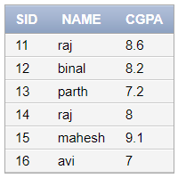
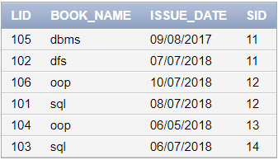
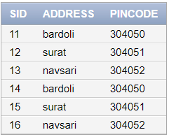
Student Library counselor
Select name, book_name from student inner join library on student.sid = library.sid;
Select name, book_name from student ,library where student.sid = library.sid;
Select name, book_name from student ,library where student.sid = library.sid and student.sid=11;
Notes:
s105d09

Slide 20
Student Library counselor
Select name, book_name from student inner join library on student.sid = library.sid;
Select name, book_name from student ,library where student.sid = library.sid;
Select name, book_name from student ,library where student.sid = library.sid and student.sid=11;
Notes:
s105d09

Slide 21
Student Library counselor
Select student.sid, name, book_name from student ,library where student.sid = library.sid and student.sid=11;
Notes:
s105d09

Slide 22
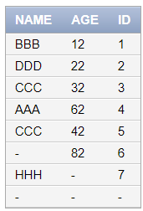


count and count(*)
mytable
Select count(name) from mytable;
Select count(*) from mytable;
s105d09
Notes:
s10

Slide 23
LIKE
The LIKE operator is used in a WHERE clause to search for a specified pattern in a column.
There are two wildcards used in conjunction with the LIKE operator:
% - The percent sign represents zero, one, or multiple characters
_ - The underscore represents a single character
SELECT * FROM Customers WHERE CustomerName LIKE 'a%';
SELECT * FROM Customers WHERE CustomerName LIKE '%a';

Slide 24
LIKE
SELECT * FROM Customers WHERE CustomerName LIKE '%or%'
SELECT * FROM Customers WHERE CustomerName LIKE '_r%'
SELECT * FROM Customers WHERE CustomerName LIKE 'a_%_%'
SELECT * FROM Customers WHERE ContactName LIKE 'a%o'
SELECT * FROM Customers WHERE CustomerName NOT LIKE 'a%'

Slide 25
BETWEEN
The SQL BETWEEN condition allows you to easily test if an expression is within a range of values (inclusive). It can be used in a SELECT, INSERT, UPDATE, or DELETE statement.
Syntax : expression BETWEEN value1 AND value2;
SELECT * FROM suppliers WHERE supplier_id BETWEEN 300 AND 600;
SELECT * FROM suppliers WHERE supplier_id >= 300 AND supplier_id <= 600;

Slide 26
BETWEEN
SELECT * FROM orders WHERE order_date BETWEEN TO_DATE ('2016/04/19', 'yyyy/mm/dd') AND TO_DATE ('2016/05/01', 'yyyy/mm/dd');

Slide 27
GROUP BY Clause
In Oracle GROUP BY clause is used with SELECT statement to collect data from multiple records and group the results by one or more columns.
Syntax:
SELECT expression1, expression2, ... expression_n,
aggregate_function (aggregate_expression)
FROM tables
WHERE conditions
GROUP BY expression1, expression2, ... expression_n;

Slide 28
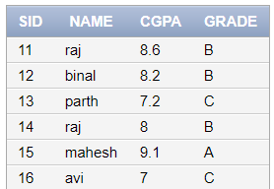
GROUP BY Clause
select grade,count(grade) from stud group by grade;
select grade,count(grade) from stud group by grade having count(grade)>2;
select grade,count(grade) from stud where sid>2 group by grade;
select count(grade) from stud where sid>2 group by grade;

Slide 29
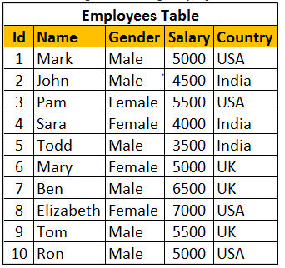
Group By Example

Slide 30
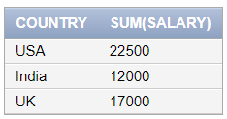
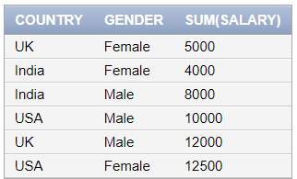
Group By Example
1. Select country,sum(salary) from employees group by country;
2.
Select country,gender,sum(salary)
from employees
group by country,gender;

Slide 31
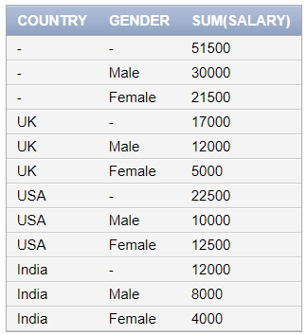
CUBE
Cube() in SQL Server produces the result set by generating all combinations of columns specified in GROUP BY CUBE().
Select country,gender,sum(salary)
from employees
group by cube (country,gender);

Slide 32
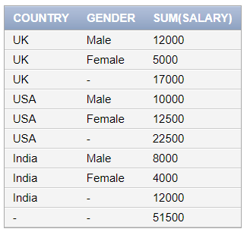
ROLLUP
ROLLUP in SQL Server is used to do aggregate operation on multiple levels in hierarchy.
Example:
Select country,gender,sum(salary)
from employees
group by rollup (country,gender);

Slide 33
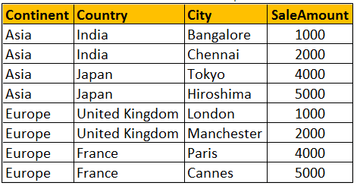
Difference between CUBE and ROLLUP
CUBE generates a result set that shows aggregates for all combinations of values in the selected columns, where as ROLLUP generates a result set that shows aggregates for a hierarchy of values in the selected columns.

Slide 34
Difference between CUBE and ROLLUP
ROLLUP(Continent, Country, City) produces Sum of Salary for the following hierarchy Continent, Country, City Continent, Country, Continent ()
CUBE(Continent, Country, City) produces Sum of Salary for all the following column combinations Continent, Country, City Continent, Country, Continent, City Continent Country, City Country, City ()

Slide 35
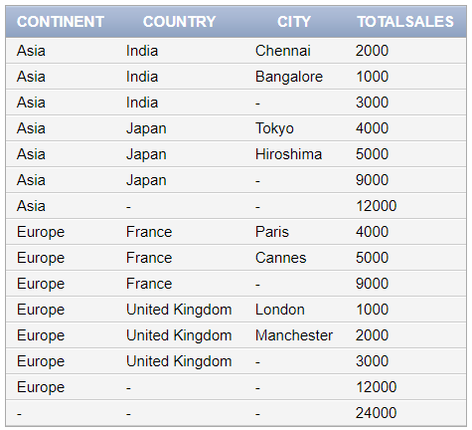
Difference between CUBE and ROLLUP
SELECT Continent, Country, City, SUM(SaleAmount) AS TotalSales FROM Sales GROUP BY ROLLUP(Continent, Country, City)

Slide 36
Difference between CUBE and ROLLUP
SELECT Continent, Country, City, SUM(SaleAmount) AS TotalSales FROM Sales GROUP BY CUBE(Continent, Country, City)
Check live query
You won't see any difference when you use ROLLUP and CUBE on a single column. Both the following queries produces the same output.

