Slide 1
Subqueries
11
Notes:
Schedule: Timing Topic
25 minutes Lecture
30 minutes Practice
55 minutes Total

Slide 2

Objectives
After completing this lesson, you should be able to do the following:
  Describe the types of problems that subqueries can solve
  Define subqueries
  List the types of subqueries
  Write single-row and multiple-row subqueries
Notes:
Lesson Aim
In this lesson, you will learn about more advanced features of the SELECT statement. You can write subqueries in the WHERE clause of another SQL statement to obtain values based on an unknown conditional value. This lesson covers single-row subqueries and multiple-row subqueries.

Slide 3
Using a Subquery to Solve a Problem
“Who has a salary greater than Jones’?”
Main Query
“Which employees have a salary greater than Jones’ salary?”
?
Subquery
?
“What is Jones’ salary?”
Notes:
Using a Subquery to Solve a Problem
Suppose you want to write a query to find out who earns a salary greater than Jones’ salary.
To solve this problem, you need two queries: one query to find what Jones earns and a second query to find who earns more than that amount.
You can solve this problem by combining the two queries, placing one query inside the other query.
The inner query or the subquery returns a value that is used by the outer query or the main query. Using a subquery is equivalent to performing two sequential queries and using the result of the first query as the search value in the second query.

Slide 4
Subqueries
SELECT select_list
FROM table
WHERE expr operator
(SELECT select_list
FROM table);
  The subquery (inner query) executes once before the main query.
  The result of the subquery is used by the main query (outer query).
Notes:
Subqueries
A subquery is a SELECT statement that is embedded in a clause of another SELECT statement. You can build powerful statements out of simple ones by using subqueries. They can be very useful when you need to select rows from a table with a condition that depends on the data in the table itself.
You can place the subquery in a number of SQL clauses:
WHERE clause
HAVING clause
FROM clause
In the syntax:
operator includes a comparison operator such as >, =, or IN
Note: Comparison operators fall into two classes: single-row operators (>, =, >=, <, <>, <=) and multiple-row operators (IN, ANY, ALL).
The subquery is often referred to as a nested SELECT, sub-SELECT, or inner SELECT statement. The subquery generally executes first, and its output is used to complete the query condition for the main or outer query.
Class Management Note
Additionally, subqueries can be placed in the CREATE VIEW statement, CREATE TABLE statement, UPDATE clause, INTO clause of an INSERT statement, and SET clause of an UPDATE statement.

Slide 5
Subqueries
A subquery is a SELECT statement that is embedded in a clause of another SELECT statement.
They can be very useful when you need to select rows from a table with a condition that depends on the data in the table itself.
You can place the subquery in a number of SQL clauses:
WHERE clause
HAVING clause
FROM clause

Slide 6
Using a Subquery
SQL> SELECT ename
2 FROM emp
3 WHERE sal >
4 (SELECT sal
5 FROM emp
6 WHERE empno=7566);
2975
In the example, the inner query determines the salary of employee 7566. The outer query takes the result of the inner query and uses this result to display all the employees who earn more than this amount.
ENAME
----------
KING
FORD
SCOTT
Notes:
Using a Subquery
In the slide, the inner query determines the salary of employee 7566. The outer query takes the result of the inner query and uses this result to display all the employees who earn more than this amount.
Class Management Note
Execute the subquery (inner query) on its own first to show the value that the subquery returns. Then execute the outer query using the result returned by the inner query. Finally, execute the entire query (containing the subquery) and show that the result is the same.

Slide 7
Guidelines for Using Subqueries
  Enclose subqueries in parentheses.
  Place subqueries on the right side of the comparison operator.
  Do not add an ORDER BY clause to a subquery.
  Use single-row operators with single-row subqueries.
  Use multiple-row operators with multiple-row subqueries.
Notes:
Guidelines for Using Subqueries
A subquery must be enclosed in parentheses.
A subquery must appear on the right side of the comparison operator.
Subqueries cannot contain an ORDER BY clause. You can have only one ORDER BY clause for a SELECT statement, and if specified it must be the last clause in the main SELECT statement.
Two classes of comparison operators are used in subqueries: single-row operators and
multiple-row operators.
Class Management Note
A subquery can execute multiple times in correlated subqueries, which are not included in this course. Students may ask how many subqueries can be written. The Oracle Server imposes no limit on the number of subqueries. The limit is related to the buffer size that the query uses.

Slide 8
Types of Subqueries
  Single-row subquery : Queries that return only one row from the inner SELECT statement
Main query
returns
Subquery
CLERK
  Multiple-row subquery Queries that return more than one row from the inner SELECT statement
Main query
returns
CLERK
MANAGER
Subquery
  Multiple-column subqueryQueries that return more than one column from the inner SELECT statement
Main query
returns
CLERK 7900
MANAGER 7698
Subquery
Notes:
Types of Subqueries
Single-row subqueries: Queries that return only one row from the inner SELECT statement
Multiple-row subqueries: Queries that return more than one row from the inner SELECT statement
Multiple-column subqueries: Queries that return more than one column from the inner SELECT statement

Slide 9
Single-Row Subqueries
  Return only one row
  Use single-row comparison operators
Operator
=
>
>=
<
<=
<>
Meaning
Equal to
Greater than
Greater than or equal to
Less than
Less than or equal to
Not equal to
Notes:
Single-Row Subqueries
A single-row subquery is one that returns one row from the inner SELECT statement. This type of subquery uses a single-row operator. The slide gives a list of single-row operators.
Example
Display the employees whose job title is the same as that of employee 7369.
ENAME JOB
---------- ---------
JAMES CLERK
SMITH CLERK
ADAMS CLERK
MILLER CLERK
SQL> SELECT ename, job
2 FROM emp
3 WHERE job =
4 (SELECT job
5 FROM emp
6 WHERE empno = 7369);

Slide 10
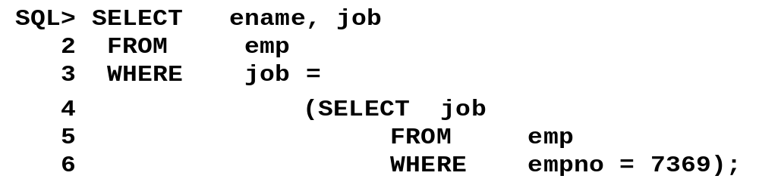
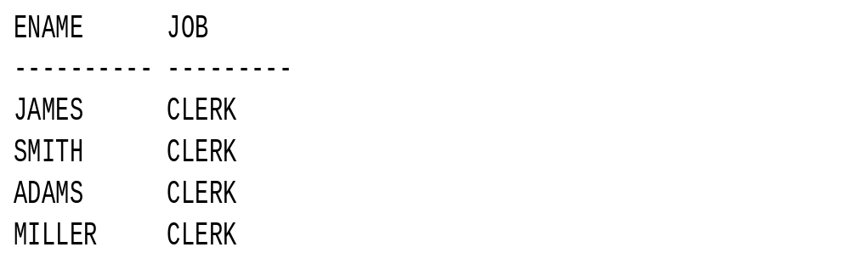
Display the employees whose job title is the same as that of employee 7369.

Slide 11
Executing Single-Row Subqueries
The example on the slide displays employees whose job title is the same as that of employee 7369 and whose salary is greater than that of employee 7876.
SQL> SELECT ename, job
2 FROM emp
3 WHERE job =
4 (SELECT job
5 FROM emp
6 WHERE empno = 7369)
7 AND sal >
8 (SELECT sal
9 FROM emp
10 WHERE empno = 7876);
CLERK
1100
ENAME JOB
---------- ---------
MILLER CLERK
Notes:
Executing Single-Row Subqueries
A SELECT statement can be considered as a query block. The example on the slide displays employees whose job title is the same as that of employee 7369 and whose salary is greater than that of employee 7876.
The example consists of three query blocks: the outer query and two inner queries. The inner query blocks are executed first, producing the query results: CLERK and 1100, respectively. The outer query block is then processed and uses the values returned by the inner queries to complete its search conditions.
Both inner queries return single values (CLERK and 1100, respectively), so this SQL statement is called a single-row subquery.
Note: The outer and inner queries can get data from different tables.

Slide 12
Using Group Functions in a Subquery
Display the employee name, job title, and salary of all employees whose salary is equal to the minimum salary.
SQL> SELECT ename, job, sal
2 FROM emp
3 WHERE sal =
4 (SELECT MIN(sal)
5 FROM emp);
800
ENAME JOB SAL
---------- --------- ---------
SMITH CLERK 800
Notes:
Using Group Functions in a Subquery
You can display data from a main query by using a group function in a subquery to return a single row. The subquery is in parentheses and is placed after the comparison operator.
The example on the slide displays the employee name, job title, and salary of all employees whose salary is equal to the minimum salary. The MIN group function returns a single value (800) to the outer query.

Slide 13
HAVING Clause with Subqueries
  The Oracle Server executes subqueries first.
  The Oracle Server returns results into the HAVING clause of the main query.
The SQL statement on the slide displays all the departments that have a minimum salary greater than that of department 20.
SQL> SELECT deptno, MIN(sal)
2 FROM emp
3 GROUP BY deptno
4 HAVING MIN(sal) >
5 (SELECT MIN(sal)
6 FROM emp
7 WHERE deptno = 20);
800
Notes:
HAVING Clause with Subqueries
You can use subqueries not only in the WHERE clause, but also in the HAVING clause. The Oracle Server executes the subquery, and the results are returned into the HAVING clause of the main query.
The SQL statement on the slide displays all the departments that have a minimum salary greater than that of department 20.
Example
Find the job with the lowest average salary.
DEPTNO MIN(SAL)
--------- ---------
10 1300
30 950
SQL> SELECT job, AVG(sal)
2 FROM emp
3 GROUP BY job
4 HAVING AVG(sal) = (SELECT MIN(AVG(sal))
5 FROM EMP
6 GROUP BY job);

Slide 14
What Is Wrong with This Statement?
SQL> SELECT empno, ename
2 FROM emp
3 WHERE sal =
4 (SELECT MIN(sal)
5 FROM emp
6 GROUP BY deptno);
Single-row operator with
multiple-row subquery
ERROR:
ORA-01427: single-row subquery returns more than
one row
no rows selected
Notes:
Errors with Subqueries
One common error with subqueries is more than one row returned for a single-row subquery.
In the SQL statement on the slide, the subquery contains a GROUP BY (deptno) clause, which implies that the subquery will return multiple rows, one for each group it finds. In this case, the result of the subquery will be 800, 1300, and 950.
The outer query takes the results of the subquery (800, 950, 1300) and uses these results in its WHERE clause. The WHERE clause contains an equal (=) operator, a single-row comparison operator expecting only one value. The = operator cannot accept more than one value from the subquery and hence generates the error.
To correct this error, change the = operator to IN.

Slide 15
Errors with Subqueries
One common error with subqueries is more than one row returned for a single-row subquery.
In the SQL statement on the slide, the subquery contains a GROUP BY (deptno) clause, which implies that the subquery will return multiple rows, one for each group it finds. In this case, the result of the subquery will be 800, 1300, and 950.
The outer query takes the results of the subquery (800, 950, 1300) and uses these results in its WHERE clause. The WHERE clause contains an equal (=) operator, a single-row comparison operator expecting only one value. The = operator cannot accept more than one value from the subquery and hence generates the error.
To correct this error, change the = operator to IN.

Slide 16
Will This Statement Work?
SQL> SELECT ename, job
2 FROM emp
3 WHERE job =
4 (SELECT job
5 FROM emp
6 WHERE ename='SMYTHE');
no rows selected
Subquery returns no values
Notes:
Problems with Subqueries
A common problem with subqueries is no rows being returned by the inner query.
In the SQL statement on the slide, the subquery contains a WHERE (ename='SMYTHE') clause. Presumably, the intention is to find the employee whose name is Smythe. The statement seems to be correct but selects no rows when executed.
The problem is that Smythe is misspelled. There is no employee named Smythe. So the subquery returns no rows. The outer query takes the results of the subquery (null) and uses these results in its WHERE clause. The outer query finds no employee with a job title equal to null and so returns no rows.

Slide 17
Problems with Subqueries
A common problem with subqueries is no rows being returned by the inner query.
In the SQL statement on the slide, the subquery contains a WHERE (ename='SMYTHE') clause. Presumably, the intention is to find the employee whose name is Smythe. The statement seems to be correct but selects no rows when executed.
The problem is that Smythe is misspelled. There is no employee named Smythe. So the subquery returns no rows. The outer query takes the results of the subquery (null) and uses these results in its WHERE clause. The outer query finds no employee with a job title equal to null and so returns no rows.

Slide 18
Multiple-Row Subqueries
  Return more than one row
  Use multiple-row comparison operators
Operator
IN
ANY
ALL
Meaning
Equal to any member in the list
Compare value to each value returned by the subquery
Compare value to every value returned by the subquery
Notes:
Multiple-Row Subqueries
Subqueries that return more than one row are called multiple-row subqueries. You use a multiple-row operator, instead of a single-row operator, with a multiple-row subquery. The multiple-row operator expects one or more values.
Example
Find the employees who earn the same salary as the minimum salary for departments.
The inner query is executed first, producing a query result containing three rows: 800, 950, 1300. The main query block is then processed and uses the values returned by the inner query to complete its search condition. In fact, the main query would look like the following to the Oracle Server:

Slide 19
Using ANY Operator in Multiple-Row Subqueries
Display the employees whose salary is less than any clerk and who are not clerks.
SQL> SELECT empno, ename, job
2 FROM emp
3 WHERE sal < ANY
4 (SELECT sal
5 FROM emp
6 WHERE job = 'CLERK')
7 AND job <> 'CLERK';
1300
1100
800
950
EMPNO ENAME JOB
--------- ---------- ---------
7654 MARTIN SALESMAN
7521 WARD SALESMAN
<ANY means less than the maximum. >ANY means more than the minimum. =ANY is equivalent to IN.
Notes:
Multiple-Row Subqueries (continued)
The ANY operator (and its synonym SOME operator) compares a value to each value returned by a subquery. The slide example displays employees whose salary is less than any clerk and who are not clerks. The maximum salary that a clerk earns is $1300. The SQL statement displays all the employees who are not clerks but earn less than $1300.
<ANY means less than the maximum. >ANY means more than the minimum. =ANY is equivalent to IN.
Class Management Note
When using SOME or ANY, you often use the DISTINCT keyword to prevent rows from being selected several times.

Slide 20
Using ALL Operator in Multiple-Row Subqueries
Display the employees whose salary is greater than the average salaries of all the departments.
SQL> SELECT empno, ename, job
2 FROM emp
3 WHERE sal > ALL
4 (SELECT avg(sal)
5 FROM emp
6 GROUP BY deptno);
1566.6667
2175
2916.6667
EMPNO ENAME JOB
--------- ---------- ---------
7839 KING PRESIDENT
7566 JONES MANAGER
7902 FORD ANALYST
7788 SCOTT ANALYST
>ALL means more than the maximum and <ALL means less than the minimum.The NOT operator can be used with IN, ANY, and ALL operators.
Notes:
Multiple-Row Subqueries (continued)
The ALL operator compares a value to every value returned by a subquery. The slide example displays employees whose salary is greater than the average salaries of all the departments. The highest average salary of a department is $2916.66, so the query returns those employees whose salary is greater than $2916.66.
>ALL means more than the maximum and <ALL means less than the minimum.
The NOT operator can be used with IN, ANY, and ALL operators.

Slide 21
Summary
Subqueries are useful when a query is based on unknown values.
SELECT select_list
FROM table
WHERE expr operator
(SELECT select_list
FROM table);
Notes:
Summary
A subquery is a SELECT statement that is embedded in a clause of another SQL statement. Subqueries are useful when a query is based on unknown criteria.
Subqueries have the following characteristics:
Can pass one row of data to a main statement that contains a single-row operator, such as =, <>, >, >=, <, or <=
Can pass multiple rows of data to a main statement that contains a multiple-row operator, such as IN
Are processed first by the Oracle Server, and the WHERE or HAVING clause uses the results
Can contain group functions

