Slide 1
Set Operations
Union
Intersect
Minus

Slide 2
Set Operations
It combines rows from different tables.
Union
Intersect
Minus

Slide 3
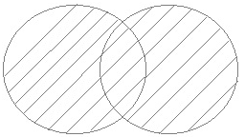
Union Operation
UNION is used to combine the results of two or more Select statements.
It will eliminate duplicate rows from its result set.
Number of columns and datatype must be same in both the tables.
Syntax: SQL statement1 UNION SQL statement2;

Slide 4

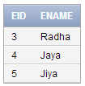

Example:
select * from cust1 union select * from emp1;
cust1
emp1

Slide 5

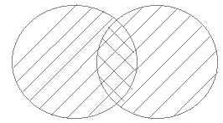
Union All
This operation is similar to Union but it also shows the duplicate rows.
Syntax: SQL statement1 UNION ALL SQL statement2;
Example: select * from cust1 union all select * from emp1;

Slide 6
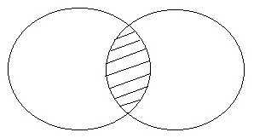

Intersect Operation
Intersect operation is used to combine two SELECT statements and it only returns the records which are common from both SELECT statements.
Number of columns and datatype must be same.
Syntax: SQL statement1 INTERSECT SQL statement2;
Example: select * from cust1 intersect select * from emp1;

Slide 7
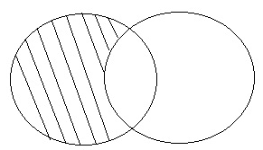

Minus Operation
Minus operation combines result of two Select statements and return only those result which belongs to only first set of result.
Syntax: SQL statement1 MINUS SQL statement2;
Example: select * from cust1 minus select * from emp1;

