Slide 1
Case Statement

Slide 2
CASE Statement
The CASE statement chooses from a sequence of conditions and runs a corresponding statement.
Types:
Value match (Simple) CASE expression: Compares single value and run statement accordingly.
Searched CASE expression: Evaluates boolean expression and run statement accordingly.

Slide 3
Value match (Simple) CASE expression
Syntax:
SELECT [<column_names>,]
CASE <column_name>
WHEN <value> THEN ‘stmt’
END [AS <alias_name>]
FROM <table_name>;

Slide 4
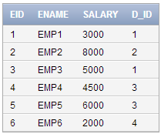
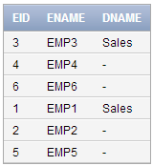
Example
Display eid, ename and department name ‘Sales’ whose D_id =1.
select eid, ename,
CASE d_id
WHEN 1 THEN 'Sales'
END AS Dname
from employee1;

Slide 5
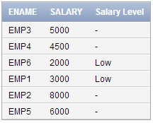
Searched CASE expression
Syntax: (Simple If)
SELECT [<column_names>,]
CASE WHEN <expression> THEN ‘stmt’
END [AS <alias_name>]
FROM <table_name>;
Example: Display the salary with salary level.
select ename, salary,
CASE WHEN
salary <= 3000 THEN 'Low'
END AS "Salary Level"
from employee1;

Slide 6
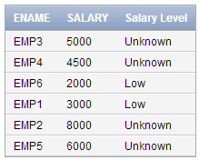
Searched CASE expression
Syntax: (Simple If-Else)
SELECT [<column_names>,]
CASE WHEN <expression> THEN ‘stmt’
ELSE ‘stmt’
END [AS <alias_name>]
FROM <table_name>;
Example:
select ename, salary,
CASE WHEN
salary <= 3000 THEN 'Low'
else 'Unknown'
END AS "Salary Level"
from employee1;

Slide 7
Searched CASE expression
Syntax: (If-Else Ladder)
SELECT [<column_names>,]
CASE WHEN <expression> THEN ‘stmt’
WHEN <expression> THEN ‘stmt’
ELSE ‘stmt’
END [AS <alias_name>]
FROM <table_name>;

Slide 8
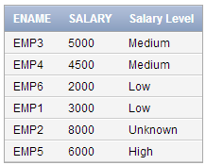
Searched CASE expression
Example:
select ename, salary,
CASE WHEN
salary <= 3000 THEN 'Low'
WHEN salary > =3000 and salary <6000 THEN 'Medium'
WHEN salary >=6000 and salary <=7000 THEN 'High'
else 'Unknown'
END AS "Salary Level"
from employee1;

Slide 9
Searched CASE expression
Syntax: (Nested If-Else)
SELECT [<column_names>,]
CASE WHEN <expression> THEN
CASE WHEN <expression> THEN ‘stmt’
ELSE ‘stmt’
END
ELSE ‘stmt’
END [AS <alias_name>]
FROM <table_name>;

Slide 10
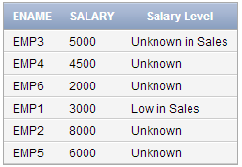
Searched CASE expression
Example:
select ename, salary,
CASE WHEN D_id = 1 THEN
CASE WHEN
salary < 5000 THEN 'Low in Sales'
else 'Unknown in Sales'
END
else 'Unknown'
END AS "Salary Level"
from employee1;

