Slide 1
PL/SQL

Slide 2
Introduction
Disadvantages of SQL:
SQL does not provide the programming techniques of condition checking, looping and branching.
SQL statements are passed to the Oracle Engine one at a time. It increases the traffic on network which decrease speed of data processing.
SQL has no facility for handling errors that arise during the manipulation of data.

Slide 3
PL/SQL
PL/SQL is a superset of SQL.
It is a block-structured language that enables developers to combine the power of SQL with procedural statements.
It bridges the gap between database technology and procedural programming languages.

Slide 4
Advantages
PL/SQL is development tool that supports SQL data manipulation and provides facilities of conditional checking, branching and looping.
PL/SQL sends an entire block of SQL statements to the Oracle engine all in one go which reduces network traffic.
PL/SQL provides facility for displaying user-friendly messages, when errors are encountered.
It allows declaration and use of variables in block of code.
Via PL/SQL block, calculations can be done quickly and efficiently without the use of Oracle engine.
Applications written in PL/SQL are portable to any computer hardware and operating system.

Slide 5
Structure of PL/SQL block
Structure contains following sections:
  Declare section (optional): Variables and Oracle objects can be declared and initialized.
  Begin section: Contains set of SQL and PL/SQL statements.
  Exception section (optional): It handles the errors that arise during execution. Error can arise due to syntax, logic and validation rule violation.
  End section: It marks the end of PL/SQL block.

Slide 6
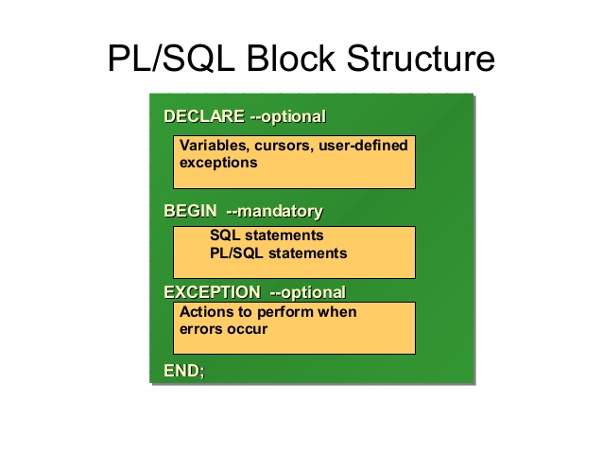
Continue...

Slide 7
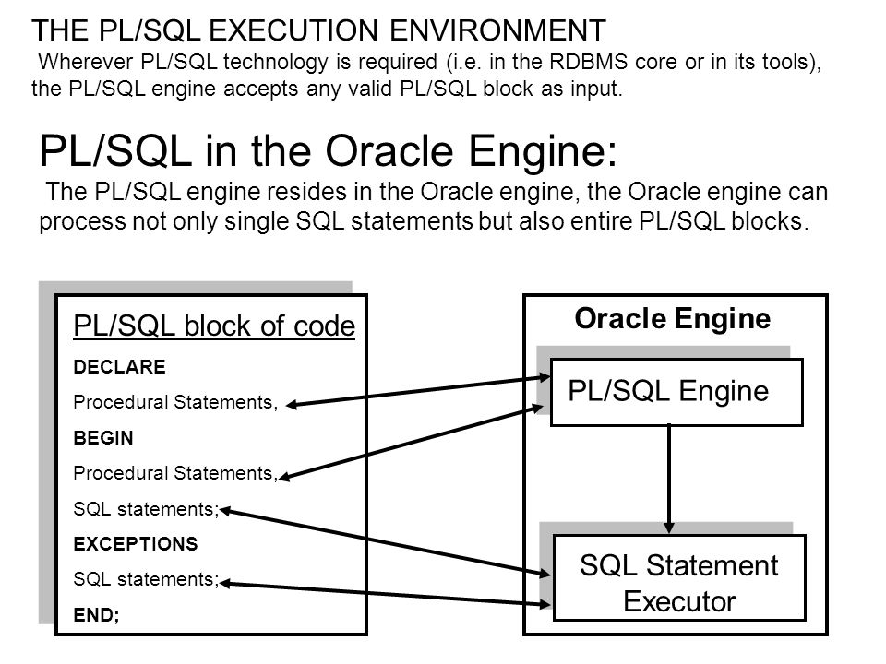
PL/SQL Execution Environment

Slide 8
Data Types
Number, char, date, boolean
%TYPE: This attribute is used to declare variables based on definitions of columns in table.
Variables:
Variable can be declared in declare section using following syntax:
Var_name datatype
:= is used to assign the values to variables.

Slide 9
Display User message
DBMS_OUTPUT: It is a package which includes functions and procedures that accumulates information in a buffer so that it can be retrieved later.
PUT_LINE: It can be used to display the message which is in string.
For taking values from user, ‘:’ operator is used.

Slide 10
Comments
Single line comment: Double hyphen (--)
Multi line comment: /*….*/

Slide 11
Example-1
Write PL/SQL block to take input from user and print it.
DECLARE
a int :=10;
BEGIN
a := :Enter_value_of_a;
dbms_output.put_line('value of a: ' || a);
END;

Slide 12
Example-2
Write PL/SQL block to update the balance of given account number.
declare
d_bal int;
n_acc_no varchar(20);
n_bal number(8,2);
begin
n_acc_no := :Account_number;
d_bal := :New_balance;
update account set bal= d_bal where acc_no=n_acc_no;
select bal into n_bal from account where acc_no= n_acc_no;
dbms_output.put_line('Updated successfully');
dbms_output.put_line('New Balance is:' || n_bal);
end

Slide 13
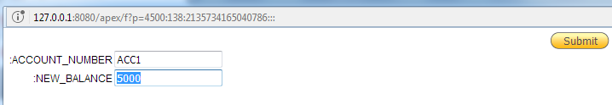

Output

Slide 14
Control Structure
Conditional Control
Iterative Control
Sequential Control

Slide 15
Conditional Control
Syntax:
  IF <condition> THEN <ACTION>
  ELSIF <condition> THEN <ACTION>
  ELSE <ACTION>
  END IF;

Slide 16
Conditional Control
Example:
  declare
  marks int;
  begin
  marks := :Enter_marks;
  if marks > 22 then
  dbms_output.put_line('Grade A');
  elsif marks >15 and marks<=22 then
  dbms_output.put_line('Grade B');
  else
  dbms_output.put_line('Grade C');
  end if;
  end

Slide 17
Iterative Control
Simple Loop
  LOOP
  <sequence of statements>
  EXIT WHEN <condition>
  END LOOP;
WHILE Loop
  WHILE <condition>
  LOOP
  <ACTION>
  END LOOP;

Slide 18
FOR Loop
  FOR variable IN [REVERSE] start..end
  LOOP
  <ACTION>
  END LOOP;

Slide 19
Examples
Write PL/SQL block to print first 10 numbers.
Simple Loop:
  declare
  i int:=0;
  begin
  LOOP
  dbms_output.put_line(i);
  i := i+1;
  EXIT WHEN i>10;
  END LOOP;
  end

Slide 20
Examples
While Loop:
  declare
  i int:=0;
  begin
  WHILE i<10
  LOOP
  dbms_output.put_line(i);
  i := i+1;
  END LOOP;
  end

Slide 21
Examples
For Loop:
  begin
  FOR i in 0..10
  LOOP
  dbms_output.put_line(i);
  END LOOP;
  END

Slide 22
Sequential Control
GOTO Statement
  GOTO <<code_block name>>
It changes the flow of control within the block.
The entry point of code is marked using the tag <<userdefined name>>.
This tag is used by GOTO to jump into that block of code for execution.

Slide 23
Example
  begin
  FOR i in 0..10
  LOOP
  if i<5 then
  dbms_output.put_line(i);
  else goto label1;
  END IF;
  END LOOP;
  <<label1>> dbms_output.put_line('Ended');
  END

Slide 24
Examples
Write PL/SQL block to check whether number is positive or negative.
Write PL/SQL bock to find sum of all digits of a given number.
Write PL/SQL block to print following pattern:
  *
  **
  ***

Slide 25
Solutions-1 (Check whether number is positive or negative.)
  declare
  no int;
  begin
  no := :Enter_Number;
  if(no>0) then
  dbms_output.put_line('Positive number');
  elsif (no<0) then
  dbms_output.put_line('Negative number');
  else
  dbms_output.put_line('Number is 0');
  end if;
  END

Slide 26
Solution-2 (find sum of all digits of a given number.)
declare
no int;
d int;
div int :=10;
s int :=0;
begin
no := :Enter_Number;
while no>0
LOOP
d := mod(no, div);
s:=s + d;
no := no / div;
END LOOP;
dbms_output.put_line('Sum= ' || s);
END

Slide 27
Solution-3 (Pattern)
  begin
  for i in 1..3
  loop
  for j in 1..i
  loop
  dbms_output.put('*');
  end loop;
  dbms_output.put_line(' ');
  end loop;
  end

