Slide 1

MAEER’S MAHARASHTRA INSTITUTE OF TECHNOLOGY, PUNE KOTHRUD, PUNE: 411021
DEPARTMENT OF COMPUTER ENGINEERING
Presented By:
Chakor Pandkar – 71700425C
Rakshit Pensalwar – 71700489K
Shubham Patil – 71700447D
CLUSTERING AND DIMENTIONALITY REDUCTION USING PRINCIPAL COMPONENT ANALYSIS

Slide 2
CONTRIBUTION
Selection of topic:
Rakshit Pensalwar
Dataset Analysis:
Chakor Pandkar
Program Implementation:
Rakshit Pensalwar
Shubham Patil
Project Presentation:
Chakor Pandkar
Project Report:
Shubham Patil

Slide 3
CONTENTS
Abstract
Motivation
Introduction
Theory-
Dimensional Reduction
PCA
Algorithms
Snapshots
Conclusion
References

Slide 4
ABSTRACT
Objectives:
The objective of this report is to determine if a dimension reduction technique, namely principal component analysis, could be utilized in combination with a finite difference method for these problems. A number of numerical experiments were designed to examine the efficiency under different conditions.
Method:
An important area in wine factory concerns the amount of alcohol, alkalinity, ash, color intensity, hue, etc. When options depend on several underlying wine class, the complexity of the problem makes it difficult to solve using conventional finite difference methods. Instead, stochastic approaches are employed despite the extremely slow convergence of these methods. The results show that the proposed approach performs very well when the correlation between the underlying wine class is sufficiently high.

Slide 5
MOTIVATION
Actual Design Process involves assignment of shapes and their dimensions which in turn serve as the guidelines for the manufactureres, developers, users, and the designers themselves.
The various stages of development of a design, particularly the machinig fabrication and testing involve considering it as an approximation in the sense of defining tolerances for both shape and size parameters.
These tolerances are inevitably encountrered due to the limitations of each of the stages of the design and development process.
It is therefore only essential that the designer be equipped with tools which allow him to design and test with real-life considerations of tolerances.

Slide 6
INTRODUCTION
Principal Component Analysis (PCA) is the general name for a technique which uses sophisticated underlying mathematical principles to transforms a number of possibly correlated variables into a smaller number of variables called principal components.
The origins of PCA lie in multivariate data analysis, however, it has a wide range of other applications, as we will show in due course. PCA has been called, ’one of the most important results from applied linear algebra and perhaps its most common use is as the first step in trying to analyze large data sets’.
Some of the other common applications include; de-noising signals, blind source separation, and data compression. In general terms, PCA uses a vector space transform to reduce the dimensionality of large data sets.

Slide 7
Continued…
Using mathematical projection, the original data set, which may have involved many variables, can often be interpreted in just a few variables (the principal components).
It is therefore often the case that an examination of the reduced dimension data set will allow the user to spot trends, patterns and outliers in the data, far more easily than would have been possible without performing the principal component analysis.

Slide 8
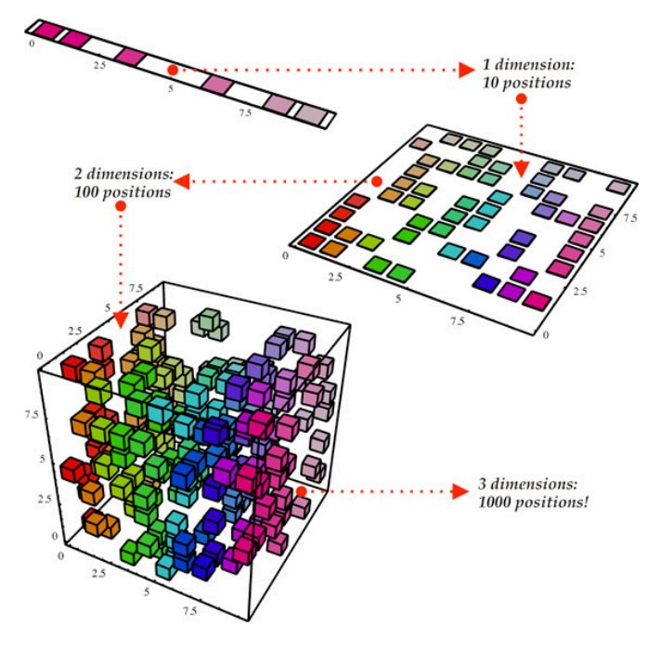
DIMESIONALITY REDUCTION
Reducing the dimensions of the feature space is called dimensionality reduction.
Reduction of dimensions is needed when there are far too many features in a dataset, making it hard to distinguish between the important ones that are relevant to the output and the redundant or not-so important ones.

Slide 9
CONCEPT CONTD..
There are many ways to achieve dimensionality reduction, but most of these techniques fall into one of two classes:
Feature Elimination: Eliminating features to reduce the feature space. As a disadvantage, information is lost due to dropped features.
Feature Extraction: In feature extraction, we create K “new” independent variables, where each independent variable is a combination of each of the given old independent variables.

Slide 10
PRINCIPAL COMPONENT ANALYSIS
History
PCA was invented in 1901 by Karl Pearson as an analogue of the principal axis theorem in mechanics; it was later independently developed and named by Harold Hotelling in the 1930s.
Mathematics Behind PCA
PCA can be thought of as an unsupervised learning problem. The whole process of obtaining principle components from a raw dataset can be simplified in six parts:
Take the whole dataset consisting of d+1 dimensions and ignore the labels such that our new dataset becomes d dimensional.
Compute the mean for every dimension of the whole dataset.
Compute the covariance matrix of the whole dataset.
Compute eigenvectors and the corresponding eigenvalues.
Sort the eigenvectors by decreasing eigenvalues and choose k eigenvectors with the largest eigenvalues to form a d × k dimensional matrix W.
Use this d × k eigenvector matrix to transform the samples onto the new subspace.

Slide 11
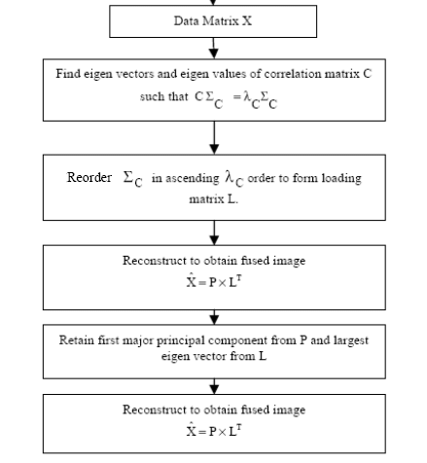
PCA Flowchart

Slide 12
S/w & H/w REQUIREDMENT
Software:
Python – 3.7.0
Jupyter
Hardware:
64-Bit O.S. Platform (Windows)

Slide 13
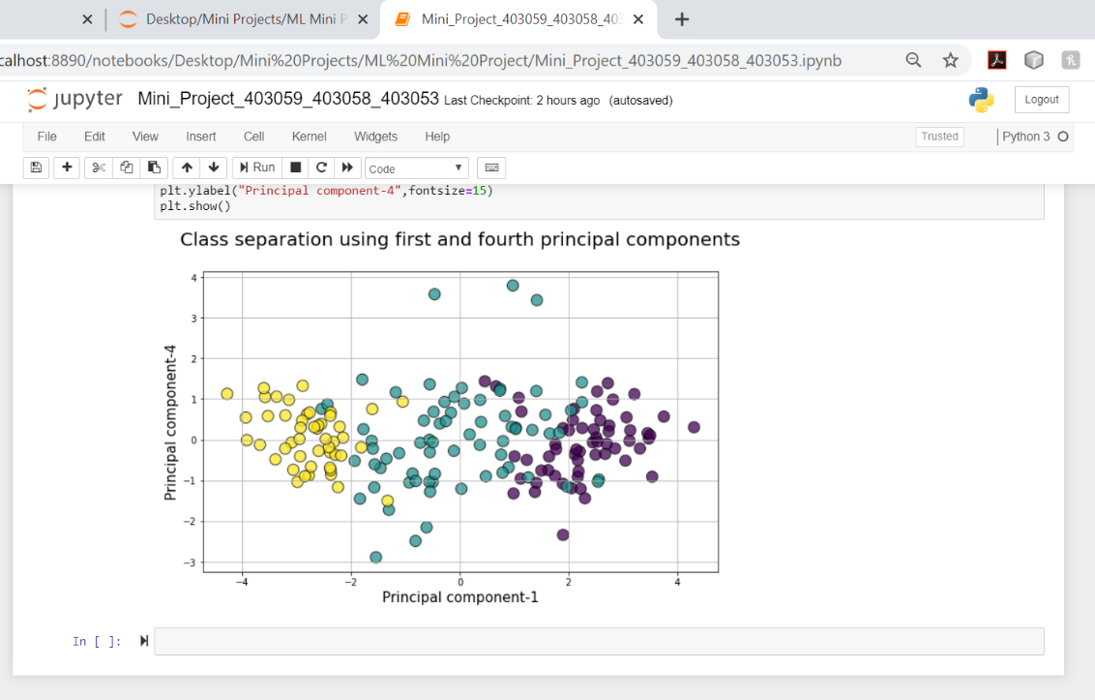
SNAPSHOTS

Slide 14
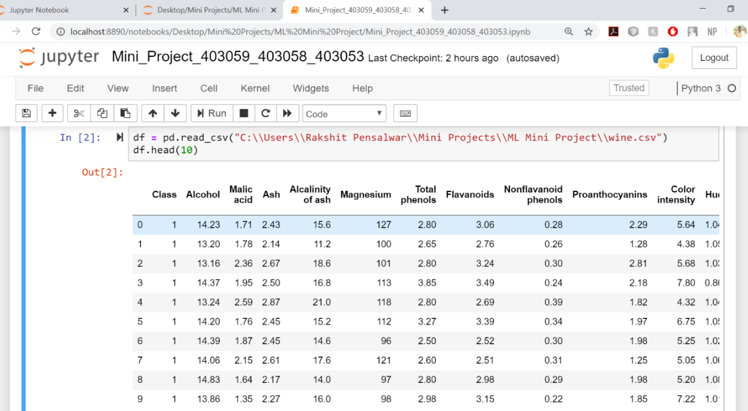
SNAPSHOTS CONTD

Slide 15
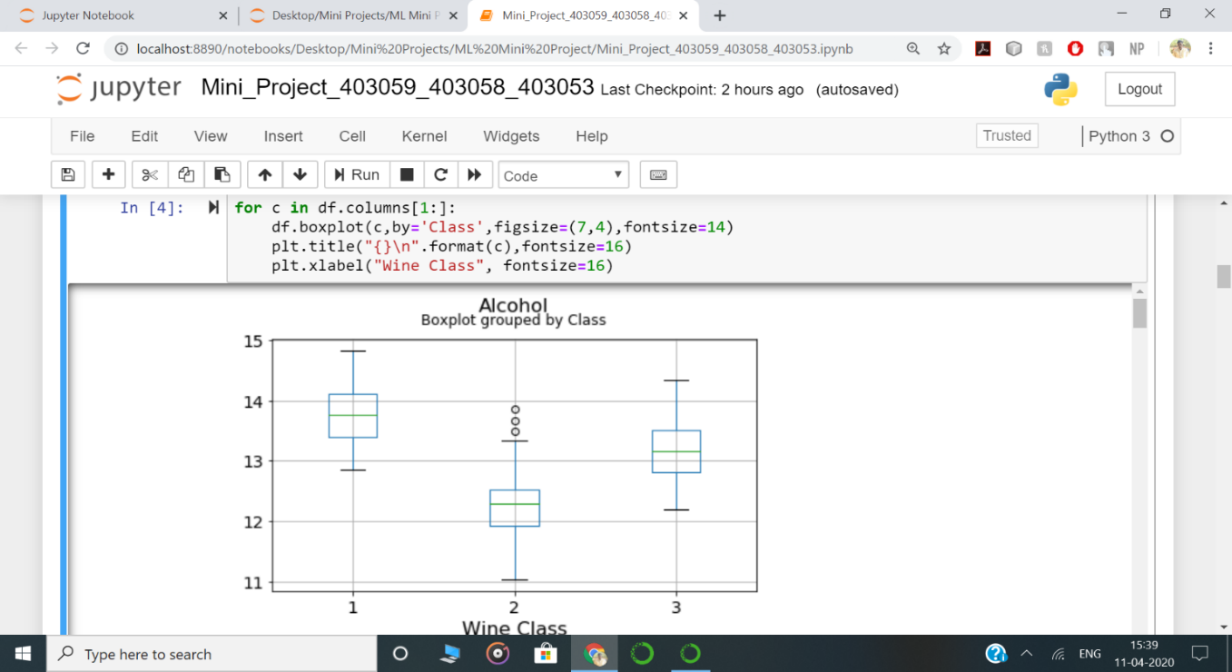
SNAPSHOTS CONTD

Slide 16

SNAPSHOTS CONTD

Slide 17
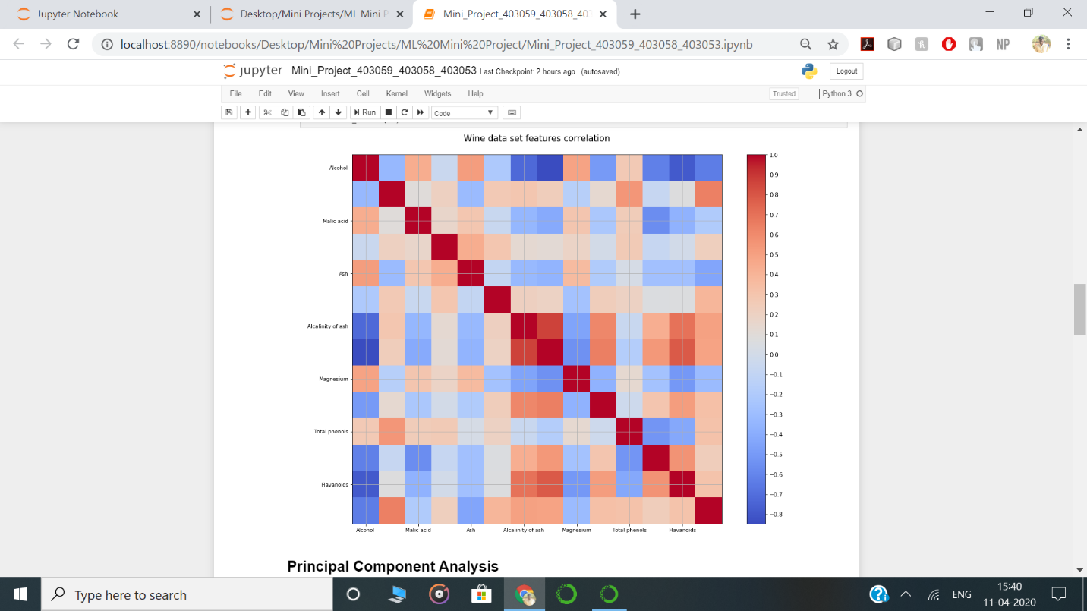
SNAPSHOTS CONTD

Slide 18
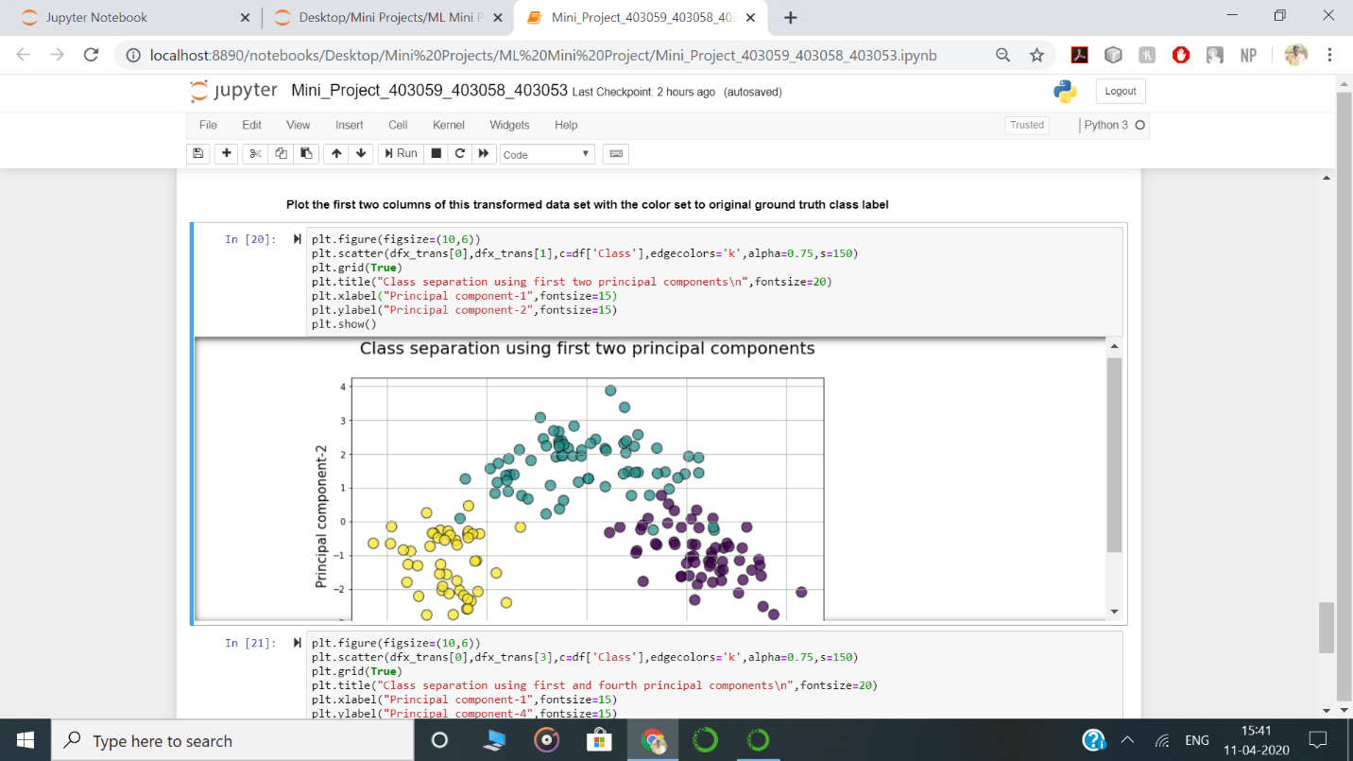
SNAPSHOTS CONTD

Slide 19
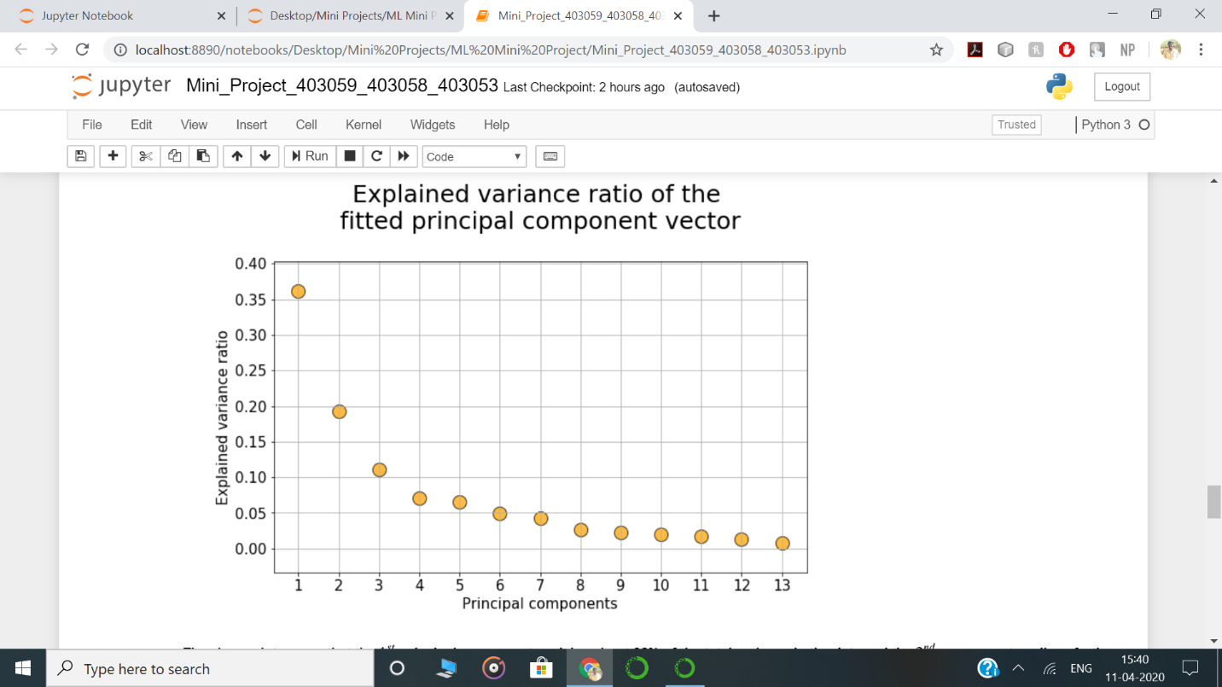
SNAPSHOTS CONTD

Slide 20
CONCLUSION
In this Project, we learned the fundamentals of working with principal component analysis (PCA), including the mathematics behind it.
Despite being widely used and strongly supported, it has its share of advantages and disadvantages.
One benefit of PCA is that we can examine the variances associated with the principle components.
Often one finds that large variances associated with the first principal components, and then a precipitous drop-off.
We can conclude that most interesting dynamics occur only in the first k dimensions. In the example of the alcohol, k = 1. This process of throwing out the less important axes can help reveal hidden, simplified dynamics in high dimensional data.

Slide 21
REFERENCES
[1] Ian T. Jolliffe. Principal Component Analysis. Springer-Verlag New York Inc., 1986.
[2] Lay, David. (2000). Linear Algebra and It’s Applications. Addison-Wesley, New York.
[3] Abdi H. and Williams L.J. (2010) Principal component analysis. Statistics & Data Mining Series, Vol. 2, John Wiley & Sons, p.433-459.
[4] Everitt BS, Dunn G (2002) Applied Multivariate Data Analysis. 2nd Edition, Arnold Publisher, London.
[5] Ma, Y. Z., 2011, Lithofacies clustering using principal component analysis and neural network: applications to wireline logs, Math. Geosciences, 43(4):401-419.

