Slide 1
SignalR All The Things!
Javier G. Lozano
javier@lozanotek.com
@jglozano

Slide 2
Goal
Get a basic understanding of what SignalR can offer to your applications.
Spark ideas about what you could add or change in a current application with the help of SignalR.

Slide 3
Agenda
What is SignalR?
Demos, Demos, Demos!

Slide 4




Info
javier@lozanotek.com
@jglozano
http://jglozano.io
https://github.com/lozanotek/SignalRAllTheThings

Slide 5
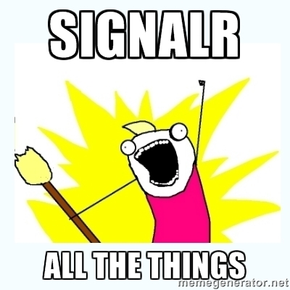
Obligatory Meme…

Slide 6

What is SignalR?
It helps address the issue with…
Ajax (XHR) Requests
Polling/Long Polling
WebSockets

Slide 7
What is SignalR?
It provides…
Abstraction from SysWeb via Open Web Interface for .NET (OWIN)
One implementation that leverages previous approaches
Simple consumer interface, great extension points

Slide 8
What is SignalR?
To the whiteboard!

Slide 9
Demo
Enough slides, let’s code.

Slide 10
Thanks!
Questions?

