Slide 1
SignalR All The Things!
Javier Lozano
javier@lozanotek.com

Slide 2
Goal
Get a basic understanding of what SignalR can offer to your applications.
Spark ideas about what you could add or change in a current application with the help of SignalR.

Slide 3
Overview
What is SignalR?
Demos
Review
Questions

Slide 4


About Me
javier@lozanotek.com
@jglozano
http://jglozano.io
http://lzno.tk/azure-aspnet

Slide 5
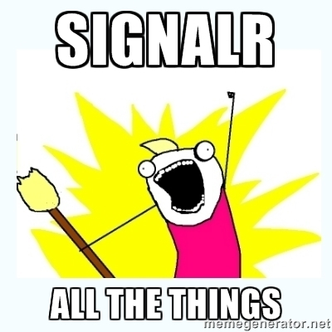
Obligatory Meme…

Slide 6
What is SignalR?
A stack that helps address the issue with …
AJAX (XHR) Requests
Custom Polling/Long Polling Approaches
WebSockets
Provides a nice abstraction layer to allow developers to focus on…
Connections
Hubs
Platform

Slide 7
What is SignalR?
Provides a nice abstraction layer to allow developers to focus on…
Connections
Hubs
Platform
Removes dependency on SysWeb via Open Web Interface for .NET (OWIN).
Simple consumer interface, with great extension points.

Slide 8
Enough slides, let’s code!

Slide 9
Review
No right answer
Leverage with current ASP.NET applications/skills
Can be used as a poor man’s “message bus”
Focus can be on client/server

Slide 10
Questions?
Please use Event Board to fill out a session evaluation.
Thank you!

