Slide 1
SignalR All The Things!
Javier G. Lozano
javier@lozanotek.com
@jglozano

Slide 2
Goal
Get a basic understanding of what SignalR can offer to your applications.
Spark ideas about what you could add or change in a current application with the help of SignalR.

Slide 3
Agenda
What is SignalR?
Demos, Demos, Demos!

Slide 4




Info
javier@lozanotek.com
@jglozano
http://jglozano.io
https://github.com/lozanotek/SignalRAllTheThings

Slide 5
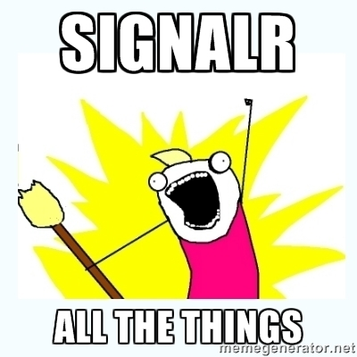
Obligatory Meme…

Slide 6
Demo
Enough slides, let’s code.

Slide 7
Thanks!
Questions?

