Slide 1
Delivery Subsystem in T24

Slide 2
Agenda
Introduction To Delivery
Classification Of Delivery Advices
Delivery Carriers
Sample Delivery Advice
Important Files In Delivery
Flow Of A Delivery Advice
Resubmitting of Advices

Slide 3
Classification of Advices
Type of Advices
Deal Slips
Generated for any application
Can be generated during any of the
functions (I,A,C,D etc)
Can be generated only online
Normally printed and handed over to
the customer across the table
Delivery Advices
Generated only for contract based
applications.
Generated only when contracts are
authorized.
Generated both online and offline
Normally printed during COB.

Slide 4
Classification of Advices
Advices
Inward
(Advices received from other banks)
Outward
(Advices sent to customers and other banks)

Slide 5
Delivery Carriers
Advices
Print
Swift
Telex

Slide 6
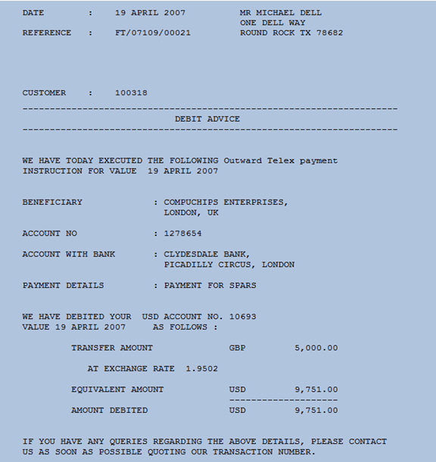
Sample Print Advice

Slide 7
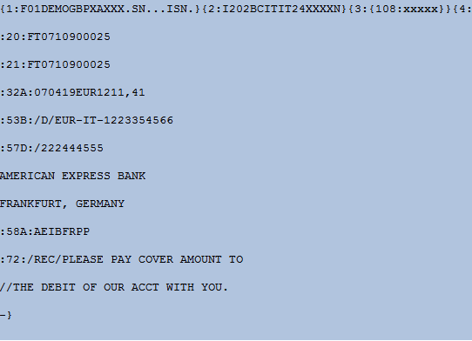
Sample Swift Advice

Slide 8
How Do We Generate A Delivery Advice?
A new Loans transaction has been input using the Loans And Deposits
module in T24 with the following values
LD ID - LD0103900009
  Customer Id - 100724
  Currency - USD
  Amount - 1200
  Value Date - 16 NOV 2007
  Maturity Date - 16 NOV 2008
  Category – 21051
  Interest Basis -E
  Rate Of Interest - 12

Slide 9
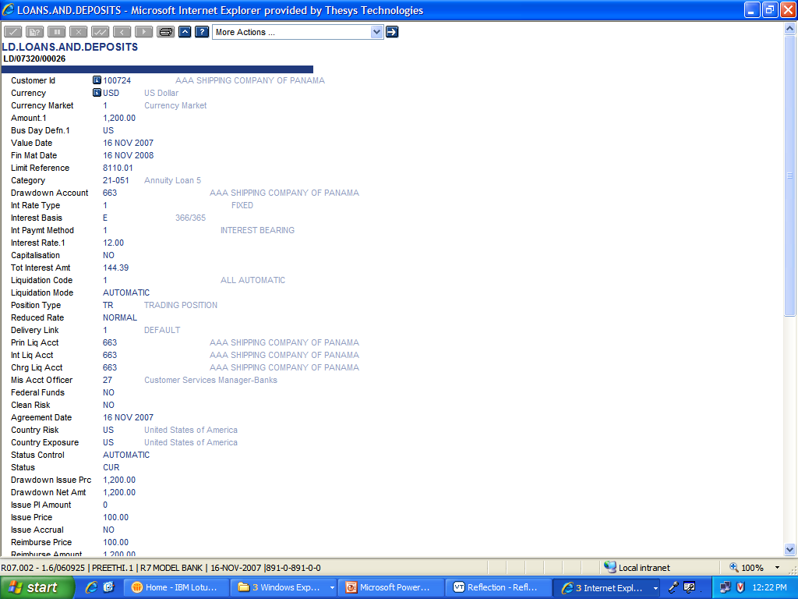
The LD Record After Authorization

Slide 10
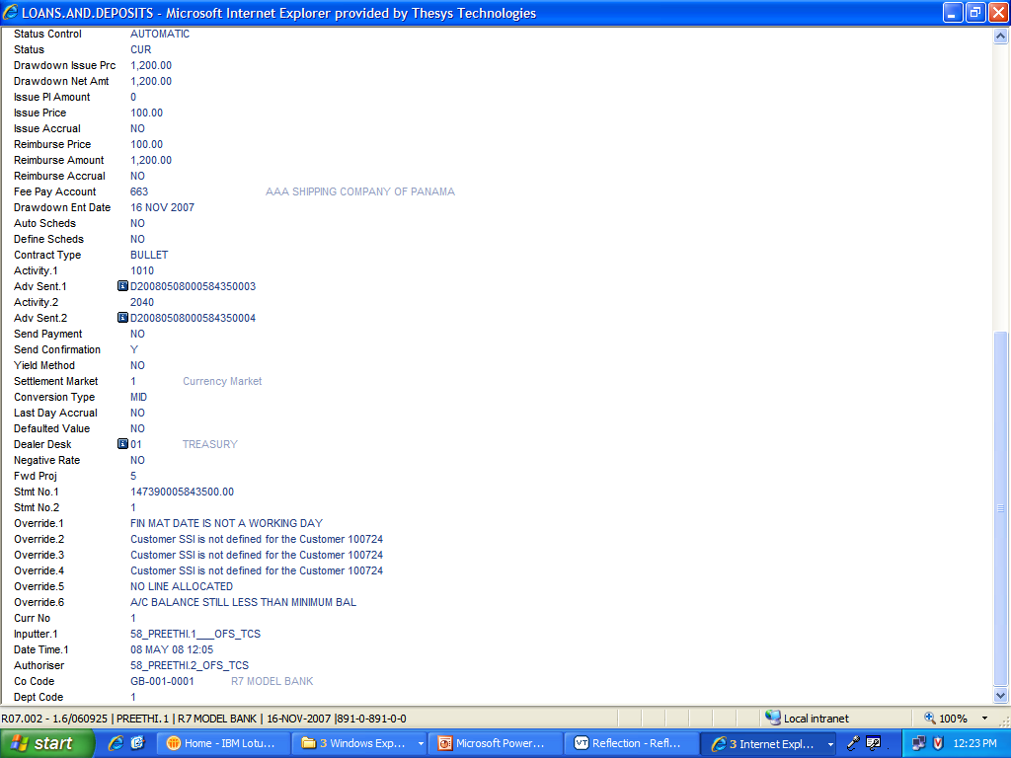
The LD Record After Authorization

Slide 11
The Delivery Reference ID
D20080508000584350003
X" "D" - message is to be delivered (outward message) or
"R" - message has been received (inward message)
"YYYYMMDD -" the date
"NNNNN" - the system user number of the inputter
"SSSSSSS" - the time in seconds since midnight
"QQ" - the sequence number of transactions within a second

Slide 12
How Do We Generate A Delivery Advice?
How do we take the values from the contract and display it in the advice?
T24 will not allow us to directly access the contract
What do we do?
Ask T24 to extract values from the contract and keep it in a place
that is accessible by us.

Slide 13
How Do We Generate A Delivery Advice?
APPLICATION.HANDOFF routine
  Gets triggered as soon as a contract is authorised
  Will extract values from the contract and write it on to DE.O.HANDOFF.
  We cannot instruct APPLICTION.HANDOFF
    What values need to be picked up from the contract
    Which position in DE.O.HANDOFF the extracted values need to be written to

Slide 14
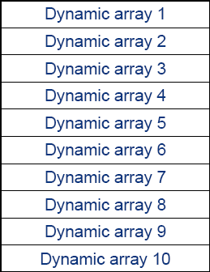
DE.O.HANDOFF
ID : Delivery Reference ID
Contains 10 fields (10 dynamic arrays)

Slide 15
How Do We Generate A Delivery Advice?
APPLICATION.HANDOFF will write values into any of the position in arrays 1 to 8 in DE.O.HANDOFF
Arrays 9 is reserved for user defined values
Array 10 not used
100069
Customer Number - Position 1.1
Value Date - Position 2.1
Currency - Position 2.2
Draw down account - Position 3.1
Maturity Date - Position 3.2
Interest Amount - Position 3.3
Interest Rate - Position 4.1
Status - Position 4.2
Loan Amount- Position 5.1
Currency- Position 6.1
Limit Reference No- Position 7.1
080801VMUSD
26937VM080802VM30.42
2VM21051
1500
CUR
2010.01
Dynamic array 8
Dynamic array 9
Dynamic array 10

Slide 16
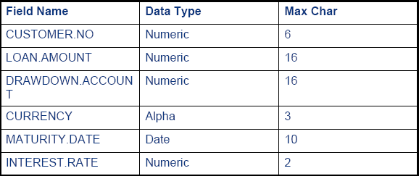
How Do We Generate A Delivery Advice?
Now we have the values in DE.O.HANDOFF. How we take it to the advice?
Define variables that can hold values extracted from DE.O.HANDOFF

Slide 17
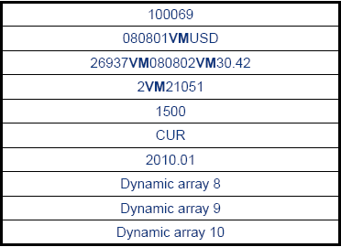
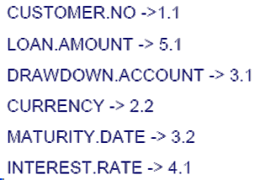
How Do We Generate A Delivery Advice?
Now that we have the variables defined, how do we populate data into them?
Link the variables and appropriate position in DE.O.HANDOFF

Slide 18
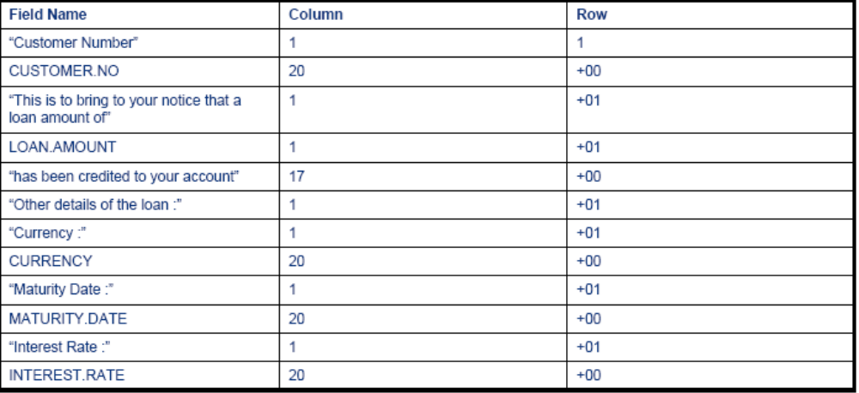
How Do We Generate A Delivery Advice?
Now that the variables have data, we need to just format them
and display them in the required format
Similar to formatting enquiries

Slide 19
Our advice is ready

Slide 20
Steps To Generate A Delivery Advice
Input a contract and authorise it
APPLICATION.HANDOFF will populate values in DE.O.HANDOFF
Define variables to hold values from DE.O.HANDOFF
Link the variables and the positions in DE.O.HANDOFF
Format the advice

Slide 21
Link The Steps To T24
Input and authorize a contract
Populate DE.O.HANDOFF Done by T24
Define the variables DE.MESSAGE
Link the variables to positions in DE.MAPPING
DE.O.HANDOFF
Format the advice DE.FORMAT.PRINT
or
DE.FORMAT.SWIFT

Slide 22
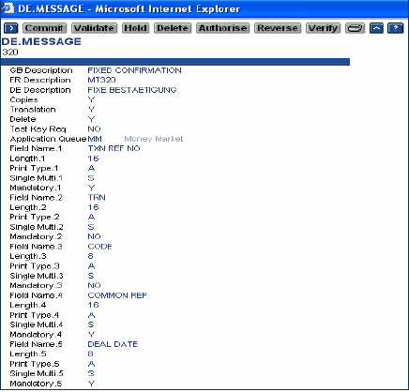
Define The Variables – DE.MESSAGE
ID – Message Type
T24 has pre defined message types

Slide 23
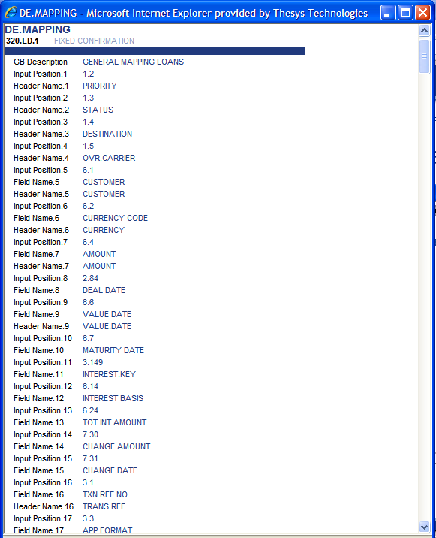
Linking variables – DE.MAPPING
ID : MessageType.ApplicationName.Subclassification
Sub classification is hard coded
by default to 1.Through parameterization
we can set the value for sub classification.
Parameterization is available for some
applications For example LC uses the
application called EB.ADVICES to set the
sub classification
Array position in DE.O.HANDOFF
Field name defined in
DE.MESSAGE

Slide 24
DE.FORMAT.PRINT
After Mapping, the data is ready, next step is to format the data
Formatting of data are done in DE.FORMAT.XXXX where XXXX is carrier e.g. PRINT, SWIFT,TELEX.
Allows formatting of text and data
  Sequence
  Language
  Position on Page

Slide 25
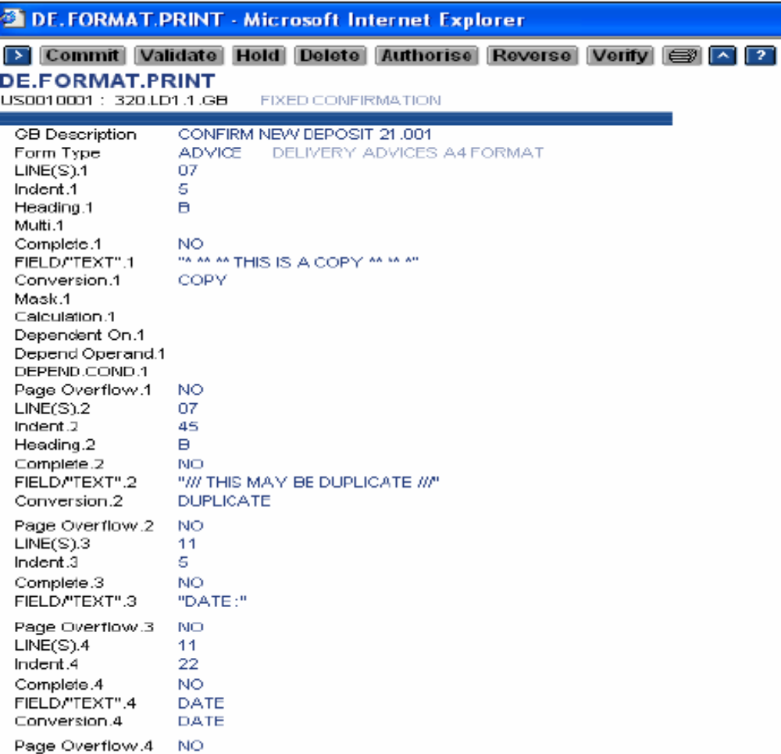
Format The Advice – DE.FORMAT.PRINT

Slide 26
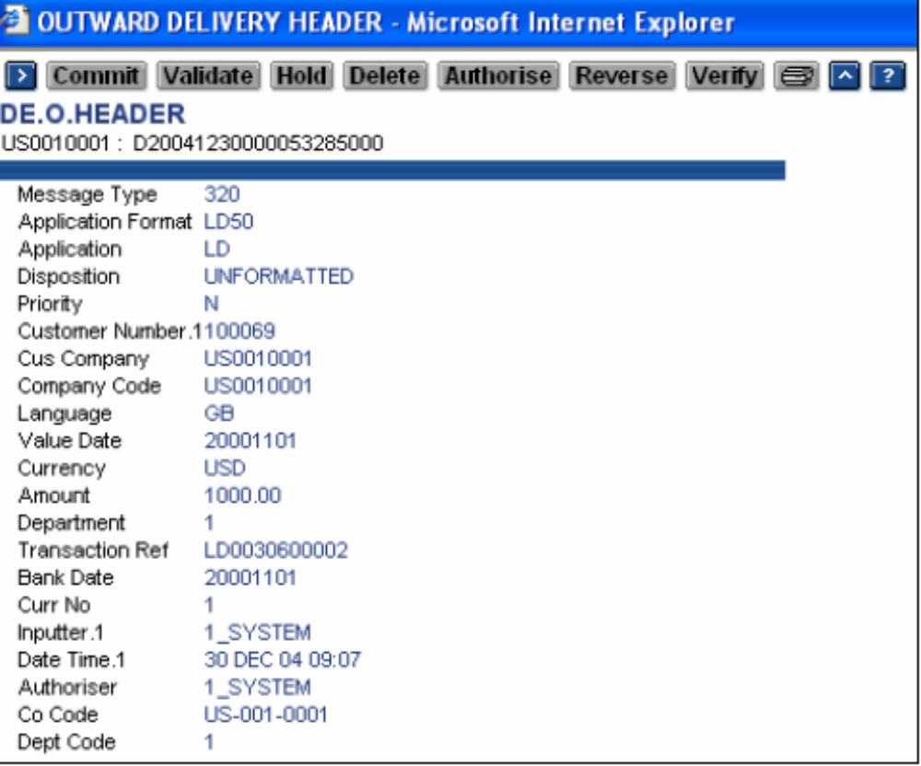
Is There A Log Of What Is Happening?
How do I know what has happened to my advice?
DE.O.HEADER

Slide 27
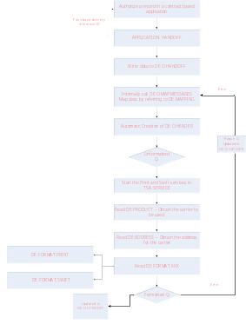
Flow Of A Delivery Advice

Slide 28
Viewing The Contents Of APPLICATION.HANDOFF
Desktop/Browser : ENQ DE.HANDOFF.DETS
  Supply Delivery Reference ID
  This enquiry can be used to obtain the DE.MAPPING ID as well.
Classic : Execute SEE.HANDOFF <Delivery Reference ID> from the database prompt.

Slide 29
DE.PRODUCT
What type of delivery advice is it?
  Company–Customer–MessageType–Application
GB0010001.C-100069.320.LD1.1
  Company–Account–MessageType–Application
GB0010001.A-123456.320.LD1.1
  Company-Customer-MessageType-All Applications
GB0010001.C-100069.320.ALL
  Company-Customer-All Message Types-All Applications
GB0010001.C-100069.ALL
  Company-All Customers-All Message Types-All Applications
GB0010001.ALL.ALL

Slide 30
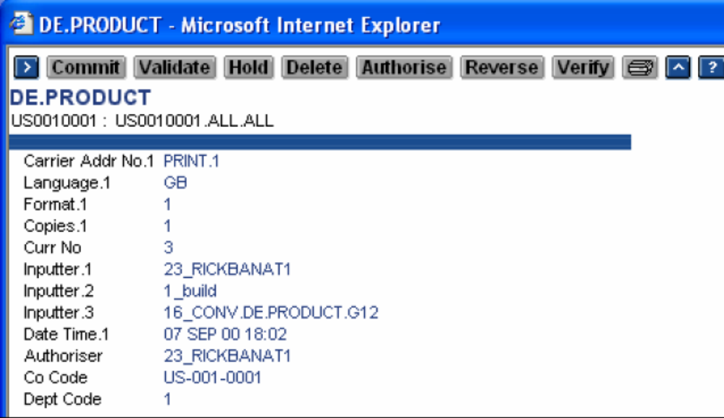
DE.PRODUCT

Slide 31
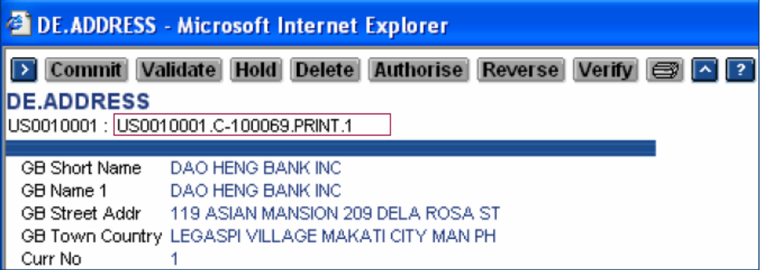
DE.ADDRESS
What is the address to which the advice needs to be sent to?
PRINT ADDRESS

Slide 32
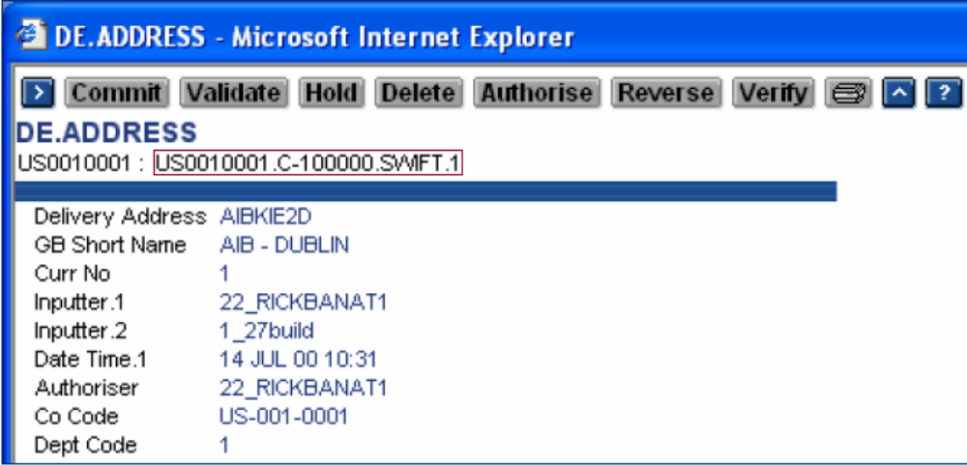
DE.ADDRESS
SWIFT Address

Slide 33
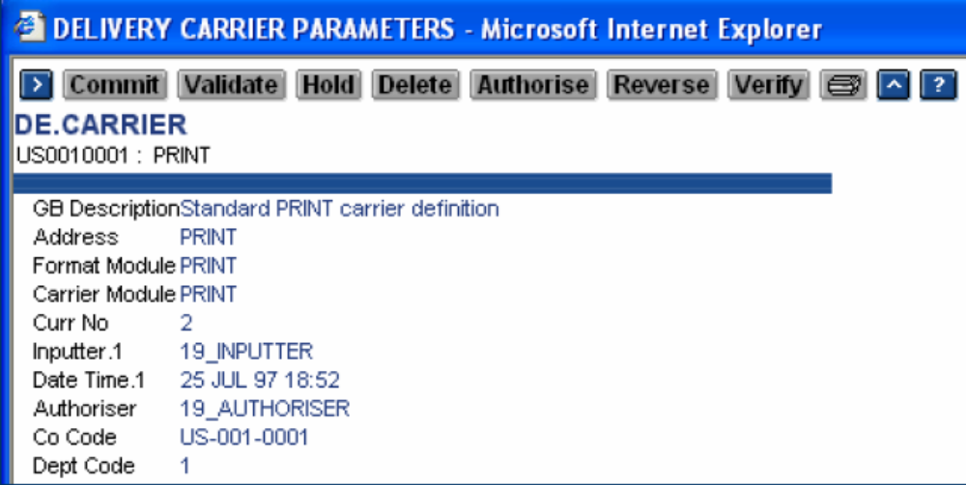
DE.CARRIER
The carrier definition

Slide 34
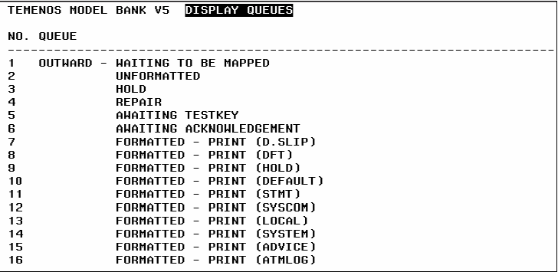
Message Queues
Type QS at the application prompt to locate in which queue the advice is in.

Slide 35
DE.MENU
Menu used to monitor and control the Delivery Sub system
Provides the operator with facilities to control the phantoms, Outward message mapping and formatting, Message display and Message control tables.

Slide 36
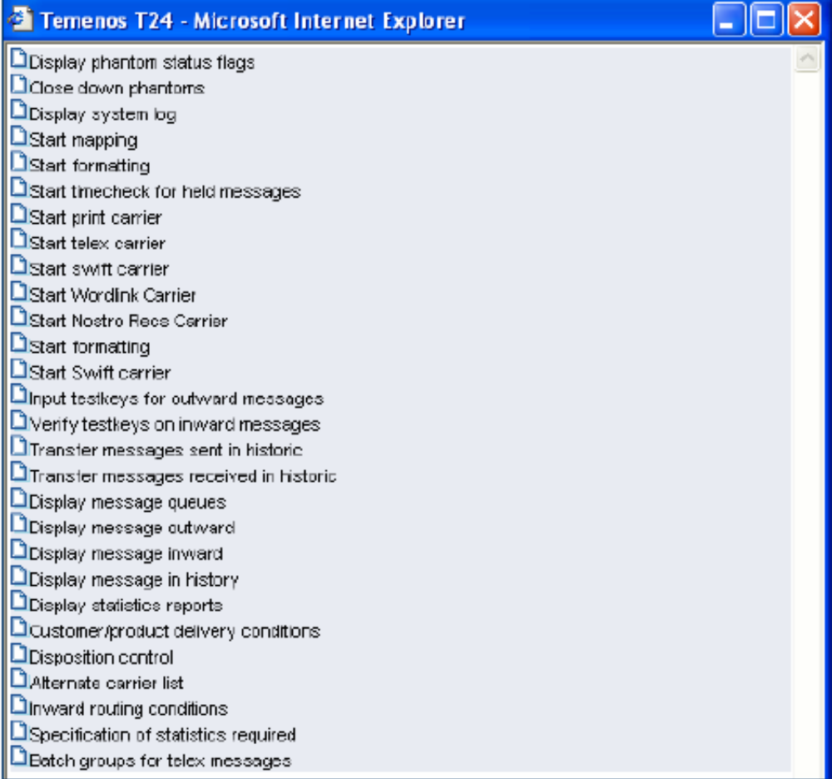
DE.MENU
Type ?DE.MENU in the Application Prompt

Slide 37
DE.MM.PRINT.MSG
Mainline program in T24
Used to see the generated delivery advice online
  Execute the program from within T24
  Specify the Delivery Reference Id
  Choose ‘V’ to view the advice

Slide 38
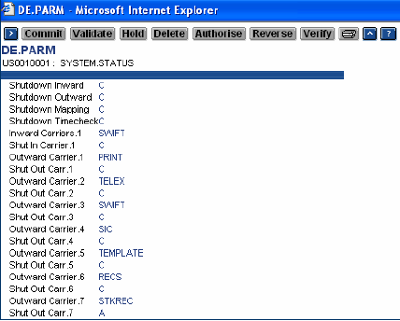
Delivery Parameter File
DE.PARM
  Contains only 1 record with ID ‘SYSTEM.STATUS’
  Is used to hold the status and delivery phantoms
  DE.MENU updates this file

Slide 39
Resubmitting Messages
Messages which have been in Repair or need to be re-produced can be submitted using application DE.O.HEADER
Select the required record and change field 32.1 MSG DISPOSITION to RESUBMIT after making the necessary corrections. Commit and authorize the record
Cannot resubmit if the problem is in the ‘Mapping Stage’

Slide 40
Workshop
Input a LD transaction and note down the following
Delivery reference ID
ID of the DE.MESSAGE record used
ID of the DE.MAPPING record used
ID of the DE.PRODUCT record used
ID of the DE.ADDRESS record used

Slide 41


www.capgemini.com/financialservices
Notes:
© 2006 Capgemini - All rights reserved

