Slide 1
Dealslip
May 2011
Notes:
© 2006 Capgemini - All rights reserved
0

Slide 2
Objective
At the end of the session the particpants will be able
To understand about Deal slip
To understand the generation of deal slip at various stages.

Slide 3
Session plan
Session- 1
Introduction
Table settings
Session- 2
Example for version
Session –3
Workshop
Session-4
Case study

Slide 4
What is Deal Slip?
Confirmation slip generated for T24 transaction at any stage
Usually printed and handed to customer

Slide 5
Why Deal Slip?
Customer requires proof/list of transaction by hand
So transaction details required to be printed

Slide 6
When Deal Slip can be triggered?
Deal slips can be produced during the following stages
I – Input
A – Authorize
C – Copy
R – Reverse
D – Delete
H – History Restore
Finish – For Teller Applications

Slide 7
Application involved for deal slip generation -Version
PRINTER.ID
DE.FORM.TYPE
REPORT.CONTROL
DEAL.SLIP.FORMAT
VERSION OF THE APPLICATION

Slide 8
Application Details
PRINTER.ID – Define printer ID
DE.FORM.TYPE – Define page layout & printer ID
REPORT.CONTROL – Define reports produced in T24 & DE.FORM.TYPE ID
DEAL.SLIP.FORMAT - Define layout of the deal slip & report control ID
VERSION/ENQUIRY – Define deal slip format ID and action on which deal slip has to be produced

Slide 9
Application Details
ENQUIRY.REPORT-It is an application which generates a report based on the parameters defined in the file ENQUIRY.
Notes:
ENQUIRY.REPORT-It can be run either as an on-line request, using the Verify function, or requested during the end of day via the job EB.PRINT.

Slide 10
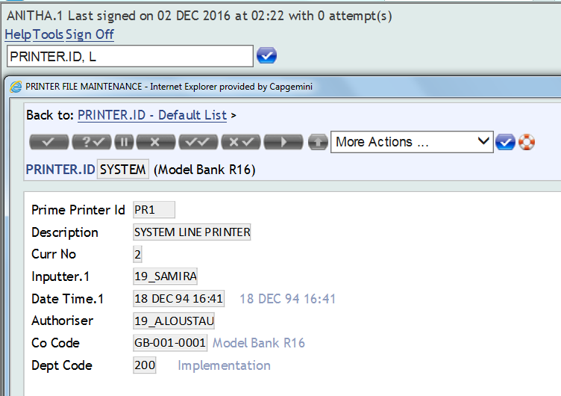
PRINTER.ID
Define valid printers on the system
Translates logical printer name to actual physical printer
Actual physical printer defined at Operating System level

Slide 11
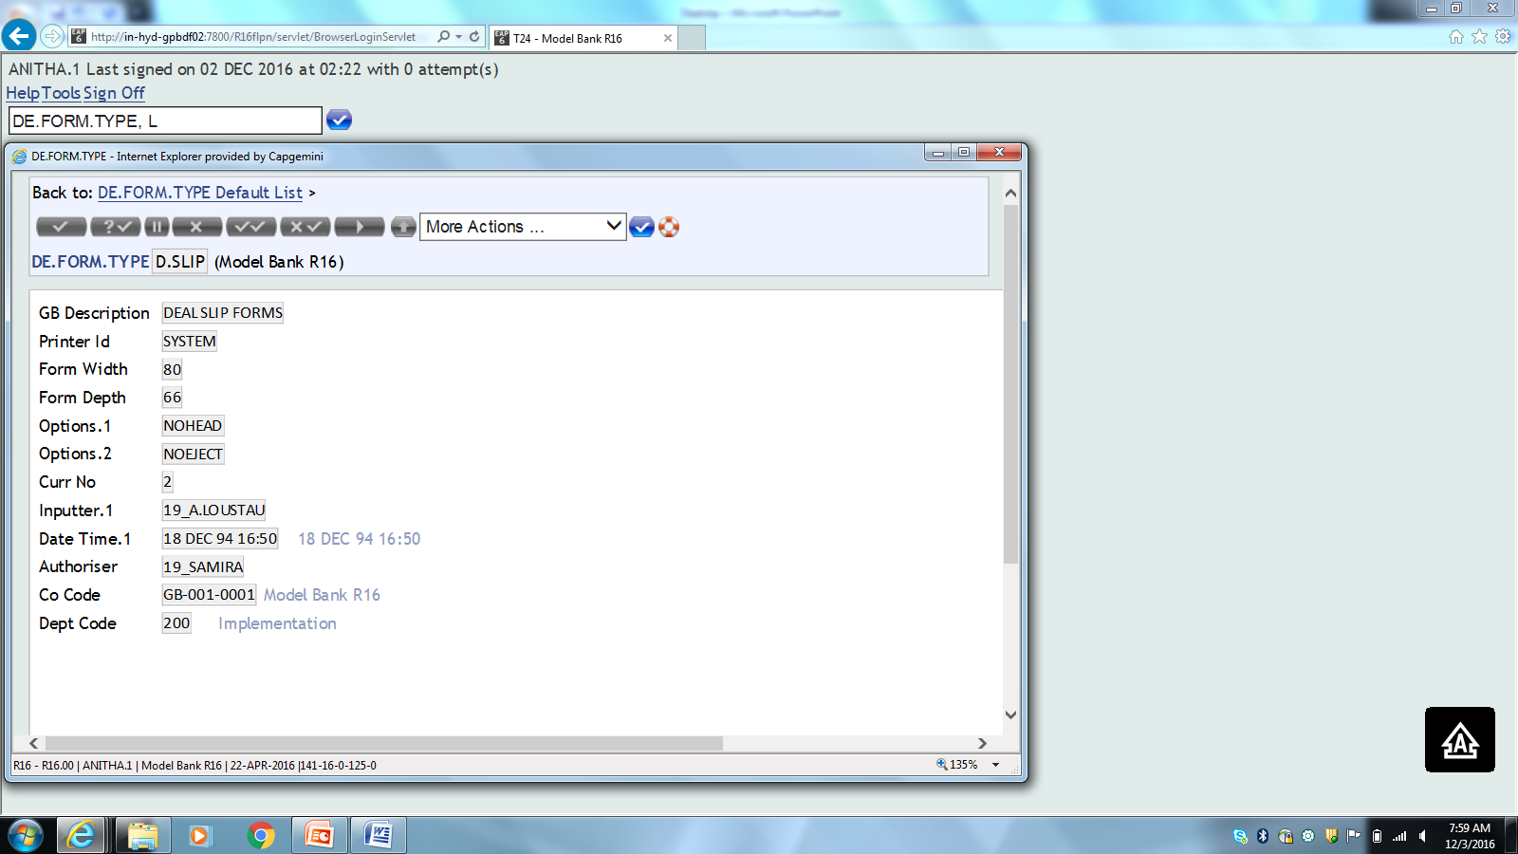
DE.FORM.TYPE
Defines the width and depth of each printed form (page layout)
Define printer to be used

Slide 12
REPORT.CONTROL
Defines all reports that can be produced by the T24 system and contains
Description of the report
Printer environment (form)
Date and time last produced and spooled
Indicator to flag the report for micro-fiching
Mnemonic to link it to a product

Slide 13
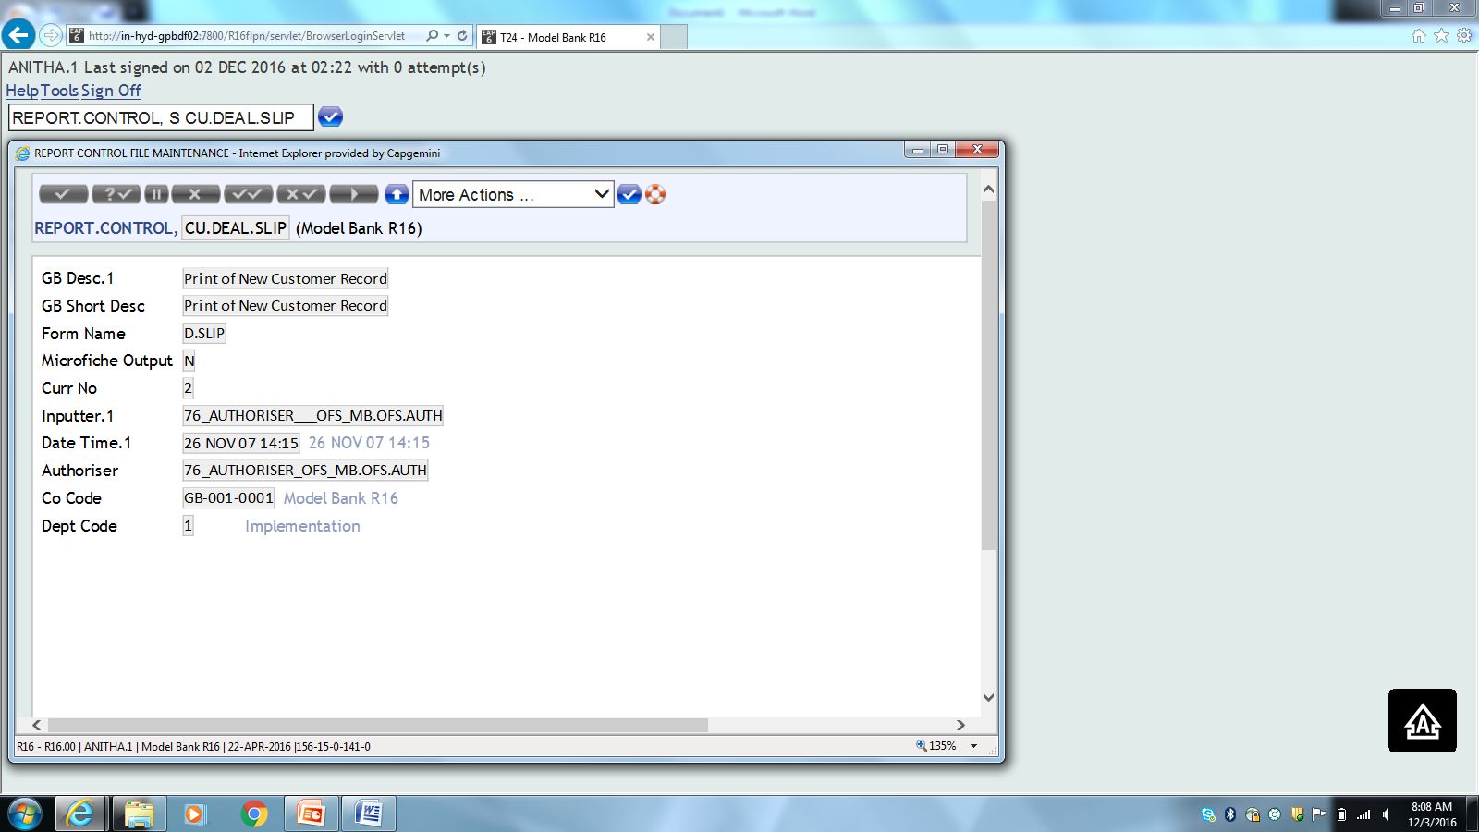
REPORT.CONTROL
Defined in DE.FORM.TYPE

Slide 14
DEAL.SLIP.FORMAT
Define the layout and content of deal slips printed within the T24 system
Deal slips are normally produced, when the contract is first input
Layout definition is divided into two sections
Files and the keys to those files, where data will be extracted from
Which fields to extract and where on the deal slip they should be printed

Slide 15
DEAL.SLIP.FORMAT
Main extract file/record –
Current application
Any file with key i.e. a field on another file
Also specify - Current application field enrichments, free format text and totals
Note: Deal slip format is intended for single page output only

Slide 16
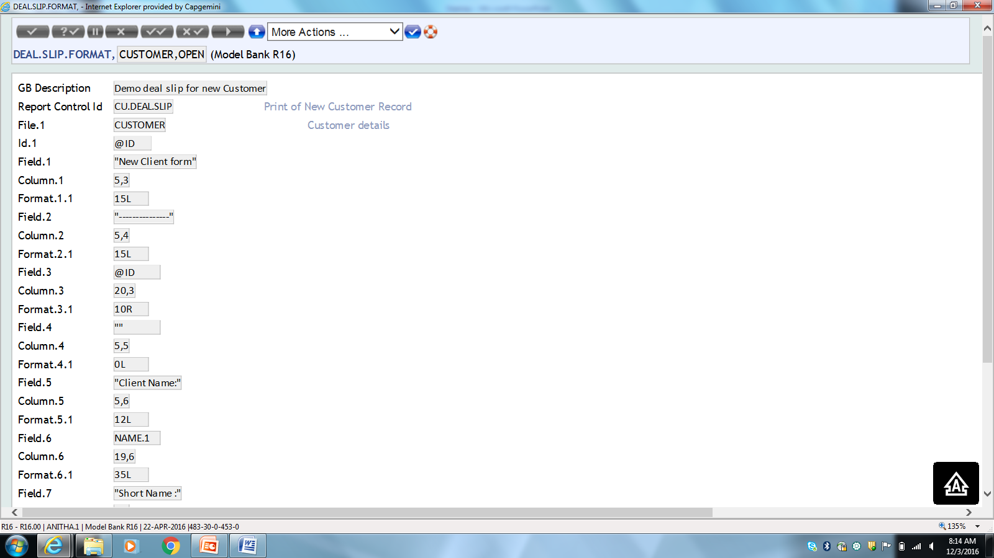
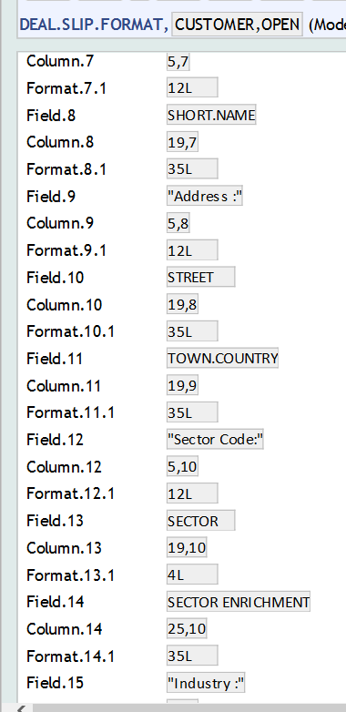
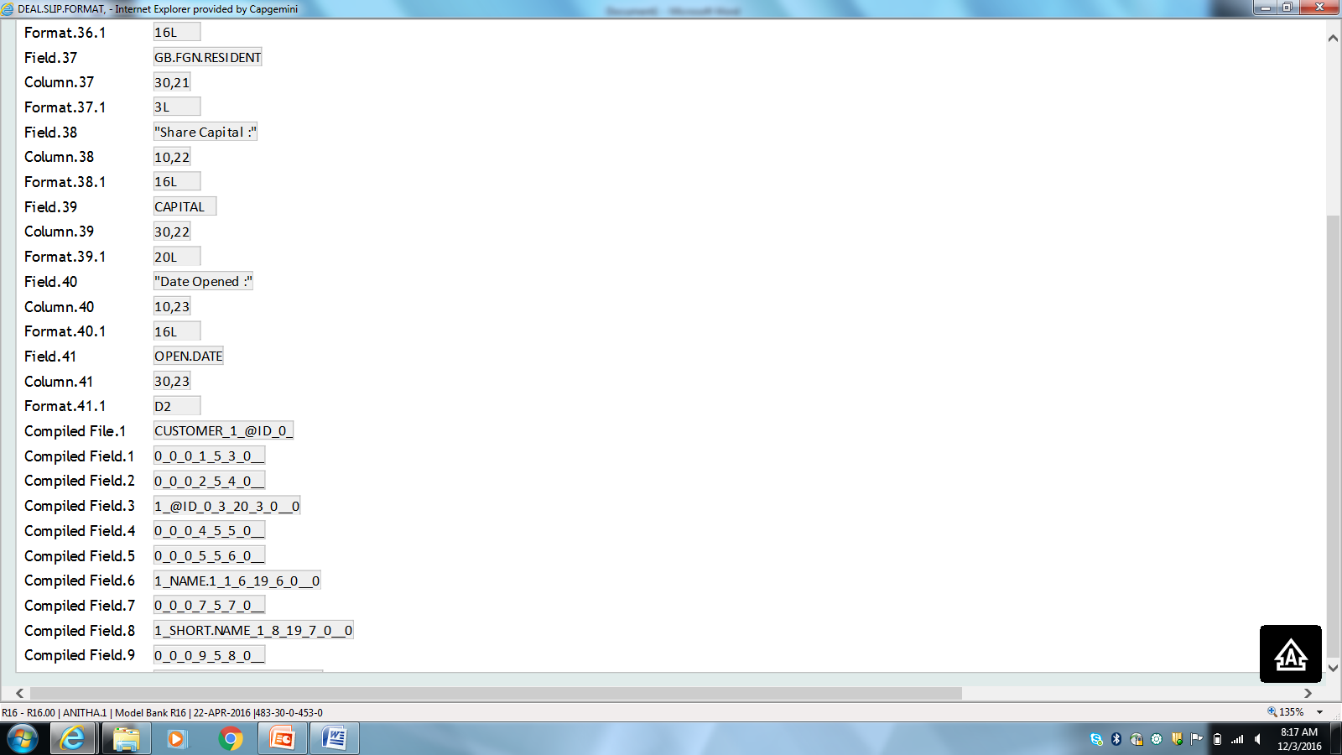
DEAL.SLIP.FORMAT

Slide 17
Version
Deal slip can be generated while performing any action in Version application
Attach the ID of Deal Slip Format in the Version, to invoke the creation of deal slip

Slide 18
Version Field
D Slip Format
Input a valid deal slip format ID
D Slip Function
Function during which deal slip has to be created
D Slip Trigger
OL – To generate deal slip automatically
RQ – To generate deal slip manually, using a HOT.KEY

Slide 19
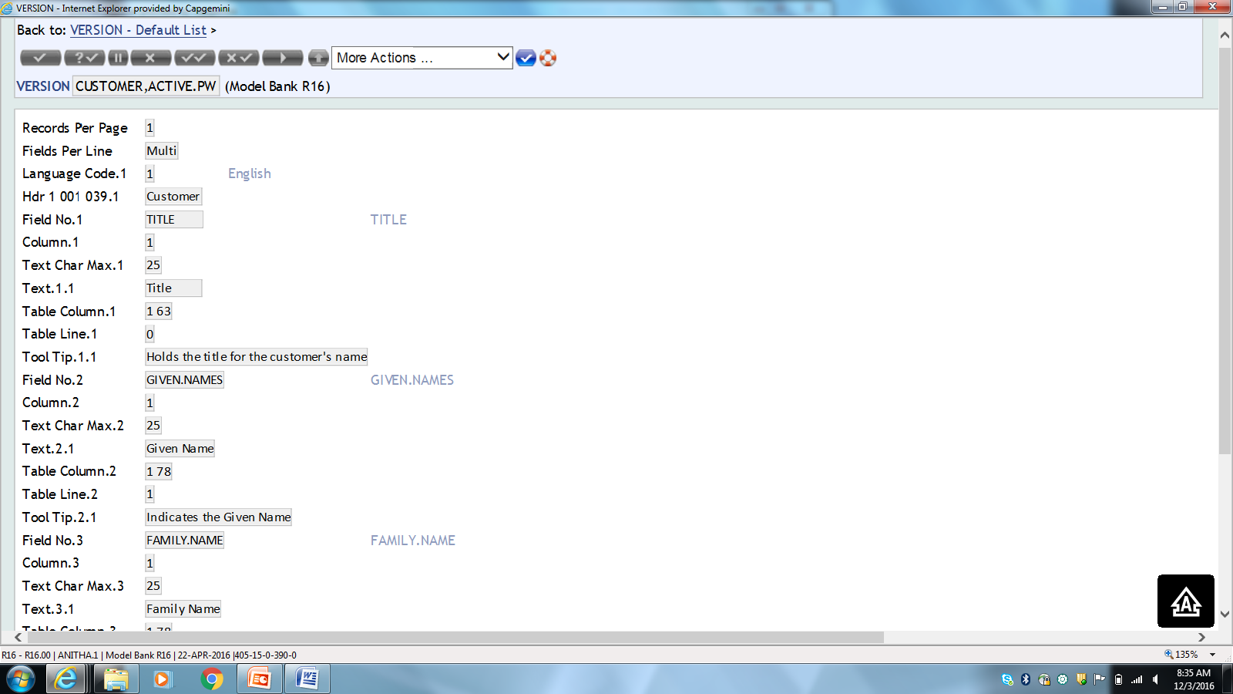
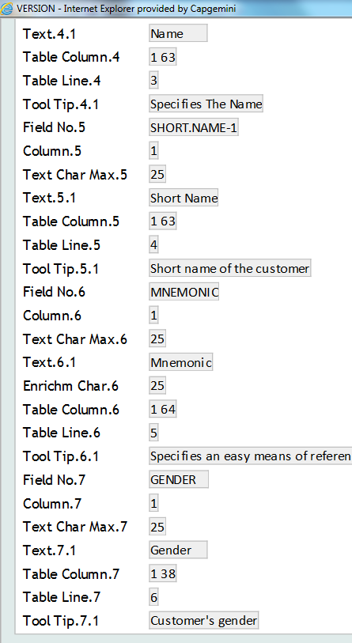
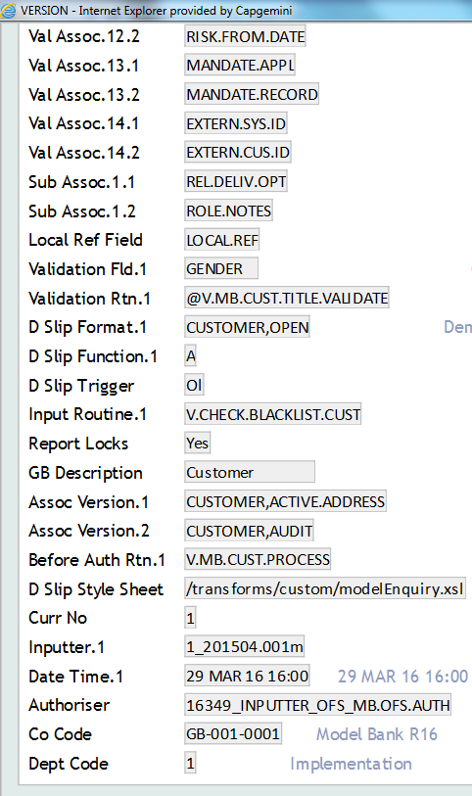
Example 1

Slide 20
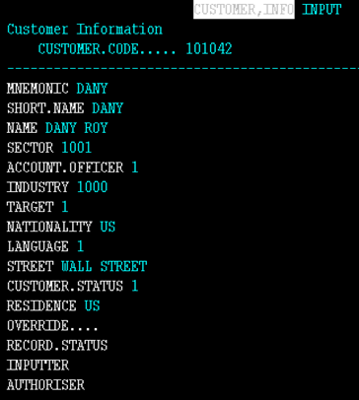
Solution
Create a Customer record using the newly created version ‘CUSTOMER,ACTIVE.PW’

Slide 21
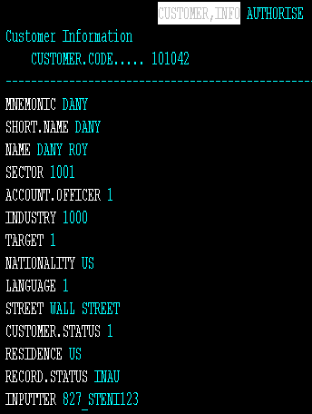
Solution
Authorize the Customer record

Slide 22
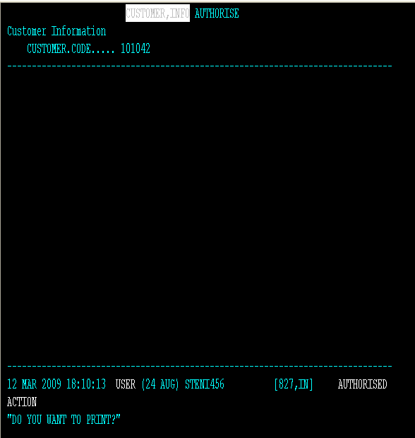
Solution
On authorization, question appears “DO YOU WANT TO PRINT?”
Input “Y”

Slide 23
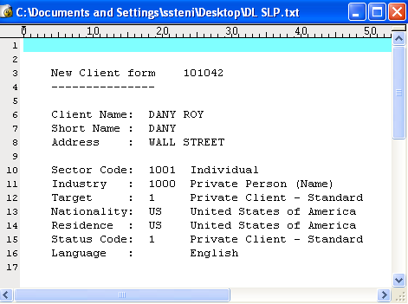
Solution
Deal slip appears as shown

Slide 24
EXERCISE 1
Create the deal slip at input stage for customer version

Slide 25
Solution
Create a version for the Customer application
Attach the valid deal slip format ID in field ‘D.SLIP.FORMAT’
Attach a valid function ‘I’ (Input) in field ‘D.SLIP.FUNCTION’ i.e. function during which deal slip has to be created
Attach ‘OL’ to field ‘D.SLIP.TRIGGER’, to generate deal slip automatically

Slide 26
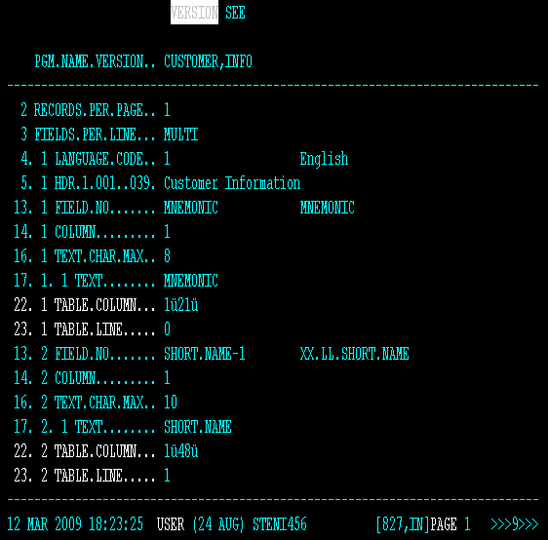
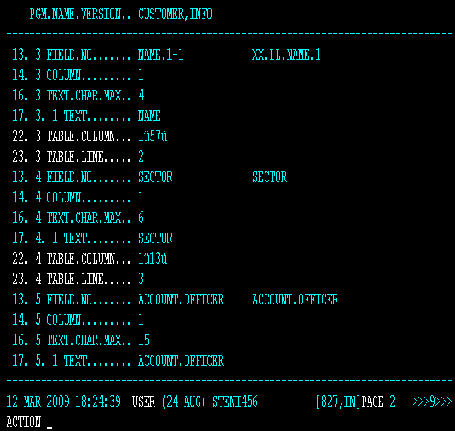
Solution 1
Step 1 – Create a version for the Customer application

Slide 27
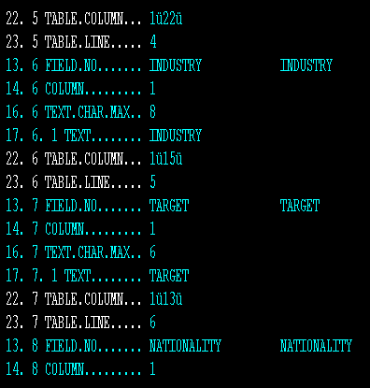
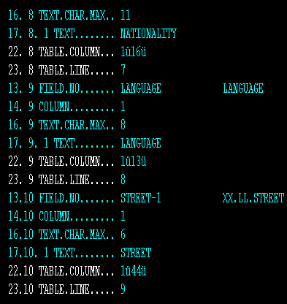
Solution 1

Slide 28
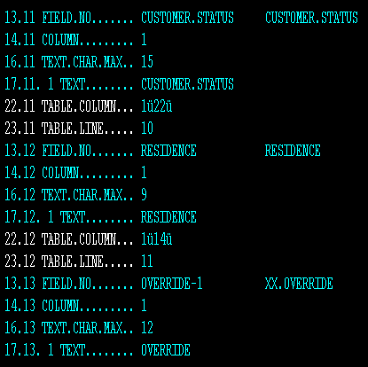
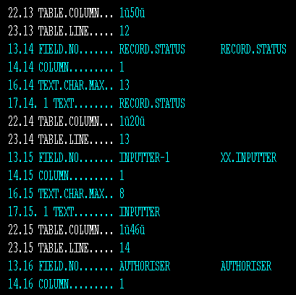
Solution 1

Slide 29
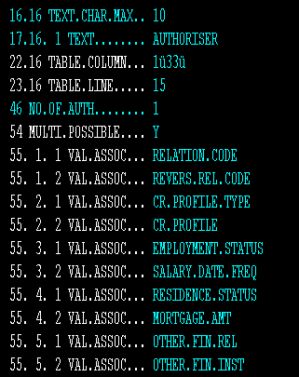
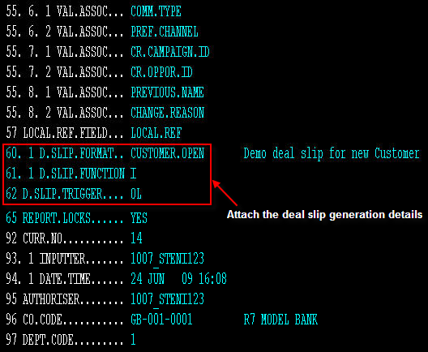
Solution 1
Step 2 -Attach the valid deal slip format ID in field ‘D.SLIP.FORMAT’

Slide 30
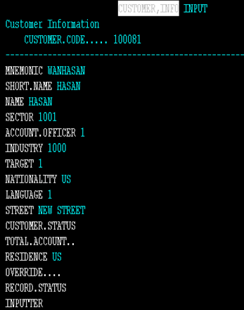
Solution 1-Customer Version
Step 3 -Input a transaction using the customer version ‘CUSTOMER,INFO’

Slide 31
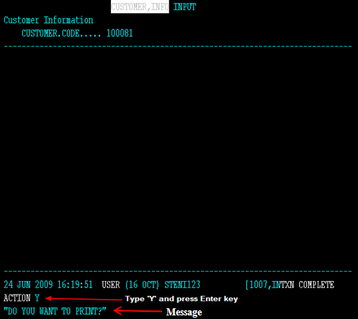
Solution 1-Customer Version
Step 4 -On committing the transaction, message appears as shown

Slide 32
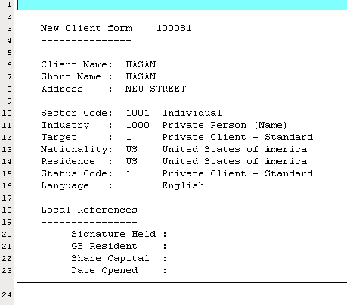
Solution 1-Deal Slip
Deal slip appears as shown

Slide 33
Case Study
Issue a DEAL SLIP to a customer, every time an account is opened for him/her. It should contains the details given below
NOTE: while printing the deal slip all the accounts (including the one created currently)should be printed separated by ;(semicolon)

Slide 34
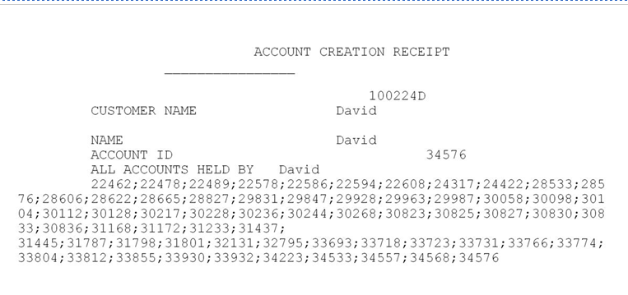
Case Study

Slide 35
Case Study - Solution
Where do we attach subroutine ?
Application : DEAL.SLIP.FORMAT
Field : FORMAT
Name of the subroutine needs to be prefixed with an @

Slide 36
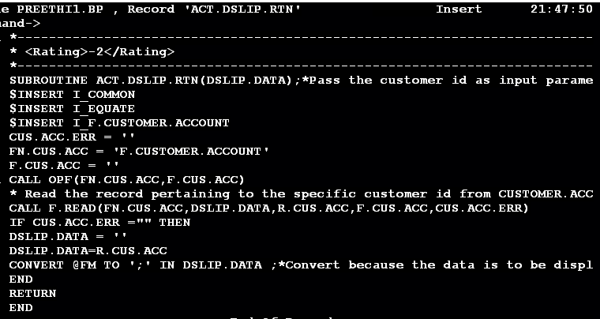
Case Study -Solution
Step 1 -Write a subroutine ,compile and catalog

Slide 37
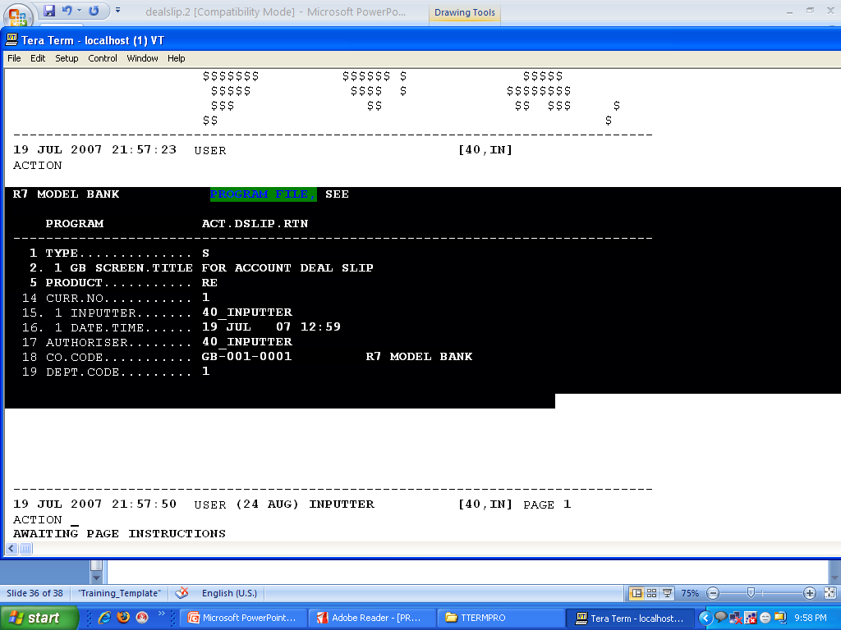
Case Study - Solution
Step 2 – Make an entry in PGM.FILE and set Type as “S”

Slide 38
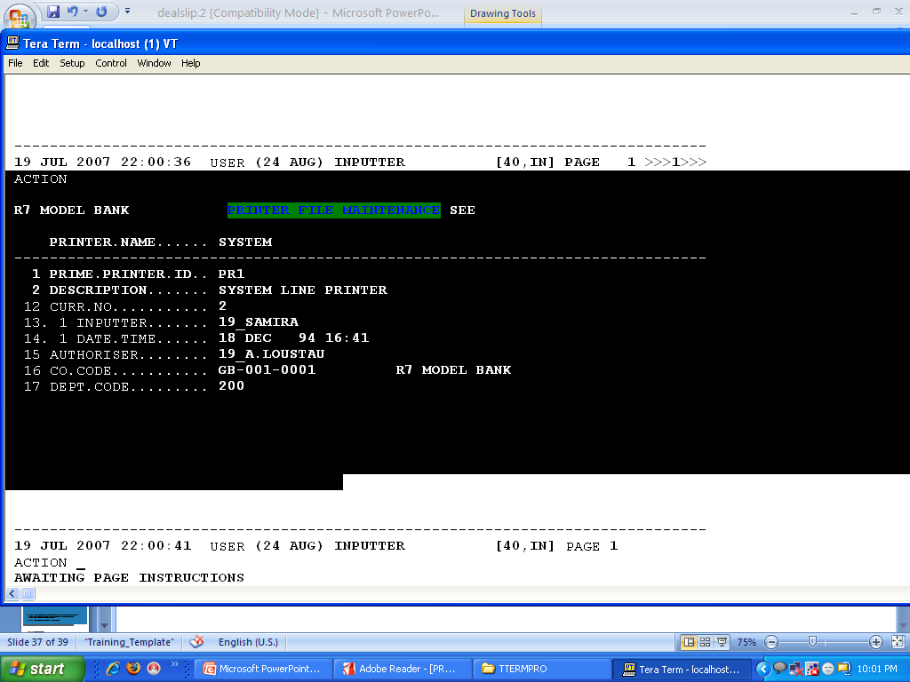
Case Study - Solution
Step 3 –Create PRINTER.ID

Slide 39
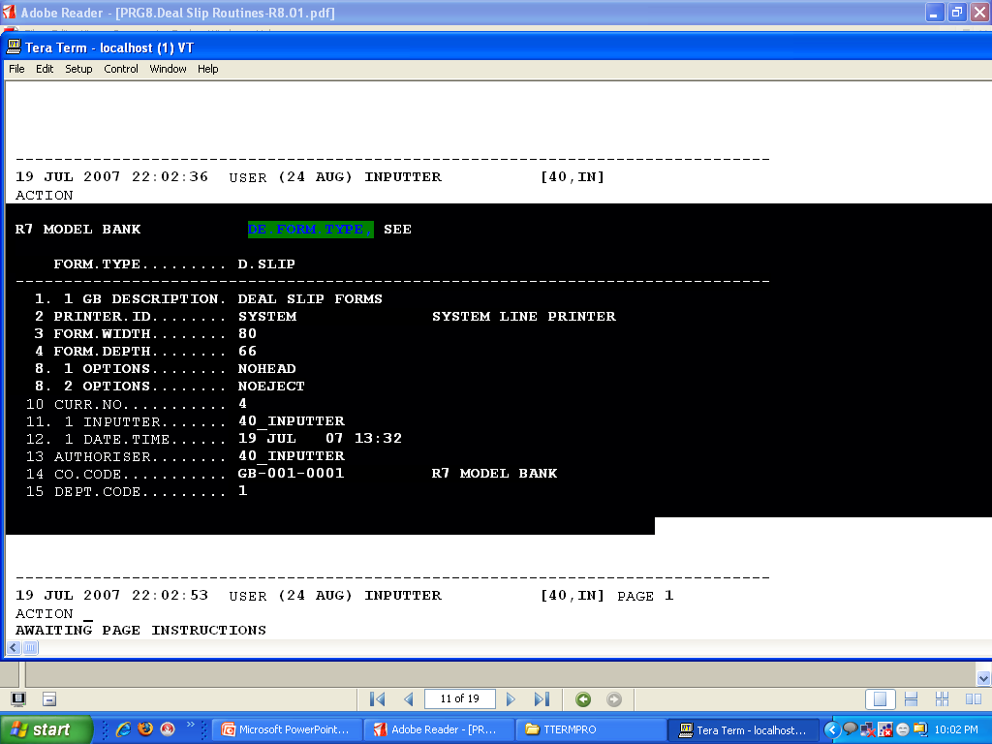
Case Study - Solution
Step 4 – Create a record in DE.FORM.TYPE

Slide 40
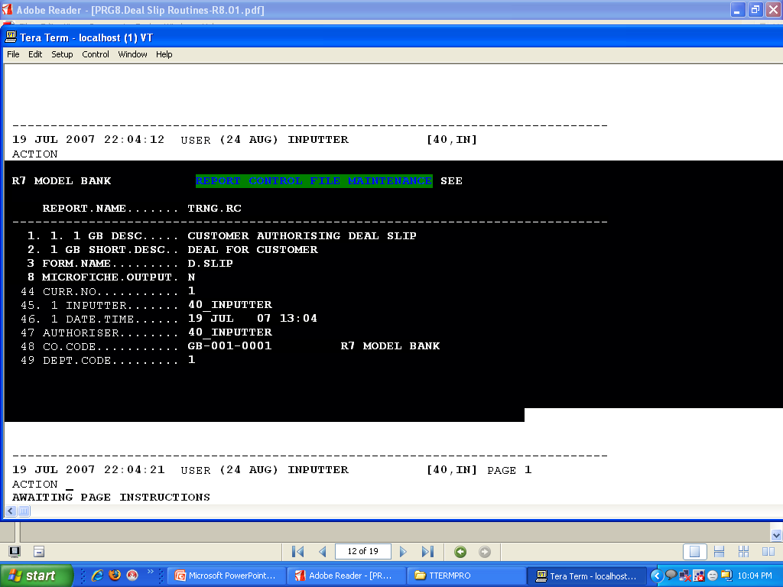
Case Study - Solution
Step 5 –Create a record in REPORT.CONTROL

Slide 41
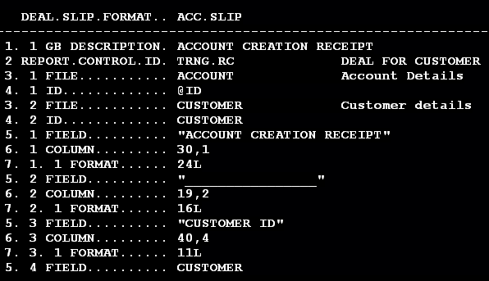
Case Study - Solution
Step 6 – Create the Deal slip using DEAL.SLIP.FORMAT

Slide 42
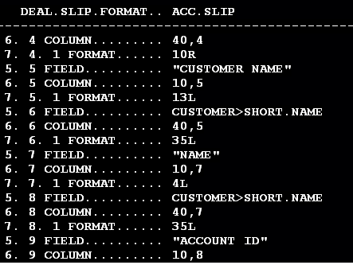
Case Study - Solution

Slide 43
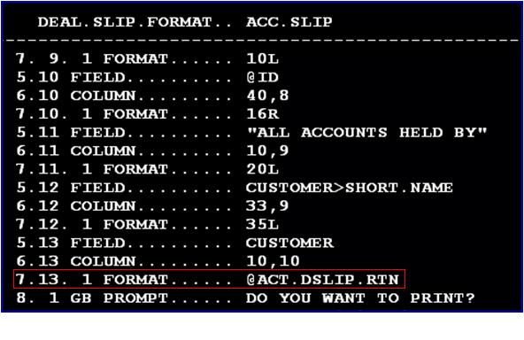
Case Study - Solution

Slide 44
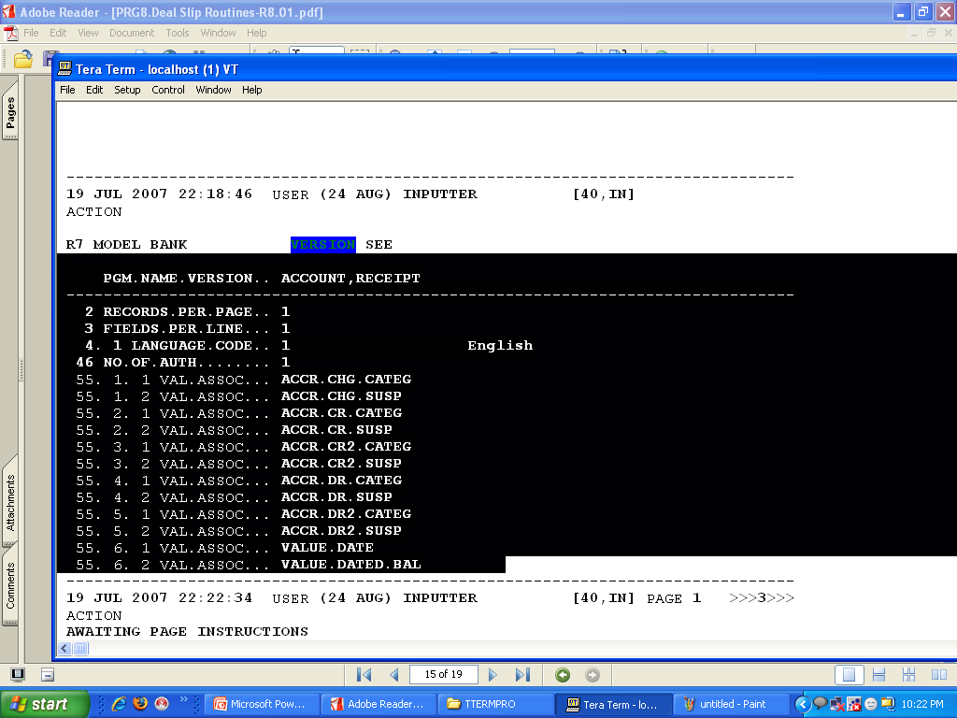
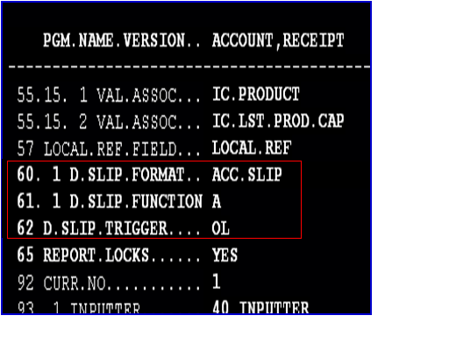
Case Study - Solution
Create the Version and attach the deal slip format in the version

Slide 45
Case Study - Solution
Step 7 – Input and authorize the account record using the version just created .
The deal slip will pop up.

Slide 46
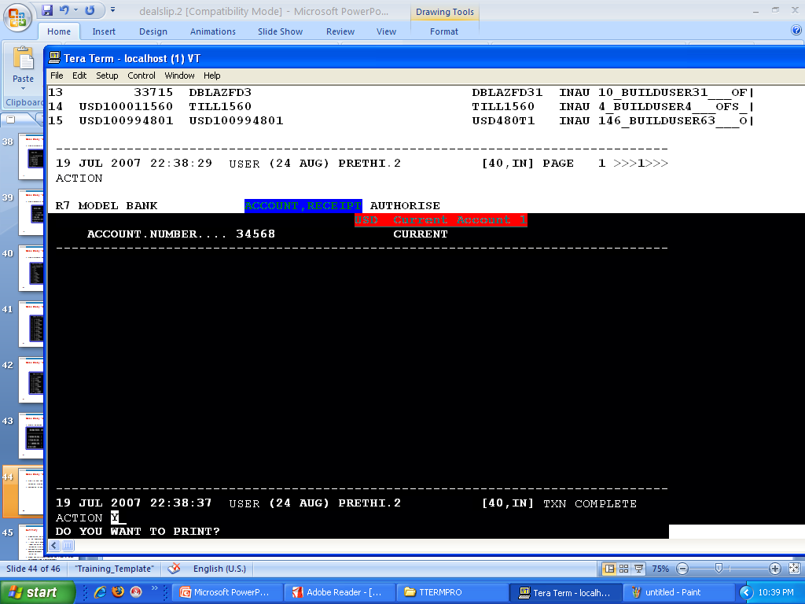
Case Study - Solution
The screen shot below is at the time account record authorization

Slide 47
Case Study - Solution
The final DEAL SLIP output

Slide 48
Summary
A deal slip can be produced using the DEAL.SLIP.FORMAT or the ENQUIRY application
It must be attached to the VERSION record and a function/ trigger can be set depending on when the user would like the deal slip to be printed
The DEAL.SLIP.FORMAT record has the REPORT.CONTROL id and thus printing is taken care via this set up
All deal slips are stored in &HOLD& and a report of the deal slip produced is held in HOLD.CONTROL
Learnt deal slip routine and executed them

Slide 49


www.capgemini.com/financialservices

