Slide 1
Menu
June 2011
Notes:
© 2006 Capgemini - All rights reserved
0

Slide 2
Session-wise topics
Session - I
Introduction to Menu
Menu Creation
Session – II
User Menu Creation

Slide 3
Objective:
At the end of this session, participants will:
Know the need and features of Menu
Be able to create Menu
Be able to attach Menu to user

Slide 4
Introduction to Menu

Slide 5
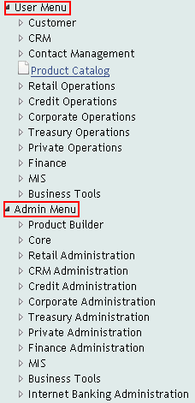
What is Menu?
List of Applications and Enquiries
In T24 Menu is sub-divided into
MB User Menu and
MB Admin Menu

Slide 6
Why Menu?
For easy navigation around T24
No need to remember applications names
Different users can use different menus
Easy grouping of tasks because of main menu and sub menus

Slide 7
Use of Menu
Allows easy navigation in T24
Users can be assigned with specific application and version
Security level is improved

Slide 8
Menu Creation

Slide 9
Creation Procedure
HELPTEXT.MENU – Enter application/version/enquiry name
HELPTEXT.MAINMENU – Enter ID of HELPTEXT.MENU

Slide 10
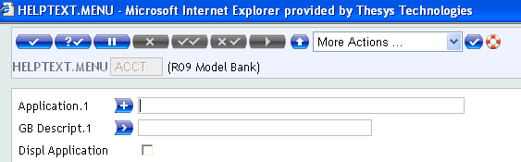
HELPTEXT.MENU
Application
Enter a valid Application name
Gb Descript
Enter a description for the Help-text Menu
Displ Application
Displays the description in the Menu

Slide 11
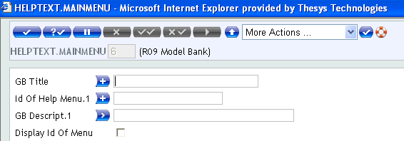
HELPTEXT.MAINMENU
Gb Title
Enter main menu title or header
Id of Help Menu
Enter ID of HELPTEXT.MENU
Display ID Of Menu
Display description entered in ‘Gb Descript’ field in main-menu

Slide 12
Example 1
Create menu for Account application

Slide 13
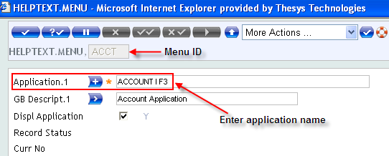
Solution 1
Create an entry in HELPTEXT.MENU application

Slide 14
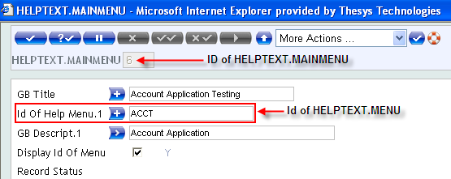
Solution 1
Create an entry in HELPTEXT.MAINMENU application

Slide 15
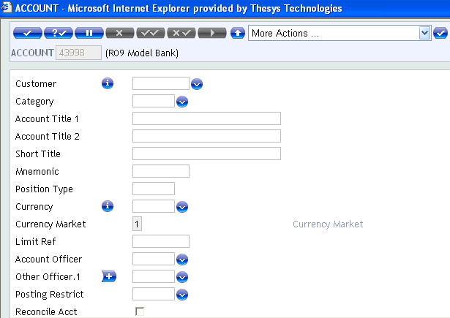
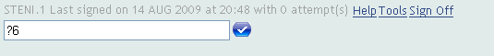
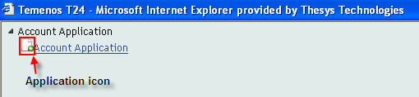
Solution 1
Enter HEPLTEXT.MAINMENU ID prefixed with ‘?’ in command line
Menu appears as shown
Click on the application icon

Slide 16
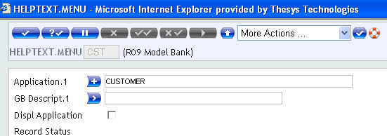
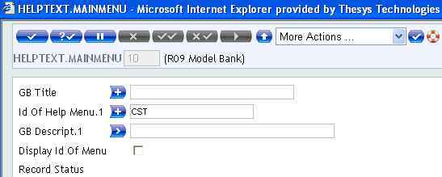
Error Handling
Blank menu screen is displayed, when Description fields of HELPTEXT MENU and MAINMENU are not updated

Slide 17
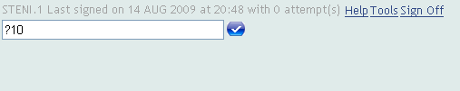
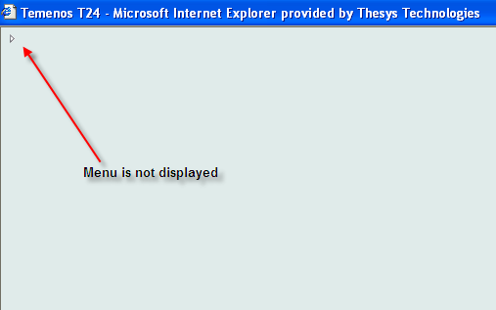
Error Handling

Slide 18
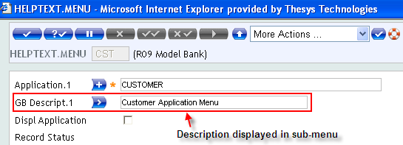
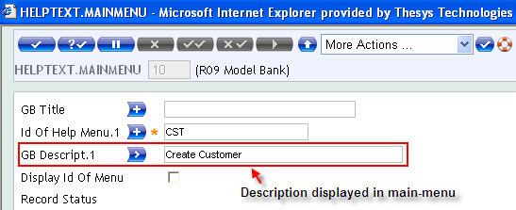
Menu Description Display
Menu is displayed, when ‘YES’ is set in either
‘Displ Application’ field of HELPTEXT MENU
(OR)
‘Display ID of Menu’ field of HELPTEXT.MAIN

Slide 19
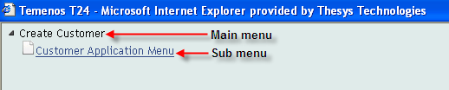
Menu Description Display
Menus are displayed with respective descriptions as ID

Slide 20
Example 2
Create sub-menu for Account application as shown below:
Account
Create Account (attach a version)
List of Account (attach an enquiry)

Slide 21
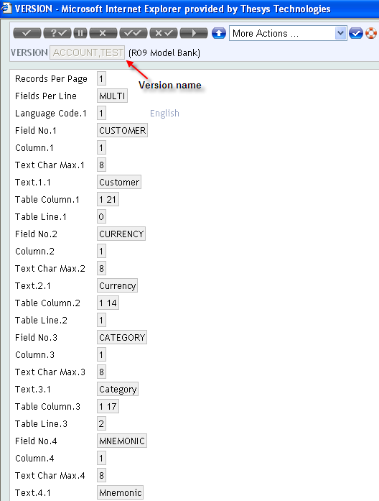
Solution 2
Create a version of the account module as shown

Slide 22
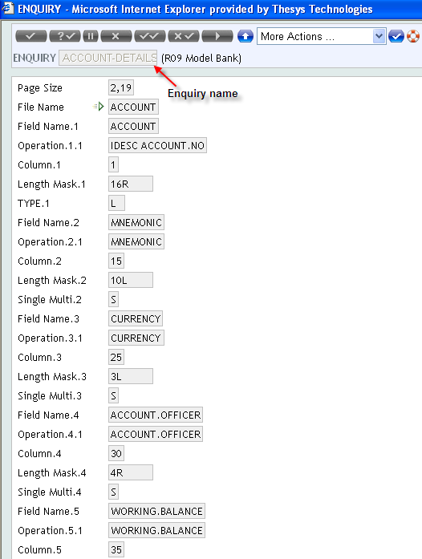
Solution 2
Create an enquiry for the account module as shown

Slide 23
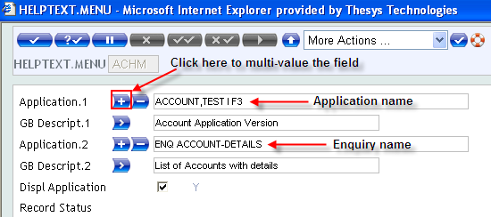
Solution 2
Attach the ID of version and enquiry to HELPTEXT.MENU
Commit and authorize the record

Slide 24
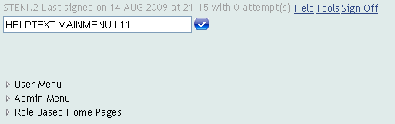
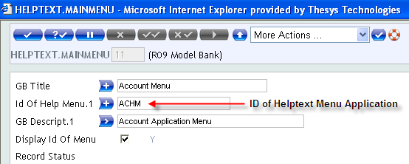
Solution 2
Attach the ID of HELPTEXT to HELPTEXT.MAINMENU

Slide 25

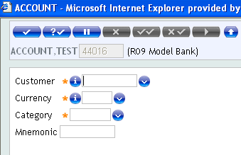
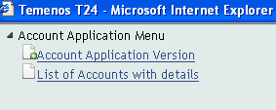
Solution 2
Enter ID of HELPTEXT.MAIN menu prefixed by ‘?’ in command line
Menu appears as shown
Click on Application icon to invoke the Account version

Slide 26
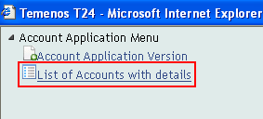
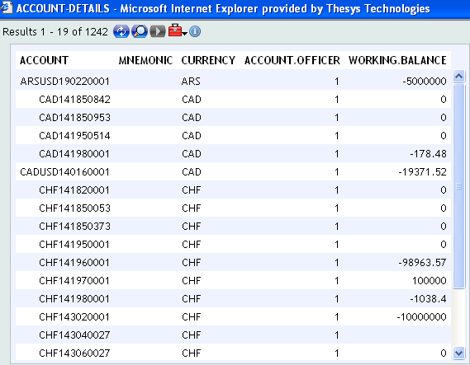
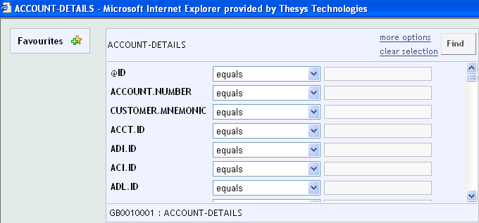
Solution 2
Click on enquiry icon to invoke the enquiry as shown

Slide 27
User Menu Creation

Slide 28
Creation Procedure
HELPTEXT.MENU – Enter application/version/enquiry name
HELPTEXT.MAINMENU – Enter ID of HELPTEXT.MENU
Attach the ID of HELPTEXT.MAINMENU in ‘Init Application’ field of User application, suffixed with ‘?’

Slide 29
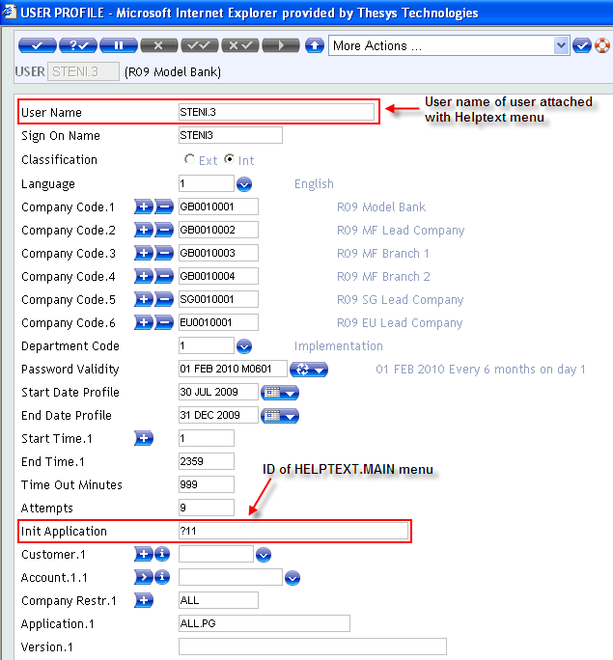
Solution 2
Attach the ID of HELPTEXT.MAINMENU to a user

Slide 30
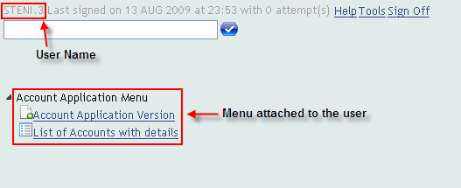
Solution 2
Open the user application, and check the Menu

Slide 31
Workshop 1
Create the following menu and attach it to a user
Funds Transfer
Account Transfer
Transfer between accounts (version of FT)
FT transaction details
List FT transactions of a particular account
List all today’s date FT transactions involving currency ‘USD’ and credit amount greater than 50000

Slide 32
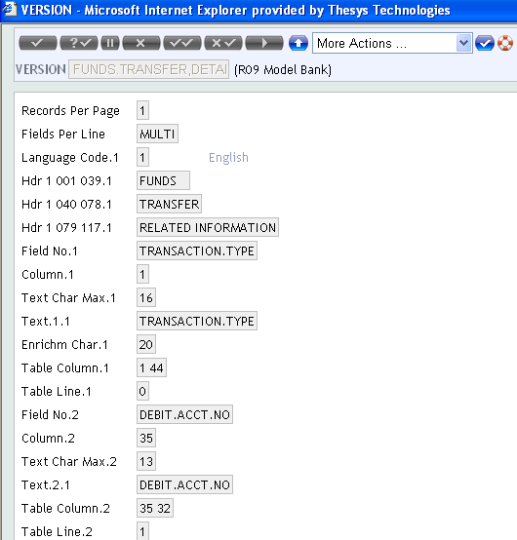
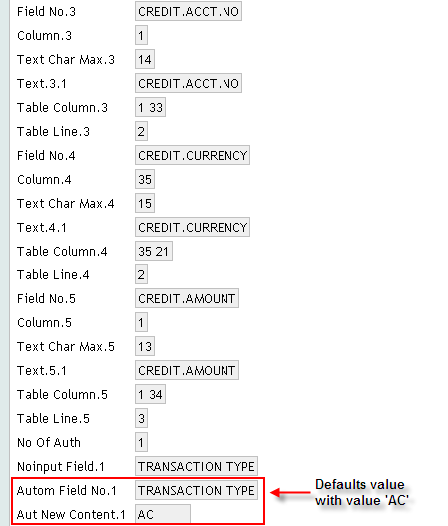
Solution 1
Create a FT version with transaction type ‘AC’ for transfer between accounts

Slide 33
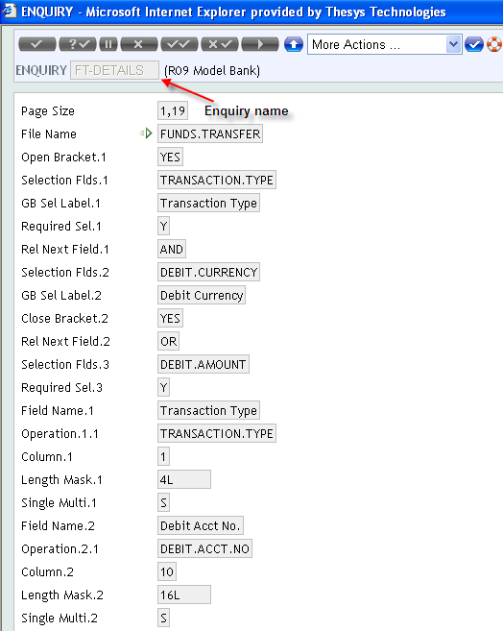
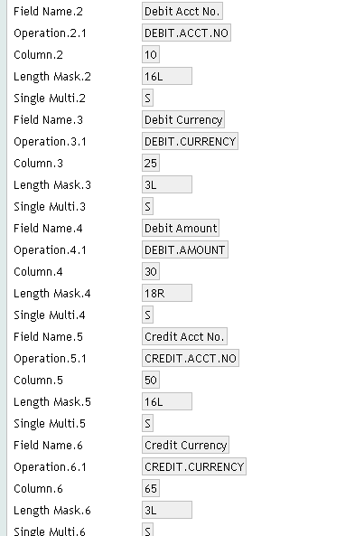
Solution 1
Create an enquiry to list all FT transactions of a particular account

Slide 34
Solution 1
Create an enquiry to list all today’s date FT transactions involving currency ‘USD’ and credit amount greater than 50000

Slide 35
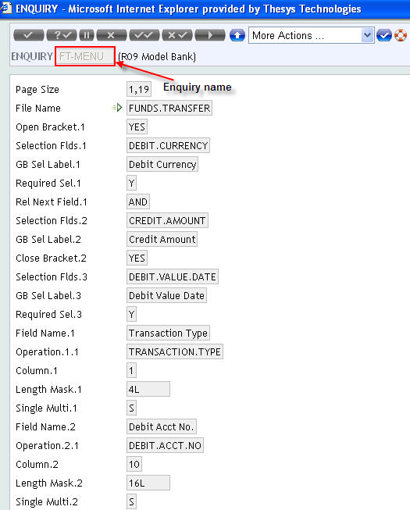
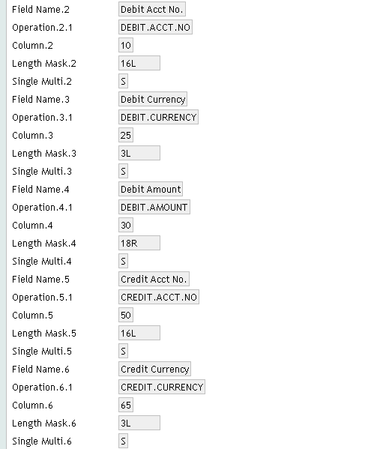
Solution 1

Slide 36
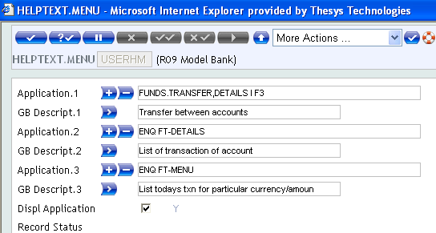
Solution 1
Attach the versions and enquiry to HELPTEXT.MENU application

Slide 37
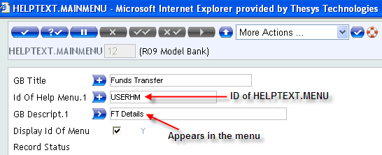
Solution 1
Attach the ID of HELPTEXT.MENU to HELPTEXT.MAINMENU application

Slide 38
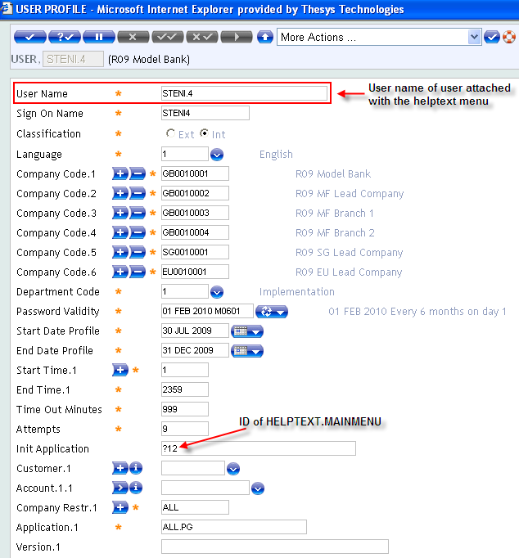
Solution 1
Attach the ID of HELPTEXT.MAINMENU to user

Slide 39
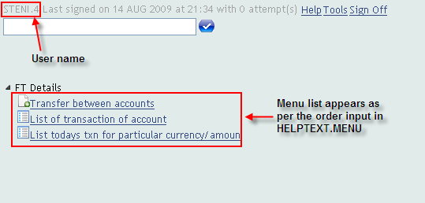
Solution 1
Menu appears as shown

Slide 40
Summary
Main-menu can be created using HELPTEXT.MAIN application
Sub-menu can be created using HELPTEXT.MAIN application
Specific users can be restricted to specific menu -> using ‘Init Application’ field of User application

Slide 41


www.capgemini.com/financialservices

