Slide 1
OFS – Open Financial Services

Slide 2
SUMMARY
OFS Architecture and Functionality
OFS message Structure
Interface Types, Request Types
Applications involved
Setting up interface definition and processing message

Slide 3
What is OFS?
Module in T24
Only standard gateway to T24
  Every single interaction with T24 is driven through OFS.
Works based on a request – response based system
  Enables III party systems to post requests and obtain responses
Slide <number>
Notes:
OFS1.Common OFS Messages-R11.01

Slide 4


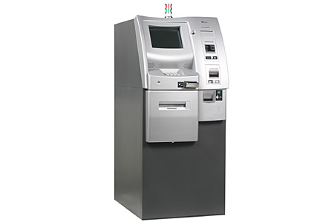

What is the need for OFS?
Data ware house
T24
Swift interface
OFS
ATM
T24 Browser
Slide <number>
Notes:
1-<number>
OFS1.Common OFS Messages-R11.01

Slide 5
Message Syntax
Transaction Request
Enquiry Request
Slide <number>
Notes:
OFS1.Common OFS Messages-R11.01

Slide 6
OFS Message Formats
Native OFS format
XML format
Slide <number>
Notes:
OFS1.Common OFS Messages-R11.01

Slide 7
Transaction Request - Sample
ACCOUNT,/I/PROCESS, INPUTT/123456,34567,CUSTOMER=100724,CATEGORY=1001,CURRENCY=USD
Request specifies application, function, fields and values
Should contain values for all mandatory fields.
OFS transaction requests cannot be used to update live files (similar to user input).
Simple comma delimited format
  Some message parts further subdivided using slashes
Slide <number>
Notes:
OFS1.Common OFS Messages-R11.01

Slide 8
Syntax diagram explained
ENQUIRY.SELECT
,
,
User Information
,
Enquiry Name
,
Message Data
Message portion
Message delimters
Repetition
Slide <number>
Notes:
OFS1.Common OFS Messages-R11.01

Slide 9
Transaction Request - Message Syntax
Operation
Operation
Operation
Operation
Operation
Options
Options
Options
Options
Options
,
,
,
,
,
User Information
User Information
User Information
User Information
User Information
,
,
,
,
,
Transaction ID
Transaction ID
Transaction ID
Transaction ID
Transaction ID
,
,
,
,
,
Message Data
Message Data
Message Data
Message Data
,
Message Data
,
,
,
,
Operation
  Contains the name of APPLICATION.
  Example: ACCOUNT.
Options
  Comprises of VERSION-NAME/FUNCTION/PROCESS TYPE
  User Information
  Comprises of SignOnName/Password/Company code
  E.g INPUTT/123456/GB0010001
Slide <number>
Notes:
OFS1.Common OFS Messages-R11.01

Slide 10
Transaction Request - Message Syntax cont…
Operation
Operation
Operation
Options
Options
Options
,
,
,
User Information
User Information
User Information
,
,
,
Transaction ID
Transaction ID
Transaction ID
,
,
,
Message Data
Message Data
,
Message Data
,
,
Transaction ID
  Contains transaction id of the record used in the transaction.
  Eg: 20548
  Mandatory for See , Authorize , Delete & functions.
  May also contain an optional message id.
    Eg: 20548/20081010001
Message Data
  Contains the data required to create or update the transaction.
  Eg: CUSTOMER=100297,CATEGORY=1001,CURRENCY=USD
Slide <number>
Notes:
OFS1.Common OFS Messages-R11.01

Slide 11
Transaction Request - Examples
Request to Input
ACCOUNT,/I/PROCESS, INPUTT/123456,34567,CUSTOMER=100724,CATEGORY=1001,CURRENCY=USD
Request to Authorise
ACCOUNT,/A,INPUTT/123456,34567
Slide <number>
Notes:
ype.
OFS1.Common OFS Messages-R11.01

Slide 12
Workshop 1.1
Write a OFS message to input a SECTOR record with id 1200
Write a OFS message to authorise this SECTOR.
Write a OFS message to input a new ABBREVIATION called UL for listing the USER records.
Write a OFS message to input a CUSTOMER record in T24. Use zero authorisers in your message
Slide <number>
Notes:
OFS1.Common OFS Messages-R11.01

Slide 13
ENQUIRY REQUEST
Slide <number>
Notes:
OFS1.Common OFS Messages-R11.01

Slide 14
Enquiry request – Message Syntax
ENQUIRY.SELECT
,
,
User Information
,
Enquiry Name
,
Message Data
Slide <number>
Notes:
OFS1.Common OFS Messages-R11.01

Slide 15
Enquiry request – Message Syntax cont…
ENQUIRY.SELECT
ENQUIRY.SELECT
ENQUIRY.SELECT
ENQUIRY.SELECT
User Information
User Information
User Information
User Information
Enquiry Name
Enquiry Name
Enquiry Name
Enquiry Name
Message Data
Message Data
Message Data
,
Message Data
,
,
,
,
,
,
,
,
,
,
,
,
,
,
,
ENQUIRY.SELECT
  Must always be ENQUIRY.SELECT.
  Name of the application that is used to run queries and return the data.
USER INFORMATION
  Same as that in the transaction type request.
ENQUIRY.NAME
  Name of the T24 Enquiry that will be run.
  Must be a valid TEMENOS T24 enquiry (i.e. must be found in the ENQUIRY application of TEMENOS T24).
Slide <number>
Notes:
OFS1.Common OFS Messages-R11.01

Slide 16
Enquiry request – Message Syntax cont…
ENQUIRY.SELECT
,
,
User Information
,
Enquiry Name
,
Message Data
MESSAGE DATA
  The message data portion of the enquiry message structure contains the selection criteria passed to the enquiry.
  The message data portion of the message can be repeated for each selection criteria separated by a comma (,).
  This is optional depending on the Enquiry
Slide <number>
Notes:
OFS1.Common OFS Messages-R11.01

Slide 17
Enquiry Request - Examples
Without criteria i.e. message data portion
ENQUIRY.SELECT,,INPUTT/654321,%ACCOUNT
With criteria
ENQUIRY.SELECT,,INPUTT/654321,%ACCOUNT, ACCOUNT.NUMBER:EQ=11109
Slide <number>
Notes:
OFS1.Common OFS Messages-R11.01

Slide 18
Workshop 1.2 – Enquiry Type Messages
Write an Enquiry type request to find the list of INDUSTRY records found in yourT24 area
Write an Enquiry type request to find the current day’s balance summary of an ACCOUNT (say for example 29987). (TIP: Use the enquiry ACCT.BAL.TODAY)
Slide <number>
Notes:
OFS1.Common OFS Messages-R11.01

Slide 19

Open Financial Service
Who sends messages to OFS?
Data ware house
T24
Swift interface
OFS
ATM
T24 Browser
  Third party systems
  T24 Applications
  Browser
Notes:
OFS2.OFS Modes(BASICS)-R11.01

Slide 20
What are the ways (and Modes )in which we use OFS ?
Batch processing
  BATCH mode – for offline requests from third party systems
Inter application processing
  GLOBUS mode – for calling applications from local code
Online processing
  TELNET mode – for processing messages online from third party systems
  SESSION mode – for processing messages online from browser
Notes:
OFS2.OFS Modes(BASICS)-R11.01

Slide 21


What do we do with Batch Mode – Offline processing
Post request(s)
III Party System
IN
Queue
FT
LD
OFS
MM
OUT
Queue
AC
T24 Server
Notes:
OFS2.OFS Modes(BASICS)-R11.01

Slide 22
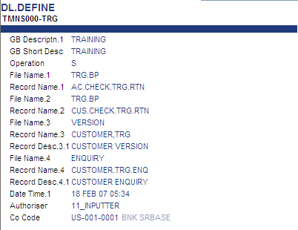
What do we do with Globus Mode – Inter Application calls
T24 Server
T24 Application 1
T24 Application 2
F.OFS.MESSAGE.QUEUE
File In T24
OFS
Notes:
OFS2.OFS Modes(BASICS)-R11.01

Slide 23
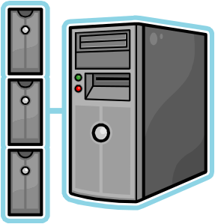
What did we do with Telnet Mode – direct connection to OFS(Obsolete)
Telnet into the T24 server
III Party System
Notes:
OFS2.OFS Modes(BASICS)-R11.01

Slide 24
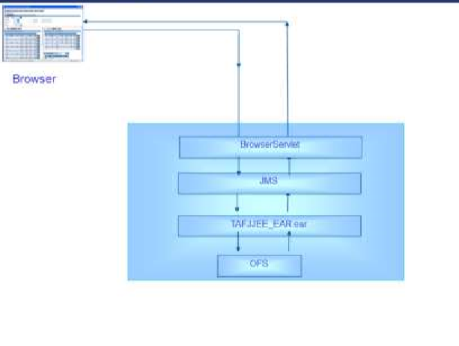
What do we do with Session Mode – browser connection
Notes:
OFS2.OFS Modes(BASICS)-R11.01

Slide 25
OFS.SOURCE
OFS.SOURCE contains the parameters for setting up a OFS connection into T24.
Usually different OFS source records are used for each connection
Slide <number>
Notes:
OFS3.OFS Batch mode-R11.01

Slide 26
OFS.SOURCE
Key Fields To Understand Now
Id
Source Type
Syntax Type
Slide <number>
Notes:
OFS3.OFS Batch mode-R11.01

Slide 27
Workshop 3.1
Test the following OFS messages you wrote in workshop 1.1
Write a OFS message to input a SECTOR record with id 1200
Write a OFS message to input a new ABBREVIATION called UL for listing the USER records.
Write a OFS message to input a CUSTOMER record in T24. Use zero authorisers in your message
Slide <number>
Notes:
OFS3.OFS Batch mode-R11.01

Slide 28
Workshop 3.2 – Enquiry Type Messages
Create a Enquiry type request to find the list of INDUSTRY records found inT24 environment.
Create an Enquiry type request to find the current day’s balance summary of an ACCOUNT (say for example 29987). (TIP: Use the enquiry ACCT.BAL.TODAY)
Slide <number>
Notes:
OFS3.OFS Batch mode-R11.01

Slide 29
Authorize the transaction
How do you authorise?
To authorise the transaction, use the following message syntax.
Did the record get authorised ? No? Why not?
ACCOUNT,/A/PROCESS,AUTHOR/654321,39087
Slide <number>
Notes:
OFS3.OFS Batch mode-R11.01

Slide 30
Authorise …
39087//1,CUSTOMER=100724:1:1,CATEGORY=1001:1:1,ACCOUNT.TITLE.1=AAA SHIPPING COMPANY OF PANAMA:1:1,SHORT.TITLE=AAA SHIPPING COMPANY OF PANAMA:1:1,POSITION.TYPE=TR:1:1,CURRENCY=USD:1:1,CURRENCY.MARKET=1:1:1,ACCOUNT.OFFICER=27:1:1,CONDITION.GROUP=2:1:1,PASSBOOK=NO:1:1,OPEN.CATEGORY=1001:1:1,CHARGE.CCY=USD:1:1,CHARGE.MKT=1:1:1,INTEREST.CCY=USD:1:1,INTEREST.MKT=1:1:1,ALT.ACCT.TYPE=LEGACY:1:1,ALLOW.NETTING=NO:1:1,SINGLE.LIMIT=Y:1:1,RECORD.STATUS=INAU:1:1,CURR.NO=1:1:1,INPUTTER=2_OFSUSER1___OFS_TEST.BATCH:1:1,DATE.TIME=0811012041:1:1,CO.CODE=GB0010001:1:1,DEPT.CODE=1:1:1
In the OFS response , what is the user id shown in the INPUTTER field?
Slide <number>
Notes:
OFS3.OFS Batch mode-R11.01

Slide 31
Workshop 3.3
Write a OFS message to authorise the SECTOR record with id 1200
Write a OFS message to authorise the new ABBREVIATION called UL
Slide <number>
Notes:
OFS3.OFS Batch mode-R11.01

Slide 32
Transaction Response - Sample
You can see a (familiar?) OFS response message below
39087//1,CUSTOMER=100724:1:1,CATEGORY=1001:1:1,ACCOUNT.TITLE.1=AAA SHIPPING COMPANY OF PANAMA:1:1,SHORT.TITLE=AAA SHIPPING COMPANY OF PANAMA:1:1,POSITION.TYPE=TR:1:1,CURRENCY=USD:1:1,CURRENCY.MARKET=1:1:1,ACCOUNT.OFFICER=27:1:1,CONDITION.GROUP=2:1:1,PASSBOOK=NO:1:1,OPEN.CATEGORY=1001:1:1,CHARGE.CCY=USD:1:1,CHARGE.MKT=1:1:1,INTEREST.CCY=USD:1:1,INTEREST.MKT=1:1:1,ALT.ACCT.TYPE=LEGACY:1:1,ALLOW.NETTING=NO:1:1,SINGLE.LIMIT=Y:1:1,RECORD.STATUS=INAU:1:1,CURR.NO=1:1:1,INPUTTER=2_OFSUSER1___OFS_TEST.BATCH:1:1,DATE.TIME=0811012041:1:1,CO.CODE=GB0010001:1:1,DEPT.CODE=1:1:1
Slide <number>
Notes:
OFS4.OFS Response-R11.01

Slide 33
OFS Message Syntax – Transaction Response Format
Transaction ID
/
Message ID
/
Success / Fail Indicator
,
Returned Message Data
39087//1,CUSTOMER=100724:1:1,CATEGORY=1001:1:1,ACCOUNT.TITLE.1=AAA SHIPPING COMPANY OF PANAMA:1:1,SHORT.TITLE=AAA SHIPPING COMPANY OF PANAMA:1:1,POSITION.TYPE=TR:1:1,CURRENCY=USD:1:1,CURRENCY.MARKET=1:1:1,ACCOUNT.OFFICER=27:1:1,CONDITION.GROUP=2:1:1,PASSBOOK=NO:1:1,OPEN.CATEGORY=1001:1:1,CHARGE.CCY=USD:1:1,CHARGE.MKT=1:1:1,INTEREST.CCY=USD:1:1,INTEREST.MKT=1:1:1,ALT.ACCT.TYPE=LEGACY:1:1,ALLOW.NETTING=NO:1:1,SINGLE.LIMIT=Y:1:1,RECORD.STATUS=INAU:1:1,CURR.NO=1:1:1,INPUTTER=2_OFSUSER1___OFS_TEST.BATCH:1:1,DATE.TIME=0811012041:1:1,CO.CODE=GB0010001:1:1,DEPT.CODE=1:1:1
39087//1,CUSTOMER=100724:1:1,CATEGORY=1001:1:1,ACCOUNT.TITLE.1=AAA SHIPPING COMPANY OF PANAMA:1:1,SHORT.TITLE=AAA SHIPPING COMPANY OF PANAMA:1:1,POSITION.TYPE=TR:1:1,CURRENCY=USD:1:1,CURRENCY.MARKET=1:1:1,ACCOUNT.OFFICER=27:1:1,CONDITION.GROUP=2:1:1,PASSBOOK=NO:1:1,OPEN.CATEGORY=1001:1:1,CHARGE.CCY=USD:1:1,CHARGE.MKT=1:1:1,INTEREST.CCY=USD:1:1,INTEREST.MKT=1:1:1,ALT.ACCT.TYPE=LEGACY:1:1,ALLOW.NETTING=NO:1:1,SINGLE.LIMIT=Y:1:1,RECORD.STATUS=INAU:1:1,CURR.NO=1:1:1,INPUTTER=2_OFSUSER1___OFS_TEST.BATCH:1:1,DATE.TIME=0811012041:1:1,CO.CODE=GB0010001:1:1,DEPT.CODE=1:1:1
39087//1,CUSTOMER=100724:1:1,CATEGORY=1001:1:1,ACCOUNT.TITLE.1=AAA SHIPPING COMPANY OF PANAMA:1:1,SHORT.TITLE=AAA SHIPPING COMPANY OF PANAMA:1:1,POSITION.TYPE=TR:1:1,CURRENCY=USD:1:1,CURRENCY.MARKET=1:1:1,ACCOUNT.OFFICER=27:1:1,CONDITION.GROUP=2:1:1,PASSBOOK=NO:1:1,OPEN.CATEGORY=1001:1:1,CHARGE.CCY=USD:1:1,CHARGE.MKT=1:1:1,INTEREST.CCY=USD:1:1,INTEREST.MKT=1:1:1,ALT.ACCT.TYPE=LEGACY:1:1,ALLOW.NETTING=NO:1:1,SINGLE.LIMIT=Y:1:1,RECORD.STATUS=INAU:1:1,CURR.NO=1:1:1,INPUTTER=2_OFSUSER1___OFS_TEST.BATCH:1:1,DATE.TIME=0811012041:1:1,CO.CODE=GB0010001:1:1,DEPT.CODE=1:1:1
39087//1,CUSTOMER=100724:1:1,CATEGORY=1001:1:1,ACCOUNT.TITLE.1=AAA SHIPPING COMPANY OF PANAMA:1:1,SHORT.TITLE=AAA SHIPPING COMPANY OF PANAMA:1:1,POSITION.TYPE=TR:1:1,CURRENCY=USD:1:1,CURRENCY.MARKET=1:1:1,ACCOUNT.OFFICER=27:1:1,CONDITION.GROUP=2:1:1,PASSBOOK=NO:1:1,OPEN.CATEGORY=1001:1:1,CHARGE.CCY=USD:1:1,CHARGE.MKT=1:1:1,INTEREST.CCY=USD:1:1,INTEREST.MKT=1:1:1,ALT.ACCT.TYPE=LEGACY:1:1,ALLOW.NETTING=NO:1:1,SINGLE.LIMIT=Y:1:1,RECORD.STATUS=INAU:1:1,CURR.NO=1:1:1,INPUTTER=2_OFSUSER1___OFS_TEST.BATCH:1:1,DATE.TIME=0811012041:1:1,CO.CODE=GB0010001:1:1,DEPT.CODE=1:1:1
39087//1,CUSTOMER=100724:1:1,CATEGORY=1001:1:1,ACCOUNT.TITLE.1=AAA SHIPPING COMPANY OF PANAMA:1:1,SHORT.TITLE=AAA SHIPPING COMPANY OF PANAMA:1:1,POSITION.TYPE=TR:1:1,CURRENCY=USD:1:1,CURRENCY.MARKET=1:1:1,ACCOUNT.OFFICER=27:1:1,CONDITION.GROUP=2:1:1,PASSBOOK=NO:1:1,OPEN.CATEGORY=1001:1:1,CHARGE.CCY=USD:1:1,CHARGE.MKT=1:1:1,INTEREST.CCY=USD:1:1,INTEREST.MKT=1:1:1,ALT.ACCT.TYPE=LEGACY:1:1,ALLOW.NETTING=NO:1:1,SINGLE.LIMIT=Y:1:1,RECORD.STATUS=INAU:1:1,CURR.NO=1:1:1,INPUTTER=2_OFSUSER1___OFS_TEST.BATCH:1:1,DATE.TIME=0811012041:1:1,CO.CODE=GB0010001:1:1,DEPT.CODE=1:1:1`
Slide <number>
Notes:
OFS4.OFS Response-R11.01

Slide 34
Transaction response (continued… )
Success / Fail Indicator
Success / Fail Indicator
Transaction ID
Success / Fail Indicator
Transaction ID
Transaction ID
Message ID
Message ID
Message ID
Returned Message Data
Returned Message Data
/
Returned Message Data
/
/
,
,
/
,
/
/
TRANSACTION ID
  The transaction ID contains either the value supplied for the transaction in the request or the value that is automatically generated by the TEMENOS T24 application (when no value is supplied in the request).
MESSAGE ID
  The Message ID contains the value of Message ID if supplied in the request.
Slide <number>
Notes:
OFS4.OFS Response-R11.01

Slide 35
Transaction response (continued… )
Success / Failure Indicator
Transaction ID
Success / Failure Indicator
Transaction ID
Message ID
Message ID
Returned Message Data
/
Returned Message Data
/
,
/
,
/
SUCCESS / FAIL INDICATOR
  Indicates the status of the transaction request processed. OFS returns one of the following values:
    1 Successful transaction.
    -1 Errors encountered during processing.
    -2 Override condition (s) encountered during processing.
    -3 T24 server is offline
Slide <number>
Notes:
OFS4.OFS Response-R11.01

Slide 36
Transaction response (continued… )
Success / Failure Indicator
Transaction ID
Success / Failure Indicator
Transaction ID
Message ID
Message ID
Returned Message Data
/
Returned Message Data
/
,
/
,
/
RETURNED MESSAGE DATA
  A successfully processed message will contain all the fields populated in the transaction. Field and value pairs are separated by commas.
  The format is the same as that of the request message data.
  However for a unsuccessful transaction, the returned message data has a slightly different format.
Slide <number>
Notes:
OFS4.OFS Response-R11.01

Slide 37
Transaction response – Returned Message Data
Response when MV and SV are supplied in the request:
Field Name
:
Muliti
Value Number
:
Sub value number
=
Field content
When MV and SV are not provided in the request, the values are defaulted to
1 and appears in the GTS format as below
It is recommended that MV and SV are supplied in the request
Field Name –The field name is as in the STANDARD.SELECTION record of the application.
Multi value number –the multi value field number is returned.
Sub value number –the sub value field number is returned.
Field content – the contents of the field
Field Name
=
Field content
:
Multi value number
:
Sub value number
Slide <number>
Notes:
OFS4.OFS Response-R11.01

Slide 38
Transaction response – example 1
FUNDS.TRANSFER,,ARCUSER01/654321,,TRANSACTION.TYPE=AC,DEBIT.ACCT.NO=19038,DEBIT.CURRENCY=EUR,DEBIT.AMOUNT=1000,CREDIT.ACCT.NO=19089,DEBIT.VALUE.DATE=20080109
FT080090DL32//1,TRANSACTION.TYPE=AC:1:1,DEBIT.ACCT.NO=19038:1:1,CURRENCY.MKT.DR=1:1:1,DEBIT.CURRENCY=EUR:1:1,DEBIT.AMOUNT=1000.00:1:1,DEBIT.VALUE.DATE=20080109:1:1,CREDIT.ACCT.NO=19089:1:1,CURRENCY.MKT.CR=1:1:1,CREDIT.CURRENCY=EUR:1:1,CREDIT.VALUE.DATE=20080109:1:1,PROCESSING.DATE=20080109:1:1,CHARGE.COM.DISPLAY=NO:1:1,COMMISSION.CODE=DEBIT PLUS CHARGES:1:1,CHARGE.CODE=DEBIT PLUS CHARGES:1:1,PROFIT.CENTRE.CUST=100288:1:1,RETURN.TO.DEPT=NO:1:1,FED.FUNDS=NO:1:1,POSITION.TYPE=TR:1:1,AMOUNT.DEBITED=EUR1000.00:1:1,AMOUNT.CREDITED=EUR1000.00:1:1,CREDIT.COMP.CODE=GB0010001:1:1,DEBIT.COMP.CODE=GB0010001:1:1,LOC.AMT.DEBITED=1420.00:1:1,LOC.AMT.CREDITED=1420.00:1:1,CUST.GROUP.LEVEL=99:1:1,DEBIT.CUSTOMER=100288:1:1,CREDIT.CUSTOMER=100381:1:1,DR.ADVICE.REQD.Y.N=Y:1:1,CR.ADVICE.REQD.Y.N=Y:1:1,CHARGED.CUSTOMER=100381:1:1,TOT.REC.COMM=0:1:1,TOT.REC.COMM.LCL=0:1:1,TOT.REC.CHG=0:1:1,TOT.REC.CHG.LCL=0:1:1,RATE.FIXING=NO:1:1,TOT.REC.CHG.CRCCY=0:1:1,TOT.SND.CHG.CRCCY=0:1:1,STMT.NOS=VAL:1:1,OVERRIDE=WITHDRAWL.LT.MIN.BAL}WITHDRAWL MAKES A/C BAL LESS THAN MIN BAL:1:1,OVERRIDE=ACCT.UNAUTH.OD}Unauthorised overdraft of & & on account &.{EUR}2000}19038{EUR{2000{19038{100288{213{{:2:1,RECORD.STATUS=INAU:1:1,CURR.NO=1:1:1,INPUTTER=213_ARCUSER___OFS_GCS:1:1,DATE.TIME=0902201108:1:1,CO.CODE=GB0010001:1:1,DEPT.CODE=1:1:1
Notes:
OFS4.OFS Response-R11.01

Slide 39
Transaction response – example 2
FUNDS.TRANSFER,/A,AUTHOR/123456,FT080090DL32
FT080090DL32//1,TRANSACTION.TYPE:1:1=AC,DEBIT.ACCT.NO:1:1=19038,CURRENCY.MKT.DR:1:1=1,DEBIT.CURRENCY:1:1=EUR,DEBIT.AMOUNT:1:1=1000.00,DEBIT.VALUE.DATE:1:1=20080109,CREDIT.ACCT.NO:1:1=19089,CURRENCY.MKT.CR:1:1=1,CREDIT.CURRENCY:1:1=EUR,CREDIT.VALUE.DATE:1:1=20080109,PROCESSING.DATE:1:1=20080109,COMMISSION.CODE:1:1=DEBIT PLUS CHARGES,CHARGE.CODE:1:1=DEBIT PLUS CHARGES,PROFIT.CENTRE.CUST:1:1=100288,RETURN.TO.DEPT:1:1=NO,FED.FUNDS:1:1=NO,POSITION.TYPE:1:1=TR,AMOUNT.DEBITED:1:1=EUR1000.00,AMOUNT.CREDITED:1:1=EUR1000.00,DELIVERY.OUTREF:1:1=D20090220002134077900-900.1.1 DEBITADVICE,DELIVERY.OUTREF:2:1=D20090220002134078000-910.2.1 CREDIT ADVICE,CREDIT.COMP.CODE:1:1=GB0010001,DEBIT.COMP.CODE:1:1=GB0010001,LOC.AMT.DEBITED:1:1=1420.00,LOC.AMT.CREDITED:1:1=1420.00,CUST.GROUP.LEVEL:1:1=99,DEBIT.CUSTOMER:1:1=100288,CREDIT.CUSTOMER:1:1=100381,DR.ADVICE.REQD.Y.N:1:1=Y,CR.ADVICE.REQD.Y.N:1:1=Y,CHARGED.CUSTOMER:1:1=100381,TOT.REC.COMM:1:1=0,TOT.REC.COMM.LCL:1:1=0,TOT.REC.CHG:1:1=0,TOT.REC.CHG.LCL:1:1=0,RATE.FIXING:1:1=NO,TOT.REC.CHG.CRCCY:1:1=0,TOT.SND.CHG.CRCCY:1:1=0,AUTH.DATE:1:1=20080109,STMT.NOS:1:1=150270021340776.00,STMT.NOS:2:1=1-2,OVERRIDE:1:1=WITHDRAWL.LT.MIN.BAL}WITHDRAWL MAKES A/C BAL LESS THAN MIN BAL,OVERRIDE:2:1=ACCT.UNAUTH.OD}Unauthorised overdraft of &&Onaccount&.{EUR}2000}19038{EUR{2000{19038{100288{213{{,CURR.NO:1:1=1,INPUTTER:1:1=213_ARCUSER___OFS_GCS,DATE.TIME:1:1=0902201119,AUTHORISER:1:1=213_AUTHORISER_OFS_GCS,CO.CODE:1:1=GB0010001,DEPT.CODE:1:1=1
Notes:
OFS4.OFS Response-R11.01

Slide 40
Transaction response – example 3
FUNDS.TRANSFER,/R/VALIDATE,AUTHOR/123456,FT080090DL32
FT080090DL32//1,TRANSACTION.TYPE:1:1=AC,DEBIT.ACCT.NO:1:1=19038,CURRENCY.MKT.DR:1:1=1,DEBIT.CURRENCY:1:1=EUR,DEBIT.AMOUNT:1:1=1000.00,DEBIT.VALUE.DATE:1:1=20080109,CREDIT.ACCT.NO:1:1=19089,CURRENCY.MKT.CR:1:1=1,CREDIT.CURRENCY:1:1=EUR,CREDIT.VALUE.DATE:1:1=20080109,PROCESSING.DATE:1:1=20080109,COMMISSION.CODE:1:1=DEBIT PLUS CHARGES,CHARGE.CODE:1:1=DEBIT PLUS CHARGES,PROFIT.CENTRE.CUST:1:1=100288,RETURN.TO.DEPT:1:1=NO,FED.FUNDS:1:1=NO,POSITION.TYPE:1:1=TR,AMOUNT.DEBITED:1:1=EUR1000.00,AMOUNT.CREDITED:1:1=EUR1000.00,DELIVERY.OUTREF:1:1=D20090220002134077900-900.1.1 DEBIT ADVICE,DELIVERY.OUTREF:2:1=D20090220002134078000-910.2.1 CREDIT ADVICE,CREDIT.COMP.CODE:1:1=GB0010001,DEBIT.COMP.CODE:1:1=GB0010001,LOC.AMT.DEBITED:1:1=1420.00,LOC.AMT.CREDITED:1:1=1420.00,CUST.GROUP.LEVEL:1:1=99,DEBIT.CUSTOMER:1:1=100288,CREDIT.CUSTOMER:1:1=100381,DR.ADVICE.REQD.Y.N:1:1=Y,CR.ADVICE.REQD.Y.N:1:1=Y,CHARGED.CUSTOMER:1:1=100381,TOT.REC.COMM:1:1=0,TOT.REC.COMM.LCL:1:1=0,TOT.REC.CHG:1:1=0,TOT.REC.CHG.LCL:1:1=0,RATE.FIXING:1:1=NO,TOT.REC.CHG.CRCCY:1:1=0,TOT.SND.CHG.CRCCY:1:1=0,AUTH.DATE:1:1=20080109,STMT.NOS:1:1=VAL,OVERRIDE:1:1=WITHDRAWL.LT.MIN.BAL}WITHDRAWL MAKES A/C BAL LESS THAN MIN BAL,OVERRIDE:2:1=ACCT.UNAUTH.OD}Unauthorised overdraft of & & on account &.{EUR}2000}19038{EUR{2000{19038{100288{213{{,RECORD.STATUS:1:1=RNAU,CURR.NO:1:1=1,INPUTTER:1:1=213_ARCUSER___OFS_GCS,DATE.TIME:1:1=0902201119,AUTHORISER:1:1=213_AUTHORISER_OFS_GCS,CO.CODE:1:1=GB0010001,DEPT.CODE:1:1=1
Notes:
OFS4.OFS Response-R11.01

Slide 41
Transaction Response syntax – for incorrect data
Field Name
:
Multi value number
:
Sub value number
=
Error message
Error Message – When a attempt to store data in a field has failed, the error message is returned in place of field content
Slide <number>
Notes:
OFS4.OFS Response-R11.01

Slide 42
Transaction Response – for incorrect data portion
FUNDS.TRANSFER,/I/VALIDATE,INPUTT/123123,, TRANSACTION.TYPE=AC,DEBIT.ACCT.NO=10103, DEBIT.CURRENCY=AUD,DEBIT.AMOUNT=300,CREDIT.ACCT.NO=10138,CREDIT.CURRENCY=CHF
Sample message contains debit currency which is NOT the currency of the account
FT080091P41D//-1/NO,DEBIT.CURRENCY:1:1=DEBIT ACCT CCY NOT EQ DEBIT CCY
Error message returned in place of Debit Currency value
Slide <number>
Notes:
OFS4.OFS Response-R11.01

Slide 43
Transaction Response syntax – for incorrect messages
Error Message
The response format is different if an error occurs in the operation, option , user information or record id portion of the request.
An error message alone is returned
Slide <number>
Notes:
OFS4.OFS Response-R11.01

Slide 44
Transaction Response – for incorrect operation
FUNDS.TRANFER,/I/VALIDATE,INPUTT/123123,, TRANSACTION.TYPE=AC,DEBIT.ACCT.NO=10103, DEBIT.CURRENCY=CHF,DEBIT.AMOUNT=300,CREDIT.ACCT.NO=10138,CREDIT.CURRENCY=CHF
Sample message contains a mis-spelt FUNDS.TRANFER
APPLICATION MISSING
Error message returned
Slide <number>
Notes:
OFS4.OFS Response-R11.01

Slide 45
Transaction Response – for incorrect option
FUNDS.TRANSFER,/I/PROCES,INPUTT/123123,, TRANSACTION.TYPE=AC,DEBIT.ACCT.NO=10103, DEBIT.CURRENCY=CHF,DEBIT.AMOUNT=300,CREDIT.ACCT.NO=10138,CREDIT.CURRENCY=CHF
Sample message contains a mis-spelt PROCES
INVALID VALIDATE/PROCESS/BUILD SUPPLIED
Error message returned
Slide <number>
Notes:
OFS4.OFS Response-R11.01

Slide 46
Transaction Response – for incorrect user information
FUNDS.TRANSFER,/I/PROCESS,INPUTT/12313,, TRANSACTION.TYPE=AC,DEBIT.ACCT.NO=10103, DEBIT.CURRENCY=CHF,DEBIT.AMOUNT=300,CREDIT.ACCT.NO=10138,CREDIT.CURRENCY=CHF
Sample message contains a wrong password
SECURITY VIOLATION
Error message returned
Slide <number>
Notes:
OFS4.OFS Response-R11.01

Slide 47
ENQUIRY RESPONSE
Slide <number>
Notes:
OFS4.OFS Response-R11.01

Slide 48
Enquiry Response - Sample
ENQUIRY.SELECT,,INPUTT/123123,CURRENCY-LIST
,@ID::@ID/NUM.CCY::Ccy/NO.OF.DECIMALS::No Of Decimals/QUOTATION.CODE::Quotation Code/DAYS.DELIVERY::Delivery Days/MID.REVAL.RATE::Mid Reval Date/BUY RATE::Buy Rate/SELL::Sell Rate/DATE.TIME::Date,"AED" "784" "2 " " " "1 " " 3.67250" " 3.67300" " 3.67200" "04 DEC 07 10:22","AUD" " 36" "2 " "0 " "1 " " 0.95000" " 0.94000" " 0.96000" "04 APR 08 17:45","CAD" "124" "2 " " " "1 " " 1.20125" " 1.20150" " 1.20100" "04 DEC 07 10:25","CHF" "756" "2 " " " "1 " " 1.18600" " 1.19600" " 1.17600" "04 DEC 07 10:25"
Slide <number>
Notes:
OFS4.OFS Response-R11.01

Slide 49
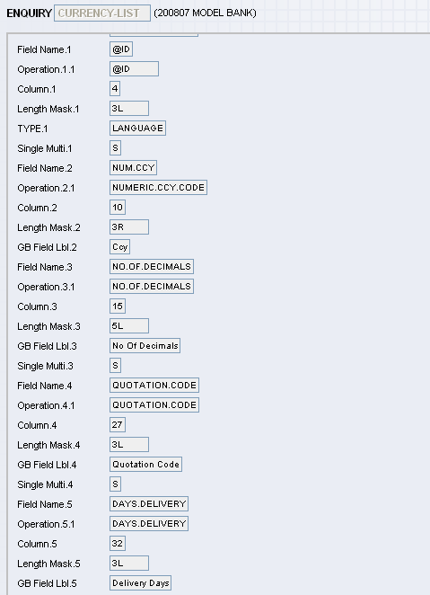
Enquiry and output
,@ID::@ID/NUM.CCY::Ccy/NO.OF.DECIMALS::No Of Decimals/QUOTATION.CODE::Quotation Code/ DAYS.DELIVERY::Delivery Days/MID.REVAL.RATE::Mid Reval Date/BUY RATE::Buy Rate/SELL::Sell Rate/DATE.TIME::Date,"AED" "784" "2 " " " "1 " " 3.67250" " 3.67300" " 3.67200" "04 DEC 07 10:22","AUD" " 36" "2 " "0 " "1 " " 0.95000" " 0.94000" " 0.96000" "04 APR 08 17:45","CAD" "124" "2 " " " "1 " " 1.20125" " 1.20150" " 1.20100" "04 DEC 07 10:25","CHF" "756" "2 " " " "1 " " 1.18600" " 1.19600" " 1.17600" "04 DEC 07 10:25"
Slide <number>
Notes:
OFS4.OFS Response-R11.01

Slide 50
OFS Enquiry Response - Syntax
Header Caption details
,
Column Details
,
Returned Data
Notes:
OFS4.OFS Response-R11.01

Slide 51
Enquiry Response syntax– Header Caption part
Header Caption Identifier
=
Header Text
/
,
Notes:
OFS4.OFS Response-R11.01

Slide 52
Header - Sample
ENQUIRY.SELECT,,INPUTT/123123,CUSTOMER.POSITION, CUSTOMER.NO:EQ=100285
HEADER=@ID/HEADER=F DISP.CUST/HEADER=F CUSTOMER/HEADER=F ACCT.OFFICER, MODULE::Module/TXN.REF::Transaction.Ref/ DISPLAY.NARRATIVE::Display Narrative/DEAL.CCY::Deal CCY/DISP.AMT::Display AMT/MARGIN.DISP::Margin.Disp/ FORWARD.IND::Forward.IND/ COLL.RGHT.COVER::COLL.RIGHT.COVER/COLL.RIGHT::COLL.RIGHT,
"AC" "14362" "MICROSOFT" "USD" " 2,780,234,562.14 " "" "" " " “ ","100285" "MICROSOFT ","" " ","" "" "ACCRUED INTEREST -667,667.69”
Slide <number>
Notes:
OFS4.OFS Response-R11.01

Slide 53
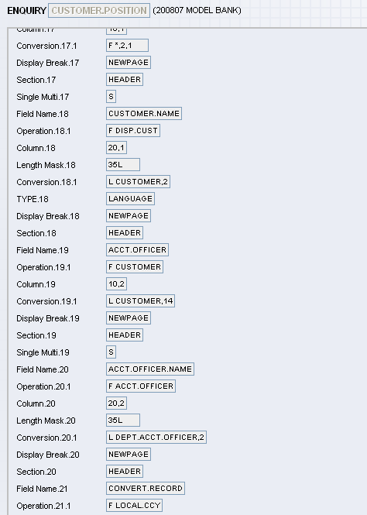
When are headers shown?
Headers are shown when an enquiry field contains data meant to be displayed as a header
Why? Fixed column position
Slide <number>
Notes:
OFS4.OFS Response-R11.01

Slide 54
Enquiry Response syntax - Column details
Column Identifier
:
Column Format Type
:
Column Label
/
,
,@ID::@ID/NUM.CCY::Ccy/NO.OF.DECIMALS::No Of Decimals/QUOTATION.CODE::Quotation Code/DAYS.DELIVERY::Delivery Days/MID.REVAL.RATE::Mid Reval Date/BUY RATE::Buy Rate/SELL::Sell Rate/DATE.TIME::Date,"AED" "784" "2 " " " "1 " " 3.67250" " 3.67300" " 3.67200" "04 DEC 07 10:22","AUD" " 36" "2 " "0 " "1 " " 0.95000" " 0.94000" " 0.96000" "04 APR 08 17:45","CAD" "124" "2 " " " "1 " " 1.20125" " 1.20150" " 1.20100" "04 DEC 07 10:25","CHF" "756" "2 " " " "1 " " 1.18600" " 1.19600" " 1.17600" "04 DEC 07 10:25"
Notes:
OFS4.OFS Response-R11.01

Slide 55
Enquiry Response syntax - Returned data
Column Value n
Tab
,
HEADER=@ID/HEADER=F DISP.CUST/HEADER=F CUSTOMER/HEADER=F ACCT.OFFICER, MODULE::Module/TXN.REF::Transaction.Ref/ DISPLAY.NARRATIVE::Display Narrative/DEAL.CCY::Deal CCY/DISP.AMT::Display AMT/MARGIN.DISP::Margin.Disp/ FORWARD.IND::Forward.IND/ COLL.RGHT.COVER::COLL.RIGHT.COVER/COLL.RIGHT::COLL.RIGHT,
"AC" "14362" "MICROSOFT" "USD" " 2,780,234,562.14 " "" "" " " “ ","100285" "MICROSOFT ","" " ","" "" "ACCRUED INTEREST -667,667.69”
Notes:
OFS4.OFS Response-R11.01

Slide 56
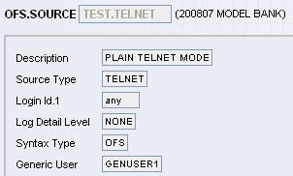
OFS.SOURCE entries for Telnet Mode
Key Fields To Understand Now
Id
Source Type
Login Id
Syntax Type
Generic User
Sample Data to fill out
Id : TEST.TELNET
Source Type : TELNET
Login Id : ANY
Syntax Type :OFS
Generic User : GENUSER1
Slide <number>
Notes:
OFS5.OFS Telnet Mode -R11.01

Slide 57
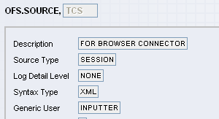
OFS.SOURCE entry for Session Mode
Key Fields To Understand Now
Id
Source Type
Syntax Type
Generic User
Sample Data to fill out
Id : TCS
Source Type : SESSION
Syntax Type : XML
Generic User : INPUTTER
Slide <number>
Notes:
OFS5.OFS Telnet Mode -R11.01

Slide 58
Simulating an online connection
Type tSS followed by the OFS.source.id at the jshell prompt
You should get a screen similar to the one shown below
Slide <number>
Notes:
OFS5.OFS Telnet Mode -R11.01

Slide 59
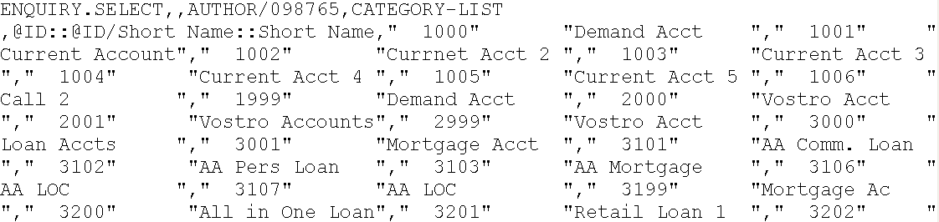
Testing Telnet mode (cont…)
Enter an OFS Enquiry Request. E.g.
ENQUIRY.SELECT,,AUTHOR/123123,CATEGORY-LIST
Response
Slide <number>
Notes:
OFS5.OFS Telnet Mode -R11.01

Slide 60
Testing Telnet mode (cont…)
Enter the following OFS transaction request
ABBREVIATION,/I/PROCESS,AUTHOR/123123,CUST,ORIGINAL.TEXT=CUSTOMER
Response
Slide <number>
Notes:
OFS5.OFS Telnet Mode -R11.01

Slide 61
Logs
2 Types
  Standard log – like &COMO&
  OFS Request Detail
Written by OFS Request Manager
Slide <number>
Notes:
OFS6.OFS Logging - R11.01

Slide 62
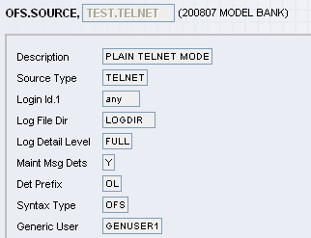
Log Settings
Key fields with sample data
Fields | Sample data
Log File Dir | LOGDIR
Log Detail Level | FULL
Slide <number>
Notes:
OFS6.OFS Logging - R11.01

Slide 63
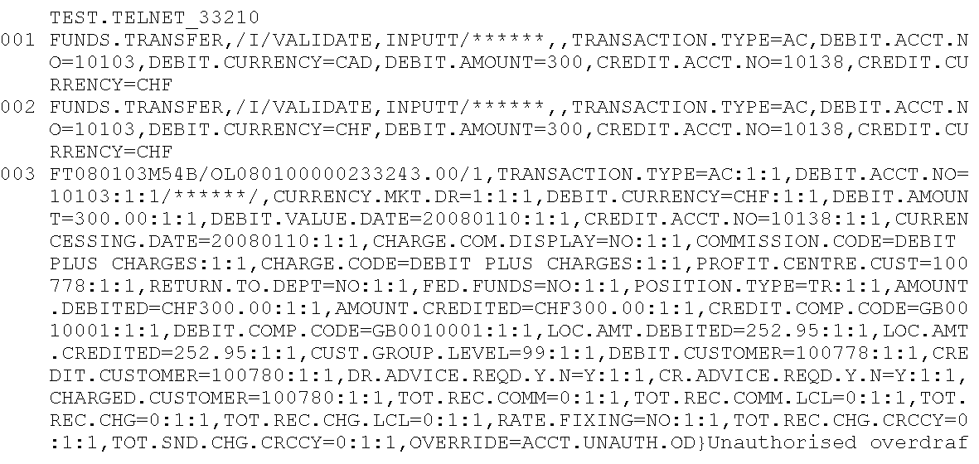
SAMPLE LOG
Slide <number>
Notes:
OFS6.OFS Logging - R11.01

Slide 64
Logging using ORD
Key fields with sample data
Fields | Sample data
Maint Msg Dets | Y
Det Prefix | OL
Slide <number>
Notes:
OFS6.OFS Logging - R11.01

Slide 65
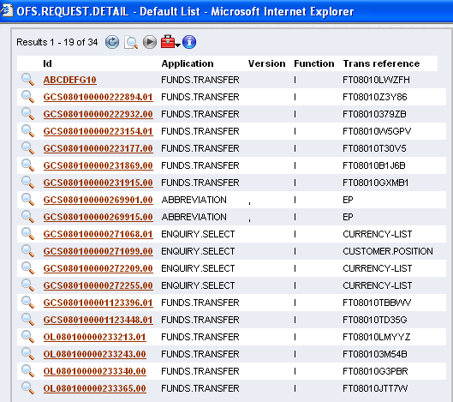
OFS.REQUEST.DETAIL
User specified
System generated
PPPPPPJJJJJUUUUUTTTTTT.NN
Slide <number>
Notes:
OFS6.OFS Logging - R11.01

Slide 66
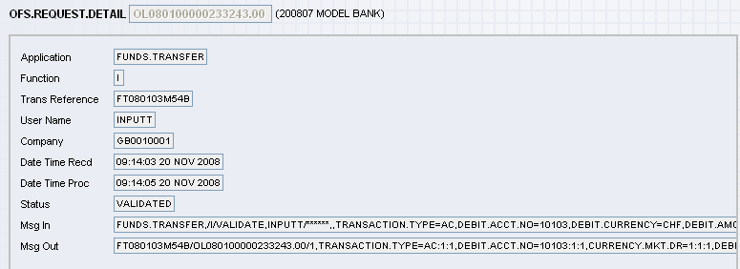
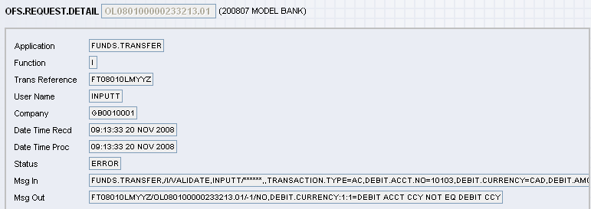
ORD records
Slide <number>
Notes:
You can see two ORD records on the screen. The first one is a log of a message that was successful. The second is that of a message which failed. The status field tells us the message status.
The status of a message could be;
RECEIVED - message has been received by OFS but not processed nor validated
VALIDATED - message has been validated
PROCESSED - message has been processed
ERROR - message resulted in an error
OFS6.OFS Logging - R11.01

Slide 67
Workshop 6.1
Change your batch OFS.SOURCE record to include a log directory called OFSLOG.
Switch on the log and ORD
Make sure that you put in prefix for your ORD record ids.
Input two messages – one that is correct and one that has a wrong field value.
Check your log and ORD
Slide <number>
Notes:
OFS6.OFS Logging - R11.01

Slide 68
Other OFS.SOURCE fields
Slide <number>
Notes:
OFS6.OFS Logging - R11.01

Slide 69
Preventing Duplicate messages - Message Ids
Request
FUNDS.TRANSFER,/I/PROCESS,INPUTT/123123,/ABCDEFG10,TRANSACTION.TYPE=AC,DEBIT.ACCT.NO=10103,DEBIT.CURRENCY=CHF,DEBIT.AMOUNT=300,CREDIT.ACCT.NO=10138,CREDIT.CURRENCY=CHF
Slide <number>
Slide <number>
Notes:
An OFS message could have a message id embedded within it.
OFS6.OFS Logging - R11.01

Slide 70
Preventing Duplicate messages - Attributes Field
OFS.SOURCE Attributes field
  NO.DUPLICATE.CHECK
Checks F.OFS.UNIQUE.MSG.REF
Slide <number>
Notes:
When OFS messages are sent from a third party system, there is a possibility that the same message might be sent twice. How does OFS ensure that a message is not repeated? Simple!! It uses the message reference id. This means the message id has to be included within a OFS message and OFS has to store this message reference so that it can check against it later. Where does it store the message reference? In a file called F.OFS.UNIQUE.MSG.REF.
OFS6.OFS Logging - R11.01

Slide 71
Preventing Duplicate messages - example
Request
FUNDS.TRANSFER,TEST.OVERRIDE/I/PROCESS,INPUTT/123123,/ABCDEFG10,TRANSACTION.TYPE=AC,DEBIT.ACCT.NO=10014,DEBIT.CURRENCY=AUD,DEBIT.AMOUNT=19,CREDIT.ACCT.NO=10057
Response
FT08010LWZFH/ABCDEFG10/1,DUPLICATE.TRAP:1:1=TRUE
Slide <number>
Slide <number>
Notes:
This is a different FT but using the same message id as the previous. Notice the error message. The FT does not get processed because of the duplicate id and a DUPLICATE.TRAP response is returned.
OFS6.OFS Logging - R11.01

Slide 72
Restricting Access in OFS
For an application
  PGM.FILE - enter .NOFS in the ADDITIONAL.INFO field
Slide <number>
Notes:
You may restrict access to OFS in the following way,
b. At an application level
Enter .NOFS in the ADDITIONAL.INFO field, in the PGM.FILE entry for that record.
OFS6.OFS Logging - R10.01

Slide 73


www.capgemini.com/financialservices
Notes:
© 2006 Capgemini - All rights reserved

