Slide 1
SMS
September 2011
Notes:
© 2006 Capgemini - All rights reserved
0

Slide 2
Session-wise Plan
Session I & II
SMS
User creation
Access to user profiles
Session III & IV
SMS
Authorization rights
Sign-on & password reset
Sign-on deactivation & password reactivation

Slide 3
Objective
At the end of this session, participants will
Appreciate security management system of T24
Know how to set up security at various levels including user, application, field and function levels

Slide 4
Introduction to SMS

Slide 5
Security Management System (SMS)
Security – Prime concern of Banks, irrespective of their size and network
Bank requires safeguard of:
Secrecy of Customers and their Accounts,
Exposure levels,
Access to data,
Authorization of financial commitments, etc.

Slide 6
SMS
Detects & Stops usage of the system
Aids in avoiding fraudulent transactions
Records unauthorized usage of the system
All activities of the users are recorded and a log can be maintained

Slide 7
SMS in T24

Slide 8
User Creation

Slide 9
Why User?
Bank user/Banker
For implementing various banking operations through T24
Banker -> Allowed to perform only specified or enabled operations
Enhances the security of banking

Slide 10
User Creation
Enter USER, I <User-name>
Enter the mandatory fields
Commit the record

Slide 11
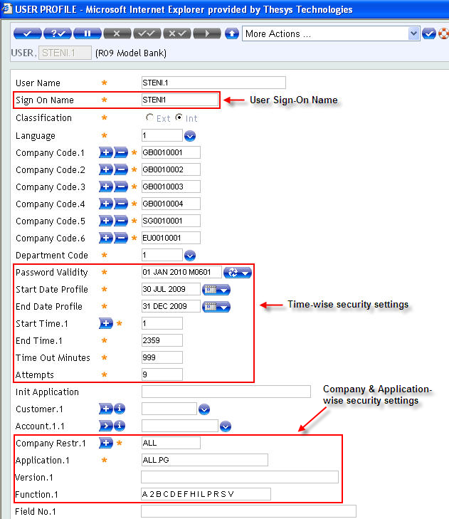
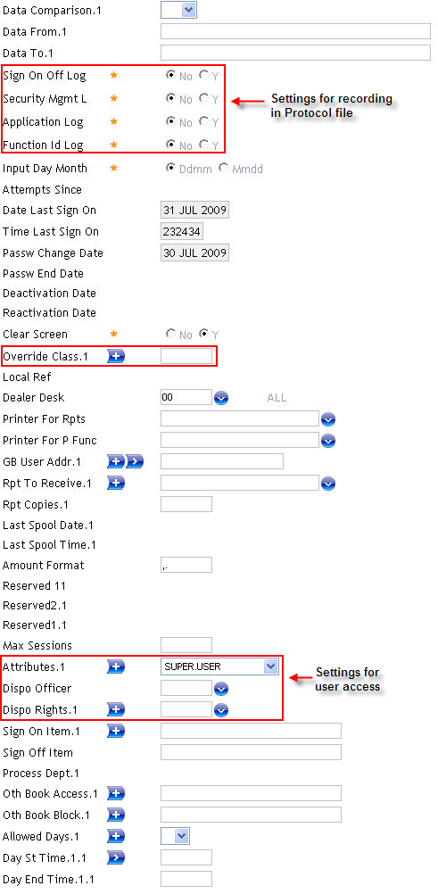
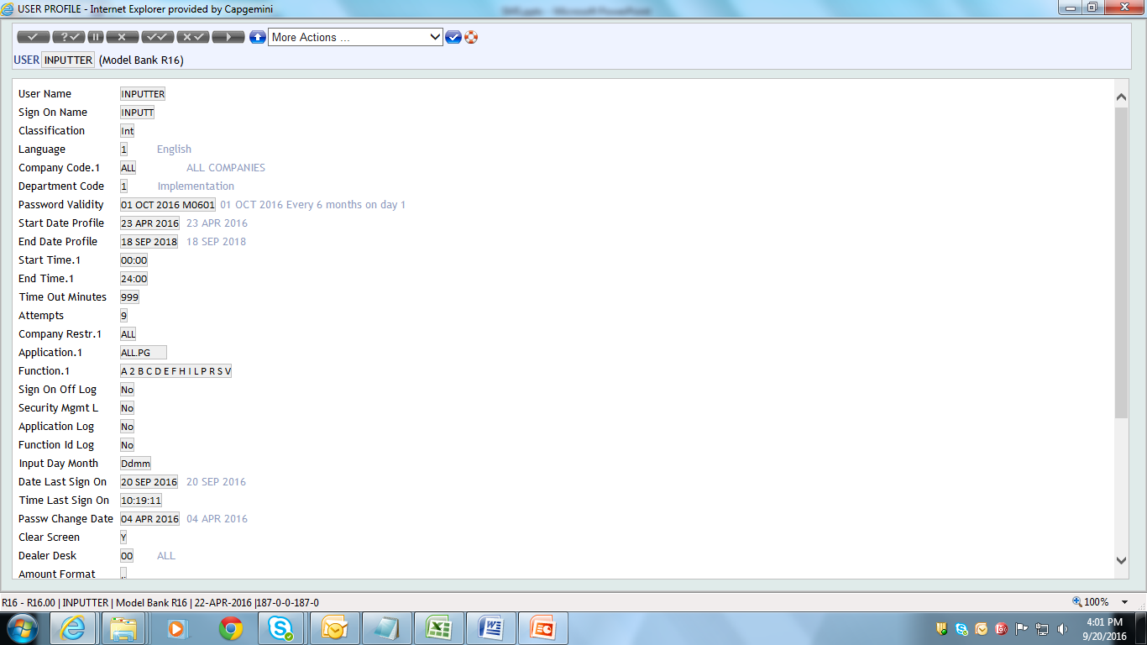
User Creation - Input Fields

Slide 12
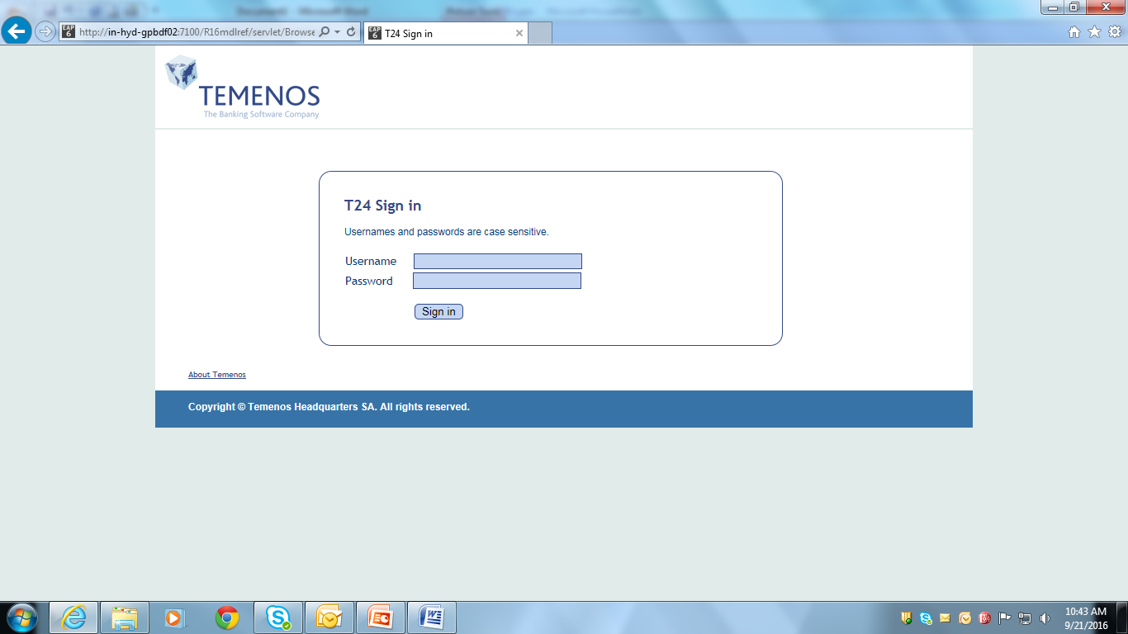
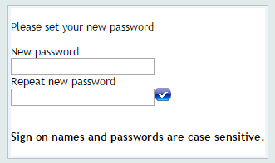
New User – Sign On
Use assigned IP address for T24 browser Sign on
Enter the User name and password
Repeat the password to sign into T24

Slide 13
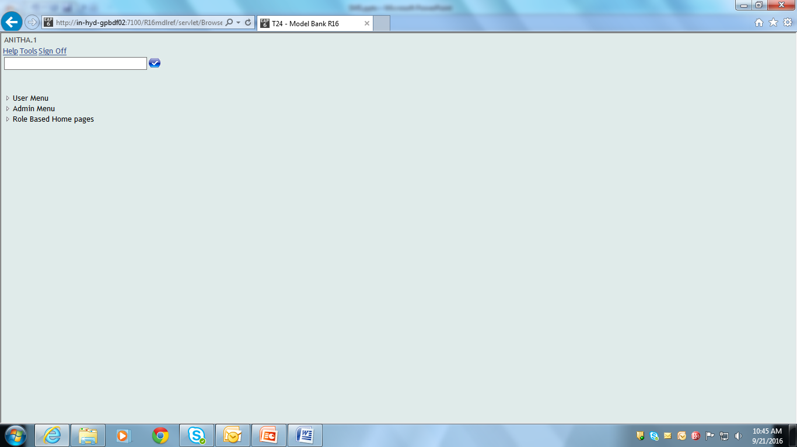
New User – Sign On
User is successfully signed-on

Slide 14
Access to User Profiles

Slide 15
User Profile Access
Based on the business profile of user,
Access is given to the relevant applications
To perform the permitted operations/functions
Helps in maintaining the confidentiality of the information available in the system

Slide 16
User Profile Access
Access restricted to each individual or group of users through -> USER Application
Any changes to user profile is reflected only when
User logs off the system
Logs in again using the same user name

Slide 17
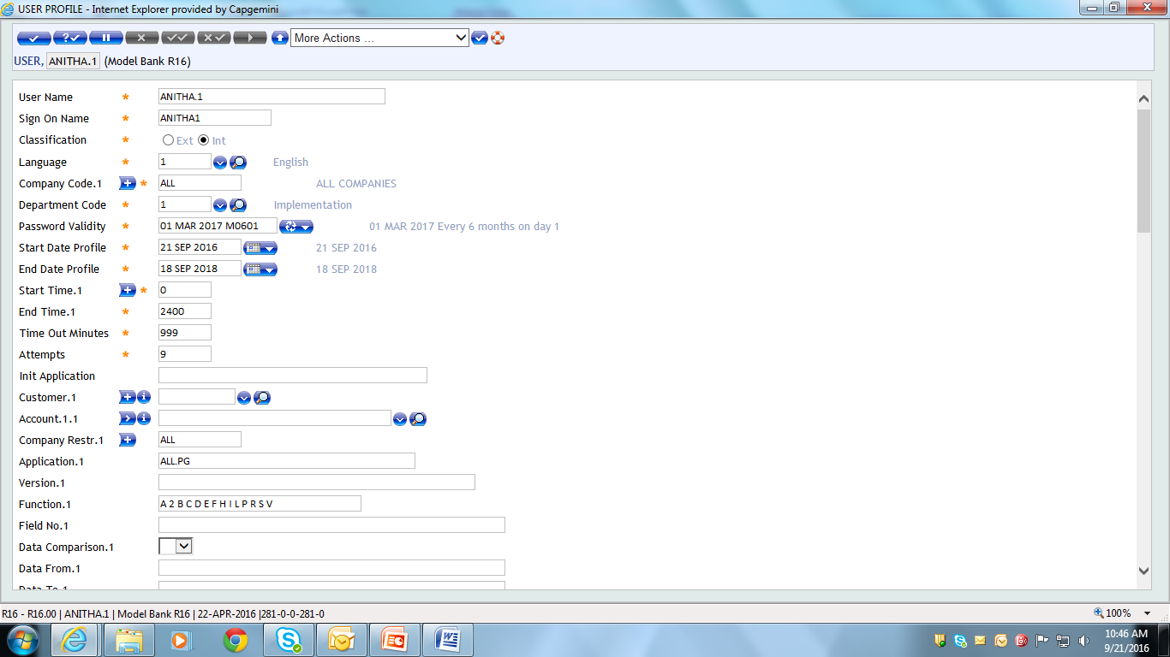
Access Restriction
Company level restriction is set using “Company Restr” field
Application level restriction is set using “Application” field
ALL.PG -> Allows access to all application
<Application-name> -> Allow specific application to the user
Version level restriction is set using “Version” field
<Version-name> -> Version of application set in “Application” field
Notes:
‘Company Restr’ field specifies the Company to which the User must be Signed On in order to use the Applications, Versions and Functions specified in the related Fields Application, version, Function, Field No, Data comparison, Data From and Data To.
Company.Restr field is used, together with the above associated Fields, to specify for each Company to whose records this User has access, precisely which records in which Applications can be accessed using which Versions and Functions.
The group of above Fields can be repeated up to 999 times

Slide 18
Access Restriction
Function level restriction is set using “Function” field
A – Authorise
C – Copy
R – Reverse
D – Delete

Slide 19
Access Restriction
H – History Restore
I – Input
P – Print
S – See
V – Verify
Q – Auditor Review

Slide 20
Example
Create a User who is restricted to use:
Account application with
Copy, Input, Print and See functions
In “GB0010001” company

Slide 21
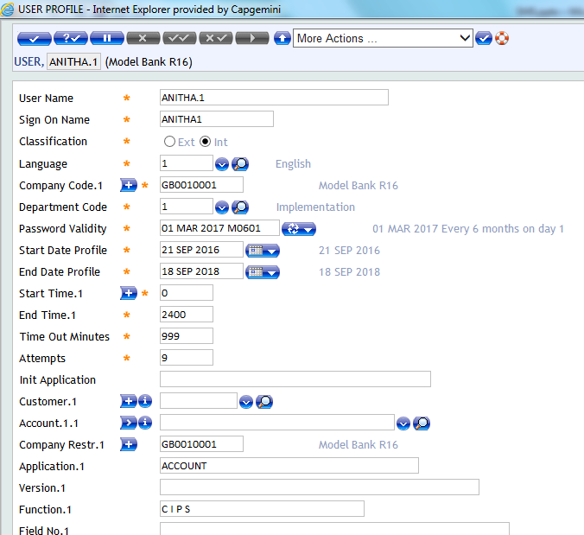
Solution

Slide 22
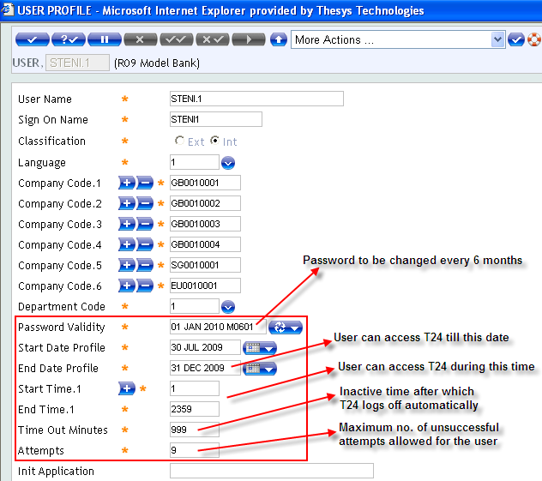
Access Restriction
Notes:
Time Out Minutes refers to the maximum time after which T24 will log off automatically.
The maximum value allowed in this field is 999 i.e. equal to 10 minutes.

Slide 23
Access Restriction
Time Out Minutes
Refers to the maximum time after which T24 will log off automatically
The maximum value allowed in this field is 999 i.e. equal to 10 minutes

Slide 24
Access Restriction
Attempts
Specifies the number of unsuccessful Attempts to sign on allowed using the Sign on name of the User record, before the Password is Disabled
User records Disabled in this way are shown in the Password exception list
The maximum value allowed in this field is 9

Slide 25
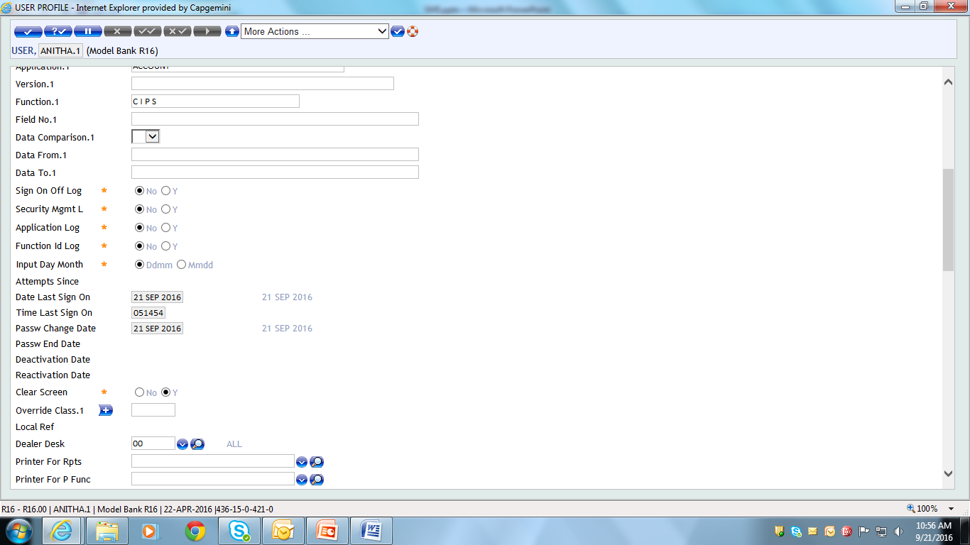
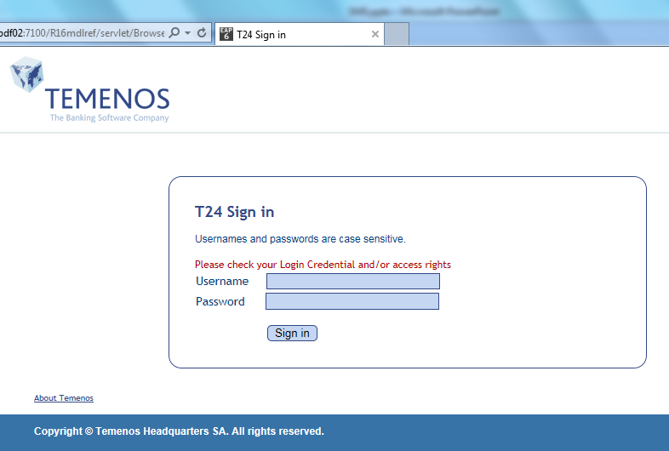
Unsuccessful User Attempt
Field ‘ATTEMPTS.SINCE’ -> Stores no. of unsuccessful Attempts to Sign on
Error Appears as shown, when ATTEMPTS.SINCE is greater than ATTEMPTS

Slide 26
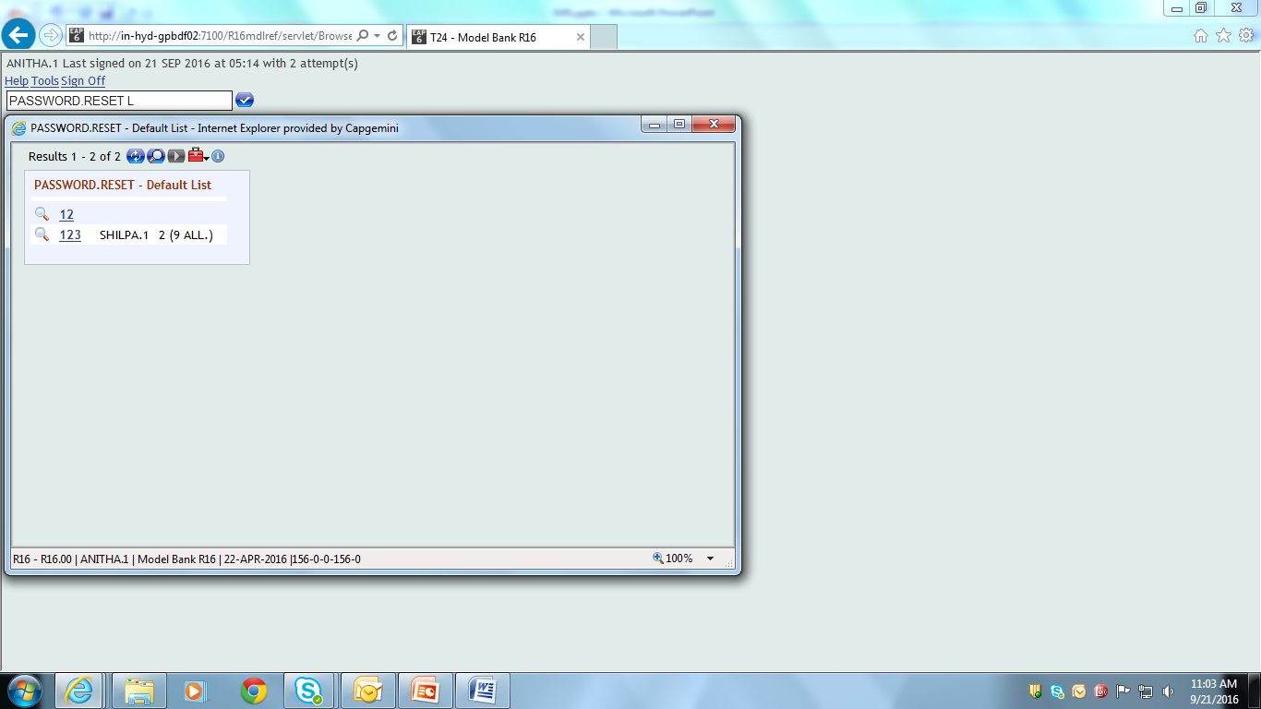
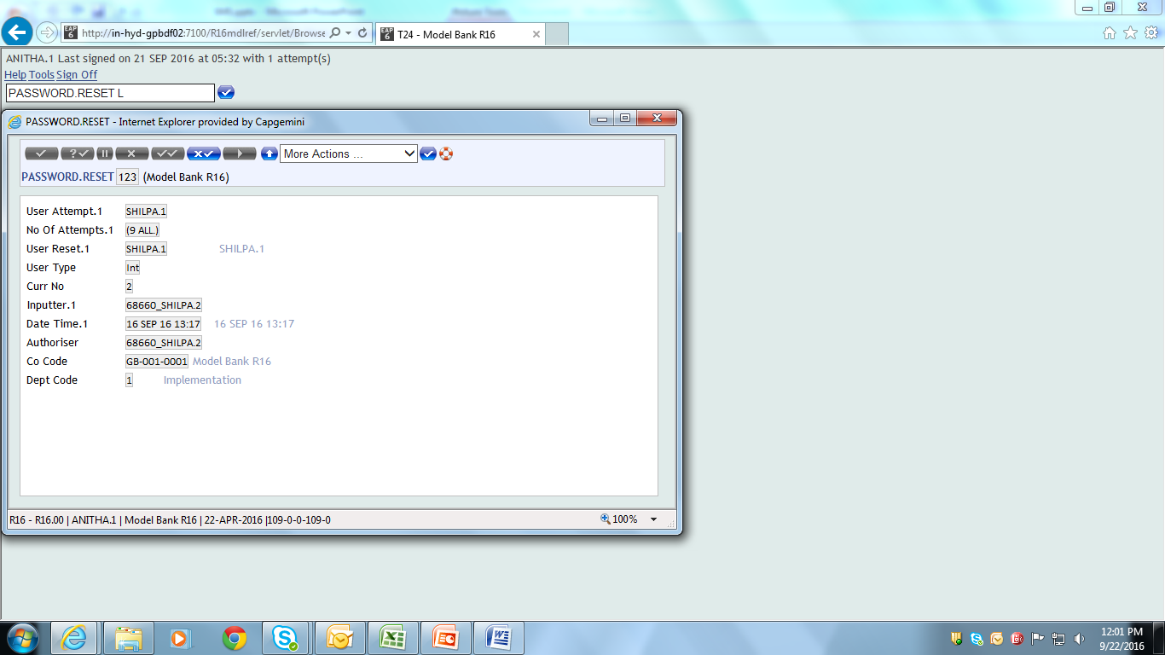
User Access
Application ‘PASSWORD.RESET’ -> Reset the password
Above Application restricted to Bank Administrator

Slide 27
User linking with Protocol file
SIGN.ON.OFF.LOG
Specifies whether or not a record should be written to the Protocol file, recording every time this User Signs On/off
Note: Unsuccessful attempts to SIGN.ON are always logged, regardless of the value in this field
SECURITY.MGMT.L
Specifies whether or not a record should be written to the Protocol file, every time this User accesses any of the Security Management Applications

Slide 28
User linking with Protocol file
APPLICATION.LOG
Specifies whether or not records should be written to the Protocol file, recording every Application accessed by this User
FUNCTION.ID.LOG
Specifies whether or not full details of every
Application,
Function and
record ID accessed by this User should be recorded in the Protocol file

Slide 29
USER.SMS.GROUP
Grouping of Users having same user rights
Allows definition of restriction at Application & Function level
Creation of Logical groups that can be attached to User profile
Avoid repetition of related application in different User profiles

Slide 30
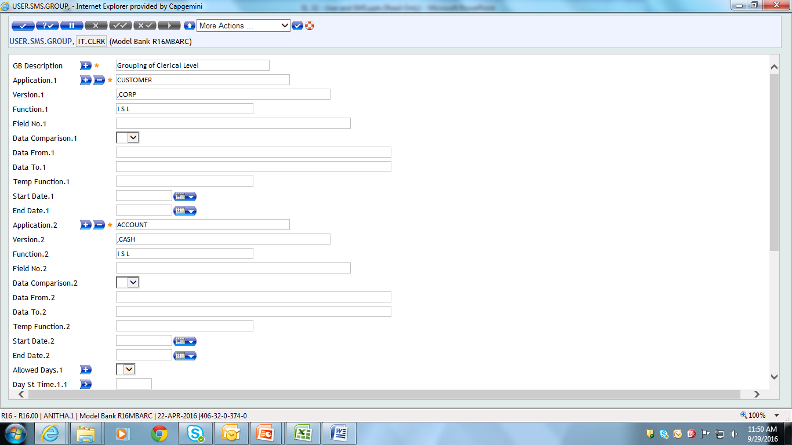
USER.SMS.GROUP
Define the required conditions for a particular user group
Notes:
Define application name, version name & function allowed for a particular user group in the fields ‘Application’ , ‘ Version’ and ‘Function’

Slide 31
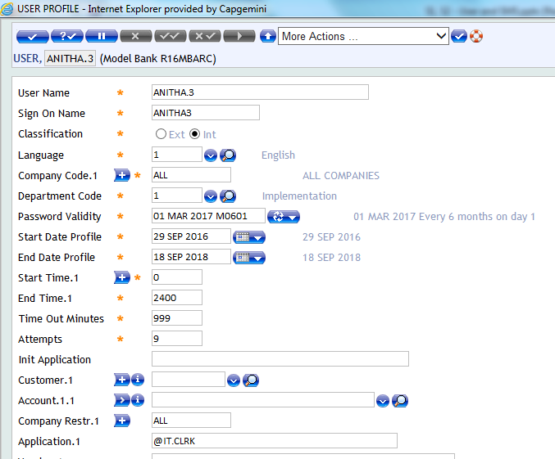
Grouping – Application Level
User profiles can be group using ID of USER.SMS.GROUP
Field ‘Application’ -> Attach group name prefixed with ‘@’ symbol

Slide 32
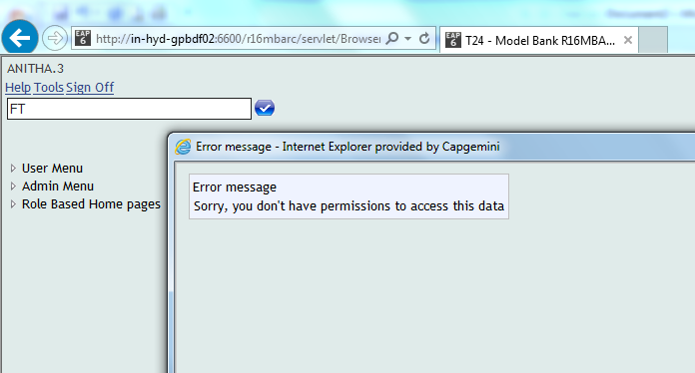
Grouping – Application Level
Error appears as shown, preventing user from using the Application attached in USER.SMS.GROUP

Slide 33
Grouping – Field Level
Field level grouping of user profiles can be done using ID of USER.SMS.GROUP
Use fields:
Field No
Data Comparison
Data from
Data to

Slide 34
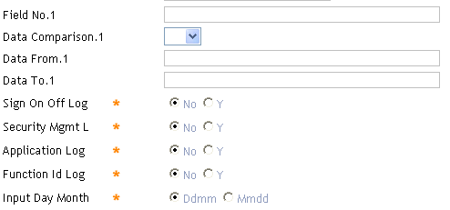
Grouping – Field Level
Define Conditions, based on which the corresponding application is accessed by the respective user profile
Fields -> Interlinked fields

Slide 35
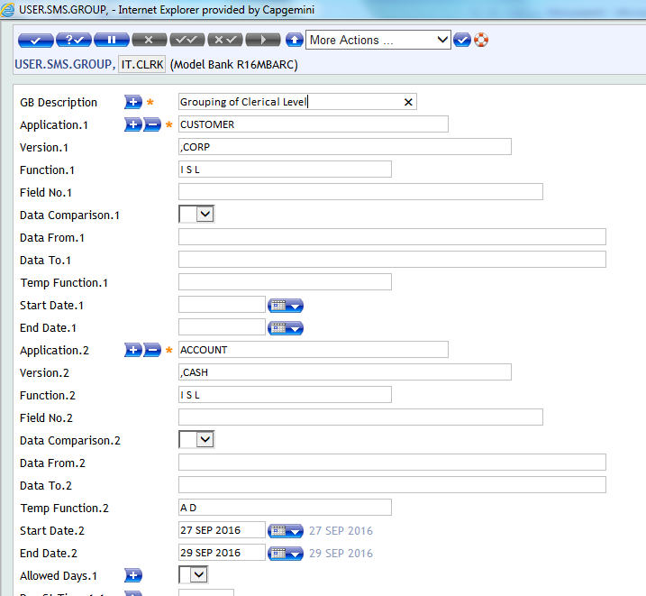
Grouping – Field Level

Slide 36
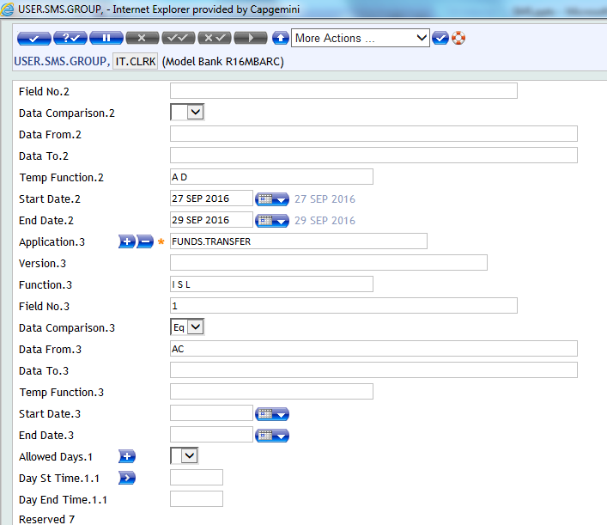
Grouping – Field Level
Example,
Any FT record created by this User can only have ‘AC’ as the Transaction Type
Notes:
It is also possible to allocate Temporary functions in User SMS Group for a particular period – using field ‘Temp Function’

Slide 37
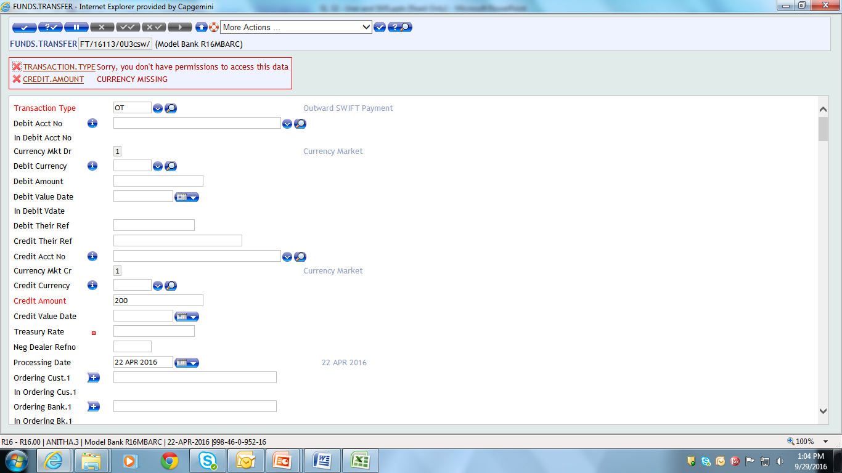
Grouping – Field Level
Error appears as the User is not allowed to input Transaction type other than ‘AC’ in the FT version

Slide 38


www.capgemini.com/financialservices

