Slide 1
VALIDATION ROUTINE:
Validation routines are used to validate the record at field level.

Slide 2
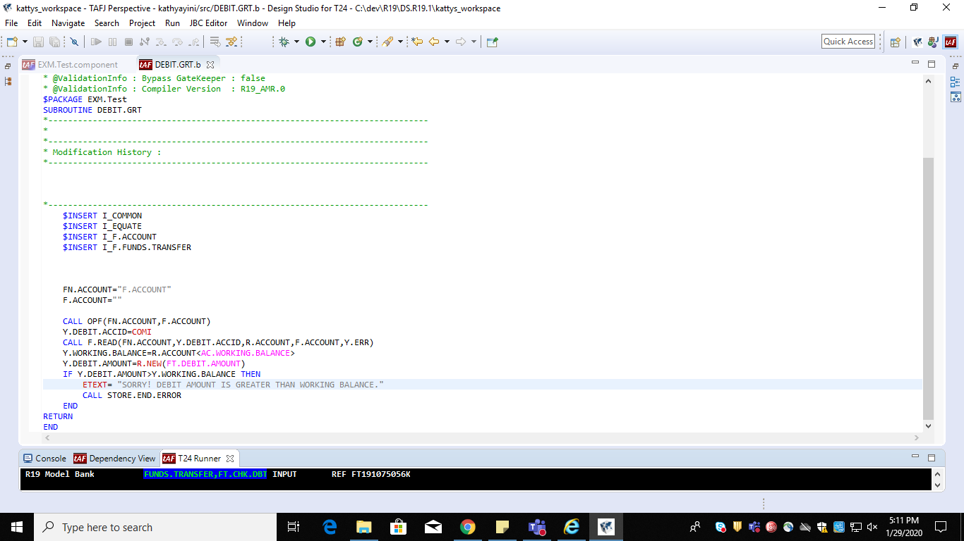
WRITE THE VALIDATION ROUTINE:

Slide 3
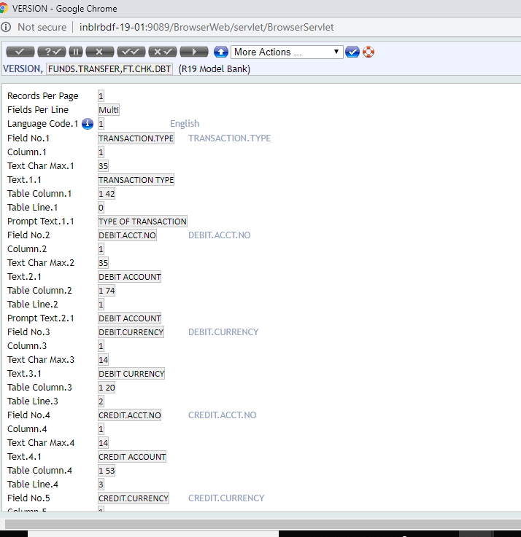
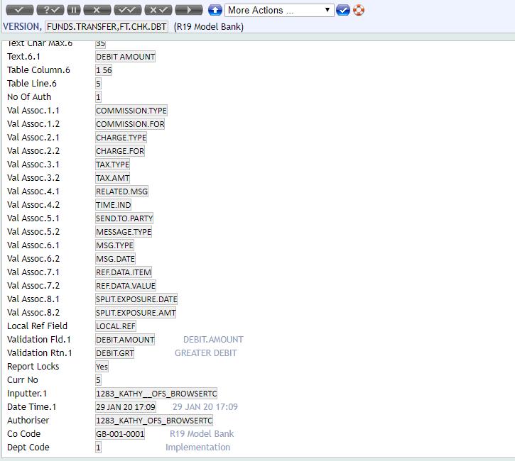
CREATE THE VERSION FOR FUNDS TRANSFER:
Command to create a version:
VERSION, I FUNDS.TRANSFER,FT.CHK.DBT
Name of the version:FT.CHK.DBT
Attach the routine- DEBIT.GRT to the version at
Validation Fld.1 – the field that should be validated. Here it is debit amount
Validation Rtn.1 – the name of the routine to do validation.
Routine is attached

Slide 4
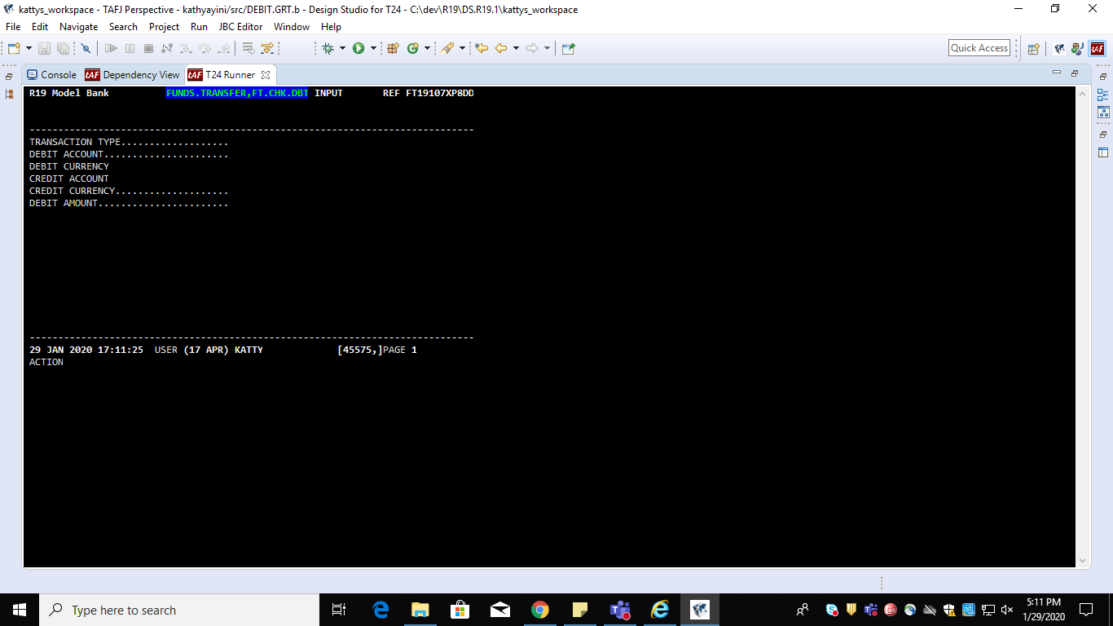
Open the attached version in classic mode and do the funds transfer:
Commands: FUNDS.TRANSFER,FT.CHK.DBT, I

Slide 5
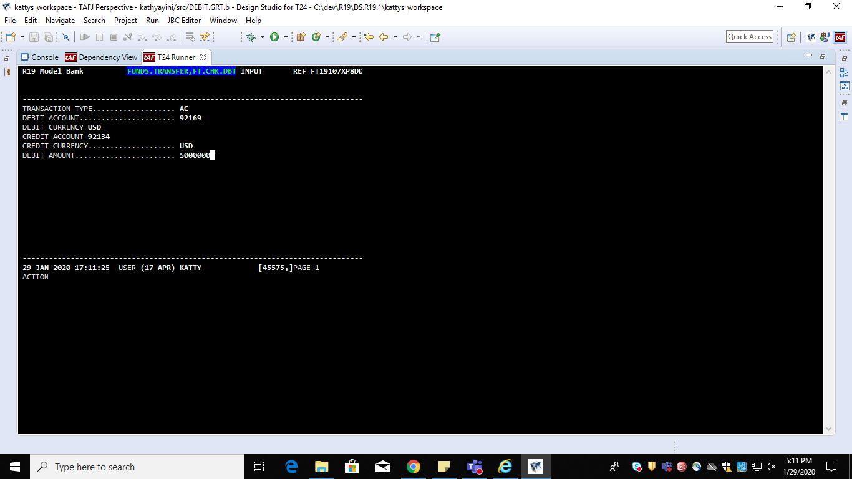
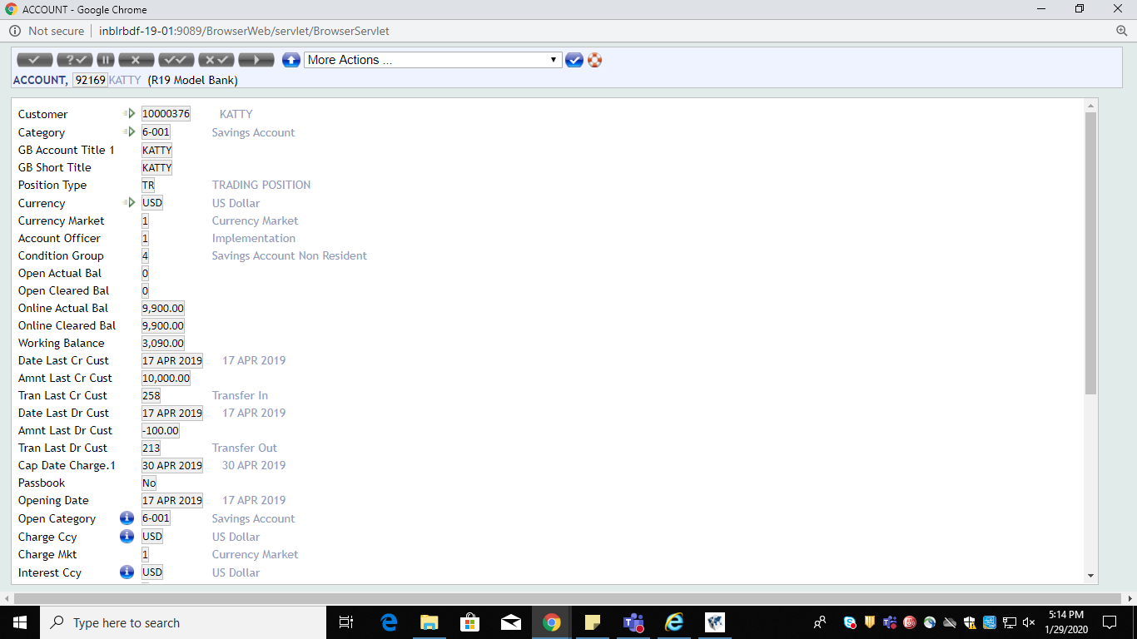
GIVE THE AMOUNT GREATER THAN WORKING BALANCE TO CHECK THE VALIDATION.

Slide 6
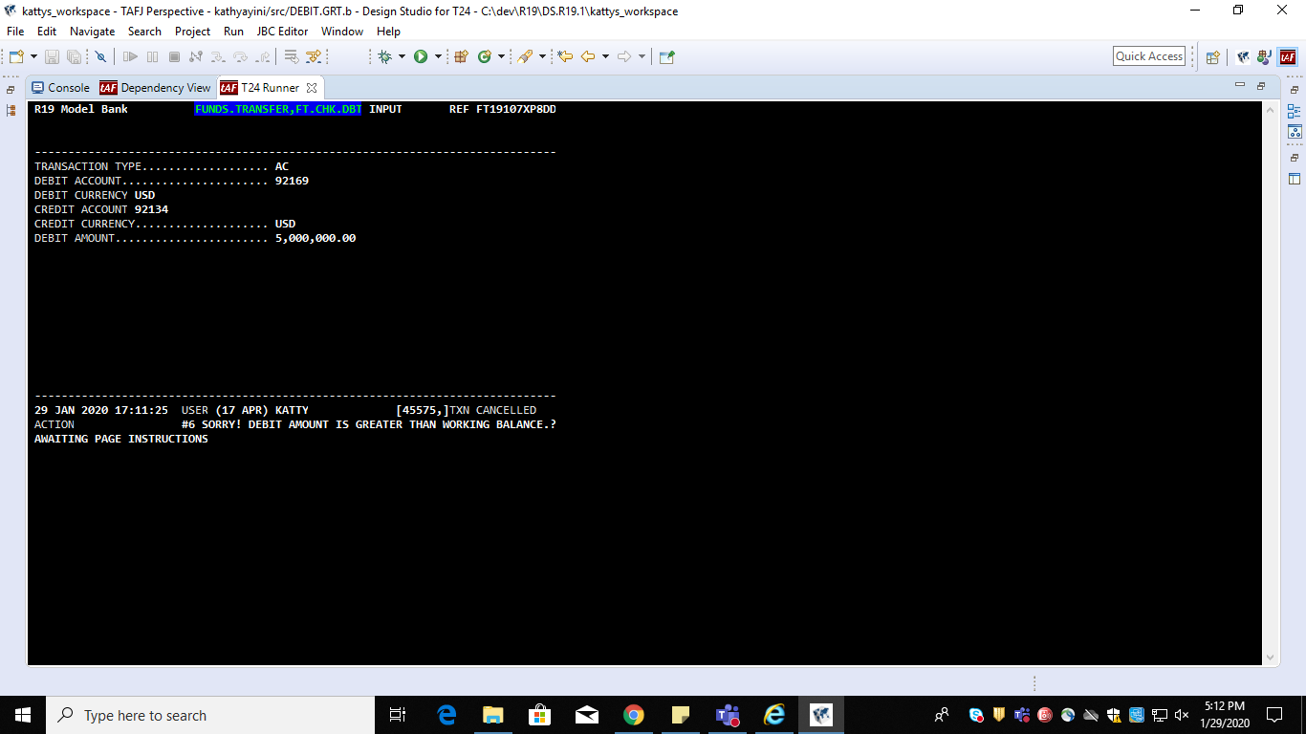
AFTER COMMITTING RECORD, TXN IS CANCELLED SHOWING THE ERROR MESSAGE.
As mentioned before, validation fld is checked and error is displayed.

