Slide 1
Template Programming
May 2011
Notes:
© 2006 Capgemini - All rights reserved
0

Slide 2
Introduction
Application in T24:
Through an application data is entered
This data is stored in the associated file in the data base
Example
CUSTOMER

Slide 3
Introduction
Product in T24:
Collection of applications that works together to create a business functionality.
Example
LOANS AND DEPOSITS

Slide 4
Introduction
Templates in T24:
T24 has a model subroutine
This is used as a base for all applications
This is done so that they look and feel the same.

Slide 5
Creating an Application
Things to be considered for creating an Application
What business functionality must be covered
Properties (Static information) of the Application
Retain T24 Application Flow

Slide 6
Creating an Application
Naming
Name of the Application must be meaningful.
Some indication of purpose should also be there
Should be prefixed by the product code
The product code should be available in EB.PRODUCT
Eg. PW.ACTIVITY.
File name should not exceed 25 characters
Notes:
The file name cannot exceed 25 characters, to allow for the addition of the company mnemonic and the $NAU or $HIS suffix.

Slide 7
Classifications
Classification | Details
INT | Installation - This covers files like COMPANY, USER, LANGUAGE, where only one version of the file will exist regardless of the number of companies
CUS | Customer - for files where the data can be shared between companies. Primarily static information and tables.
FIN | Financial - for files that hold financial level details (amounts, balances etc.) where the data cannot be shared with other companies.

Slide 8
Stereo Types
The stereotype of the application decides which files will be created and used. There are three files that may be created:
The main file is the live file or authorised file and has no suffix.
The unauthorised file is suffixed with $NAU and holds the record as input or changed before it has been authorised.
The history file is suffixed by $HIS and contains images of the record prior to each change.

Slide 9
Stereo types
Application
Allows data entry, authorisation, deletion, history restore, etc. e.g. CUSTOMER
Display
Used to simply view the data on a file maintained by the system rather than the user e.g. STMT.ENTRY
Utility
Allows data entry and a Verification function which initiates a process, e.g. ENQUIRY.REPORT

Slide 10
Stereo Types
Type | Description
Application (H or U) | Used as the trigger field for operation processing.
Display (L) | Used for the display of a 'non-inputtable / live’ file
Utility (W) | Used to allow standard input without an unauthorised file and the verify function to execute special procedures

Slide 11
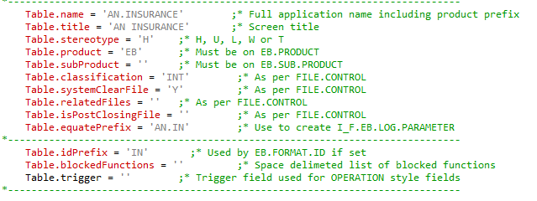
Naming, Stereo Types,Classification – Example

Slide 12
Defining an Application
The first step is to define the high level properties of the application.
The example “TEMPLATE”, which ships with each release of T24, holds the properties for the application.
Notes:
The file name cannot exceed 25 characters, to allow for the addition of the company mnemonic and the $NAU or $HIS suffix.

Slide 13
Defining an Application
Property | Example | Explanation
Name | EB.INSURANCE | Full application name including the product prefix. Must be the same as the application name
Title | Insurance Product | Screen Title
Stereotype | H | Type of the file
Product | EB | The sub product of the application. Must be an entry on EB.SUB.PRODUCT
Classification | INT | INT, FIN or CUS file
systemClearFile | Y | Should be set to YES for any transient (i.e. financial) applications
equatePrefix | EB.IN | Used to create the insert for the application that contains the equated field names
Notes:
The file name cannot exceed 25 characters, to allow for the addition of the company mnemonic and the $NAU or $HIS suffix.

Slide 14
Defining an Application
Property | Example | Explanation
idPrefix | EBIN | If set, invokes EB.FORMAT.ID to produce transaction reference style keys
blockedFunctions |  | A space delimited list of functions that are not allowed on an application
triggerField |  | Used as the trigger field for operation processing. Refer to “Operations”.
Notes:
The file name cannot exceed 25 characters, to allow for the addition of the company mnemonic and the $NAU or $HIS suffix.

Slide 15
Define the Fields
Every application MUST have a corresponding field definitions subroutine.
The name of this subroutine is the full name of the application with the suffix “.FIELDS”, e.g. EB.INSURANCE.FIELDS
.FIELDS subroutine should be based on the TEMPLATE.FIELDS template
Once finished the subroutine has to be saved and compiled

Slide 16
Define the Fields
Table has the following methods to define the fields:
Methods | Meaning
Table.addField | Add a field with standard data types
Table.addFieldDefinition | Add a field using F, N and T style
Table.addFieldWithEbLookup | Add a field with a virtual table
Table.defineId | Define the ID field
Field.setCheckFile | Add a check file to a field
Table.setAuditPosition | Defines the last field position

Slide 17
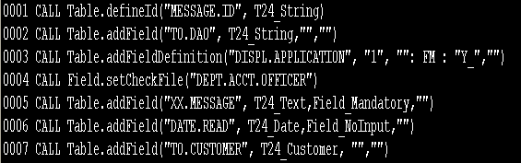
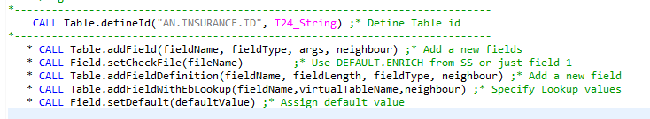
Defining Fields - Example

Slide 18
Field Settings
Each field is defined by five settings
Field Names and Grouping
Field Length
Field Type
Check file

Slide 19
Single valued fields
Each element of the array is assigned the text string to be used on the screen to label the field. This can be up to 18 alphanumeric characters and must NOT include spaces. The first two characters cannot be 'XX' e.g.
CALL Table.addField(‘MYFIELD’,T24_String,’’,’’)

Slide 20
Multi valued fields
Any field (except the record id) can be multi-valued.
They can be individual multi-valued fields
Multi-valued in association with a language code
Part of a group of fields whose multi-values are always in association with each other.
Individual multi-valued fields are defined by setting their table element to 'XX.' followed by the field name,
CALL Table.addField(‘XX.NARRATIVE’,T24_Text,’’,’’)

Slide 21
Multi valued fields
Language associated multi-values allow several translations of the value of the field to be held on the record.
The appropriate multi-value being used according to the language code of the user.
These are defined by setting the element to 'XX.LL' followed by the field name.
CALL Table.addField(‘XX.LL.DESCRIPTION’,T24_Text,’’,’’)

Slide 22
Associated Multi value fields
Associated groups of multi-values are defined by setting the third character to '<' for the first field of the association, '-' for intermediate fields and '>' for the last associated field.
CALL Table.addField('XX<DATE_NOW‘,T24_Date,’’,’’)
CALL Table.addField('XX-CHARGE.RATE‘,T24_Number,’’,’’)
CALL Table.addField('XX-LOWER.LIMIT' ,T24_Text,’’,’’)
CALL Table.addField('XX>UPPER.LIMIT' ,T24_Text,’’,’’)

Slide 23
Sub valued fields
Any multi-valued field can be sub-valued.
For example
'XX<CURRENCY'
'XX-XX<CHARGE.RATE'
'XX-XX-LOWER.LIMIT'
'XX>XX>UPPER.LIMIT'

Slide 24
Check file
The file to be checked for the field could also be specified
This is done through the API call immediately next to the addField call of that field
Field.setCheckFile is the API call used

Slide 25
Check file - Example
If the Field MANAGER should have the entries from the APPLICATION DEPT.ACCT.OFFICER then
CALL Table.addField(‘MANAGER’,T24_Text,’’,’’)
CALL Field.setCheckFile("DEPT.ACCT.OFFICER")

Slide 26
Adding a field
Field could be added using
Table.addField(fieldName, fieldType, args, neighbour)
Has four arguments
Argument 1:
Field name
Argument 2:
Field Type
Argument 3:
Args
Argument 4:
Neighbour

Slide 27
Field Type
Example:
CALL Table.addField("XX.MESSAGE", T24_Text,Field_Mandatory,"")
Other values for the 3rd argument are:
Field_NoInput
Field_NoChange
Field_Extern

Slide 28
Data type
The data type is defined by the second argument in the CALL routine
Example
CALL Table.addField(‘MYFIELD’,T24_String,’’,’’)

Slide 29
Data type Examples
Account Number
T24_Numeric
Alphanumeric
T24_String
Text Box
T24_Text
Customer Number
T24_Customer

Slide 30
Data type Examples
Date
T24_Date
Amount
T24_Amount

Slide 31
Table Field Definition
Table can also be added using
CALL Table.addFieldDefinition(fieldName, fieldLength, fieldType, neighbour)
Argument 1:
Field Name
Argument 2:
Field Length
Argument 3:
Field Type
Argument 4:
Neighbour

Slide 32
Standard Fields - addReservedField
All new applications MUST define a set of reserved fields
These can be used to add extra fields to the application without the need to change the layout of the data.
Ten reserved fields may be added
The names of which should be RESERVED.1 etc.
The standard API for this is:
Table.addReservedField(fieldname)

Slide 33
Standard Fields - addLocalReferenceField
All applications MUST contain a LOCAL.REF field.
This allows T24 clients to add user definable fields to the application.
The standard API for this is:
Table.addLocalReferenceField

Slide 34
Standard Fields - addOverrideField
All applications MUST have a field to store overrides.
Even if the application does not currently use the override processing this is required
The standard API for this is:
Table.addOverrideField

Slide 35
Standard Fields - addDeliveryReferenceField
Applications that raise delivery events must define a field to hold the delivery references.
By default, the name of this field should be DELIVERY.REF
Multiple fields are required to hold delivery references for multiple involved parties.
The standard API for this is:
Table.addDeliveryReferenceField

Slide 36
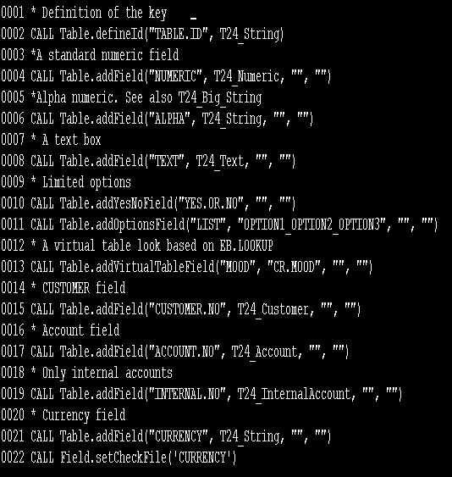
Example field type - APIs

Slide 37
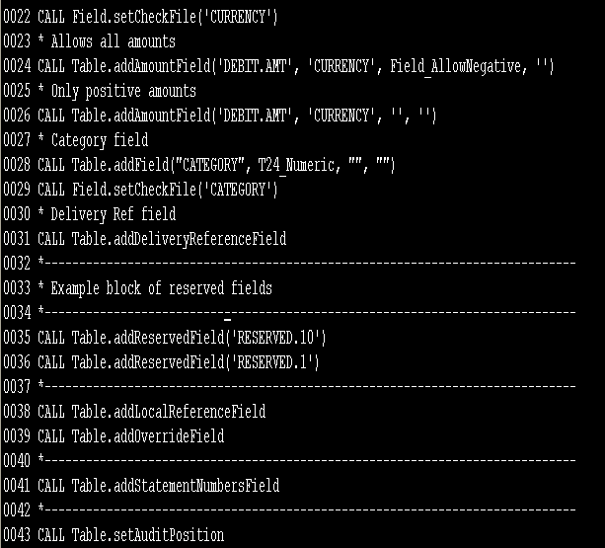
Example field type - APIs

Slide 38
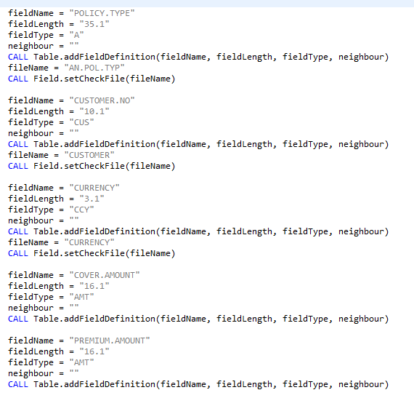
Example field type - APIs

Slide 39
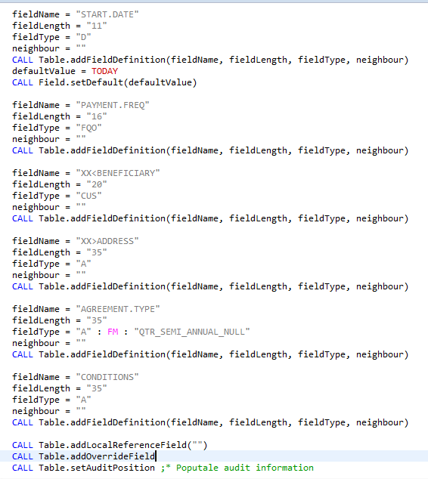
Example field type - APIs

Slide 40
Step 3 – Artefact Creation EB.DEV.HELPER
EB.DEV.HELPER is a standard utility that creates all of the artefacts that are required to run an application in T24.
The key to the record is application that is worked out
Once verified will perform a number of actions if relevant field is flagged

Slide 41
Step 3 – Artefact Creation EB.DEV.HELPER
This creates:
a PGM.FILE record,
a FILE.CONTROL record,
an INSERT file (I_F.MY.APPLICATION) that holds the equated field names, and
CREATE.FILES file to create the physical database files
Updates/creates the STANDARD.SELECTION record via OFS and sets the REBUILD.SYS.FIELDS flag to ‘Y’
Creates the DAS routines for the application using CREATE.DAS.PGMS

Slide 42
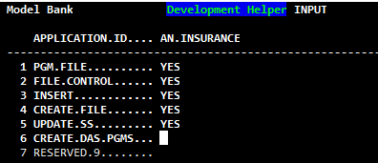
Step 3 – Artefact Creation EB.DEV.HELPER

Slide 43
Workshop

Slide 44
Workshop
Create a template with the following specification:
No | Field Name | Type | Description | Mandatory
1 | POLICY.NO | 16,A | Standard T24 ID – Prefix IN | Y
2 | POLICY.TYPE | 35, | Should be a valid Policy Type in the POLICY.TYPE | Y
3 | CUSTOMER.NO | 10,CUS | Must be a valid CUSTOMER | Y
4 | CURRENCY | 3,CCY | Must be a valid CURRENCY | Y
5 | COVER.AMOUNT | 16,AMT |  | Y
6 | PREMIUM.AMOUNT | 16,AMT |  | Y
7 | START.DATE | 11,D | Defaults to TODAY

Slide 45
Workshop
No | Field Name | Type | Description | Mandatory
8 | PAYMENT.FRQ | 16,FQO | Must be after START.DATE
9 | XX<BENEFICIARY | 10,CUS OR 35,A | Free Text
10 | XX>ADDRESS | 35,A | Free Text
11 | AGREEMENT.TYPE | 35,A | Only the following options are valid OPTION1 – OPTION4 Either agreement type or CONDITIONS must be set
12 | CONDITIONS | 35,A | Free Text
13 | XX.LOCAL.REF

Slide 46
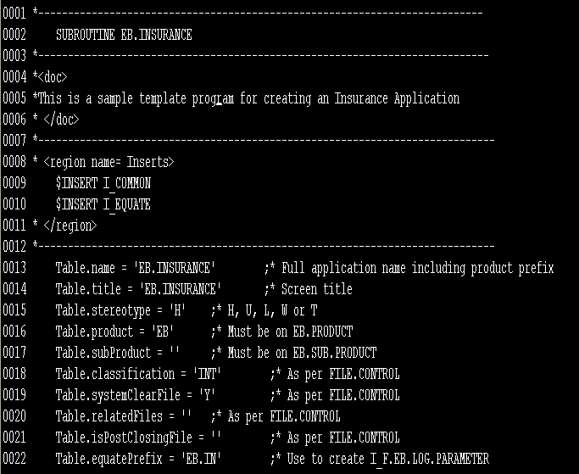
Solution – EB.INSURANCE
Notes:
INSERT I_table missing

Slide 47
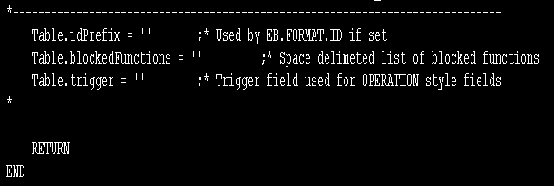
Solution

Slide 48
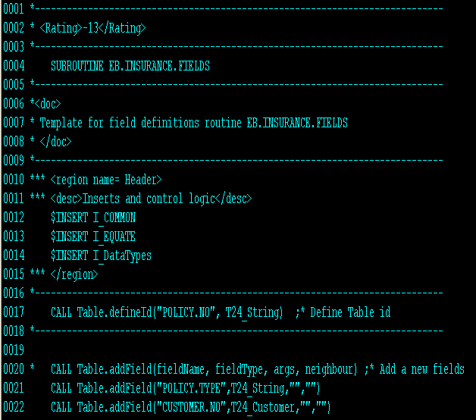
Solution – EB.INSURANCE.FIELDS

Slide 49
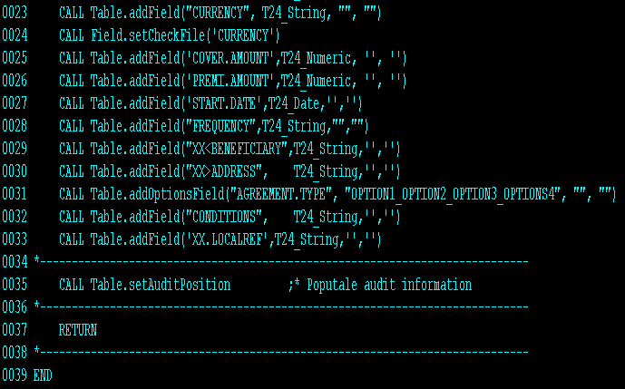
Solution – EB.INSURANCE.FIELDS

Slide 50
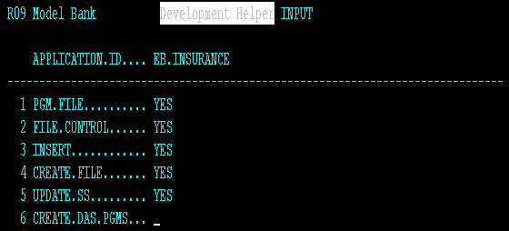
Solution – EB.DEV.HELPER

Slide 51
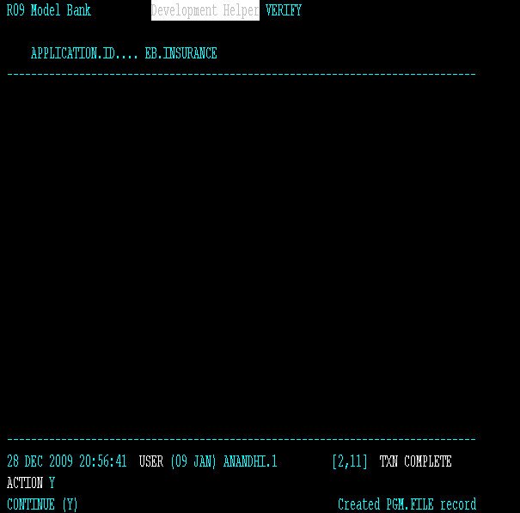
Solution – EB.DEV.HELPER

Slide 52
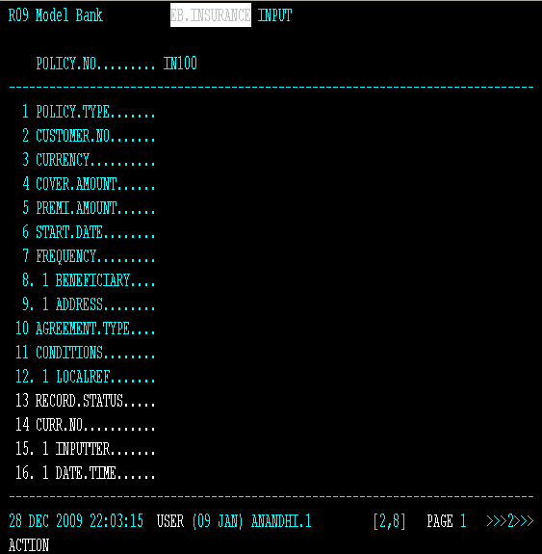
Solution

Slide 53
Summary
You will able to
Create a template in R09
Add fields in the template

Slide 54


www.capgemini.com/financialservices

