Slide 1
Lunch and Learn Maui
Juandré “Joe” Swart

Slide 2

AGENDA
.Net Maui overview
Customers and personal apps
Working with .Net Maui
Platform specific code
Demo

Slide 3
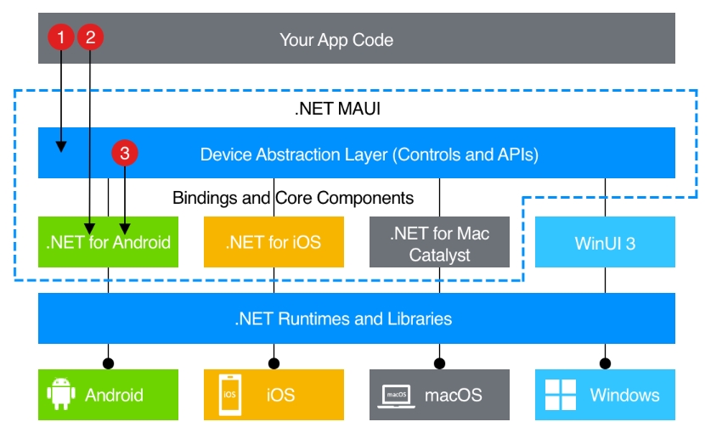
1. .Net MAUI OVERVIEW
What is .NET Maui?
.NET Multi-platform App UI (.NET MAUI) is a cross-platform framework for creating native mobile and desktop apps with C# and XAML.
Using .NET MAUI, you can develop apps that can run on Android, iOS, macOS, and Windows from a single shared code-base.
Evolution from Xamarin and opensource.
Blazor and .NET MAUI?

Slide 4
1. Deployment and Testing
Android Play Console
Android can run and deploy from Windows/Linux/Mac.
No account needed to deploy to physical device. The device needs to be in developer mode.
Beta testing using PlayConsole. This will require developer account and store listing. The app doesn’t need to be published yet.
Release deployment gets signed by app signing key. Either manual or through the store. (Maui can create a signing key as well)
iOS/Mac
Need mac to build and deploy.
Need apple developer account to debug on real device.
Beta testing using TestFlight. This will require developer account and store listing. The app doesn’t need to be published yet.
Release deployment gets signed by an apple certificate created in your developer account. (Maui can create this for you through your account)

Slide 5
2. Customers
Aptys Solutions
Help create their Moli app from start to finish.
Bank transfer app.
Was done in Xamarin.
Acato
Help finish their proof-of-concept app.
Geofence tracking app.
Was done in Xamarin.
RCP Inc.
Natural Gas/Energy Sector.
Mobile App to complete compliance checks for pressure tests on pipes.
Blue-tooth communication from MAUI App to specialized sensor.

Slide 6
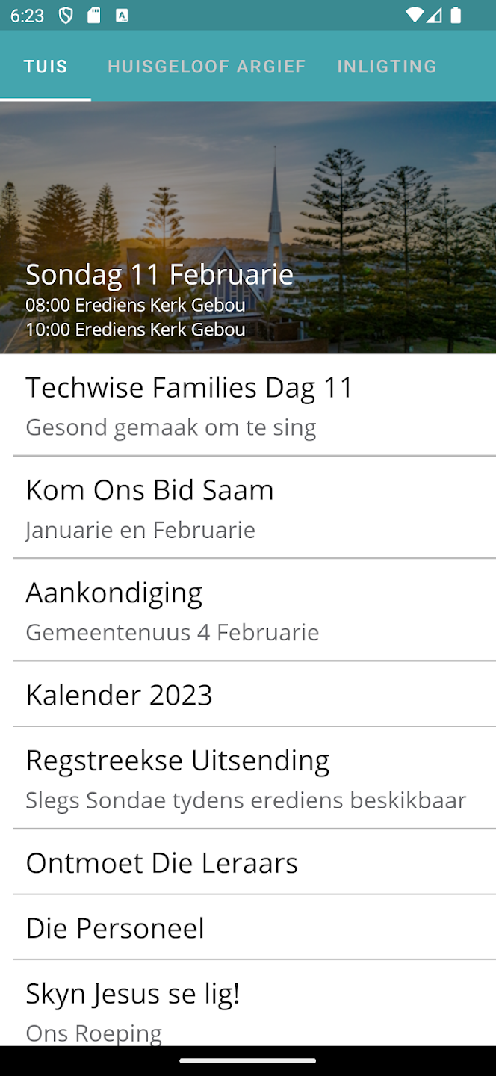
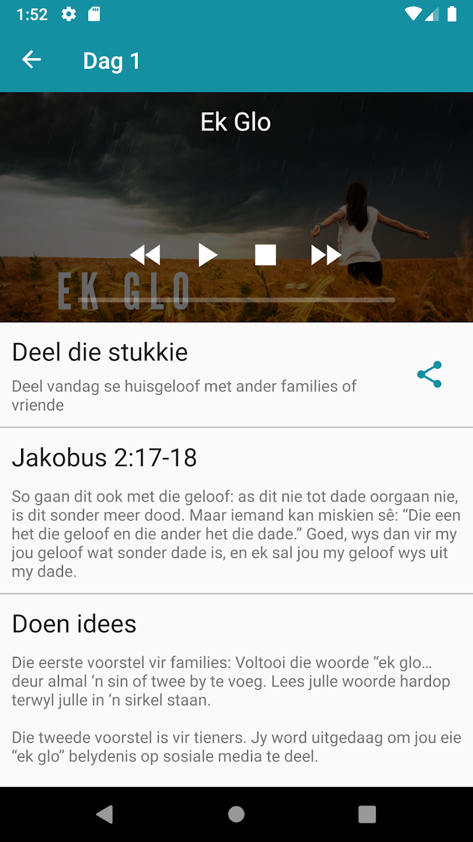
2. Personal Projects
NGKHartenbos
Church app with daily message
Migrated to .NET MAUI from Xamarin
Firebase backend
Dinkjeug
Youth church app with daily message.
In the process of migrating to .NET MAUI
Firebase backend

Slide 7
3. Working with .Net MAUI
Installation
Windows: Visual Studio installer or vscode with maui extension.
Mac: VSCode with maui extension and maui workload. (Visual Studio retired)
Linux: VSCode with maui extension
AndroidSDK can be installed everywhere
iOS mac only, but you can run on device/emulator from windows.
Mac Catalyst mac only
WinUI 3 windows only
Upgrading from previous versions usually simple, usually just require updating versions.

Slide 8
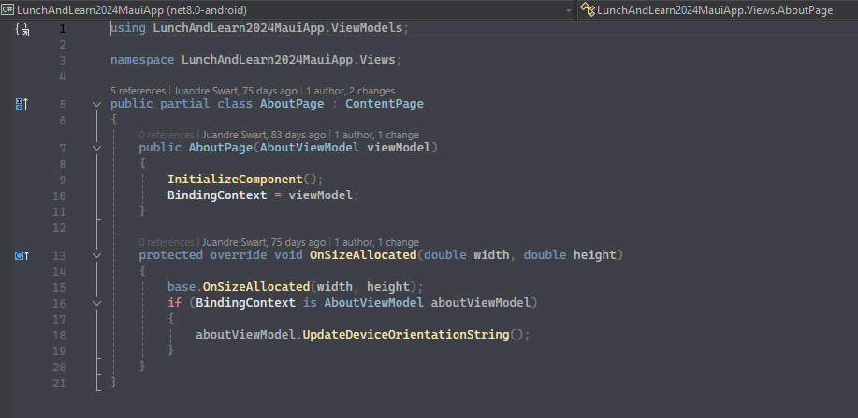
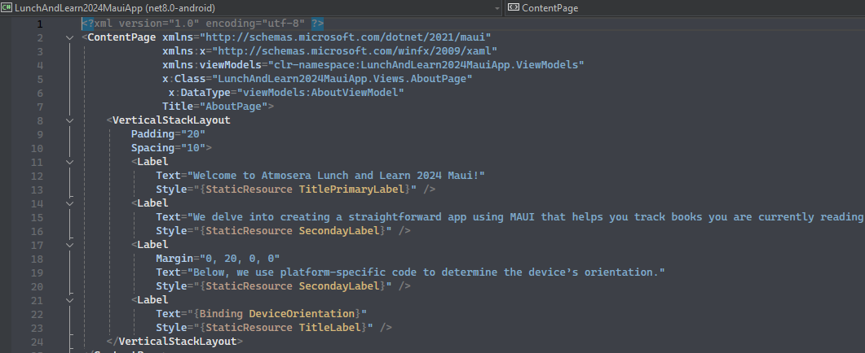
3. Working with .net maui
The following images shows how a xaml page/view will look like. Each xaml page/view has a corresponding c# class that initializes the content.

Slide 9
3. Working with .net maui
The following image shows how you can create a page/view just using code.
This is helpful when you dynamically add content.

Slide 10
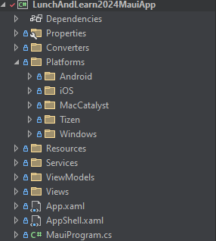
4. Platform specific code
A .NET MAUI app project contains a Platforms folder, with each child folder representing a platform that .NET MAUI can target
The folders for each platform contain platform-specific resources, and code that starts the app on each platform
Ways to use platform code:
Conditional compilation. #IF ANDROID
Partial Classes and Methods
Dependency Injection
Add native library to platform project.

Slide 11
DEMO
Juandré “Joe” Swart
joe.swart@atmosera.com

Slide 12
Thank You
Juandré “Joe” Swart
joe.swart@atmosera.com

