Slide 1
iStalk
Randy Jordan
Josh Moore
Jon Rall
Moustafa Ismael
Ben chieu

Slide 2
Project Overview
The software will be used to allow users to take photos of other users, which they can then tag with the system using facial recognition to recognize individuals in the photo.
It will also allow users to flag photos they deem inappropriate and administrators to review and delete those photos.
Users will be able to:
make profiles
delete profiles
un-tag pictures
upload pictures
add contacts
delete contacts
view profiles of their contacts
view photos they have uploaded
view photos tagged of any of their contacts
flag pictures as inappropriate.

Slide 3
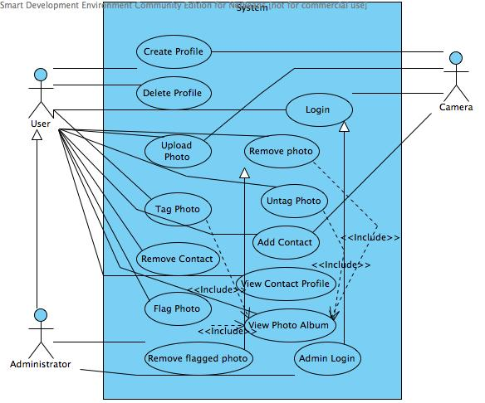
Use Cases

Slide 4
Sample Requirements
ID | Priority | Type | Source | Contained in Use Case(s) | Description
1 | High | F | Customer- John Smith | U1 | The system shall allow a user to create a profile storing their name, a photo, phone number, and email.
2 | Medium | F | Customer- John Smith | U1 | The system shall require every user to select a pin number.
3 | Medium | F | Customer- John Smith | U3 | The system shall require a user to take a photo of himself to login.
4 | High | F | Customer- John Smith | U3 | The system shall require users to enter their pins to login.
5 | Medium | F | Customer- John Smith | U3, U7 | The system shall compare images to stored profile photos to determine the identity of the persons in the picture.
24 | Low | NF | Customer- John Smith | N/A | The system shall identify images in less than 10 seconds.
25 | High | NF | Internal team | N/A | The system shall query the server no more than once every second per user.
26 | High | NF | Internal team | N/A | The system shall only allow photos less than 10mb in size to be uploaded.
27 | High | NF | Apple | N/A | The system shall conform to all iphone app standards.

Slide 5
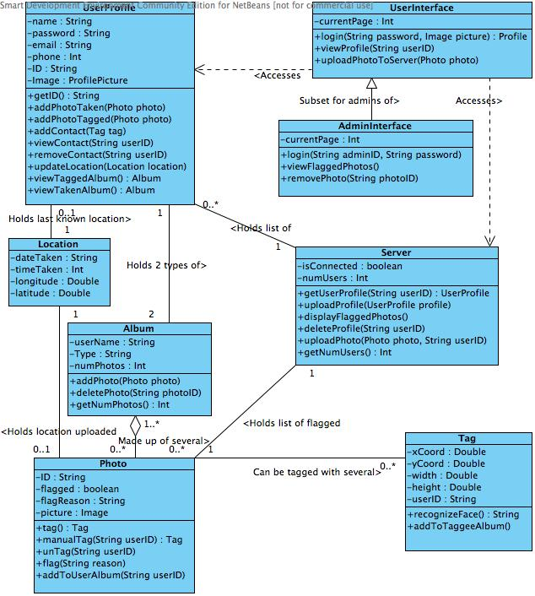
Class Diagram

Slide 6
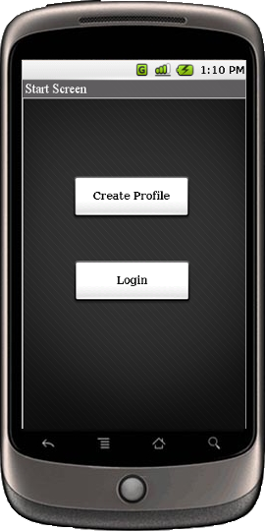
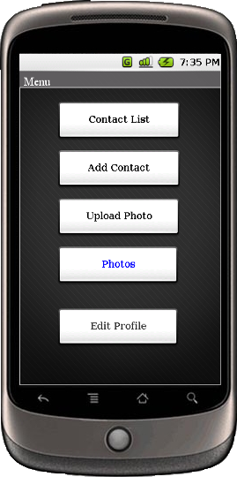
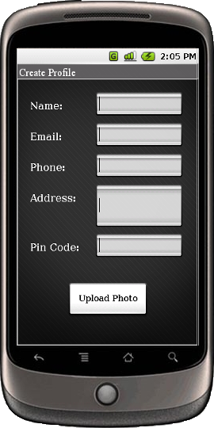
GUI prototype

Slide 7
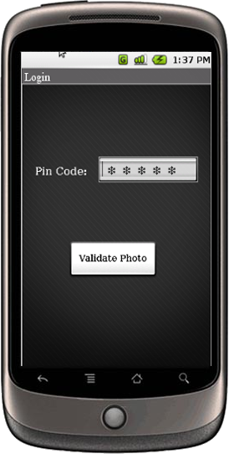
GUI prototype

Slide 8
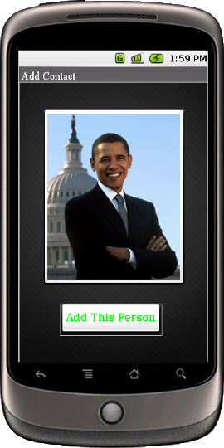
GUI prototype

Slide 9
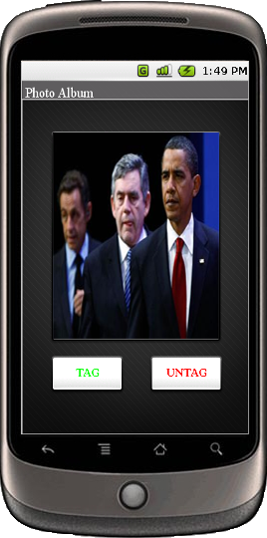
GUI Prototype

Slide 10
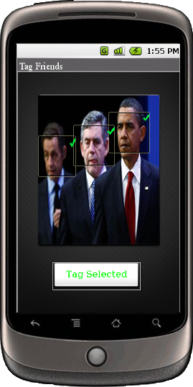
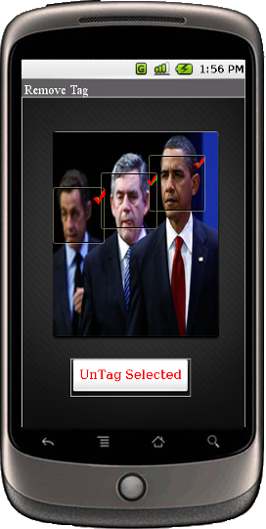
GUI Prototype

Slide 11
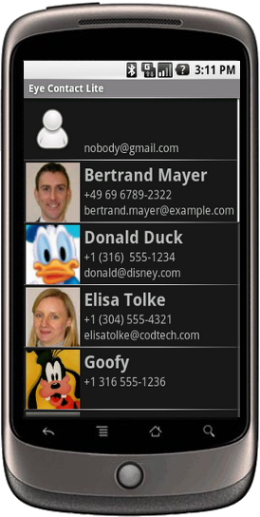
GUI prototype
All Nexus One images were taken from:
http://gmailblog.blogspot.com/2010/01/gmail-on-nexus-one.html

Slide 12
What was learned
Things that helped the most during the project was having a meeting where the majority of our group was there
Things that didn’t work would be waiting till the last minute to try to contact people to see if they had their stuff done and not having a set time and location to meet
The thing that we could have done different would be having more meetings and having better communication throughout the project.

Slide 13
Software Development
The part of the software development lifecycle that we found most useful would be:
CRC cards
Class Diagram
Activity Diagrams
The part of the software development lifecycle that we found least useful would be:
use cases
sequence diagram

Slide 14
Team Function
Our team functioned well when the communication was good and when we met and everyone pitched in their ideas
The time our team did not function well was when we could not find a time to meet where everyone was able to make it
Things that could have helped our team function would be Make a time and day that everyone could meet. If needed our team could meet and get things done.

