Slide 1

Introduction to Web Programming
Making your (first?) business website

Slide 2
Agenda
What is a web site?
Why do I need a website?
Brief overview of how the internet works
LET’s START BUILDING!

Slide 3
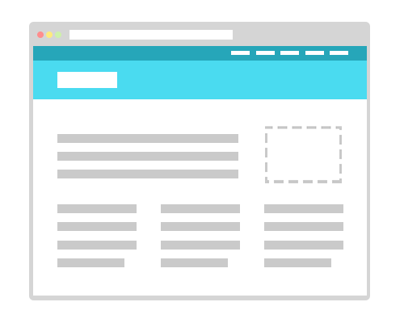
What is a website
Page called ‘home page’
With an address (what’s that?)

Slide 4
Why do I need a website?
Fastest way to present your business idea to an investor
Best way to find co-founders
Test your idea by sharing your website
Track visitor behaviour

Slide 5
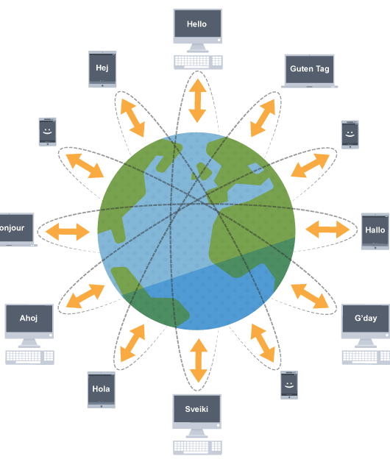
Internet overview
URL: Is text location address (www.google.com) [need addition setups to have that]
IP: Number address (64.233.191.255)
Each URL website is hosted from servers
Each IP website can be hosted from a computer

Slide 6
LET’S START CODING!

Slide 7

“The idea of waiting for something makes it more fascinating.”
–Andy Warhol

Slide 8
HTML
Paragraphs: <p>Hiiii</p>

Slide 9
CSS
Understand Hex colors (#FFFFFF - white, #000000 - black) (http://htmlcolorcodes.com/)

Slide 10

That’s it?
Rest is really common sense!

Slide 11
Cool, I know how to code, now what?

Slide 12
Steps
Download template: (www.workshop.developersfoundation.ca
Make an account on Heroku (www.heroku.com)
Design your website
Push to Heroku! Website is live!

