Slide 1
Blowfish Encryption Algorithm
Joshua Job
Gordon Standart

Slide 2
Introduction
Reason
Design Requirements and Decisions
Design Elements
Implementation
Cryptanalysis
Future Concerns

Slide 3
Reason / Justification
DES Weaknesses
  S-boxes
    Too small
    Not sufficiently random
  Key management / complexity
Other Issues
  Designed as general-purpose algorithm
  In the public domain
    C/C++, Java, C#, Visual Basic, Perl, Javascript
  One of the fastest block ciphers in widespread use
  Relatively large memory footprint. Generally not used for:
    Small embedded systems
    Early smartcards

Slide 4
Design Requirements
Fast
Compact
Simple to code
Flat keyspace
  Allow any random string (of required length) to be a possible key
Easily modifiable for different security levels

Slide 5
Design Decisions
Manipulate data in large blocks
  All operations use byte-sized blocks
  Operations use 32-bit blocks where possible
Scalable Key (32 to 448 bits)
Simple operation that are efficient on microprocessors
  XOR, Addition, Table lookup, etc
Employ Precomputable Subkeys
Variable number of iterations

Slide 6
Design Decisions
If possible, have no weak keys
  If not possible:
    Unlikely to choose a weak key
    Make weak keys explicitly known
No linear structures that reduce the complexity of exhaustive search
Use a design that is simple to understand
  Facilitate analysis
  Increase confidence in the algorithm
  Feistel iterated block cipher

Slide 7
Design Elements
64-bit block cipher with variable length key
Large key-dependent S-boxes
  More resistant to cryptanalysis
Key-dependent permutations
Diverse Mathematical Operations
  Combine XOR and addition

Slide 8
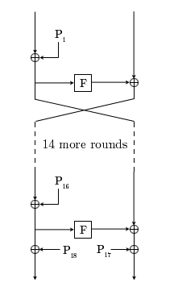
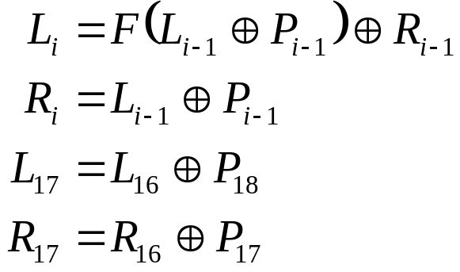
Implementation: Encryption
Arrays:
P – Number of rounds + 2 elements
4 S-boxes – 256 elements
Wikipedia, http://en.wikipedia.org/wiki/Image:BlowfishDiagram.png

Slide 9
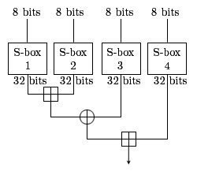
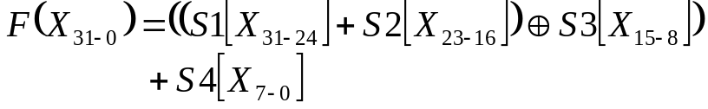
Implementation: Function F(x)
Addition is mod 2³²
Wikipedia, http://upload.wikimedia.org/wikipedia/en/8/81/BlowfishFFunction.png

Slide 10
Implementation: Subkey and S-Box Generation
Fill arrays with hexadecimal digits of pi
Xor P array with the key
Repeat
  Encrypt all zero string
  Replace two elements of p array or subkeys

Slide 11
Cryptanalysis
Differential Attack
  After 4 rounds a differential attack is no better than a brute force attack
Weak Keys
  S-box collisions

Slide 12
Future Concerns
Simplifications
  Fewer and Smaller S-boxes
  Fewer Iterations
  On-the-fly subkey calculation
Twofish
  AES Finalist
  128-bit Block Size
  More Operations

Slide 13
Summary
Reason / Justification
Design Elements
Implementation
Cryptanalysis
Future Concerns

Slide 14
References
Wikipedia (for illustrations)
  http://en.wikipedia.org/wiki/Blowfish_cipher
Applied Cryptography
  Bruce Schneier
  John Wiley and Sons, Inc. 1996
The Blowfish Paper
  http://www.schneier.com/paper-blowfish-fse.html

