Slide 1






Unit Testing workshop
TDD, Mocking and something else…

Slide 2
objectives
Introduce to Unit Testing
Create Basic Unit tests with JUnit
Introduce to Test Driven Development
Use mock objects to isolate our tests
Know and apply some best practices writing unit tests
Integration exercises
Convert you to the TDD religión and give me all your belongings… ☺

Slide 3


Why is important to test your software?
Check if it works as expected
Find bugs and fix them

Slide 4
How do you test your software?
Exercise
Write a Java class that have a method who receives a String that represents a name and returns the word “Hello” concatenated with the name you provide.
Example:
HelloWorld.sayHello(“Benjamin”) must return “Hello Benjamin!”

Slide 5
Some developers and companies think that UNIT TESTING is…
Test the whole system seeing the ouput of results.

Slide 6
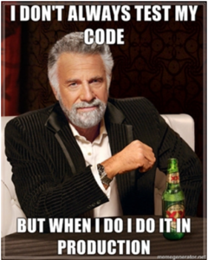
Don’t be this guy…

Slide 7
Whats WrONG with Manual tests?
Error prone
Difficult to repeat
Depends on Human Interaction
Tedious
Time consuming
Not documented the most of the times
Bugs could be introduce easily

Slide 8
Unit test: my definition
“A very single piece of code that checks an expected result with specific scenario or input and it is isolated from the rest of the system”

Slide 9
Properties of a good unit test
Automated
It should checks automatically the result
Repeateble
It should be repeateble for new executions
Accumulative
Available for anyone
Anyone should be able to run it
Practical
Every test remains for future use
You can run from an IDE button or a console command
Fast
It should run quickly
Independent
It does not depends on filesystem, database or any external resource
Reliable
A test must only fail by the right reasons.

Slide 10
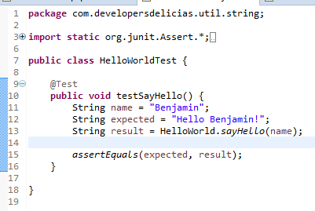
Write a single unit test using junit

Slide 11
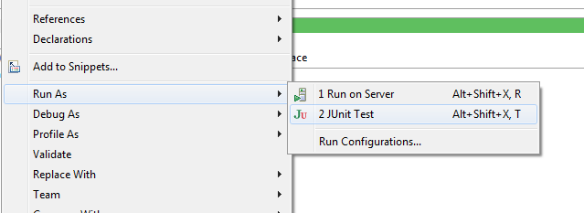
RUNNING THE TEST
Open context menu on the file class and select:

Slide 12
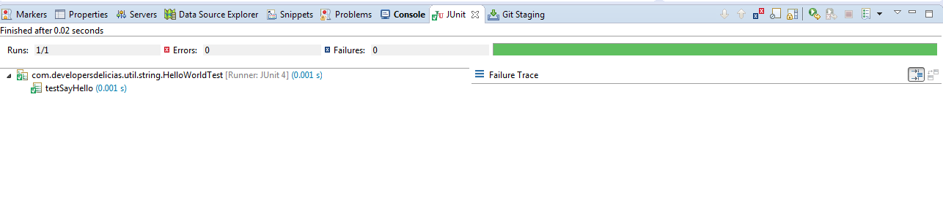
CHECK TEST RESULTS

Slide 13
Junit 4 annotations
Annotation | Use
@Test | Identifies a test method
@Before | This method is executed before each test. It is used to prepare the test environment (e.g., read input data, initialize the class).
@BeforeClass | This method is executed once, before the start of all tests. It is used to perform time intensive activities, for example, to connect to a database. Methods marked with this annotation need to be defined as static to work with JUnit.
@After | This method is executed after each test. It is used to cleanup the test environment (e.g., delete temporary data, restore defaults). It can also save memory by cleaning up expensive memory structures.
@AfterClass | This method is executed once, after all tests have been finished. It is used to perform clean-up activities, for example, to disconnect from a database. Methods annotated with this annotation need to be defined as static to work with JUnit.
@Ignore | Ignores the test method. This is useful when the underlying code has been changed and the test case has not yet been adapted. Or if the execution time of this test is too long to be included. It is best practice to provide the optional description, why the test is disabled.

Slide 14
assertions
Statement | Description
void fail(String message) | Let the method fail. Might be used to check that a certain part of the code is not reached or to have a failing test before the test code is implemented. The message parameter is optional.
assertTrue([String message,] boolean condition) | Checks that the boolean condition is true.
assertFalse([String message,] boolean condition) | Checks that the boolean condition is false.
assertSame([String message,] Object expected, Object actual) | Checks that both variables refer to the same object.
assertNotSame([String message,] Object expected, Object actual) | Checks that both variables refer to different objects.

Slide 15
assertions
Statement | Description
assertEquals([String message,] Object expected, Object actual) | Tests that two values are the same. Note: for arrays the reference is checked not the content of the arrays.
assertEquals([String message,] Object expected, Object actual, int tolerance) | Test that float or double values match. The tolerance is the number of decimals which must be the same.
assertNull([String message,] Object object) | Checks that the object is null.
assertNotNull([String message,] Object object) | Checks that the object is not null.

Slide 16


Slide 17
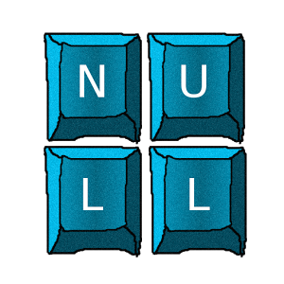
CODE SMELLS
We now have all (just one) requirements passed. But you’ve realised that a null value can be passed.
You are not sure how the method needs to manage this input so you asked your manager/lead.
She/He said you if there is a null value you must return the default value “Hello World!”

Slide 18
What should you do next?
Modify your code and resuse the test you write before and test
Modify your code and a new test method to check this new requirement
Forget it. Null value won’t be passed because we validated the entry
Another idea…?

Slide 19
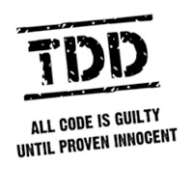
INTRODUCE TO TEST DRIVEN DEVELOPMENT
Test Driven Development or TDD is a discipline who enforce Testing as the base of the software development.
Basically it say that you need to write the tests before you write any production code.
It improves your software development because every scenario is covered by a unit test, so you gain confidence about your code.
A principle of TDD is “Small is better”

Slide 20
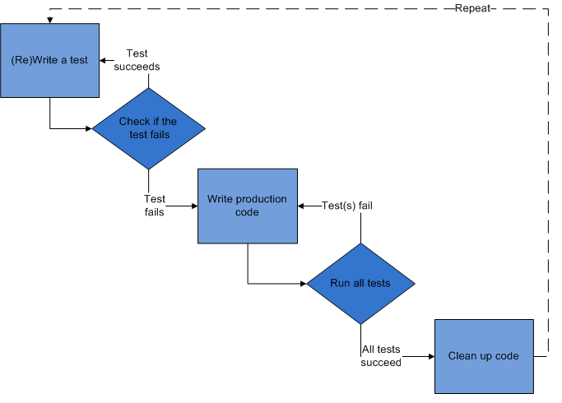
TDD PROCESS
RUN

Slide 21
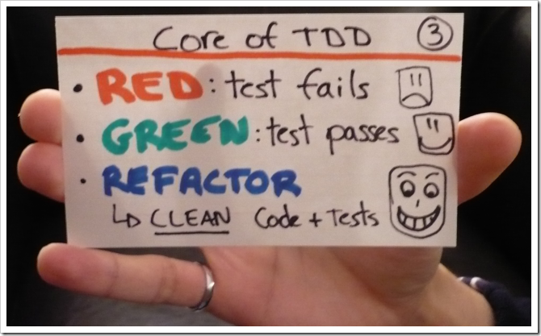
Or simpler…

Slide 22
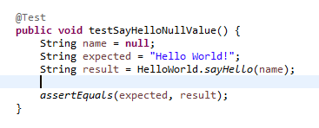
APPLYING TDD TO OUR new requirement
1. Write a test

Slide 23
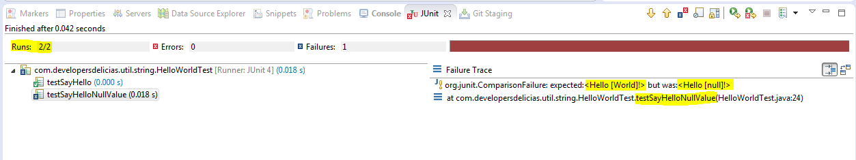
2. Run the tests

Slide 24
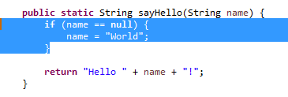
3. Modify the production code

Slide 25
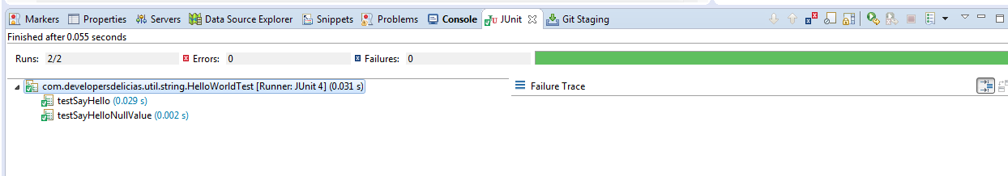
4. Run the test again

Slide 26
TDD WORKSHOP

Slide 27
unit tests best practices
Use TDD approach
Avoid tests with real (production) data
Never skip tests
Just one assertion per test method
Use the same package as the Class under test
Use separate directory for tests
Write as many different scenarios you can have (Do not repeat the same test)

Slide 28
unit tests best practices (continues)
Do not catch exceptions to check if an exception is thrown
Use Loggers in your production code only
Use Build tools like Maven or Gradle
Check test coverage
Isolate your test using Mock frameworks
Keep tests small and fast
Use meaningfull test method names: See convention I suggest
Ensure that unit tests run completely in-memory

Slide 29
unit tests best practices (continues)
Use the most appropriate assertion methods
Put assertion parameters in the proper order
Use initialization Annotations (@Before, @BeforeClass)
Write independent tests
Refactor your test code
Do not commit failed tests
Create abstract tests for interfaces or abstract classes

Slide 30
MYTHS OF UNIT TESTING (AUTOMATIC)
Myth 1: It makes changes more difficult to make
Myth 2: It slows down the development process
Myth 3: It disconnects the developers from the code
Myth 4: It makes documentation more difficult
Myth 5: The work gone into making unit tests is wasted once the project is finished
Myth 6: It’s a waste of time

Slide 31
MYTHS OF UNIT TESTING (AUTOMATIC) part 2
Myth 7: But it’s such simple code, why write a test?
Myth 8: You only need unit testing when there are many developers
Myth 9: It doesn’t help debugging or prevent bugs
Myth 10: Unit testing makes you code differently
Myth 11: Debugging isn’t complete
Myth 12: Unit testing increases development costs

Slide 32
RECOMMENDED RESOURCES
Tutorials
http://www.vogella.com/tutorials/JUnit/article.html
Books
https://www.manning.com/books/junit-in-action-second-edition
The Art of Unit Testing with examples in .NET – Roy Osherove – Manning 2009
Videos
https://www.youtube.com/user/osherove/videos

Slide 33

About ME
Benjamín Cisneros (cisnerosbarraza@gmail.com)
Java Developer with 4 years of experience
From Delicias Chihuahua and very proud to be ITD Halcón
Very passionated about Software Development using the Best Practices
Always looking for challenge projects

