Slide 1






Unit Testing workshop
TDD, Mocking and something else…

Slide 2
objectives
Introduce to Unit Testing
Create Basic Unit tests with JUnit
Introduce to Test Driven Development
Use mock objects to isolate our tests
Know and apply some best practices writing unit tests
Integration exercises
Convert you to the TDD religion and give me all your belongings… ☺

Slide 3


Why is important to test your software?
Check if it works as expected
Find bugs and fix them

Slide 4
How do you test your software?
Exercise
Write a Java class that have a method who receives a String that represents a name and returns the word “Hello” concatenated with the name you provide.
Example:
HelloWorld hello = new HelloWorld();
String result = hello.sayHello(“Benjamin”);
//should return “Hello Benjamin!”

Slide 5
Some developers and companies think that UNIT TESTING is…
Test the whole system seeing the ouput of results.

Slide 6

Don’t be this guy…

Slide 7
Whats WrONG with Manual tests?
Error prone
Difficult to repeat
Depends on Human Interaction
Tedious
Time consuming
Not documented the most of the times
Bugs could be introduce easily

Slide 8
Unit test: my definition
“A very single piece of code that checks an expected result with specific scenario or input and it is isolated from the rest of the system”

Slide 9
Properties of a good unit test
Automated
It should checks automatically the result
Repeateble
It should be repeateble for new executions
Accumulative
Available for anyone
Anyone should be able to run it
Practical
Every test remains for future use
You can run from an IDE button or a console command
Fast
It should run quickly
Independent
It does not depends on filesystem, database or any external resource
Reliable
A test must only fail by the right reasons.

Slide 10
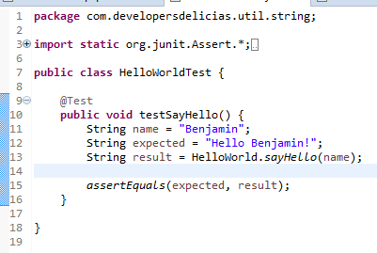
Write a single unit test using junit

Slide 11
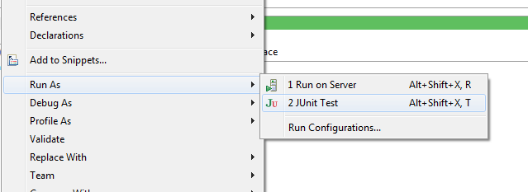
RUNNING THE TEST
Open context menu on the file class and select:

Slide 12
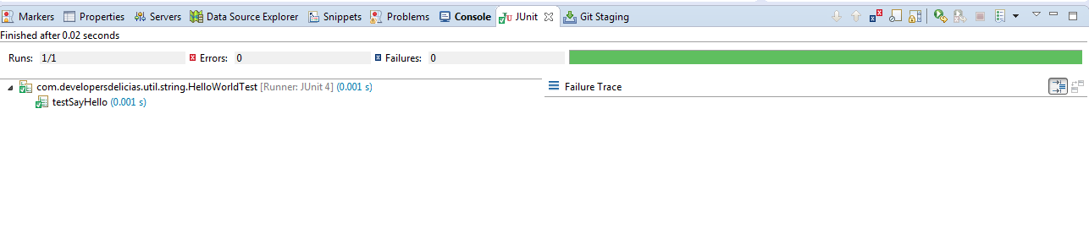
CHECK TEST RESULTS

Slide 13
Junit 4 annotations
Annotation | Use
@Test | Identifies a test method
@Before | This method is executed before each test. It is used to prepare the test environment (e.g., read input data, initialize the class).
@BeforeClass | This method is executed once, before the start of all tests. It is used to perform time intensive activities, for example, to connect to a database. Methods marked with this annotation need to be defined as static to work with JUnit.
@After | This method is executed after each test. It is used to cleanup the test environment (e.g., delete temporary data, restore defaults). It can also save memory by cleaning up expensive memory structures.
@AfterClass | This method is executed once, after all tests have been finished. It is used to perform clean-up activities, for example, to disconnect from a database. Methods annotated with this annotation need to be defined as static to work with JUnit.
@Ignore | Ignores the test method. This is useful when the underlying code has been changed and the test case has not yet been adapted. Or if the execution time of this test is too long to be included. It is best practice to provide the optional description, why the test is disabled.

Slide 14
assertions
Statement | Description
void fail(String message) | Let the method fail. Might be used to check that a certain part of the code is not reached or to have a failing test before the test code is implemented. The message parameter is optional.
assertTrue([String message,] boolean condition) | Checks that the boolean condition is true.
assertFalse([String message,] boolean condition) | Checks that the boolean condition is false.
assertSame([String message,] Object expected, Object actual) | Checks that both variables refer to the same object.
assertNotSame([String message,] Object expected, Object actual) | Checks that both variables refer to different objects.

Slide 15
assertions
Statement | Description
assertEquals([String message,] Object expected, Object actual) | Tests that two values are the same. Note: for arrays the reference is checked not the content of the arrays.
assertEquals([String message,] Object expected, Object actual, int tolerance) | Test that float or double values match. The tolerance is the number of decimals which must be the same.
assertNull([String message,] Object object) | Checks that the object is null.
assertNotNull([String message,] Object object) | Checks that the object is not null.

Slide 16
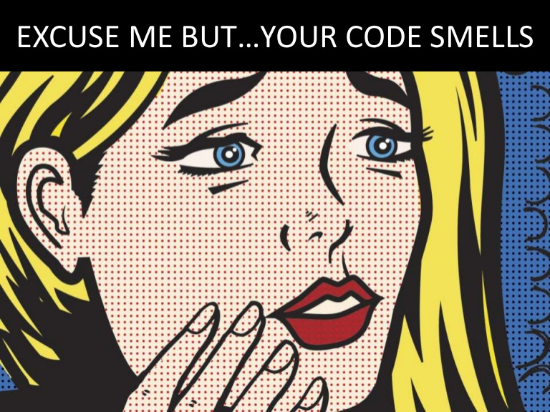

Slide 17

CODE SMELLS
We now have all (just one) requirements passed.
But you’ve realised that a null value can be passed.
You are not sure how the method needs to manage this input so you asked your manager/lead.
She/He said you if there is a null value you must return the default value “Hello World!”

Slide 18
What should you do next?
Modify your production code and resuse the test you write before and test
Modify your production code and a new test method to check this new requirement
Forget it. Null value won’t be passed because we validated the entry
Another idea…?

Slide 19

INTRODUCE TO TEST DRIVEN DEVELOPMENT
Test Driven Development or TDD is a discipline who enforce Testing as the base of the software development.
Basically it say that you need to write the tests before you write any production code.
It improves your software development because every scenario is covered by a unit test, so you gain confidence about your code.
A principle of TDD is “Small is better”

Slide 20
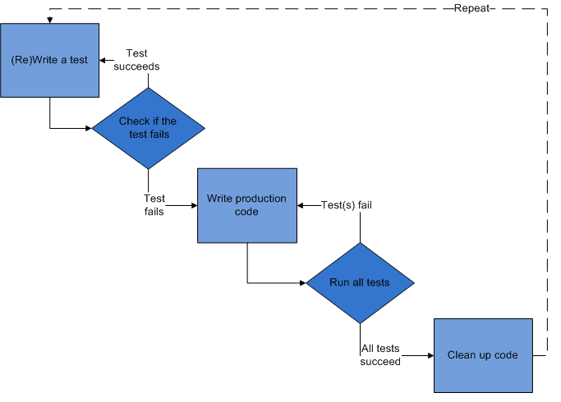
TDD PROCESS
Note: Even code does not compile
RUN
Refactor and test if possible

Slide 21
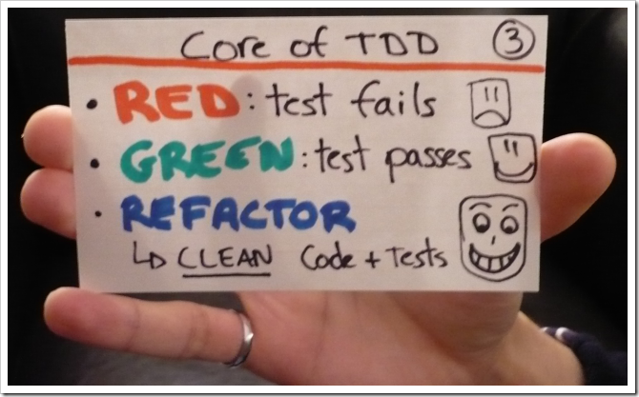
Or simpler…

Slide 22
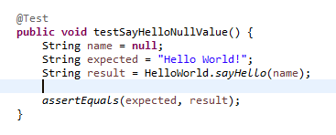
APPLYING TDD TO OUR new requirement
1. Write a test

Slide 23
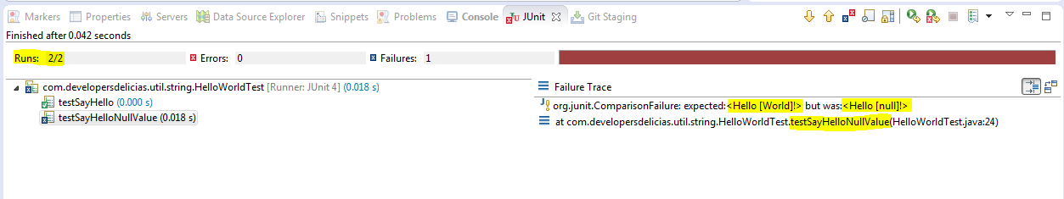
2. Run the tests

Slide 24
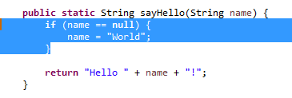
3. Modify the production code

Slide 25
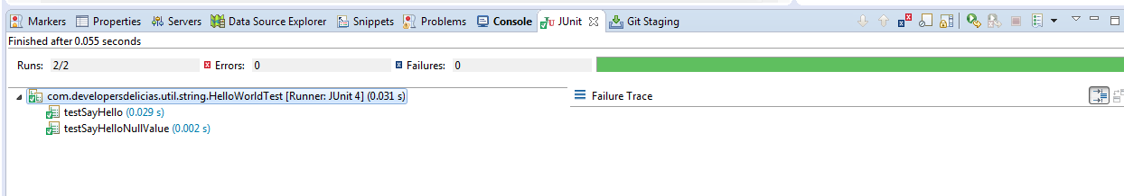
4. Run the test again

Slide 26
INTEGRATION PRACTICE
Problem Statement:
Natan is a Palindrome fanatic and he spends a lot of time creating new and complex palindromes in his free time.
But he wants an application where he can type a phrase and it can determine if it is a palindrome and also calculate tthe palindrome complexity.
If you are wondering what is a palindrome, it is just a phrase that have the same letters when you read from left to right and viceversa.

Slide 27
INTEGRATION PRACTICE-examples
oso
taco cat
Race car
Amor, Roma
Was it a car or a cat I saw?
No 'x' in Nixon
Campus motto: Bottoms up Mac.
Marge lets Norah see Sharon’s telegram.
A man, a plan, a canal, Panama!
Are we not pure? “No sir!” Panama’s moody Noriega brags. “It is garbage!” Irony dooms a man; a prisoner up to new era.
More examples at:
http://www.palindromelist.net/

Slide 28
INTEGRATION PRACTICE
Open your git console and move to your projects folder:
cd /path/to/your/projects
Clone the repository
git clone https://github.com/bcisneros/tdd_workshop.git
Configure your repository
git config user.name “Benjamin Cisneros”
git config user.email “cisnerosbarraza@gmail.com”

Slide 29
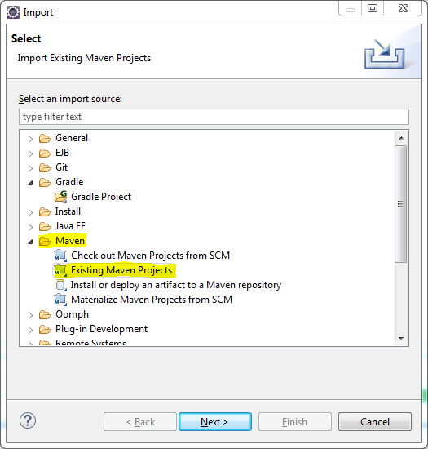
INTEGRATION PRACTICE
Open your project in Eclipse
File / Import..

Slide 30
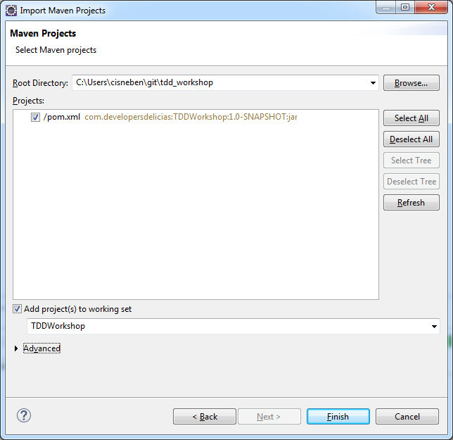
INTEGRATION PRACTICE
Select your Project folder
and select the pom.xml

Slide 31
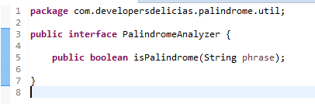
Add PalindromeAnalyzer interface

Slide 32
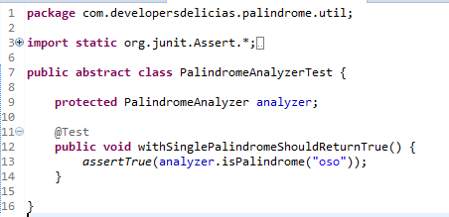
Create an abstract test class

Slide 33
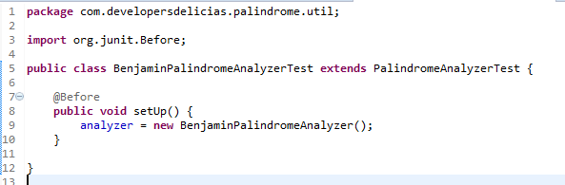
Create your own implementation test class

Slide 34
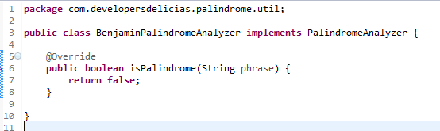
And create your own implementation of PalindromeAnalyzer

Slide 35
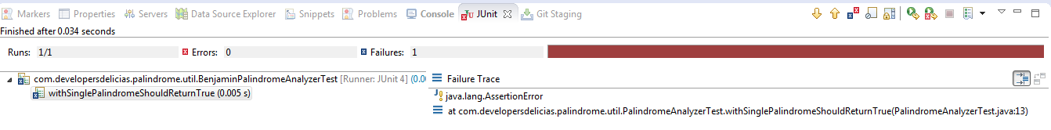
Run the test

Slide 36
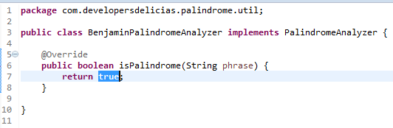
Change the mínimum code to pass this test

Slide 37
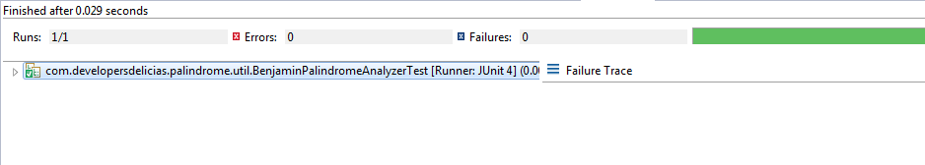
Run the test again

Slide 38
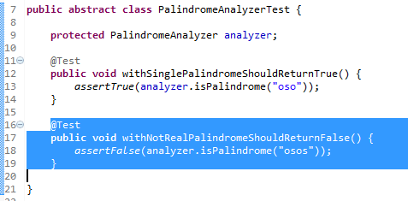
Add a new test, In this case we test the other scenario to créate a test that fails

Slide 39
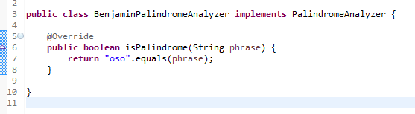
Add mínimum code to pass this test

Slide 40
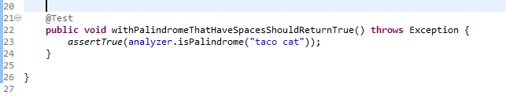
Add new test case

Slide 41
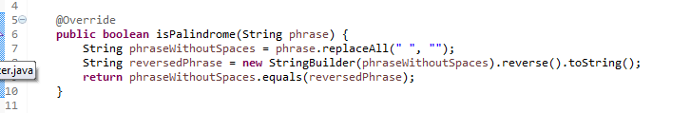
Change code to pass

Slide 42
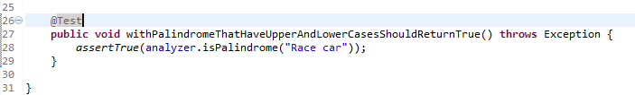
Add new test

Slide 43
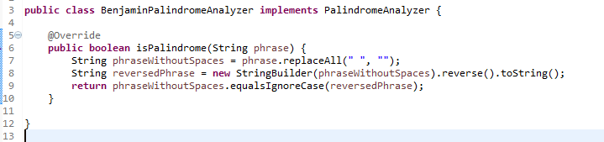
We remove all the spaces from the original phrase

Slide 44

Add new test

Slide 45

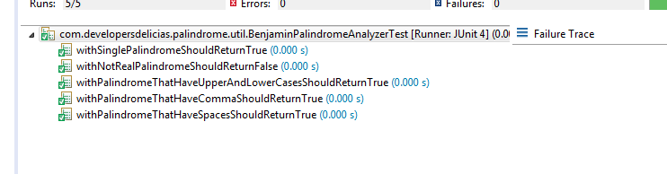
For some reason no code was needed to pass this test

Slide 46
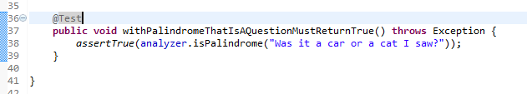
Add new test

Slide 47
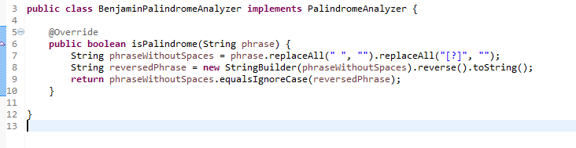
We remove all the question marks

Slide 48

Add new test

Slide 49
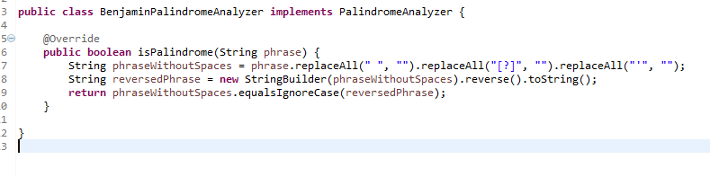
Remove the palindromes

Slide 50

Add new test

Slide 51
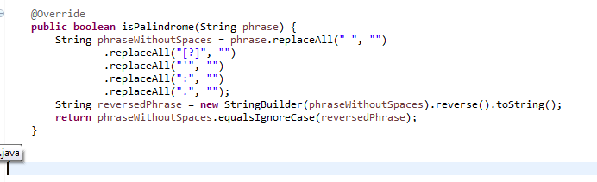

Slide 52
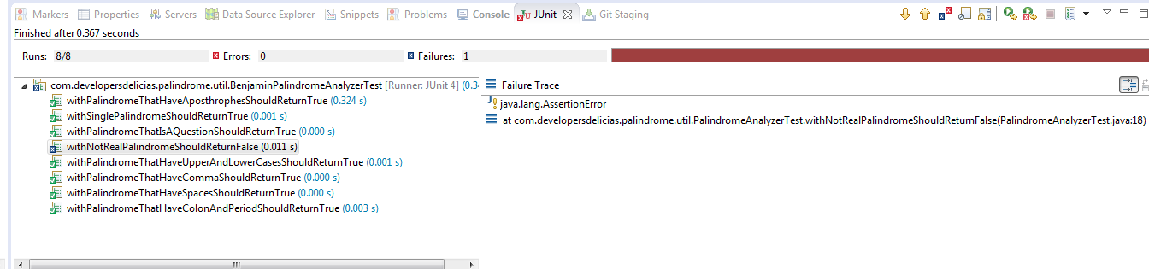
But…
We passed the new test but we fail another test we already passed.

Slide 53

We need to debug. But we are going to use logger features to créate ease this.
Add this dependency to your pom.xml if not present yet.

Slide 54
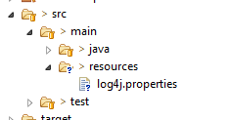
Create a log4j.properties file into src/main/resources directory

Slide 55
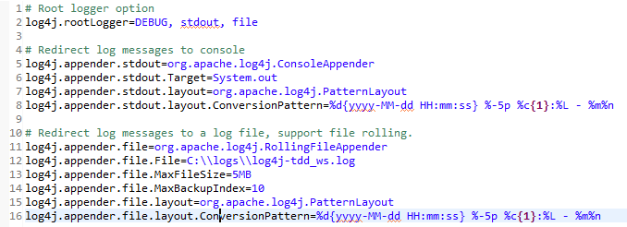
Add this properties to log4j.properties file

Slide 56
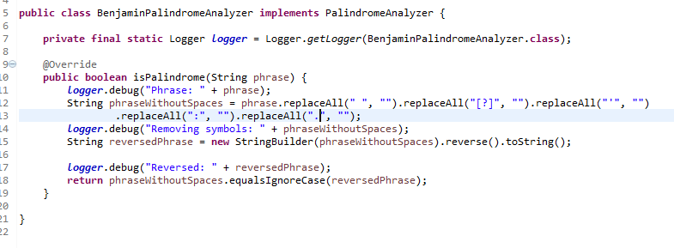
And create a Logger instance and call the debug method as you need.

Slide 57
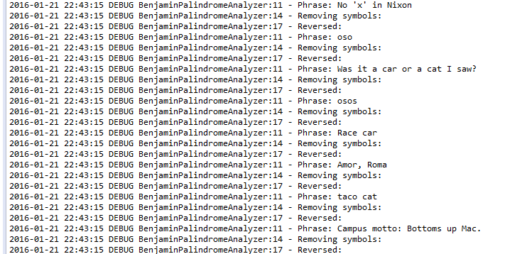
Check the ouput
All characters were removed for all test

Slide 58
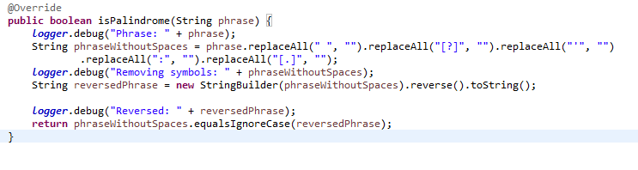
Problem was the replace for “.” because have a special meaning as Regexp

Slide 59


Slide 60
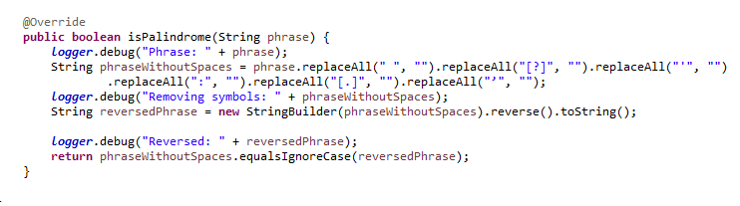

Slide 61


Slide 62
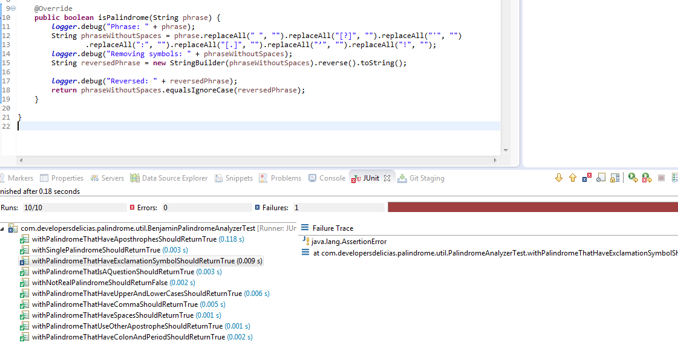

Slide 63
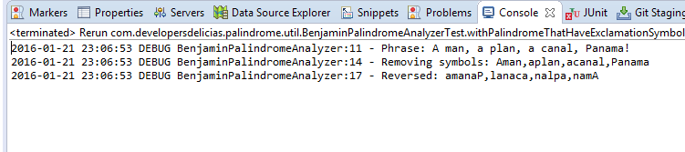

Slide 64
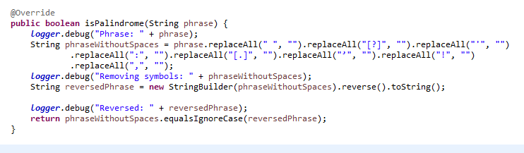

Slide 65
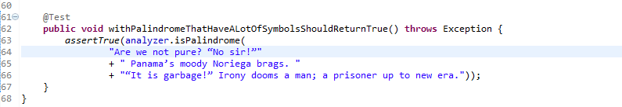

Slide 66
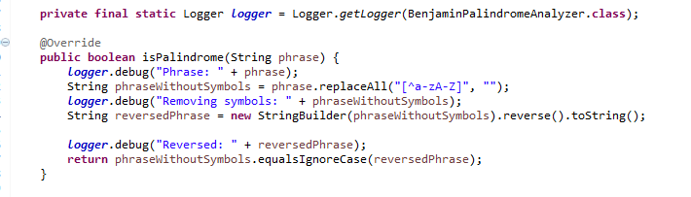
We can now refactor because we know that a palindrome must need to remove any character that is not alphabetic

Slide 67


Slide 68
But he have now some code smells again
What happen if you pass a null value, or a empty String, or even a String that have only non-alphabetic characters?
Natan say that everything else is not a palindrome so you need to test yor methods with not real palindromes values.
We add new tests

Slide 69

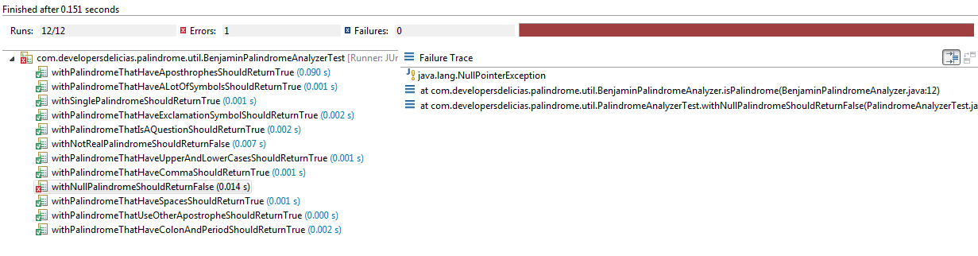

Slide 70
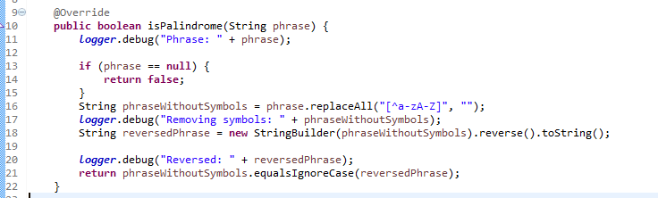

Slide 71


Slide 72
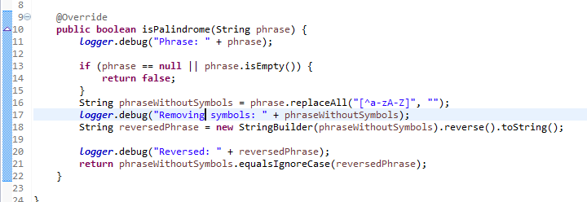

Slide 73


Slide 74


Slide 75
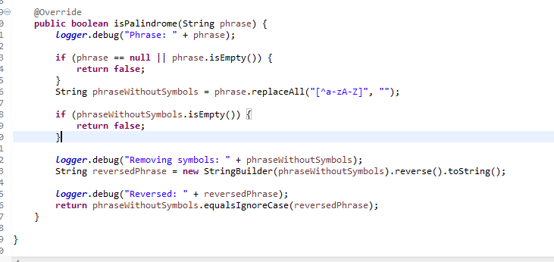

Slide 76
Now we are going to implement the next requirement: Complexity Calculation
Natan said that complexity depends on the number of words the palindrome has as shown next:
Number of words | Complexity
1-3 | Low
4-6 | Medium
7 or more | Low

Slide 77
Implementation
We can add new method inside PalindromeAnalyzer, but we are broking the Single Responsability principle.
So we create a new interface called PalindromeComplexityCalculator with a calculate method

Slide 78
But BEFORE TO START WRITING CODE..
We are going to do some of Design here.
We looked that are only three possibilities for the complexity of a Palindrome so instead of return a String object we are going to create a new enum class called PalindromeComplexity with this three posible values.
And if you realized, what happen if you pass an invalid palindrome. It could not be determined. Instead of return a null value we are going to throw an InvalidPalindromeException in our method.

Slide 79
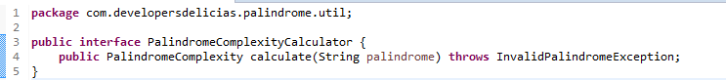
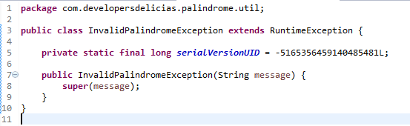


Slide 80
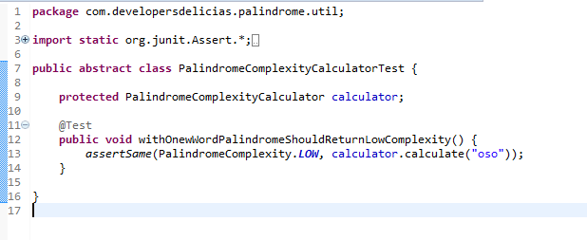
Add base test for this interface

Slide 81
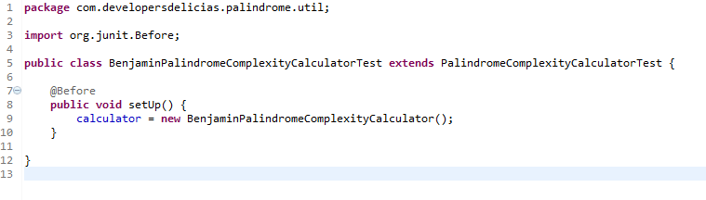
Add new test

Slide 82

Add your own implementation to pass this test

Slide 83

We add a new test for Medium Complexity

Slide 84


Slide 85


Slide 86


Slide 87

Add a new test to check if an InvalidPalindromeException is thrown

Slide 88

We now add a Colaboration with our PalindromeAnalyzer

Slide 89

We can change our last test using Junit @Test(expected = Exception.class)

Slide 90
We can add more test for the other cases adding more methods but, we are going to do something better.
We are going to use Parameterized test.
Hint: Because we need different parameters depending on the test we are going to use other library different that Junit provide because this runs for all the test with the same parameters.

Slide 91


Slide 92


Slide 93


Slide 94


Slide 95


Slide 96


Slide 97


Slide 98


Slide 99


Slide 100


Slide 101

PAY DAY
This is the pay day. We show Natan our
Fantastic PalindromeAnalyzer and he is very
Excited.
And he tells a short story about his fascination with Palindromes.
“First my name is also a Palindrome. My mother’s name is Ana and my Father’s name is Otto. My first car was “A Toyota!” and my wife’s name is Emily Lime. Everywhere I am I see palindromes. Also when my daugther was born was a palindrome: January 2nd of 2010 (01-02-2010). Is so big my fascination with palindromes that always I check in my car if the current miles is a palindrome. In fact, number palindromes has different complexity…”

Slide 102
Natan give us a new definition about number palindromes:
Number of digits | Complexity
1-10 | Low
11-20 | Medium
21 or more | Low

Slide 103

So we add a new test obviously

Slide 104

It fails because we do not considered number as palindromes.

Slide 105

As you see is easy to change the PalindromeAnalyzer implementation and resolve this. But we have a problem..
First we have a direct dependency with BenjaminPalindromeAnalyzer and it occurs when we create the instance inside the calculate method
What happen if we want to change for another implementation?

Slide 106

We are going to “Inject” this dependency

Slide 107

Now we fix our test because it does not compiles anymore

Slide 108
But doing this is almost the same we try to avoid, because your test is depending on two different implementations.
We need to isolate the test for the ComplexityCalculator and the Analyzer.
We need Mock Objects!

Slide 109
MOCK OBJECTS
A Mock object is an object that simulates an implementation of determined service but it does not provide the real implementation. You can use in your test safely because you control the results an behaviour they have.
ComplexityCalculator does not need to know if a determined String is a Palindrome because it is the Analyzer work.
It supposed this class work fine and the test need to be aimed to dermeine only the complexity.

Slide 110
Mock FRAMEWORKS
There are a lot of Mock Frameworks for Java
Most popular are:
Jmock
EasyMock
Mockito
We are going to use Mockito

Slide 111

Add Mockito to your dependencies

Slide 112

We create a mock object and pass it to our ComplexityCalculator.

Slide 113

If you run the test you can check that almost the test fails only with invalid palindromes passed. It is because mockito provides a default implementation, but we are going to change it.

Slide 114



Slide 115


Slide 116

We configure all for low complexity

Slide 117
We can continue with the other but as you see we are duplicating code, so it is time to refactor
First we are going to create a Utility class that provides Palindromes. This class is for test purpososes only so it is going under test directory folder

Slide 118


Slide 119


Slide 120

If you run your test now “magically” they pass

Slide 121
But we still have problems with code duplication
We are going to refactor our test to use the new TestPalindromeProvider in ComplexityCalculatorTest

Slide 122

Change your Palindrome provider to add a new method for low complexityPalindromes

Slide 123


Slide 124


Slide 125
Now all our test pass. We are doing a great job!
But we still duplicate code because in PalindromeAnalyzer because there are still duplicated palindromes.
If you see we create very descriptive test for this class, but if we want to refactor we loss this description of the test. We are going to use an overloaded versión of assertions to provide this description.

Slide 126

Create a more generic test method

Slide 127

And we see the error because we have not fixed the new requirement yet.

Slide 128

We are going to add now all our test cases and clean up our test

Slide 129


Slide 130


Slide 131

Now we fix our code

Slide 132
Now we concentrate in our new definitions
Add test for number palindrome complexity

Slide 133


Slide 134

Refactoring our code

Slide 135
unit tests best practices
Use TDD approach
Avoid tests with real (production) data
Never skip tests
Just one assertion per test method
Use the same package as the Class under test
Use separate directory for tests
Write as many different scenarios you can have (Do not repeat the same test)

Slide 136
unit tests best practices (continues)
Do not catch exceptions to check if an exception is thrown
Use Loggers in your production code only
Use Build tools like Maven or Gradle
Check test coverage
Isolate your test using Mock frameworks
Keep tests small and fast
Use meaningfull test method names: See convention I suggest
Ensure that unit tests run completely in-memory

Slide 137
unit tests best practices (continues)
Use the most appropriate assertion methods
Put assertion parameters in the proper order
Use initialization Annotations (@Before, @BeforeClass)
Write independent tests
Refactor your test code
Do not commit failed tests
Create abstract tests for interfaces or abstract classes

Slide 138
MYTHS OF UNIT TESTING (AUTOMATIC)
Myth 1: It makes changes more difficult to make
Myth 2: It slows down the development process
Myth 3: It disconnects the developers from the code
Myth 4: It makes documentation more difficult
Myth 5: The work gone into making unit tests is wasted once the project is finished
Myth 6: It’s a waste of time

Slide 139
MYTHS OF UNIT TESTING (AUTOMATIC) part 2
Myth 7: But it’s such simple code, why write a test?
Myth 8: You only need unit testing when there are many developers
Myth 9: It doesn’t help debugging or prevent bugs
Myth 10: Unit testing makes you code differently
Myth 11: Debugging isn’t complete
Myth 12: Unit testing increases development costs

Slide 140
RECOMMENDED RESOURCES
Tutorials
http://www.vogella.com/tutorials/JUnit/article.html
Books
https://www.manning.com/books/junit-in-action-second-edition
The Art of Unit Testing with examples in .NET – Roy Osherove – Manning 2009
Videos
https://www.youtube.com/user/osherove/videos

Slide 141

About ME
Benjamín Cisneros (cisnerosbarraza@gmail.com)
Java Developer with 4 years of experience
From Delicias Chihuahua and very proud to be ITD Halcón
Very passionated about Software Development using the Best Practices
Always looking for challenging projects

