Slide 1
EverHustle Your productivity partner
Supervisor:
Dr. Jayant Gadge
Members:
Chirag Mahajan – 1902088
Aniket More – 1902103
Shyren More – 1902104

Slide 2
Problem Statement
This pandemic has resulted in drop of productivity for most people, they are not accustomed to doing ‘work from home’.
Also, there is no single webapp for all the required productivity tools
EverHustle serves this exact purpose

Slide 3
Features
Notes
Reminders(via email)
Set daily, weekly, monthly goals
Timer
Articles

Slide 4
Notes
Make your own personalized notes
Organize them!!
List down any important point
Reminders
Schedule day wise reminders for events, submissions, projects,or any other professional or personal things
Get personalised reminders via email
Goals
Keep track of your goals
Organise them as daily, weekly, monthly
Timer
Keep track of your productive time.
The timer will track & save day-wise productive activity
Articles
Feeling demotivated?
Our articles based on productivity, self-help, motivation will help you overcome your limits

Slide 5
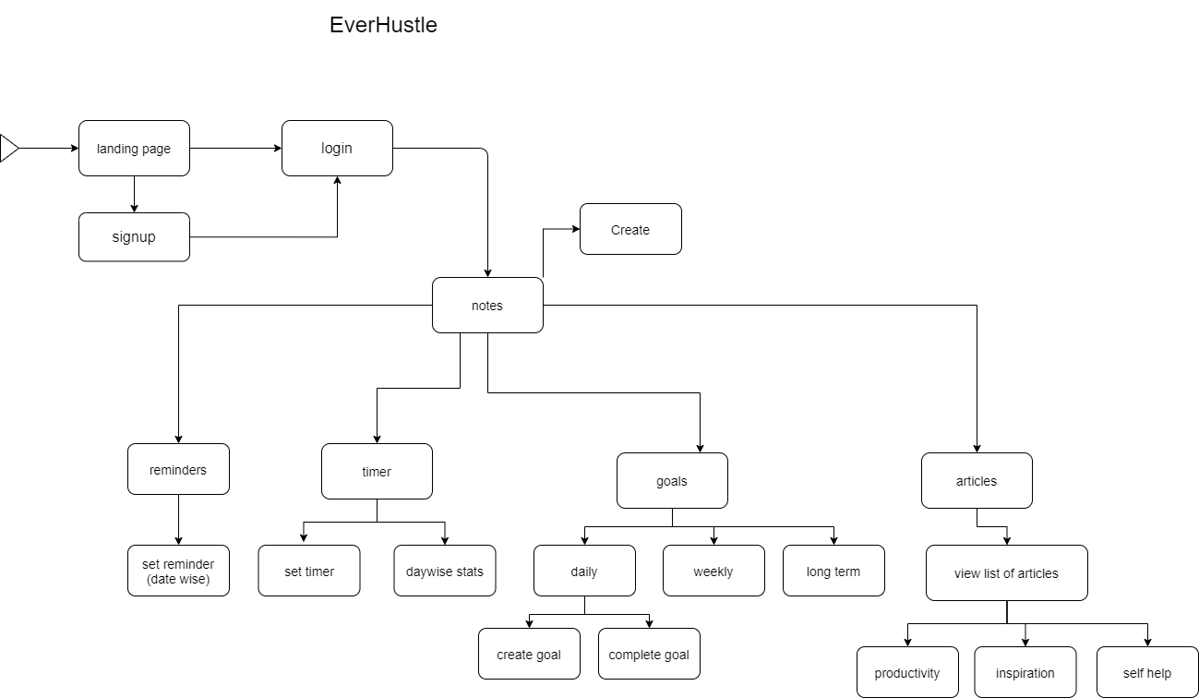
Block Diagram

Slide 6
Tools & Tech
Front-end
React.js
HTML
CSS
Back-end
MongoDB
TypeScript
Express.js
Node.js
Tools
VSCode
GitHub/Git
React-developer-tools

Slide 7
Screenshots
‹#›

Slide 8
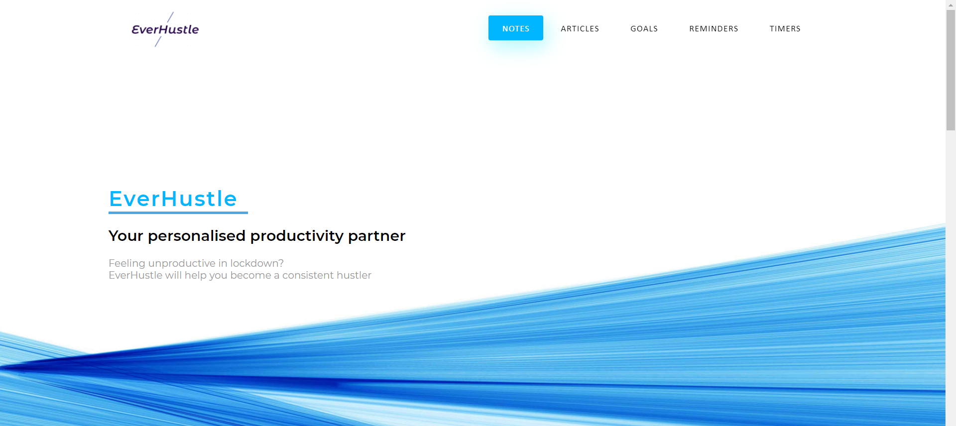
Landing page

Slide 9
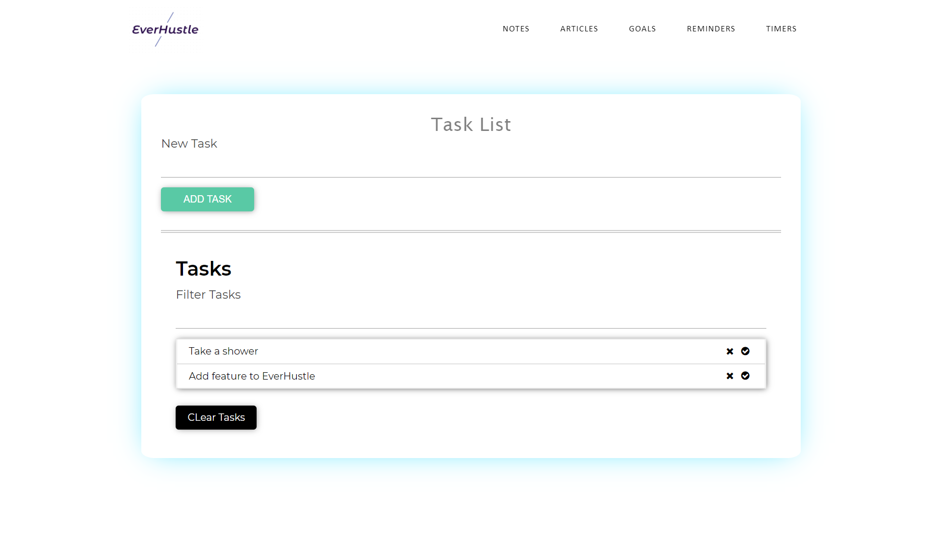
Task List page

Slide 10
View our website 👇
https://everhustle.netlify.app/

Slide 11
THANKS!
Any questions?

