Slide 1

Topic modelling using latent Dirichlet allocation
Uncovering Hidden Themes in Text Data
Digesh Patel (202318038) | Mayan Bhut (202318043)
Shubham Gupta (202318052) |Yash Chaudhary (202318022)

Slide 2
Introduction
Topic modeling is a statistical technique used to uncover hidden patterns, themes, or topics within a collection of documents. It's particularly useful for large text corpora where manual analysis would be impractical. Rather than requiring explicit categorization or labeling of documents, topic modeling algorithms automatically identify common themes or topics based on the co-occurrence of words within documents.
One popular approach to topic modeling is Latent Dirichlet Allocation (LDA), which assumes that documents are made up of a mixture of topics, and each topic is characterized by a distribution of words. Through iterative algorithms like Gibbs Sampling, LDA uncovers these latent topics and their corresponding word distributions.
The output of topic modeling is a set of topics, each represented by a list of words that are most strongly associated with that topic. Researchers and analysts can then interpret these topics to gain insights into the underlying structure and themes present in the text data. Topic modeling finds applications in various fields, including natural language processing, information retrieval, content recommendation, and market research.

Slide 3
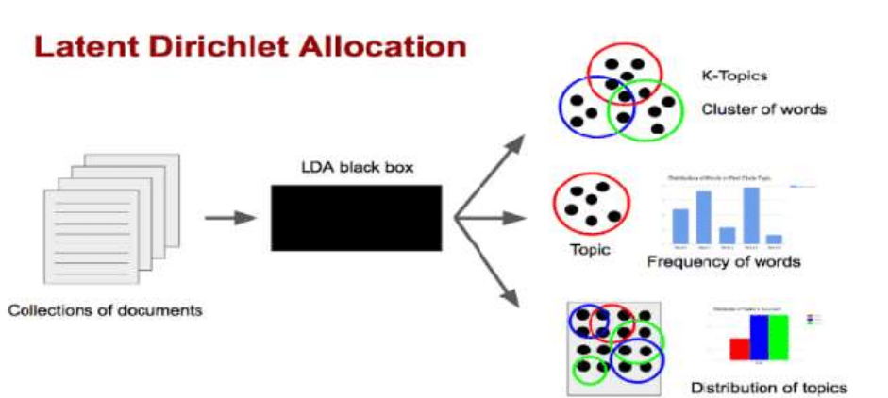
What is latent Dirichlet allocation?
Latent Dirichlet Allocation (LDA) is a probabilistic model designed for uncovering hidden structures, or topics, within a collection of documents. Let's break down its name to understand its components and how it works:
Latent: The term "latent" refers to something that is present but not visible or directly observable. In the context of LDA, it represents the underlying topics that we aim to discover within the documents. These topics are not explicitly provided but are inferred from the words present in the text.
Dirichlet: Dirichlet refers to the Dirichlet distribution, which is a family of continuous multivariate probability distributions. In LDA, Dirichlet distributions are used as priors to model the distribution of topics in documents and the distribution of words in topics. Dirichlet distributions are commonly used in Bayesian statistics to model distributions over probabilities.
Allocation: This term refers to how words in documents are assigned to topics. In LDA, each word in a document is probabilistically assigned to one of the topics based on the topic distribution of the document and the word distribution of the topic.

Slide 4
Working of LDA algorithm
At a high level, Latent Dirichlet Allocation (LDA) is a generative probabilistic model used for topic modeling. Here's a simplified overview of how LDA works:
Initialization: LDA starts by assuming a fixed number of topics (K) for the entire corpus of documents. Each document is represented as a mixture of these K topics, where each topic contributes to the document to varying degrees.
Assignment of Words to Topics: LDA iterates through each word in each document. For each word, it probabilistically assigns it to one of the K topics based on the observed word-topic and document-topic distributions.
Update Parameters: After assigning words to topics, LDA updates the parameters:
Word-topic distribution: Determines the probability of each word occurring in each topic.
Document-topic distribution: Determines the probability of each topic occurring in each document.
Repeat Iterations: LDA repeats the assignment and parameter update steps multiple times (iterations) until convergence. Convergence occurs when the assignments stabilize, and the model reaches a steady state.

Slide 5
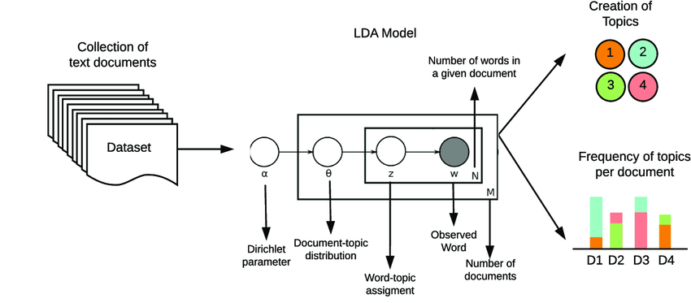
Output: Once the iterations are complete, LDA outputs the final word-topic and document-topic distributions. These distributions represent the underlying topics in the corpus and how each document is associated with these topics.
Interpretation: Analysts interpret the resulting topics by examining the words with high probabilities in each topic. Documents can be categorized or summarized based on their distributions over these topics.

Slide 6
What is LATENT SEMANTIC ANALYSIS?
Latent Semantic Analysis (LSA) is a technique in natural language processing and information retrieval that analyzes relationships between a set of documents and the terms they contain. It's based on the principle that words that are used in similar contexts tend to have similar meanings. Here's a simplified overview of the algorithm:
Build a term-document matrix: Create a matrix where rows represent unique terms (words) in the corpus, and columns represent documents. The cells contain the frequency of each term in each document.
Apply weighting: Apply some weighting scheme to the term-document matrix to account for the importance of each term in the document. This could be simple term frequency-inverse document frequency (TF-IDF) weighting or other normalization techniques.
Perform singular value decomposition (SVD): SVD is a matrix factorization technique that decomposes the term-document matrix into three matrices: U, Σ, and Vᵀ. U represents the relationship between terms and concepts, Σ represents the strength of each concept, and Vᵀ represents the relationship between documents and concepts.
Dimensionality reduction: Keep only the top k singular values and their corresponding columns in U and rows in Vᵀ. This reduces the dimensionality of the matrices and helps in capturing the most important underlying relationships.

Slide 7
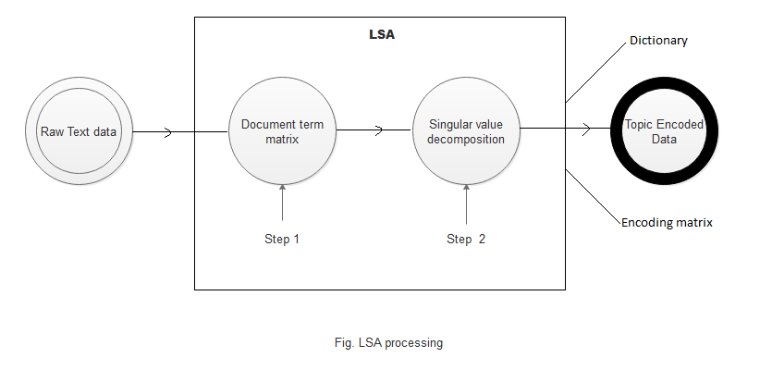
Document representation: Documents can be represented in the reduced concept space by multiplying their original TF-IDF-weighted term vectors by the truncated matrices U and Σ. This results in a lower-dimensional representation of documents.
Query handling: To handle queries, represent them in the same lower-dimensional concept space as the documents by multiplying their TF-IDF-weighted term vectors by the truncated matrices U and Σ.
Ranking: Calculate the similarity between the query and each document using cosine similarity or other similarity measures in the reduced space. Rank the documents based on their similarity to the query.

Slide 8
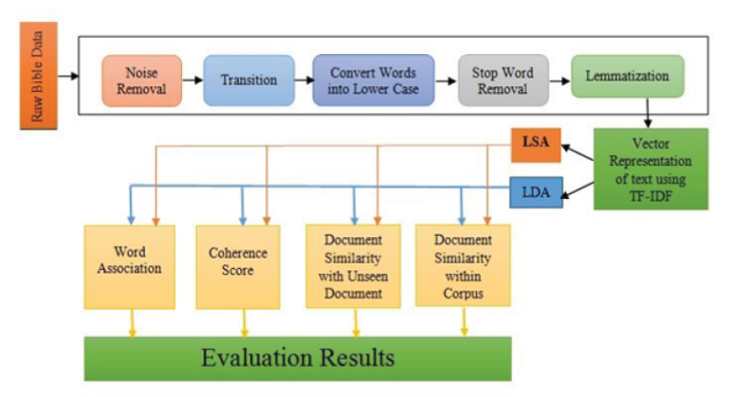
LDA vs LSA
LSA has been used in various applications such as information retrieval, document clustering, and automated essay grading. However, it has some limitations, such as difficulty in interpreting the meaning of the extracted concepts and its susceptibility to noise in the data. LDA helps overcome such difficulties and as a result turns out to be a more efficient and suited algorithm for topic modeling.

Slide 9
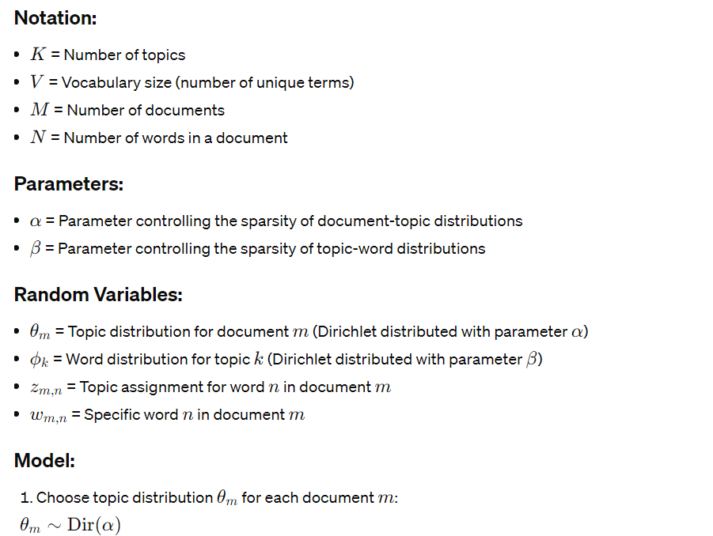
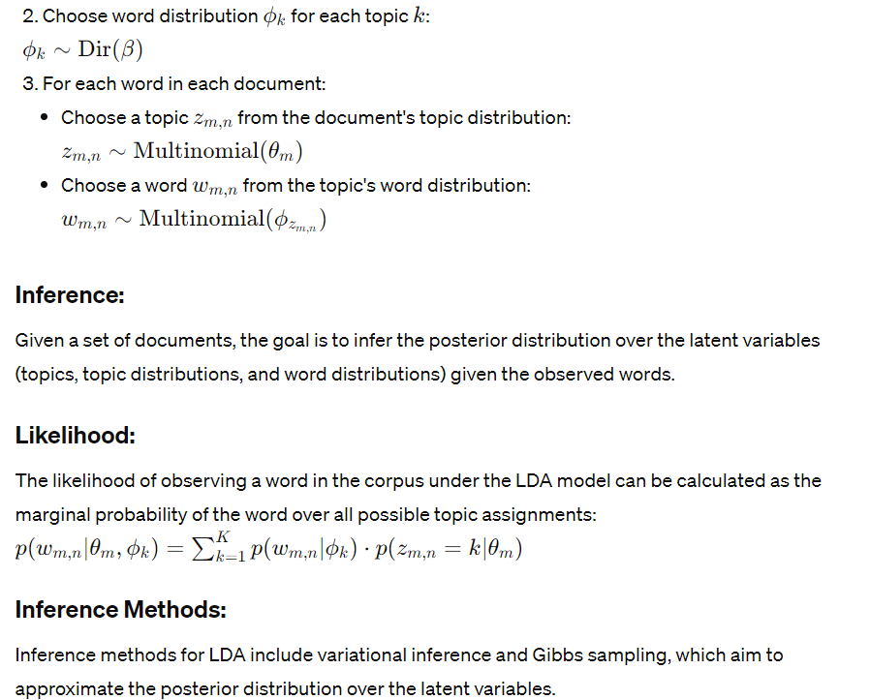
MATHEMATICAL FORMULATION OF LDA

Slide 10
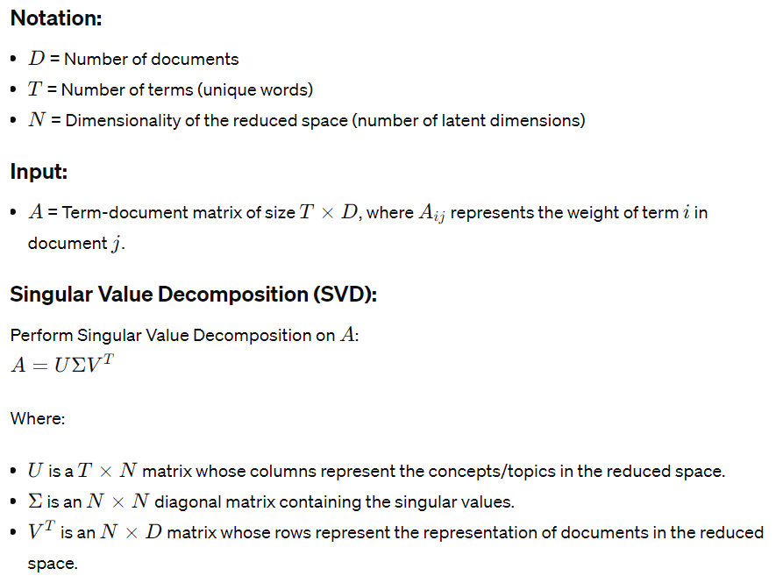
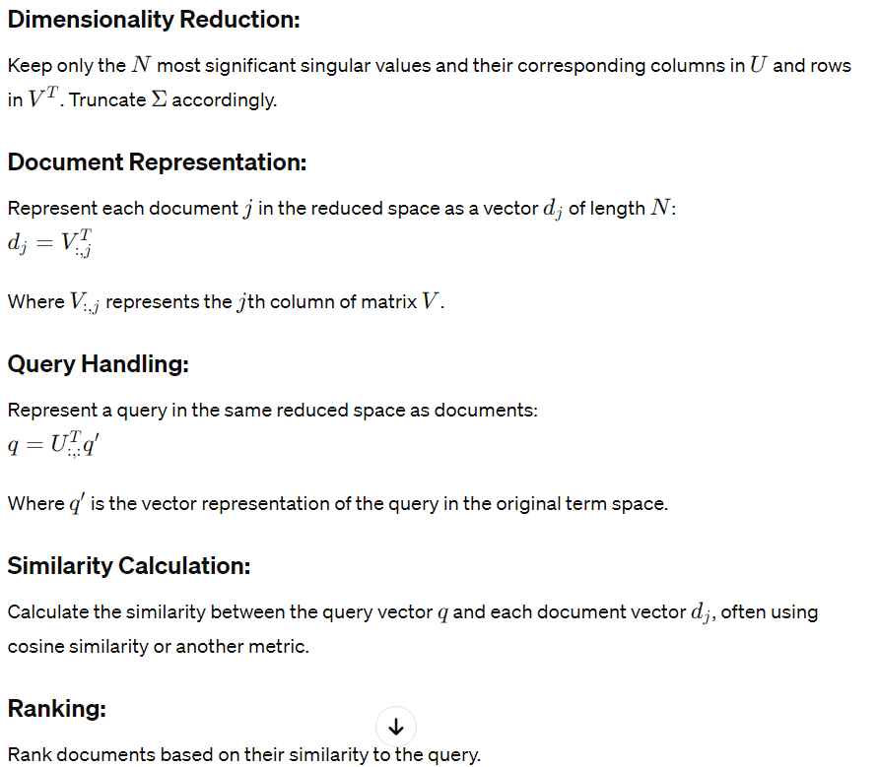
Mathematical formulation of lsa

Slide 11
About the dataset*
The dataset utilized in this study was sourced from the BBC network, a reputable and widely recognized platform renowned for its comprehensive coverage and quality journalism. Consider visiting the following link to explore more about the dataset:
http://mlg.ucd.ie/datasets/bbc.html
The dataset:
Consists of 2225 documents from the BBC news website corresponding to stories in five topical areas from 2004-2005.
Class Labels: (5)
Business
Entertainment
Politics
Sports
Technology

Slide 12
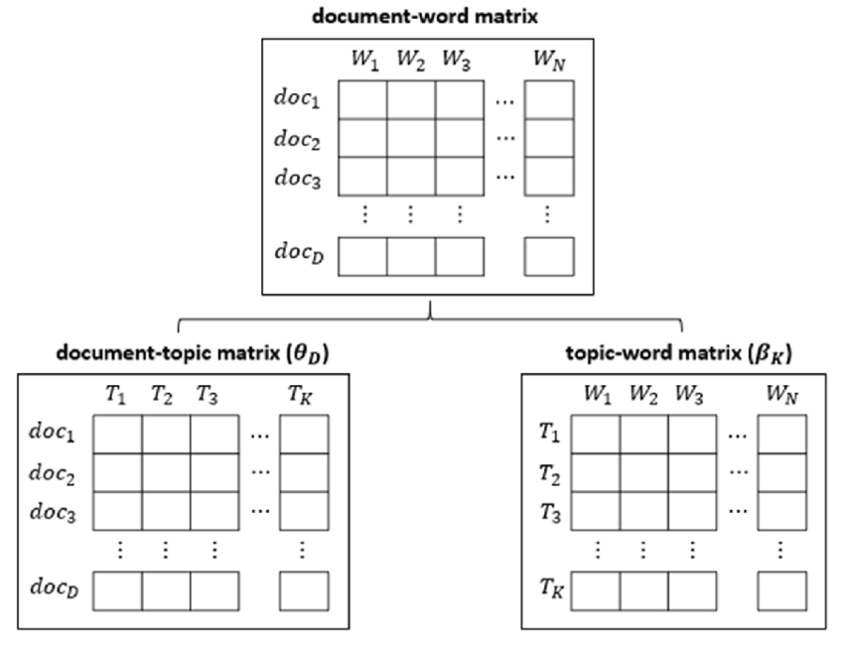
Implementation - LDA
News article
text data
Data Pre-processing and cleaning
Count Vectorization
LDA

Slide 13
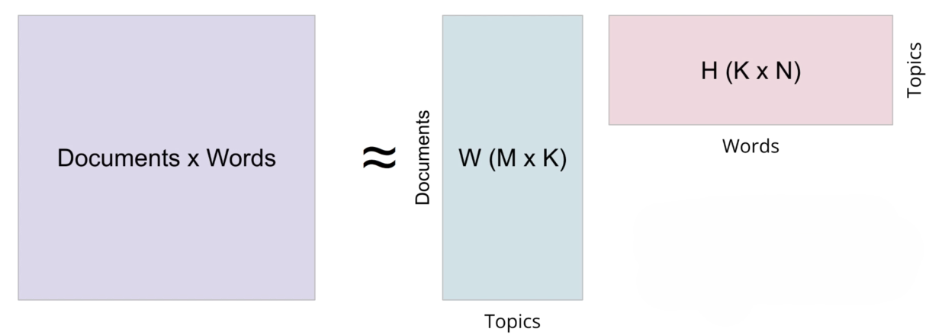

Slide 14
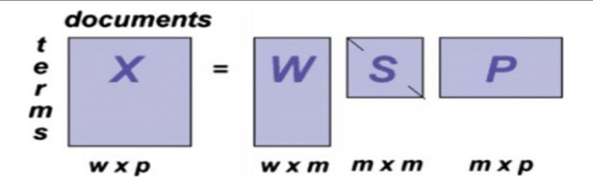
Implementation - LSA
News article
text data
Data Pre-processing and cleaning
Count Vectorization

Slide 15
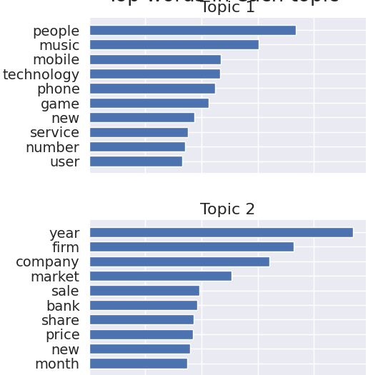
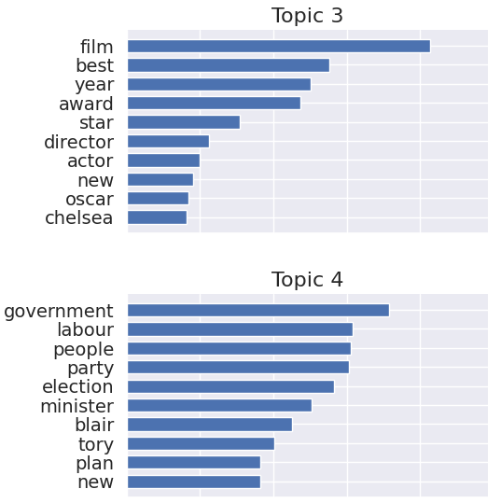
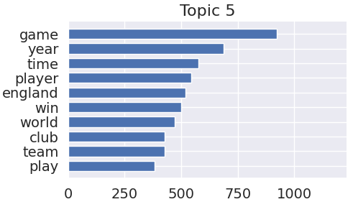
Result
On applying Latent Semantic Analysis (LSA/SVD) to the BBC News dataset, the following results were obtained:

Slide 16
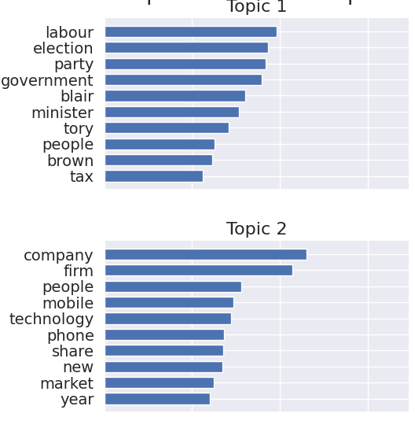
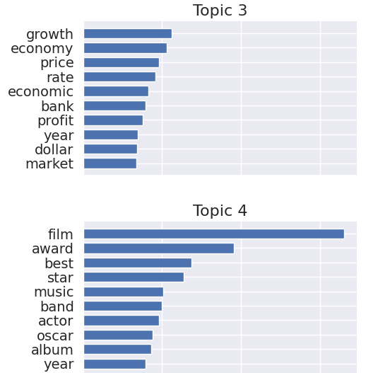
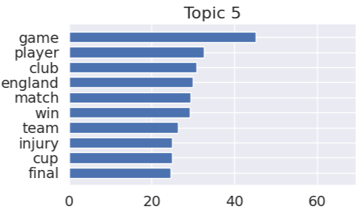
On applying Latent Dirichlet Allocation (LDA) to the BBC News dataset, the following results were obtained:

Slide 17
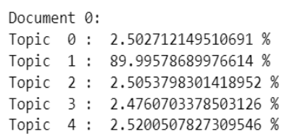
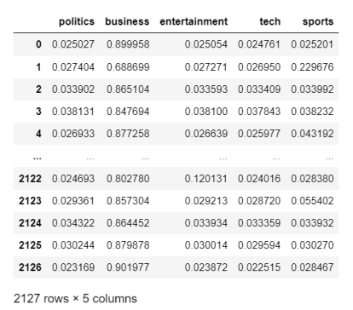
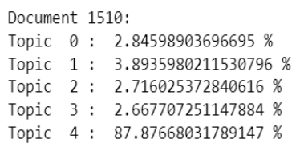

Slide 18
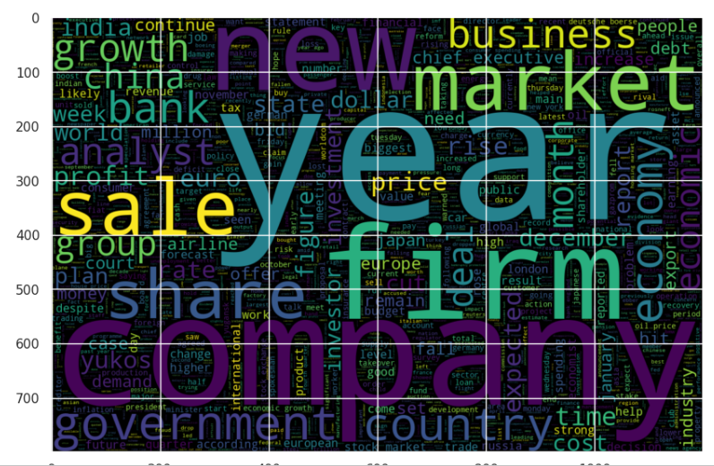

Slide 19
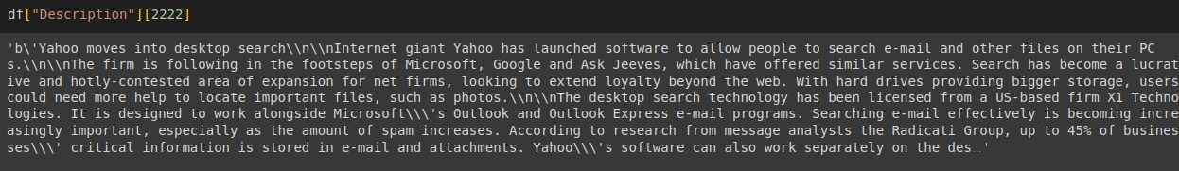
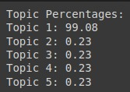
Test run
The sample text used for the test run is as follows:
Following was the output of the test run:
Based on the above result, we can see that the sample text belongs to Topic 1, i.e., Technology.

Slide 20
Conclusion
The topic modeling approach starts with data preprocessing, which identifies and removes duplicates, yielding a dataset of 2127 news articles.
Exploration finds that article proportions vary by topic, with business and sports dominating.
The dataset is further cleaned by deleting stop-words and short-length words, which reduces it by 50%.
Vectorization with TF-IDF is used, followed by modeling with LDA and LSA.
LDA effectively clusters articles into five categories, outperforming LSA and demonstrating its applicability for BBC News Article Topic Modeling.

Slide 21
Thank you

