Slide 1
Aegis
AI Defence Lab for Payment Security
identify
identify → generate → defend
A closed-loop red-team / blue-team system: the attacks it invents train the defence, and the defence's blind spots decide the next attack.
25 GenAI-era attack vectors · PR-AUC 0.944 · p99 19 ms inline · zero-day recall 0.718
100% synthetic data · simulator network-isolated by construction · all metrics reproduced by evaluate.py
Notes:
Aegis is a closed-loop adversarial AI system for payment fraud. Three stages: identify the
GenAI-era threat surface, generate feasible attacks against it, defend and measure.
The loop is the point. Most entries build a detector, or build a simulator. Here the attacks
train the defence, and per-signal recall tells us exactly where the defence is blind — which
becomes the specification for the next attack.
Every number in this deck is generated from artifacts/metrics.json by scripts/make_deck.py.
No figure is typed by hand. All data is synthetic; the simulator never touches a live system.

Slide 2
THE GAP
Fraud is now cheap to invent. Defences still learn from last year's fraud.
Generative AI collapsed the cost of designing a novel attack. Supervised fraud models need labelled examples of an attack before they can catch it — and chargeback labels arrive weeks late.
Attacker's new economics
Defender's structural lag
• Tailored social-engineering at scale — thousands of parallel conversations
• Synthetic identities and generated KYC documents that pass review
• Autonomous agents transacting on a cardholder's behalf
• Cheap iteration: probe, observe the decline, adapt
• Needs labels; labels need disputes; disputes take weeks
• Trained on the fraud that already happened
• Novel typologies are out-of-distribution by definition
• Red-teaming is manual, occasional and unmeasured
So generate the attacks first. If the defence is only ever as good as the fraud it has seen, then manufacture the fraud it hasn't seen — under constraints that keep it real.
Mastercard Innovation Challenge 2026 · Aegis: AI Defence Lab for Payment Security · 100% synthetic data — no real cardholder data, PII or production payment data
Notes:
The asymmetry: generative AI made attack *design* cheap and fast, while defence still depends on
labelled outcomes that arrive weeks later through the dispute lifecycle.
That is not a modelling problem you can fix with a better classifier. A supervised model cannot
represent a typology it has never seen. The only way to get ahead of it is to manufacture the
unseen fraud yourself — which is what the red-team half of this system does.

Slide 3
ARCHITECTURE
Red team and blue team, wired into one loop
Attacks carry declared ground truth, so detection is graded per-signal — we know whether a catch was for the right reason or luck.
IDENTIFY
GENERATE
DEFEND
Threat surface
Feasible-action agents
Three-stage cascade
25 vectors · 10 categories
Each mapped to MITRE ATLAS
Names the role GenAI plays
Only attacker-controlled levers:
amount, timing, cadence,
merchant, device, sequencing
39 rules → gradient boosting
→ graph on riskiest 20%
→ arbiter → isotonic calibration
The return path — what makes red and blue one loop, not a pipeline
Each attack declares the signals it should trip. Detection is scored against that declaration, so a miss is attributable: 39 of 39 declared signals are implemented, and the 8 that aren't are named with the reason (they need dispute-lifecycle or session telemetry that an authorization message does not carry). Uncaught signals are the backlog for the next generation of attacks.
Mastercard Innovation Challenge 2026 · Aegis: AI Defence Lab for Payment Security · 100% synthetic data — no real cardholder data, PII or production payment data
Notes:
Walk the three boxes left to right, then the return path at the bottom — that bottom band is the
actual contribution.
Because every generated attack declares its expected detection signals *before* it runs, we can
grade the defence per signal instead of per transaction. That converts "we caught 88% of fraud"
into "here are the specific mechanisms we are blind to" — which is directly actionable, and is the
input to the next round of attack generation.
We also publish the signals we cannot implement and why. Five of them need data outside the
authorization message. Naming them is more useful than letting a gap look mysterious.

Slide 4
JUDGED ON: ATTACK DIVERSITY
25 vectors across 10 categories
Breadth chosen to span the GenAI-era threat surface, not to inflate a count. Twelve vectors are deliberately built to overlap legitimate behaviour.
Synthetic identity
Generated documents, history building, bust-out
Deepfake onboarding
Liveness and KYC defeat at account opening
Account takeover
Credential stuffing, SIM-swap OTP interception
AI-driven scams
APP fraud, romance / pig-butchering
Agentic commerce
Agent impersonation, prompt injection
Fraud rings
Coordinated multi-card, mule fan-out
Merchant abuse
Fake storefronts, refund collusion
Adaptive evasion
Velocity evasion, mimicry of learned baselines
Card testing
BIN enumeration bursts
Cross-border
Corridor and exemption abuse
Every vector carries ground-truth metadata: attack_type, scenario_id, strength, expected_signals, severity, and a hard_to_detect flag — 75 campaigns generated 90,258 transactions at 3.83% fraud.
Mastercard Innovation Challenge 2026 · Aegis: AI Defence Lab for Payment Security · 100% synthetic data — no real cardholder data, PII or production payment data
Notes:
Ten categories, twenty-five vectors. The selection criterion was coverage of the GenAI-era threat
surface — specifically the vectors where generative AI changed the attacker's economics, not just
a long list of classic card fraud.
Note the deliberately hard cases: adaptive mimicry learns the victim's own baseline and stays
inside it; APP scam and romance fraud involve the genuine cardholder on their own device with
real 3-D Secure — every credential signal is clean and only the intent is wrong. Most detectors
implicitly assume compromised credentials. These do not.

Slide 5
JUDGED ON: SIMULATION FIDELITY
Attacks constrained to what an attacker actually controls
The standing criticism of adversarial ML on tabular data is that papers perturb features the attacker cannot touch. That produces impressive numbers and unusable systems.
Levers the simulator may move
Held invariant — not the attacker's to change
• Amount, and how it is split across attempts
• Timing, inter-arrival cadence, burst shape
• Merchant and MCC selection
• Device and channel presentation
• Sequencing — probe, escalate, cash out
• Text in merchant-controlled fields
• The victim's own historical baseline
• Issuer-side risk state and scoring
• Network-assigned identifiers and tokens
• AVS / CVV results returned by the issuer
• Another cardholder's genuine behaviour
• Any label the defence later assigns
Schema is ISO-8583-inspired: 1,650 tokenised cards, 263 merchants, 44 days of authorization traffic. Card identifiers are tokens — a PAN never exists in this system, synthetic or otherwise.
Mastercard Innovation Challenge 2026 · Aegis: AI Defence Lab for Payment Security · 100% synthetic data — no real cardholder data, PII or production payment data
Notes:
This slide is the fidelity argument. The left column is what a real attacker can manipulate; the
right column is what they cannot. Our generators only touch the left.
That constraint costs us headline numbers — it is much easier to score well against attacks that
cheat by editing issuer-side features. But an attack that requires rewriting the victim's own
history is not an attack, it is a data corruption. Constraining to feasible actions is what makes
the resulting detection numbers mean anything operationally.
The schema is modelled on ISO 8583 authorization fields so the features we build have live-payments
analogues. Card identifiers are tokens throughout — there is no PAN anywhere in the system.

Slide 6
JUDGED ON: SIMULATION FIDELITY — MEASURED
Fidelity as evidence, not assertion
The brief judges fidelity instrumentally, so we measure it: generated marginals against published reference bands, and how separable the attacks actually are from legitimate traffic.
Marginals vs published bands — 9/9 in band
Are the attacks trivially separable?
Benford MAD (leading digit)
0.0010
0.0–0.015
Univariate AUC on RAW authorization fields — no engineered features.
Card-not-present share
0.4237
0.3–0.6
cross_border
0.896
overlap 0.21
Cross-border share
0.1031
0.03–0.2
card_present
0.788
overlap 0.42
Overnight volume share
0.0342
0.02–0.18
merchant_age_days
0.706
overlap 0.55
hour_of_day
0.651
overlap 0.67
MCC concentration (Gini)
0.4447
0.25–0.85
amount
0.559
overlap 0.86
Primary-device share/card
0.9702
0.55–1.0
Nigrini: MAD < 0.006 is close Benford conformity. Bands are public and wide.
max 0.896 · mean attack/legit overlap 0.656
A LOW number here is the result we want
`amount` scores just 0.559 with 0.86 overlap — the generator does not take the usual shortcut of making fraud large. No raw field betrays the attacks, so the reported detection performance comes from the feature layer and cascade rather than a generation artefact. The most camouflaged vector is `VELOCITY_EVASION`, and the vectors we detect worst are the same ones that overlap legitimate traffic most — the story is internally consistent.
Mastercard Innovation Challenge 2026 · Aegis: AI Defence Lab for Payment Security · 100% synthetic data — no real cardholder data, PII or production payment data
Notes:
This slide exists because criterion 2 is judged instrumentally — the brief wants realistic
distributions, so we measure rather than assert.
Left: 9 of 9 generated marginals land inside published reference bands. The Benford
result is the one to point at — MAD 0.0010, which is 'close conformity' on Nigrini's
published scale. Real transaction amounts obey Benford's law; ours do too, and we did not tune for it.
Right, and this is the important half: if our synthetic fraud came from an obviously different
process, any classifier would score ~1.0 and the whole evaluation would be meaningless. So we
measure univariate AUC on RAW authorization fields. Max is 0.896 — and `amount` is only
0.559, which is the tell that we are not doing 'fraud = big transactions'.
Cross-border is the highest single field. That is realistic rather than an artefact — cross-border
genuinely carries elevated fraud rates in live portfolios.
If a judge suspects the data is too easy, this is the slide that answers it with numbers.

Slide 7
JUDGED ON: DETECTION EFFICACY
Verified results — reproducible from a clean checkout
Temporal split with a 5% delay block between train and test, because chargeback labels arrive late and a random split leaks the future.
PR-AUC
BEST-F1 POINT
FALSE-POSITIVE RATE
DECISION LATENCY P99
0.944
0.929
0.0008
18.8ms
95% CI 0.931–0.957
P 0.972 / R 0.891
insult rate at that point
p50 13.7ms · inline path
ZERO-DAY RECALL
VALUE DETECTION RATE
CALIBRATION ECE
ROC-AUC
0.718
0.941
0.0038
0.989
6 vectors never trained on
share of fraud value stopped
10-bin · Brier 0.00445
reported for comparability only
Why PR-AUC and not accuracy
At 2.98% test prevalence, a model that blocks nothing scores 97.0% accuracy. PR-AUC is the honest summary under imbalance; the confidence interval is bootstrapped. Calibration matters because a risk score is only useful to a downstream policy if 0.9 means 0.9.
Mastercard Innovation Challenge 2026 · Aegis: AI Defence Lab for Payment Security · 100% synthetic data — no real cardholder data, PII or production payment data
Notes:
The credibility slide. Three things to land.
First, the split: temporal with a 5% delay block. Chargeback labels arrive weeks after the
transaction, so a random split lets the model see the future. Discarding a slice of the timeline
between train and test simulates that reporting lag.
Second, PR-AUC 0.944 with a bootstrapped interval — not accuracy, which is meaningless at
2.98% prevalence.
Third, p99 18.8ms is the inline authorization decision path, not batch throughput. That is
the number that decides whether this can sit in an authorization flow at all.
Calibration: ECE 0.0038 via isotonic regression on a held-out temporal slice. A calibrated score
is what lets a bank set policy thresholds on expected loss rather than on an arbitrary cut.

Slide 8
WHERE IT FAILS
Worst-first, with the reason — not a cherry-picked table
Per-attack recall measured at a 1% analyst review budget. Read the ceiling note before reading the rows.
VECTOR
RECALL @1%
MEAN RISK
HARD BY DESIGN
Read this first
REFUND_ABUSE_COLLUSION
0.000
0.846
no
At a 1% alert budget and 2.98% prevalence, the maximum recall ANY detector could reach is 0.336. We reach 0.334 — 99.3% of the mathematical ceiling.
So a 0.000 row means 'did not survive the queue', not 'invisible to the model' — note the mean-risk column ranks them well above baseline.
Budget sized to prevalence instead: recall 0.909 at precision 0.909.
ADAPTIVE_MIMICRY
0.015
0.224
yes
SIM_SWAP_OTP
0.042
0.272
yes
DEEPFAKE_KYC_ONBOARD
0.825
0.984
no
TRA_THRESHOLD_GAMING
0.854
0.995
yes
VOICE_CLONE_ATO
0.893
0.996
no
Also stated plainly: synthetic prevalence is 3.83% versus roughly 0.1–1% in live card portfolios — necessary to train 25 vectors, but it means threshold-dependent figures would shift in production. PR-AUC, calibration and latency are the transferable ones. We do not claim per-row attribution inside the boosted component; model importance is reported globally and labelled as global.
Mastercard Innovation Challenge 2026 · Aegis: AI Defence Lab for Payment Security · 100% synthetic data — no real cardholder data, PII or production payment data
Notes:
Deliberately showing the worst rows. Two vectors sit at 0.000 recall at the 1% budget, and the
right-hand panel is why that is a queue-capacity statement rather than a model failure: the ceiling
at this prevalence is 0.336 and we are at 99.3% of it. The mean-risk column shows the model
does rank these attacks highly — they just lose the competition for 271 review slots.
Size the budget to prevalence instead and recall is 0.909 at precision 0.909.
SIM_SWAP_OTP and adaptive mimicry are genuinely hard and genuinely under-detected: mimicry learns
the victim's own baseline and stays inside it. That is the honest state of the art, and it is
exactly the gap the loop feeds back into the next attack generation.
If a judge asks what we would fix first: those two rows.

Slide 9
JUDGED ON: NOVELTY
Generalisation to typologies never trained on
6 vectors removed from training entirely, then scored at a threshold calibrated only on seen traffic.
UNSEEN RECALL
HELD-OUT VECTOR
N
RECALL
MEAN RISK
HARD
0.718
BIN_ENUMERATION_BURST
300
1.000
1.000
no
SYNTH_ID_BUSTOUT
168
0.982
0.999
no
975 held-out transactions
ATO_CREDENTIAL_STUFF
117
0.974
0.997
no
APP_SCAM_LLM
30
0.800
0.988
yes
ROMANCE_PIG_BUTCHERING
144
0.500
0.931
yes
AGENT_IMPERSONATION
216
0.116
0.866
no
Why this is the number that matters for a novel-attack claim
Reporting recall on attack types the model trained on measures memorisation. Holding six typologies out entirely — and refusing to retune the threshold on them — measures whether the causal feature layer generalises to fraud that did not exist when the model was fit. AGENT_IMPERSONATION at 0.190 is the honest weak point: an agent transacting legitimately and an agent impersonating a cardholder look nearly identical in an authorization message.
Mastercard Innovation Challenge 2026 · Aegis: AI Defence Lab for Payment Security · 100% synthetic data — no real cardholder data, PII or production payment data
Notes:
This is the novelty evidence. Six vectors — including APP scam, romance fraud, synthetic-ID bust-out
and agent impersonation — were removed from training completely. The threshold was calibrated on seen
traffic only; we did not peek.
Aggregate unseen recall 0.718. Four of six vectors are caught well because the features are causal
rather than pattern-matched — velocity against the account's own baseline, graph structure, and
verification-signal coherence transfer to typologies the model never saw.
Be upfront about AGENT_IMPERSONATION at 0.190. In an authorization message, a legitimate agentic
purchase and an impersonated one are nearly indistinguishable; separating them needs agent-identity
attestation that does not exist in the schema yet. That is a roadmap item, not something to paper over.

Slide 10
ANALYST-FACING OUTPUT
Exact reason codes, by construction
A fraud analyst needs three things: the decision, why it was made, and what would change it.
Decision
The deliberate trade-off
Calibrated risk, band, recommended action — allow, review, step up, block — alongside the payment's 3-D Secure status, AVS result and any SCA exemption claimed.
SHAP could not be installed in this environment (libomp and numba are unavailable on Python 3.14).
Rather than ship an approximate explainer and call it attribution, we architected the system so its explanation is exact: the arbiter is additive, so its decomposition is arithmetic rather than estimation.
The boosted component's importance is reported globally and labelled as global. We do not claim per-row attribution we cannot compute.
Exact score decomposition
Additive contributions to the arbiter's log-odds — the arithmetic that produced the score, not an approximation. Verified against the model's decision function in the test suite.
Reason codes
Ranked in analyst language, not feature names.
Counterfactual
What would have to change for this payment to score benign.
Mastercard Innovation Challenge 2026 · Aegis: AI Defence Lab for Payment Security · 100% synthetic data — no real cardholder data, PII or production payment data
Notes:
Explainability is a regulatory requirement in this domain, not a nice-to-have — a declined payment
may need a reason, and model governance expects decisions to be reconstructable.
The honest beat is on the right, and say it out loud. We could not install SHAP. Instead of shipping
an approximate explainer and calling it attribution, we designed the arbiter to be additive so the
decomposition is exact by construction — and the test suite verifies the reason codes reconcile with
the model's own decision function.
Where we cannot compute per-row attribution — inside the gradient-boosted component — we report
importance globally and label it as global. The literature is clear that fluent rationales raise
analyst confidence without raising accuracy, so a plausible-sounding wrong explanation is worse
than an honest boundary.

Slide 11
JUDGED ON: REAL-WORLD FEASIBILITY
Built against the constraints of a live authorization path
An inline fraud control has a latency budget, a review-capacity budget, an audit obligation and a governance process. Each shaped a design decision here.
LATENCY BUDGET
REVIEW CAPACITY
p50 13.7ms · p99 18.8ms
271 alerts at a 1% budget
The expensive graph stage runs on the riskiest 20% of traffic — an explicit compute budget, not a score threshold. That is how production cascades hold p99 inside an authorization window.
Operating points are reported against analyst capacity, not just at best-F1, because a queue nobody can work is not a control.
AUDITABILITY
DEPLOYABILITY
Append-only trail
Stdlib-first, permissive-only
Every environment change, campaign and analyst action is recorded in SQLite. Model governance expects decisions to be reconstructable after the fact.
No AGPL dependencies, no GPU requirement, no external service on the decision path. The LLM narrates; it never makes the block decision.
Positioning: this extends Mastercard's own published direction. Threat Scan simulates known attacks against issuers; AI Garage has published on adversarial fraud generation. Aegis generates novel attacks instead of replaying known ones, constrains them to be feasible, and wires them into a continuous, per-signal-graded loop.
Mastercard Innovation Challenge 2026 · Aegis: AI Defence Lab for Payment Security · 100% synthetic data — no real cardholder data, PII or production payment data
Notes:
Feasibility is a judged criterion and it is where most research prototypes quietly fail.
Four constraints, four design consequences. The latency one matters most: p99 18.8ms inline, achieved
by budgeting the graph stage to the riskiest 20% of traffic rather than gating on a score
threshold — thresholds let cost spike when an attack floods the high-risk band; a budget cannot.
The review-capacity point is the one fraud teams will care about: we report operating points against
what an analyst team can actually work, not only the point that flatters the model.
Close on positioning. This is not a new category — it extends a direction Mastercard has already
published on, which makes it adoptable rather than speculative.

Slide 12
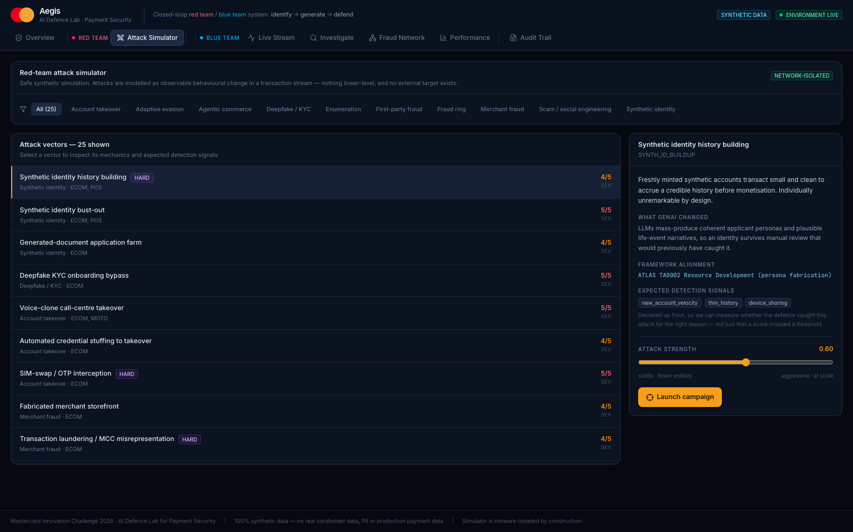
WORKING PROTOTYPE · THE RED TEAM
Attack library with declared ground truth
Each vector names what GenAI changed, its MITRE ATLAS mapping, and the detection signals it should trip — declared before the campaign runs.
Mastercard Innovation Challenge 2026 · Aegis: AI Defence Lab for Payment Security · 100% synthetic data — no real cardholder data, PII or production payment data
Notes:
This is the half of the brief most entries skip, so spend time here.
Twenty-five vectors, each with the role generative AI plays spelled out, a MITRE ATLAS mapping, and
crucially the expected detection signals declared *before* launch. That last part is what lets us
measure whether we caught an attack for the right reason instead of by luck.
Pick APP_SCAM_LLM to demo: the genuine cardholder, own device, real 3-D Secure, willingly authorising.
Every credential signal is clean; only the intent is wrong.
Live in the browser during the demo; this capture is the fallback.

Slide 13
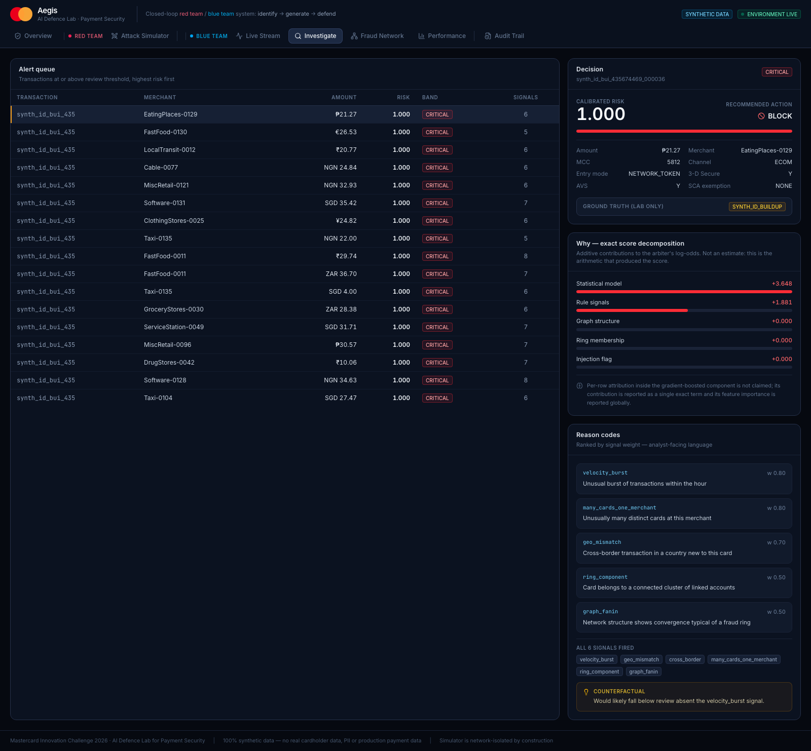
WORKING PROTOTYPE · INVESTIGATION VIEW
Exact decomposition and counterfactual
The analyst path: calibrated decision, additive contributions that reconcile with the model's decision function, ranked reason codes, and what would change the outcome.
Mastercard Innovation Challenge 2026 · Aegis: AI Defence Lab for Payment Security · 100% synthetic data — no real cardholder data, PII or production payment data
Notes:
The analyst workflow. Top-left is the decision and the payment's verification attributes; the
decomposition below it is exact arithmetic on the arbiter's log-odds, not an estimate.
Point at the caveat in the panel deliberately — the global-importance labelling for the boosted
component. Judges notice when a team knows the difference between an explanation and a plausible story.
Live in the browser during the demo; this capture is the fallback.

Slide 14
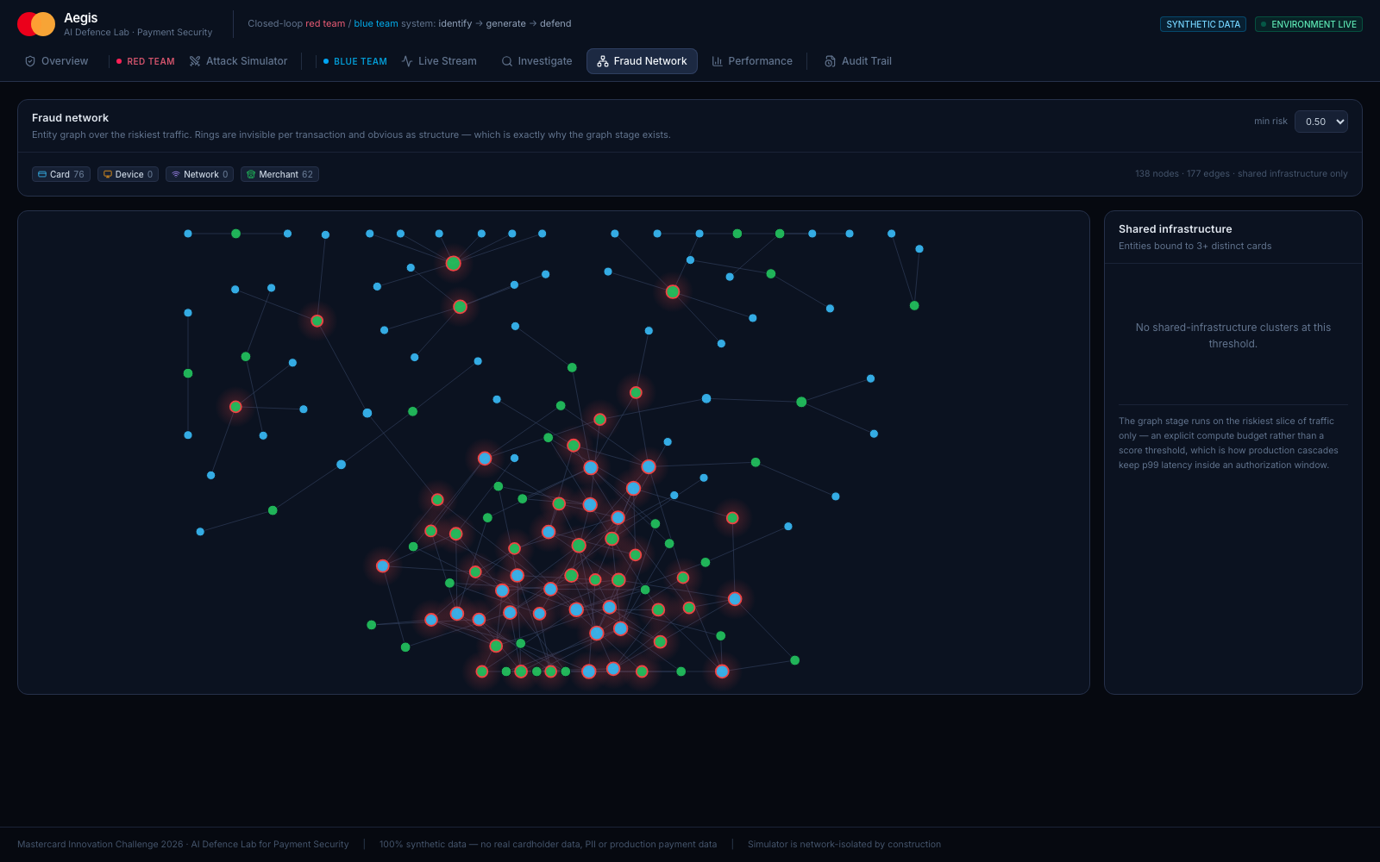
WORKING PROTOTYPE · FRAUD NETWORK
Structure that is invisible per transaction
The subgraph induced by shared infrastructure only — entities touching two or more distinct cards. One device linked to 31 cards: no single payment looks wrong, the graph does.
Mastercard Innovation Challenge 2026 · Aegis: AI Defence Lab for Payment Security · 100% synthetic data — no real cardholder data, PII or production payment data
Notes:
Rings are invisible one transaction at a time and obvious as structure.
Important detail: this is pruned to *shared* infrastructure — entities touching two or more distinct
cards. Unpruned it is mostly singleton pairs and the structure disappears into noise; that pruning
decision is what makes the panel readable.
One device, 31 distinct cards. No individual authorization is anomalous enough to decline. The graph
stage runs on the riskiest 20% of traffic, which is what keeps it inside the latency budget.
Live in the browser during the demo; this capture is the fallback.

Slide 15
Three things to take away
1. It is a loop, not a pipeline
The attacks train the defence, and per-signal recall says exactly where the defence is blind — which becomes the specification for the next attack. That feedback path is the contribution; the detector alone is not.
2. The attacks are feasible
Generators only manipulate what an attacker really controls — amount, timing, cadence, merchant, device, sequencing. Never the victim's own history or issuer-side state. That constraint is what makes the detection numbers operationally meaningful.
3. The numbers are honest and reproducible
PR-AUC 0.944 with a bootstrapped interval, temporal split with a delay block, zero-day recall 0.718 on 6 held-out typologies, and the failures shown worst-first. Every figure regenerates from evaluate.py on a clean checkout — including this deck.
Reproduce: pip install -r requirements.txt · python -m backend.app.evaluate · ./scripts/verify.sh --full (90,258 transactions · 25 vectors · 75 campaigns · generated 2026-08-17)
Mastercard Innovation Challenge 2026 · Aegis: AI Defence Lab for Payment Security · 100% synthetic data — no real cardholder data, PII or production payment data
Notes:
Close on these three, in this order.
The loop is the contribution. Feasibility is what makes it real. Honesty about the failures is what
should make the rest of the numbers believable — a deck that only shows wins invites the assumption
that the losses were hidden.
Offer the walkthrough: the whole system runs locally in two commands, and every number here
regenerates from a clean checkout.

