Slide 1


An Internship Representation
ONLINE FOOD DELIVERY SYSTEM
Submitted by
Deven Patel
190320116036
Internal Guide
Prof. Foram Gohel
External Guide
Sandip Patel

Slide 2
Contents
Introduction of Compony
Introduction of Internship Topic
Process of project
Back-end system
Conclusion
References

Slide 3

Introduction of Company
Enterprise Analytic is a Technology solution provider specializing in the following solutions:
Our aim is to analyze the specific needs of our customers and provide quality solutions on time and within budget.
We leverage Agile and Lean principles for quick go-to-market and Return on Investment.
We provide business value with a clear focus on quality and long-term relationships.
Our solutions are focused on meeting your strategic business objectives.
Our delivery process encompasses industry best practices and proven quality frameworks.

Slide 4
Introduction of Internship topic
Online food delivery System is a new generation of restaurant management software.
When users/customer will enter in the website, he/she should have an account.
If user does not have an account, user has to create a new account to order food. To create a new account user should enter unique username, email and new mobile no. with password.
User fill his/her address for food delivery. Once user enters in the website, you can see different types of food available in restaurant.
First select category of food from soups, starters, the main course dishes and desserts. After that search food as your interest. select food you want to order. After selecting all your meal place your order and confirm your address.

Slide 5
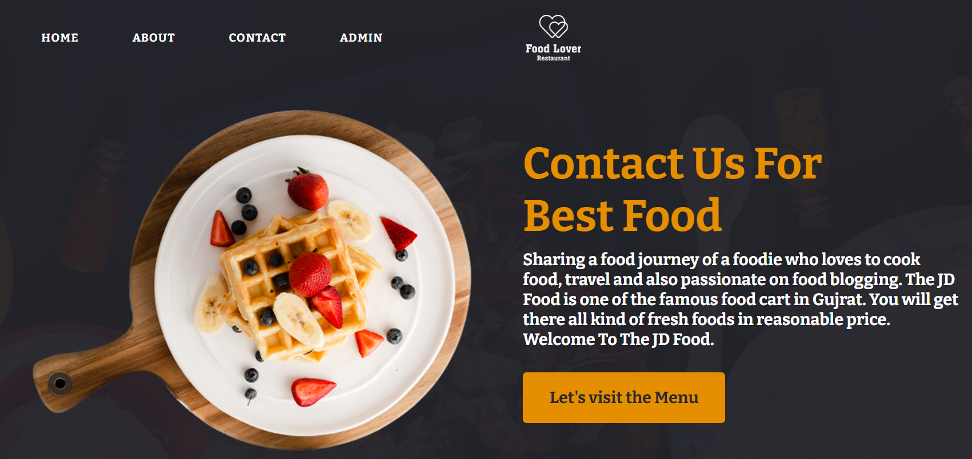
Process of project
First user will get to show this page where they can easily find all required specifications.
Although admin can directly move to the administration panel.
Now, when user click on the “Let’s visit the menu” button they directly redirect to the menu page.

Slide 6
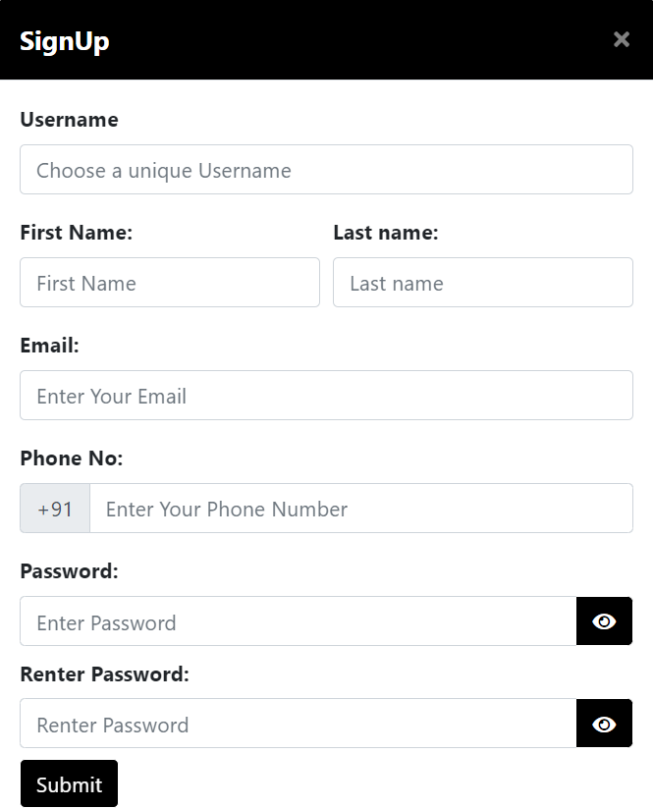
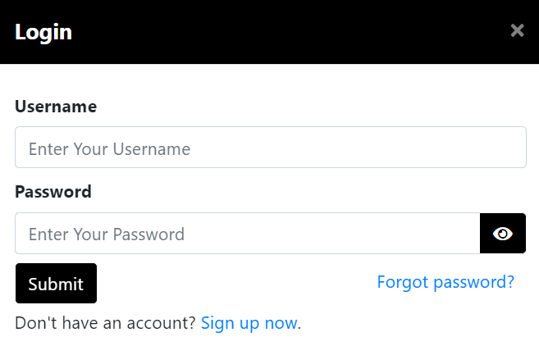
Process of project
At first user have to sign-up the shop and after that login. If already have an account then they can directly login to the page.
If they forgot the password then they can re-generate it through email authentication.
In mail section user will get username as well as link for regenerate the password.

Slide 7
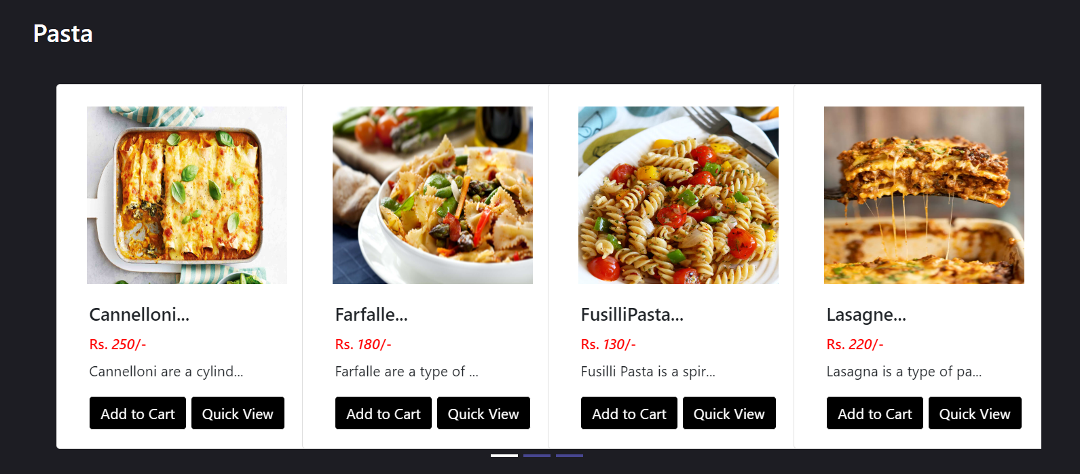
Process of project
Now after login user can easily access to the website.
And they can order their food according to their requirements.
There are various kind of categories where user can find all types of food.
Also there is a search button which provides direct product search by their name only.

Slide 8
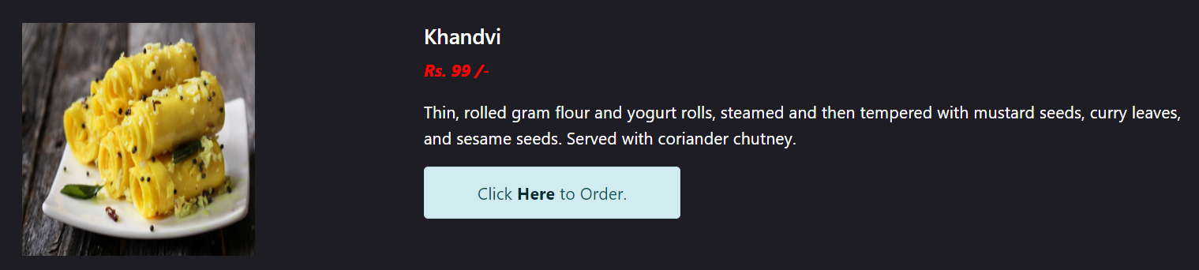
Process of project
This is quick view of particular product which illustrates the description of that food item.
“Here” button will directly redirect to that particular product if user want to purchase.

Slide 9
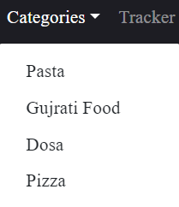
Process of project
There is a categories option in Navbar where user can directly find the product by their title.

Slide 10
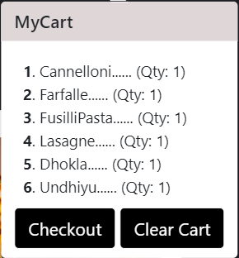
Process of project
Now after selection of food item, the items will be directly add to the cart option, which shows the names of product as well as the quantity.
After that there is a checkout button which redirect to the bill payments.
And there is also clear cart option which clear all the items.

Slide 11
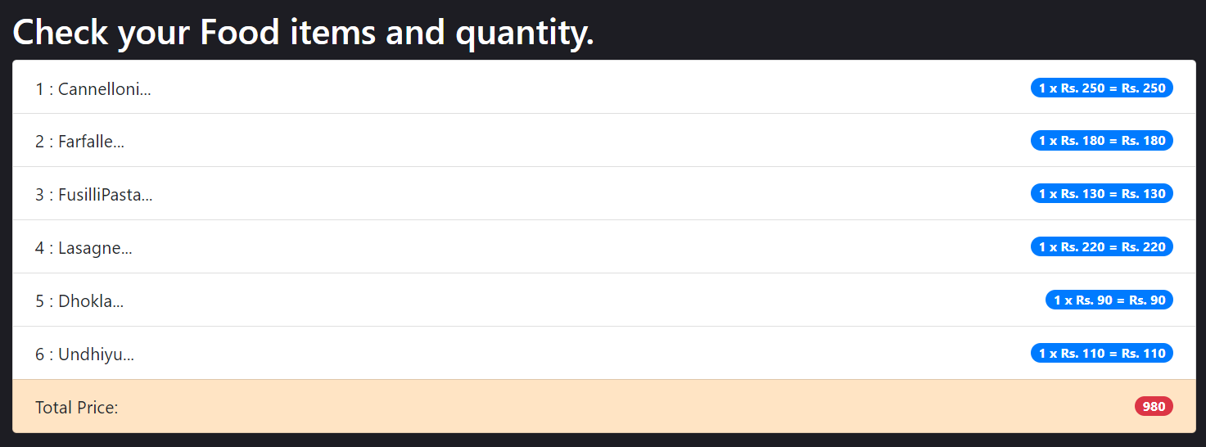
Process of project
This is the bill which indicates the whole purchases with quantity.

Slide 12
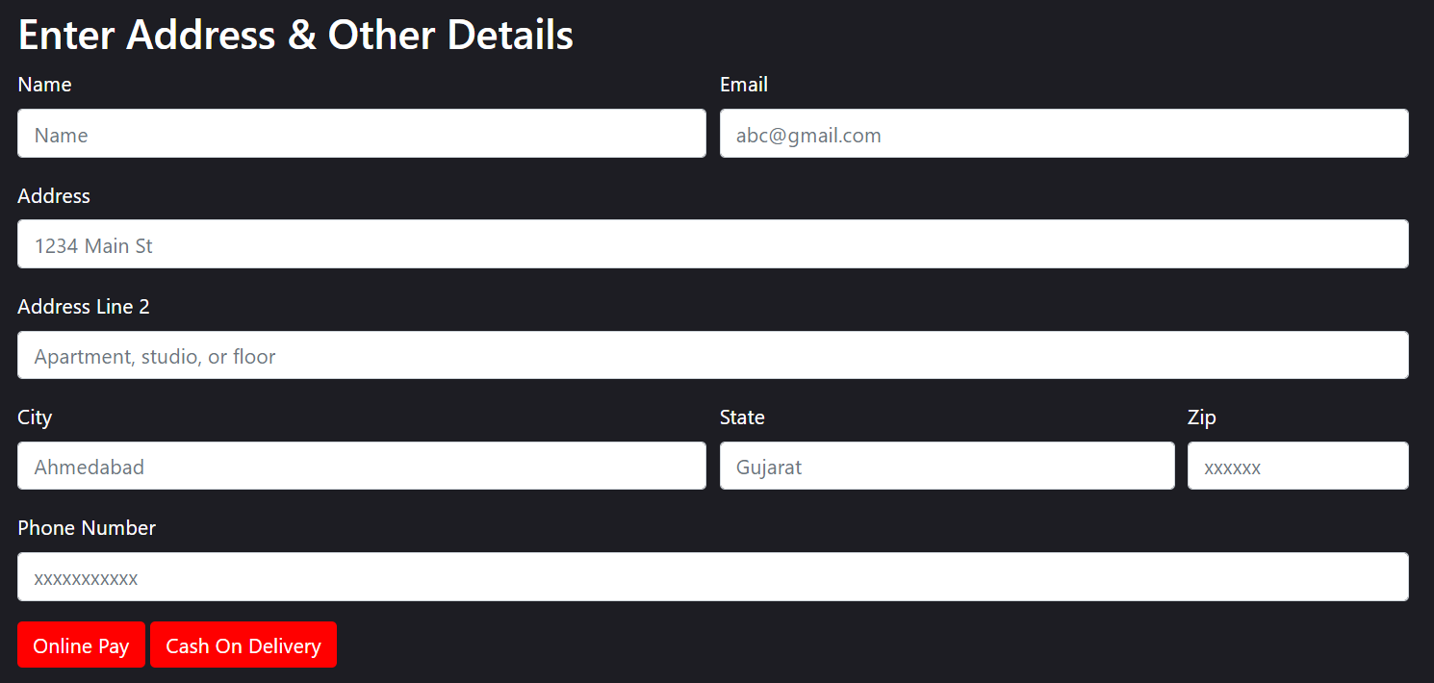
Process of project
Now just under the bill, it can be seen that some personal details of user’s.
And there is an options for payments.
Online payment is unavailable because of merchant key. Therefor on cash on delivery option is available right now.

Slide 13
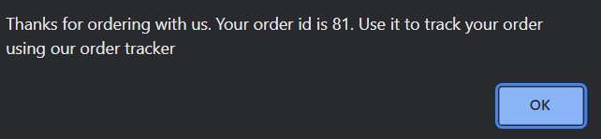
Process of project
After clicking the cash on delivery user will get a personal order id.
By using this id they can track their order.

Slide 14
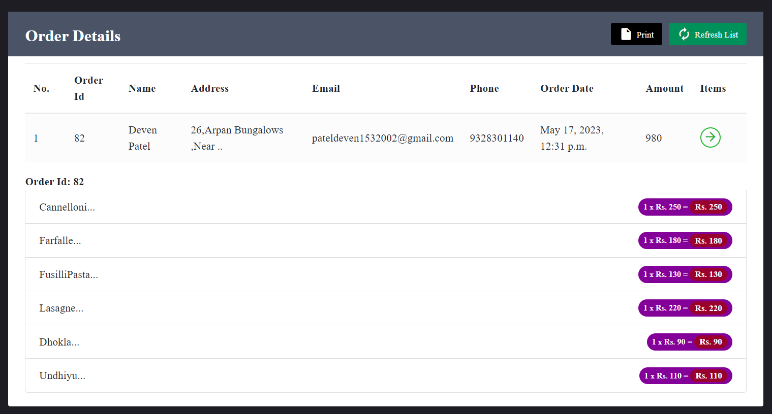
Process of project
There is an option in navbar which indicate the your order details with date, time, amount and with quantity also.
By using this id user can track the order.

Slide 15
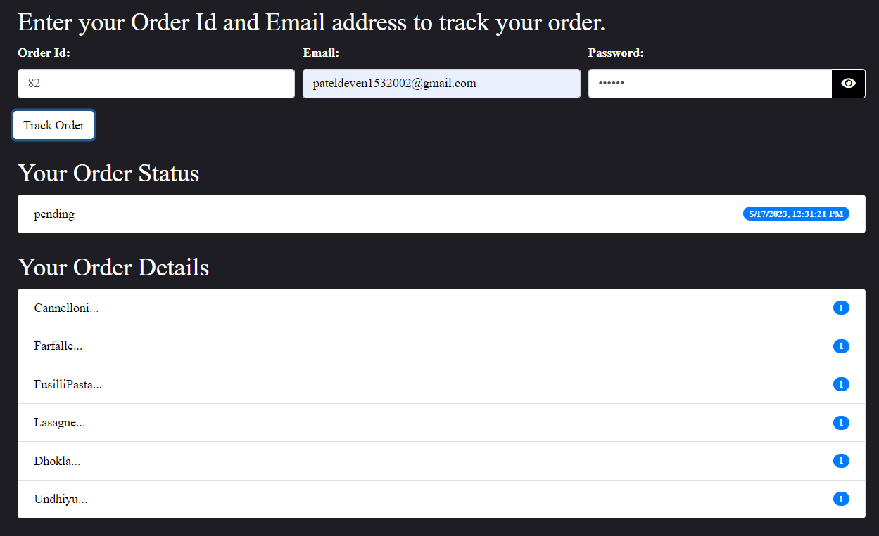
Process of project
By using the order id user can find the status of their order.
Now admin handle the whole order management and order status.

Slide 16
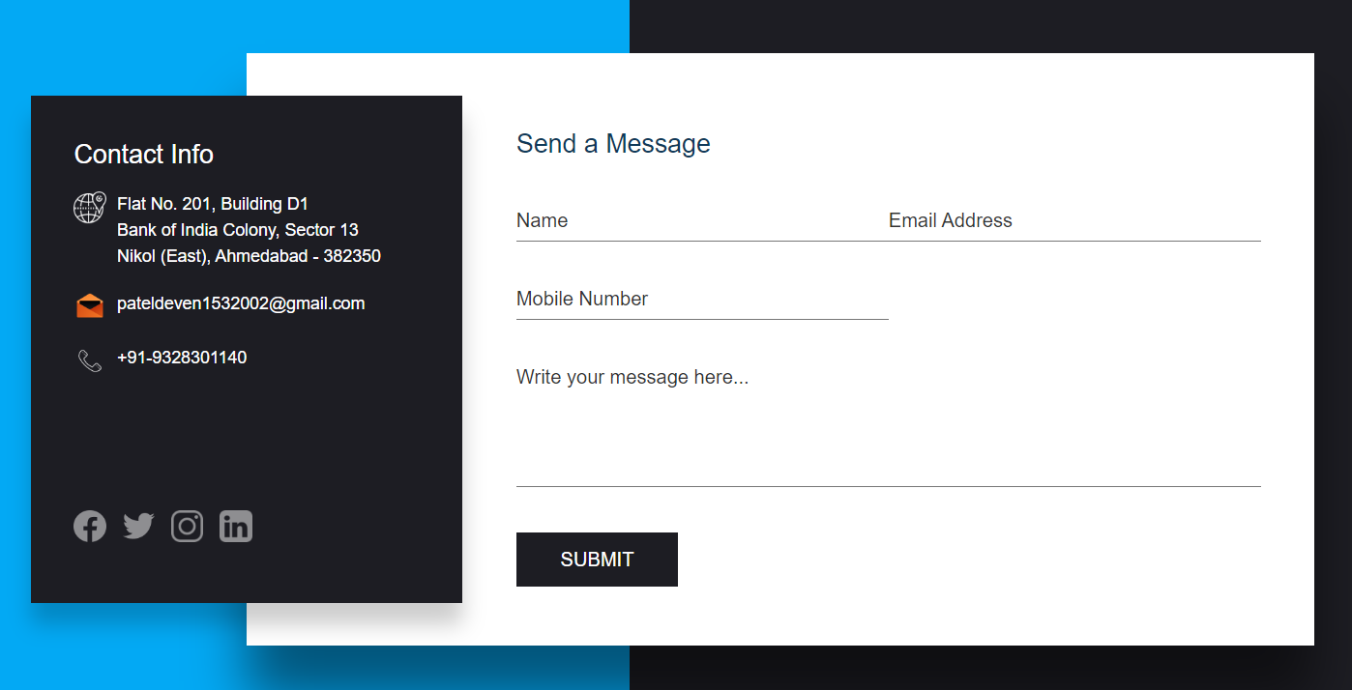
Process of project
This is the contact us page where user can send their query to the admin.
Or user can visit our restaurant which is located at given address.

Slide 17
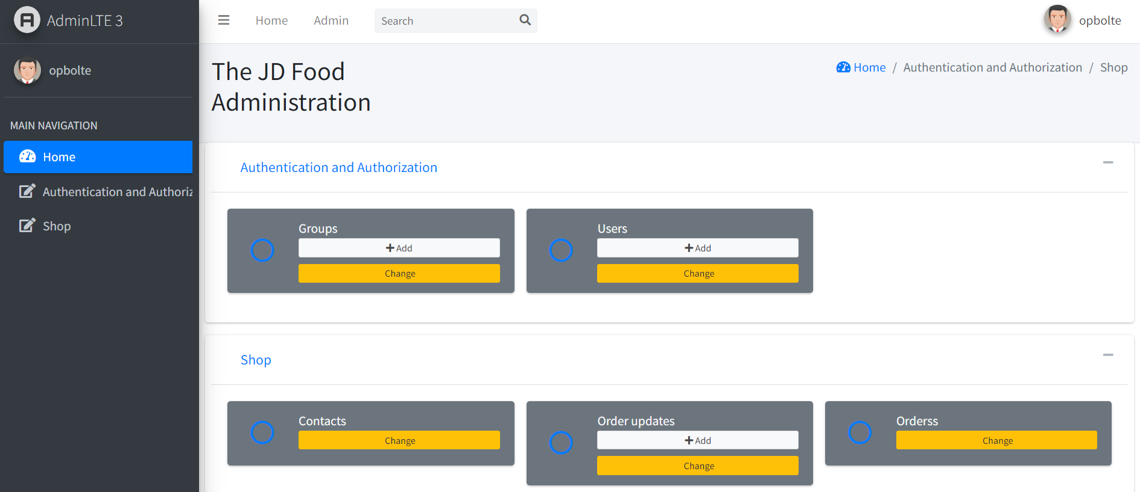
Back-end system
This the back-end administration for Admin side panel in which admin can handle all the details of users.

Slide 18
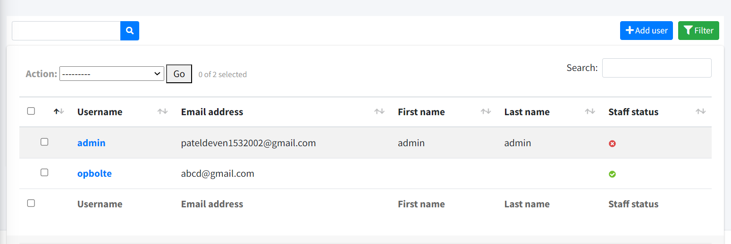
Back-end system
This section describes the total number of users who logged in and green mark illustrates the superuser which means only that member can access the whole administration panel.

Slide 19
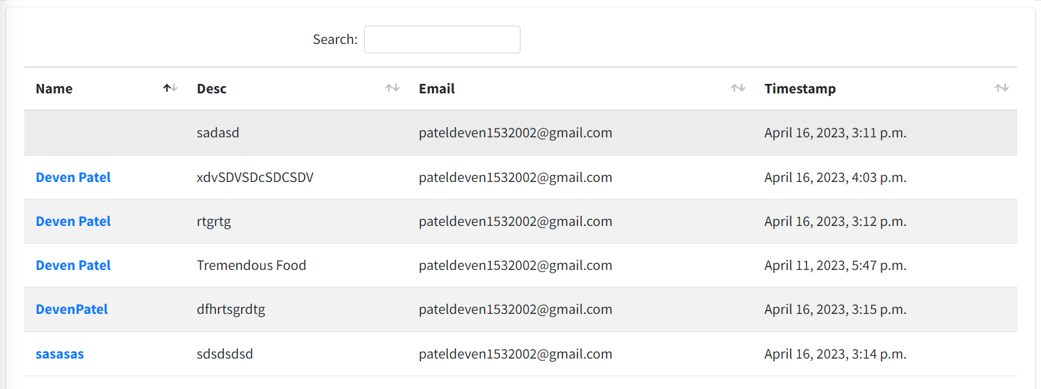
Back-end system
This section describes the total number of contact details which is sended by the user and admin directly contact by their mail.

Slide 20
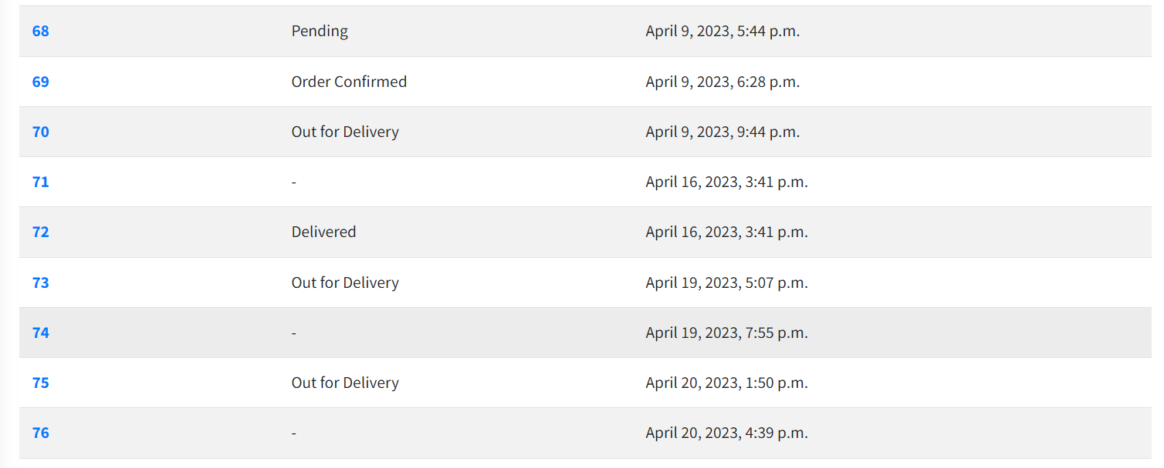
Back-end system
This section describes the total number of order details and updates which is sended by the user and admin directly send the dynamic access by their mail.

Slide 21
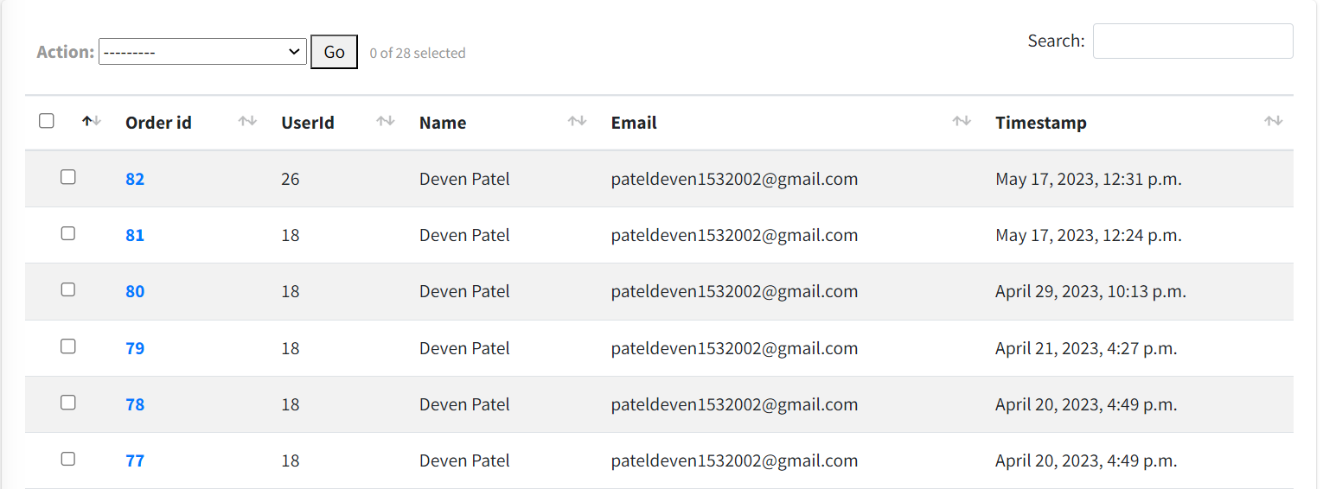
Back-end system
This section describe the total number of orders which is generated by users.

Slide 22
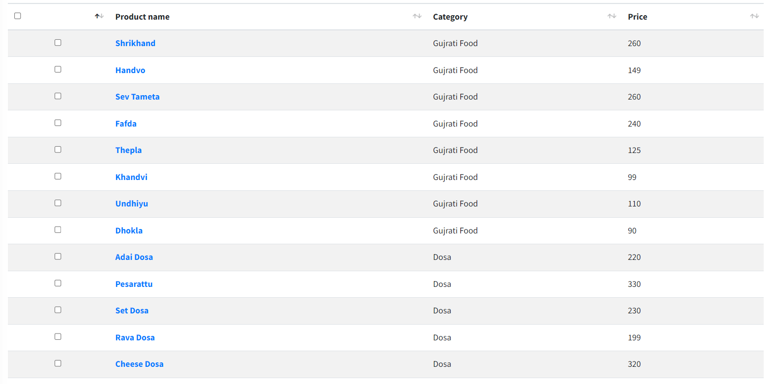
Back-end system
This part illustrates the total number of product.
Only admin can update the products, their price or categories.

Slide 23
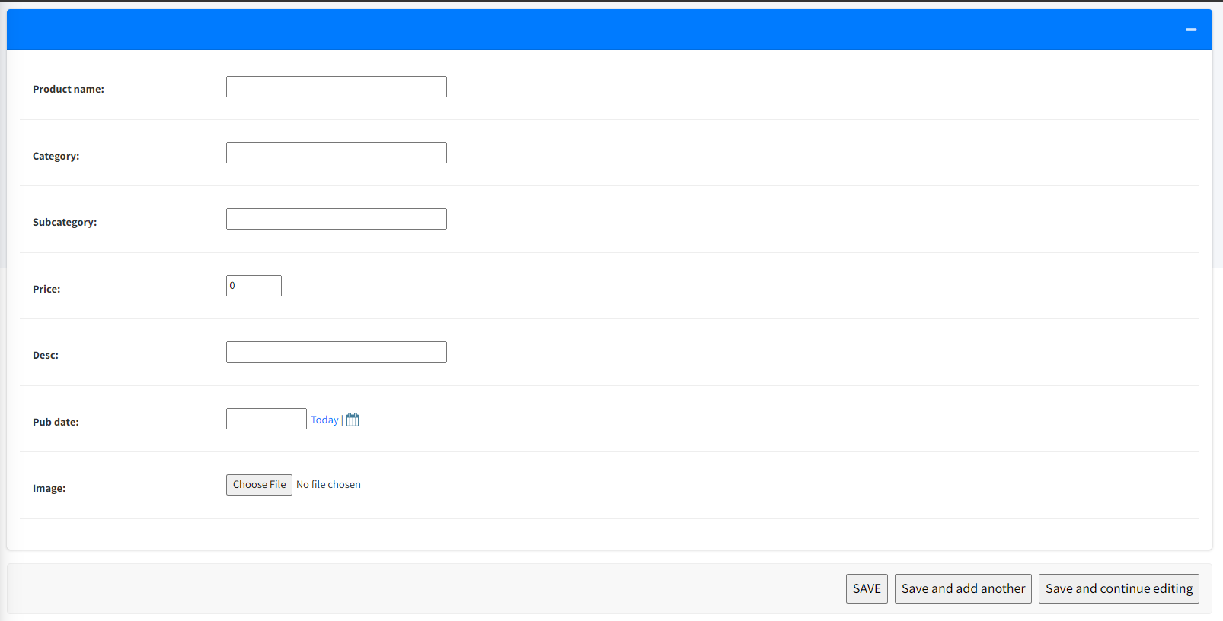
Back-end system
In this part only admin can access this section.
Admin can add new food items if it is available at restaurants.

Slide 24
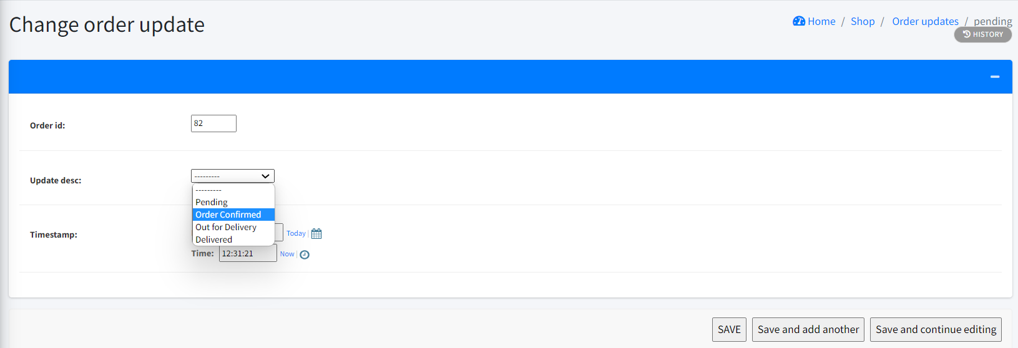
Back-end system
This is the part where user can see their order status.
Only admin can change the status of the food items.

Slide 25
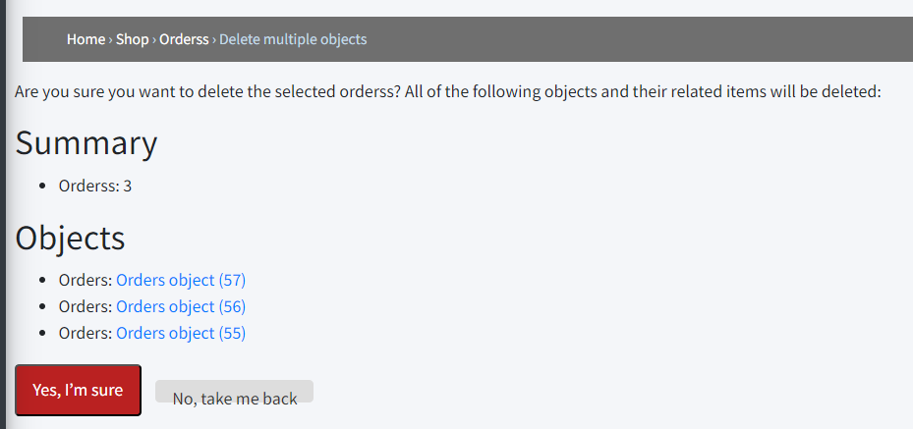
Back-end system
This section describes the delete function of food product

Slide 26
Conclusion
A food delivery website is an online platform that enables customers to order food from a particular restaurant or food outlet.
The website allows users to browse menus, place orders, and pay online for delivery or pickup. Many food delivery websites offer features like personalized recommendations, ratings and reviews, and tracking of the order status.
The website typically works with a network of restaurants and delivery partners to ensure quick and reliable delivery to customers.
These websites have become increasingly popular due to their convenience, ease of use, and the variety of food options they offer.
They are also an excellent platform for small food businesses to expand their reach and attract new customers.

Slide 27
References
During the course of project, we took help from certain external sources. Some of them are as follow:
https://www.w3schools.com/
https://www.youtube.com/kudvenkat
https://www.youtube.com/@CodeWithHarry
https://www.youtube.com/@TheCodersCubes
https://www.djangoproject.com/
https://www.youtube.com/@wscubetech

Slide 28
Thank You!

