Slide 1

Predictive Analytics
Case Study

Slide 2
Basic Terminologies
Earning
Management
Earning
Manipulation
Earning
Fraud
Accounting techniques (known as creative accounting) used to make a company’s financial reports look better constitute earnings management.
When a management takes deliberate steps to bring reported earnings to a desired level, it is called earnings manipulations.
Earnings fraud refers to the earnings manipulation by violating accounting standards and corporate laws, and/or structuring activities in such a way that reduces expected firm value.

Slide 3
Sachin Kumar, Director at MCA Technology Solutions has been asked by one of his clients if Sachin could help in checking whether any of the client’s customers were involved in earning manipulation.
Being an analytics company that specialized in auditing services, MCA Technology Solutions received several such requests from many of its customers in the banking sector to assist them with predicting earnings manipulations.
MCA Technology Solutions has employed a dedicated team of data scientists to collect relevant data and develop analytics models that could be used for predicting various types of fraud
Sachin Kumar called his chief data scientist, Saurabh Rishi and has given him the task of predicting the earnings manipulation based on the given data.
What
Is the
case about?

Slide 4
Beneish Model
Beneish’s M-Score is a mathematical model that uses eight financial ratios weighted by coefficients to identify whether a company has manipulated its profits. It was created by Professor Messod Beneish who published a paper in June 1999 called The Detection of Earnings Manipulation.
Beneish surmises that companies are incentivised to manipulate profits if they have high sales growth, deteriorating gross margins, rising operating expenses and rising leverage.
They are likely to manipulate profits by accelerating sales recognition, increasing cost deferrals, raising accruals and reducing depreciation. These eight ratios are explained in greater detail as follows:

Slide 5
1.
Days’ Sales in Receivables Index (DSRI):
A large increase in receivable days might suggest accelerated revenue recognition to inflate profits.
2.
Gross Margin Index (GMI):
A deteriorating gross margin sends a negative signal about a firm’s prospects and creates an incentive to inflate profits.
3.
Asset Quality Index (AQI):
An increase in long term assets (for example, the capitalisation of costs), other than property plant and equipment, relative to total assets indicates that a firm has potentially increased its involvement in cost deferral to inflate profits.

Slide 6
4.
Sales Growth Index (SGI):
High sales growth does not imply manipulation but high growth companies are more likely to commit financial fraud because their financial position and capital needs put pressure on managers to achieve earnings targets. If growth firms face large stock prices losses at the first indication of a slowdown, they may have greater incentives to manipulate earnings.
5.
Depreciation (DEPI):
A falling level of depreciation relative to net fixed assets raises the possibility that a firm has revised upwards the estimated useful life of assets, or adopted a new method that is income increasing.

Slide 7
6.
Sales, General and Administrative Expenses (SGAI):
High sales growth does not imply manipulation but high growth companies are more likely to commit financial fraud because their financial position and capital needs put pressure on managers to achieve earnings targets. If growth firms face large stock prices losses at the first indication of a slowdown, they may have greater incentives to manipulate earnings.
7.
Leverage Index (LVGI):
Leverage is measured as total debt relative to total assets. An increase in leverage creates an incentive to manipulate profits in order to meet debt covenants.

Slide 8
8.
Total Accruals to Total Assets (TATA):
Total accruals are calculated as the change in working capital (other than cash) less depreciation relative to total assets. Accruals, or a portion thereof, reflect the extent to which managers make discretionary accounting choices to alter earnings. A higher level of accruals is, therefore, associated with a higher likelihood of profit manipulation.
Beneish M-Score = -4.84 + 0.92*DSRI + 0.528*GMI + 0.404*AQI + 0.892*SGI + 0.115*DEPI – 0.172*SGAI + 4.679*TATA – 0.327*LVGI
Beneish concluded that if a company scored greater than -2.22 (i.e. a less negative or positive number) there was a likely probability of profit manipulation.

Slide 9
The Imbalanced Data Problem
What is Imbalanced data ?
Imbalanced classes are a common problem in machine learning classification where there is a disproportionate ratio of observations in each class. The training data for one class (majority) greatly outnumbers the other class (minority). Class imbalance can be found in many different areas including medical diagnosis, spam filtering, and fraud detection.
Issues arising due to imbalanced data
Accuracy: The standard algorithms are driven by accuracy (minimization of the overall error) to which the minority class contributes very little.
For example : For a data set containing 98 majority examples and 2 minority examples, by assigning all data to the majority class, a 98% accuracy is achieved.

Slide 10
How to mitigate class imbalance ?
Resampling Techniques :- Oversample minority class
Oversampling can be defined as adding more copies of the minority class. Oversampling can be a good choice when you don’t have a ton of data to work with.
Resampling techniques :- Under sample majority class Under sampling can be defined as removing some observations of the majority class.
Generate synthetic samples :- A technique similar to up sampling is to create synthetic samples. Here we can use SMOTE or Synthetic Minority Oversampling Technique. SMOTE uses a nearest neighbours algorithm to generate new and synthetic data we can use for training our model.

Slide 11
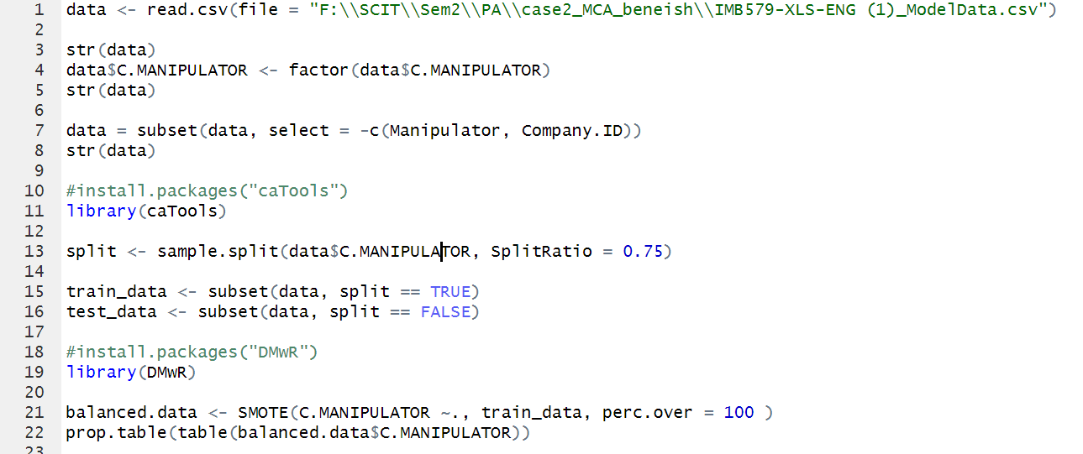
Logistic Regression with Sample data

Slide 12
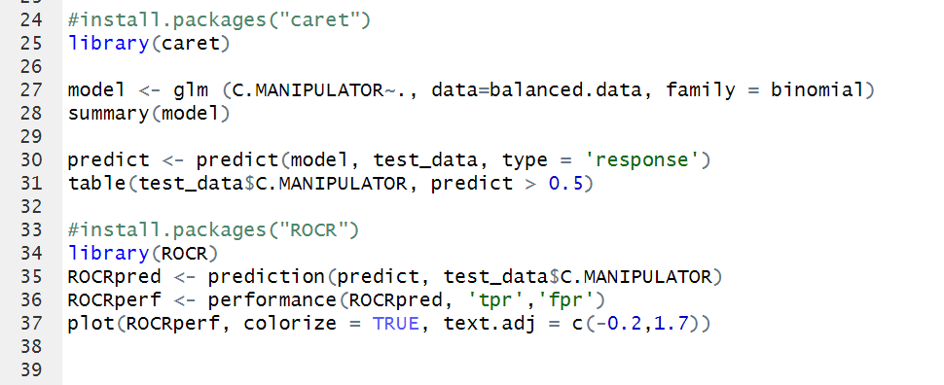
Logistic Regression with Sample data

Slide 13
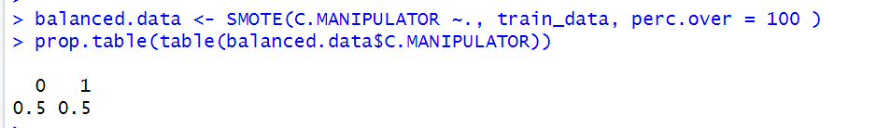
Logistic Regression with Sample data

Slide 14
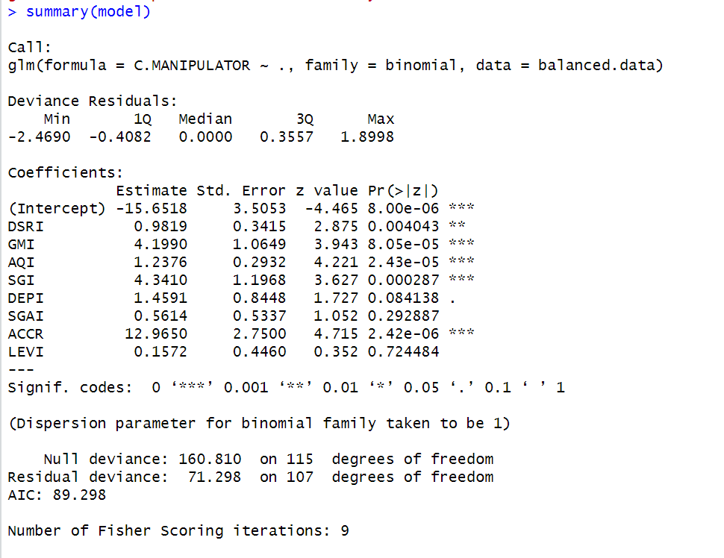
Logistic Regression with Sample data

Slide 15
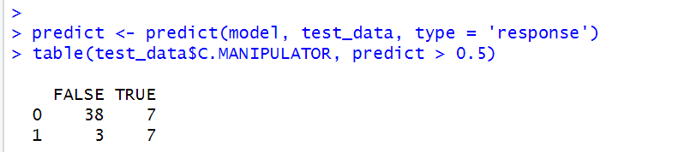
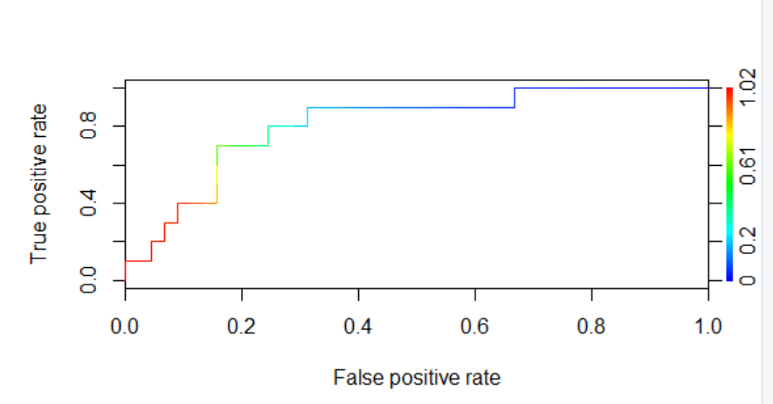
Logistic Regression with Sample data
Accuracy: 81%

Slide 16
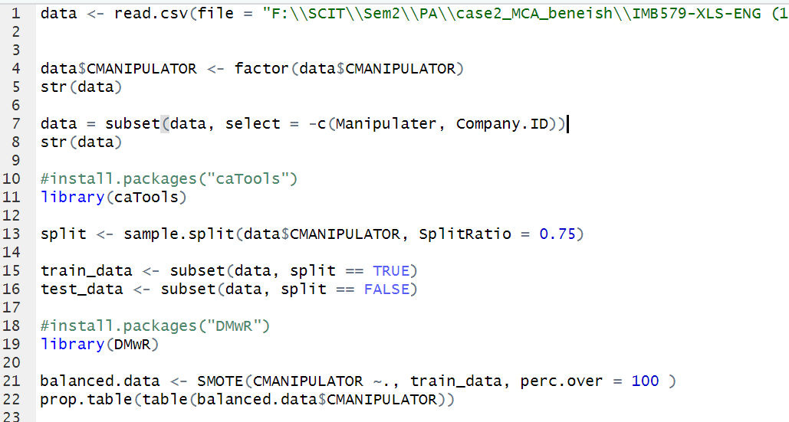
Logistic Regression with Complete data

Slide 17
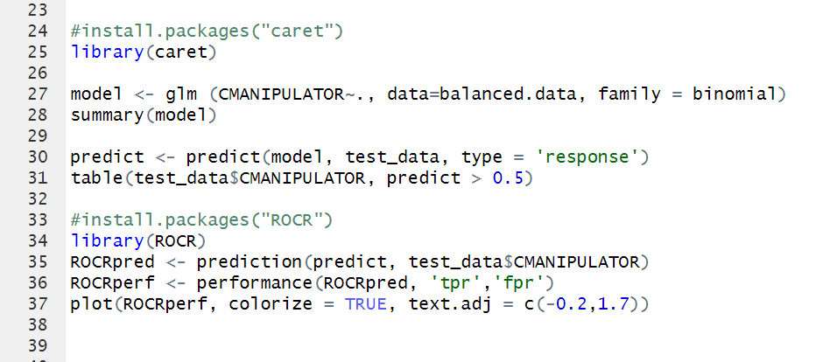
Logistic Regression with Complete data

Slide 18
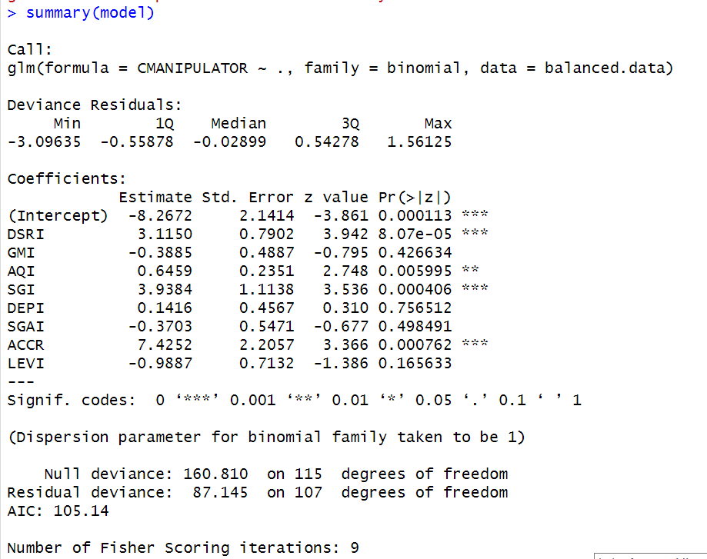
Logistic Regression with Complete data

Slide 19
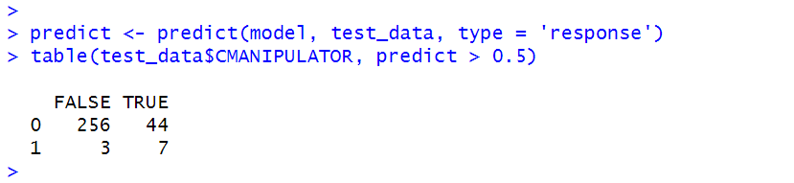
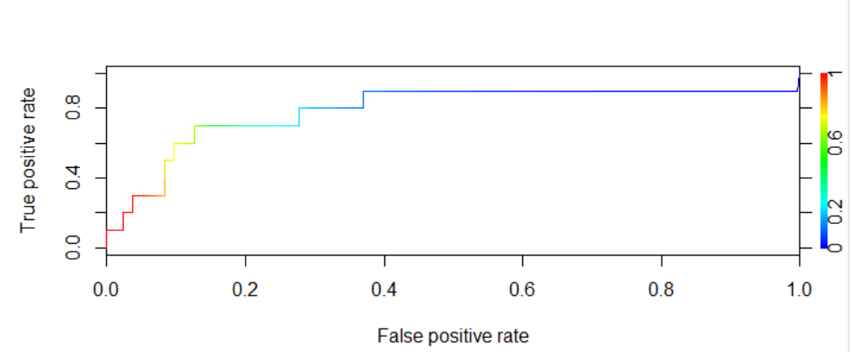
Logistic Regression with Complete data
Accuracy: 84%

Slide 20
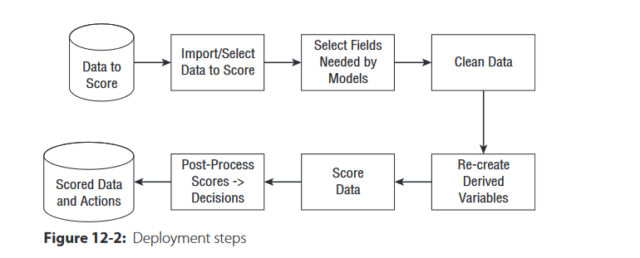
Deployment Strategy

Slide 21
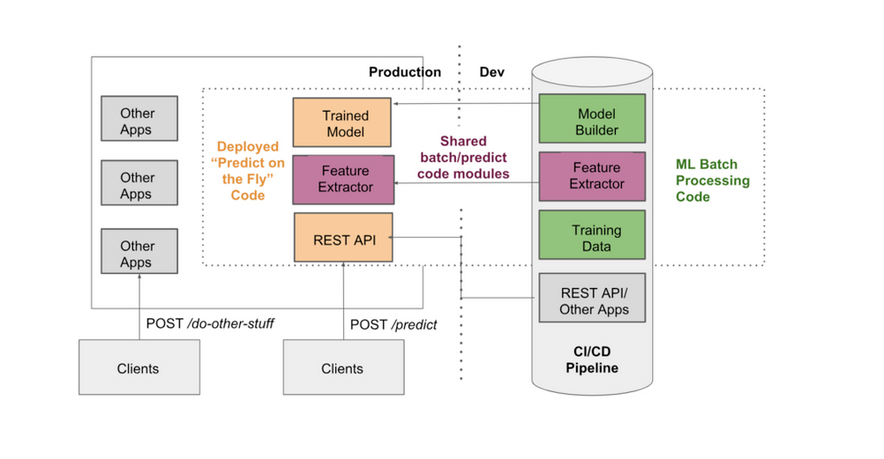
Deployment Strategy

Slide 22
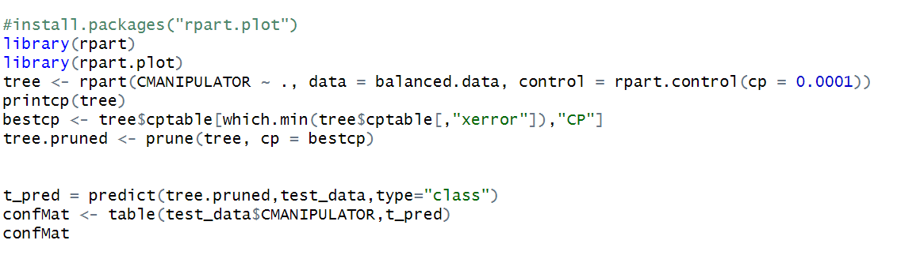
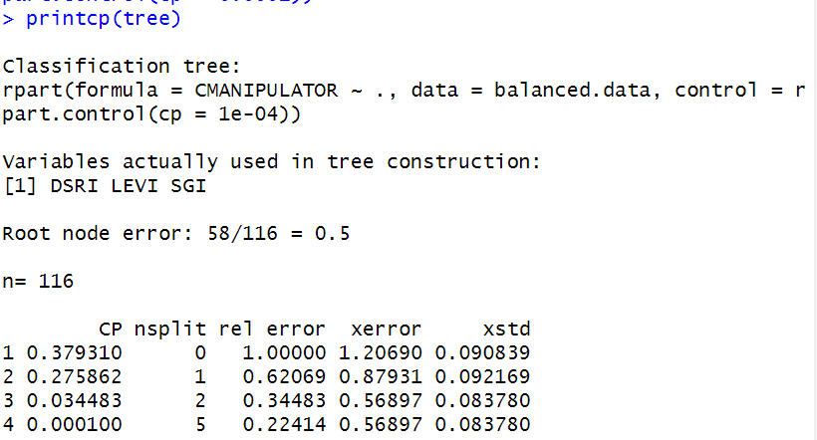
Other Models
Classification Tree (CART)

Slide 23
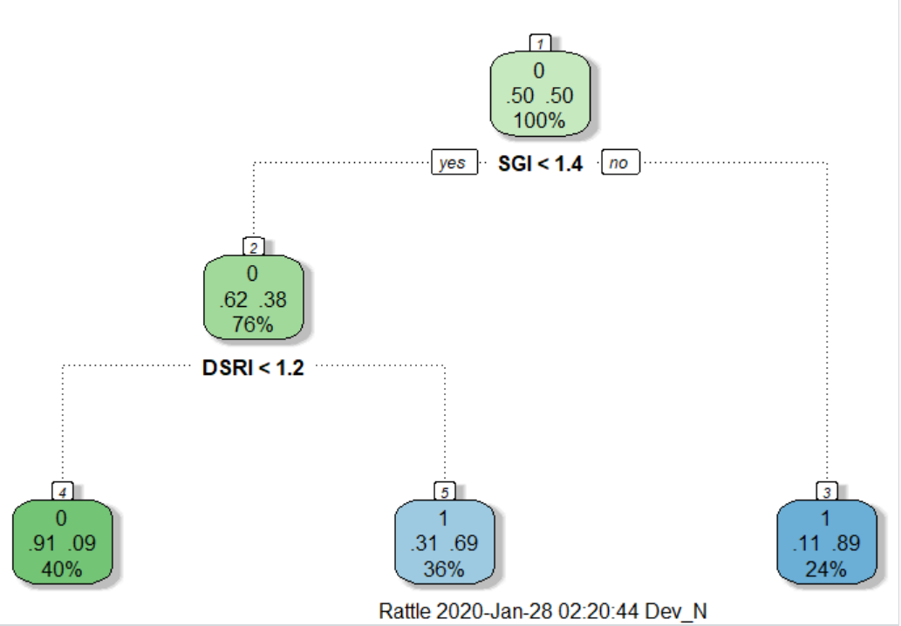
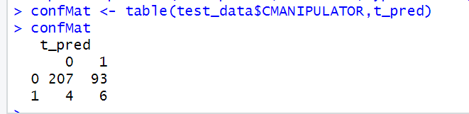
Other Models
Classification Tree (CART)
Accuracy: 68%

Slide 24
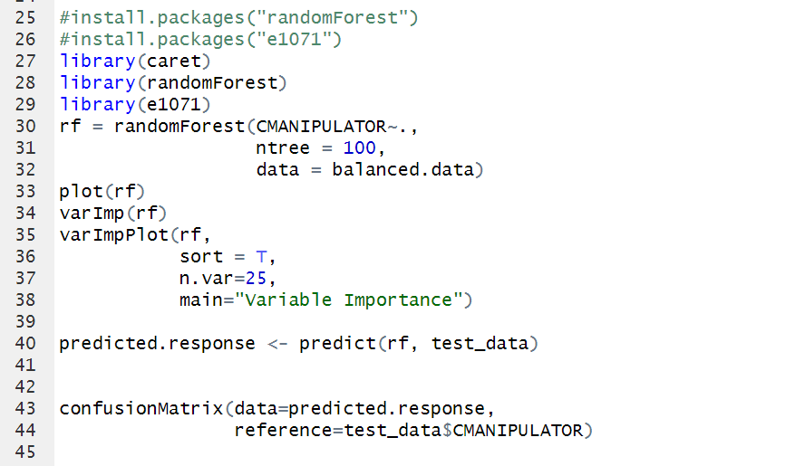
Other Models
Random Forest

Slide 25
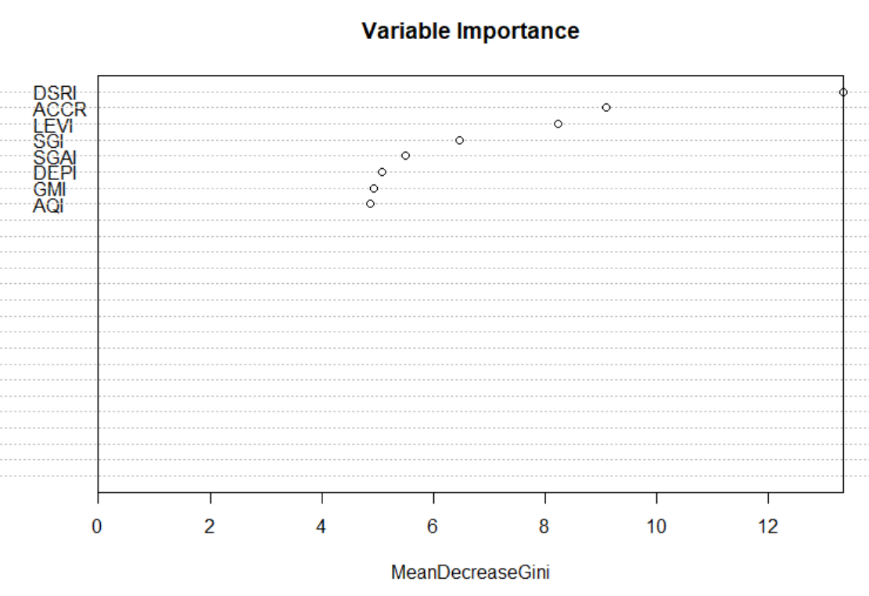
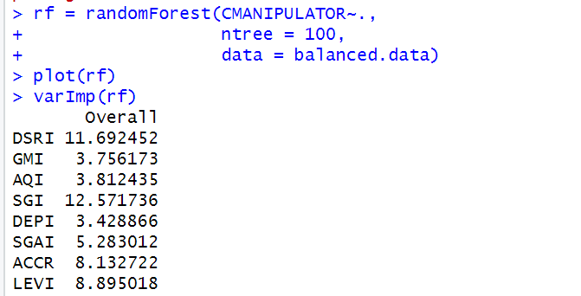
Other Models
Random Forest

Slide 26
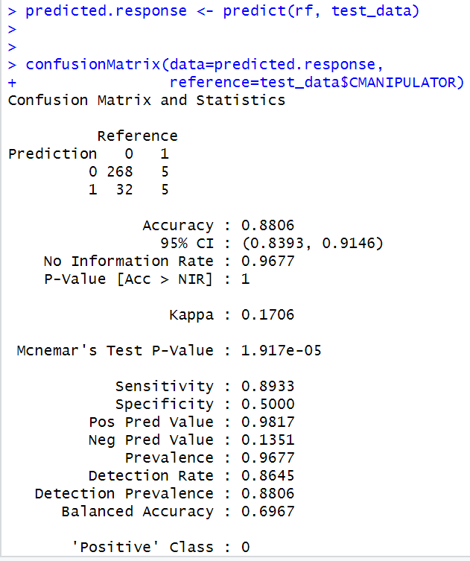
Other Models
Random Forest

Slide 27
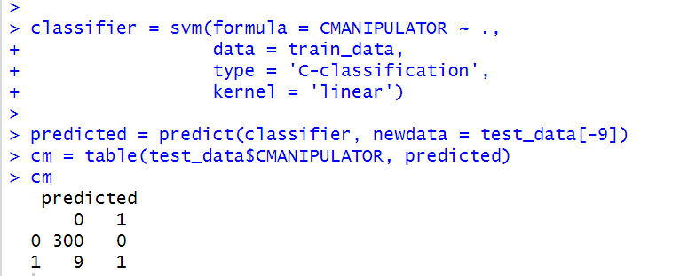
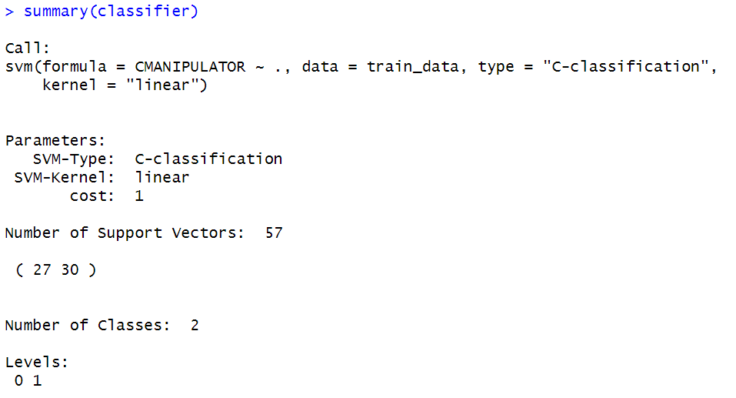
Other Models
Support Vector Machine

Slide 28
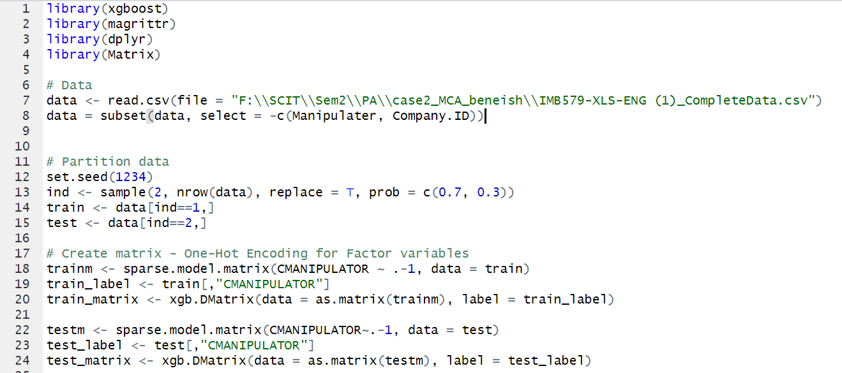
Other Models
XGBoost

Slide 29
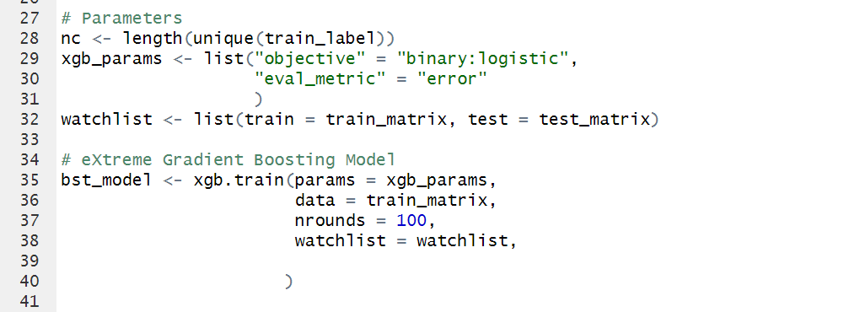
Other Models
XGBoost

Slide 30
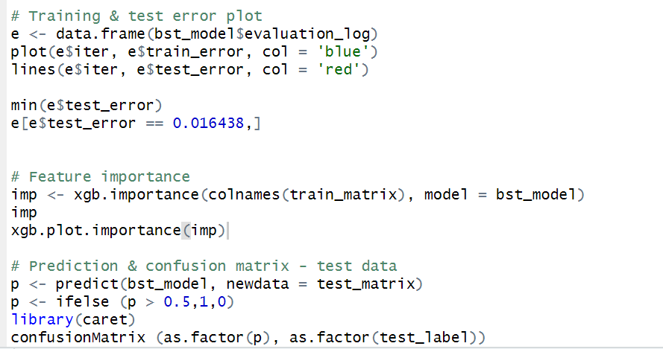
Other Models
XGBoost

Slide 31
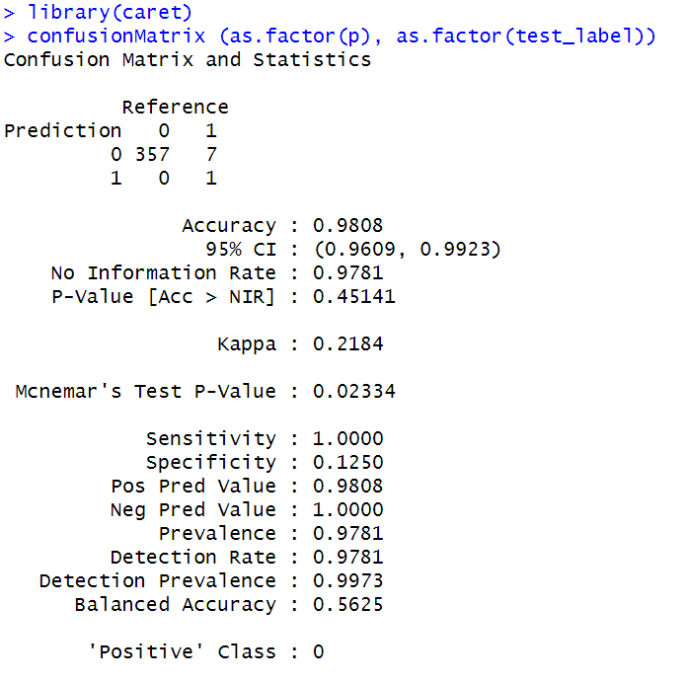
Other Models
XGBoost

Slide 32
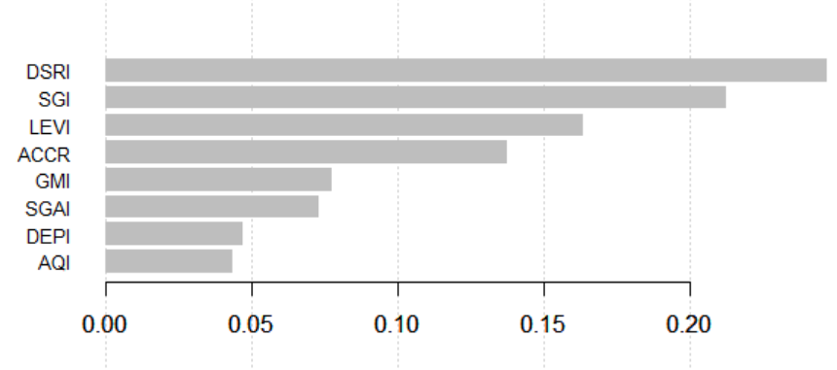
Other Models
XGBoost

Slide 33
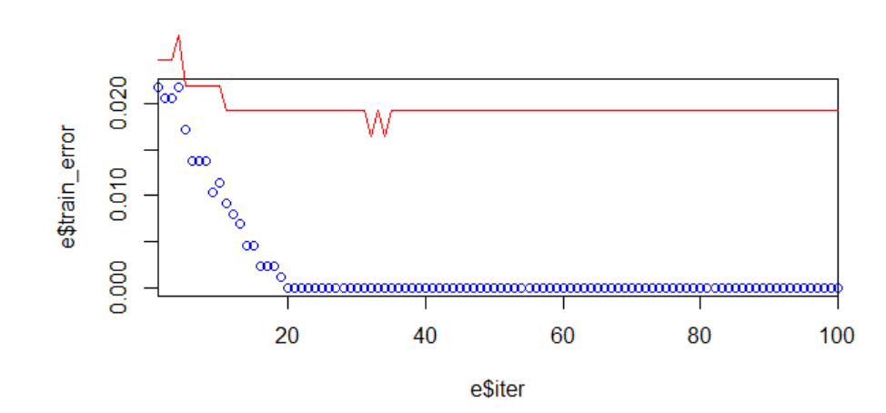
Other Models
XGBoost

Slide 34
Thank You

