Slide 1
Smart Mobile Robot for Security of Low Visibility Environment

Slide 2
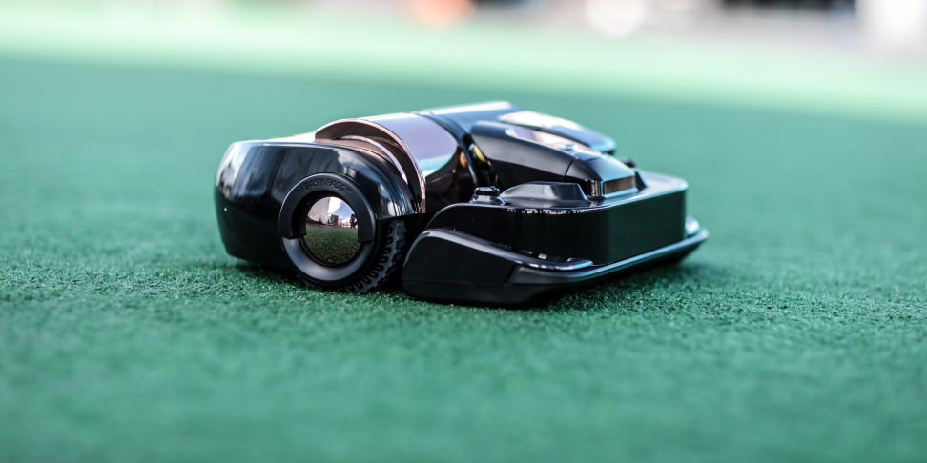
In the last decade, mobile robots have become an important topic in the security field. Several methods have been introduced to deal with mobile robot and security.
We are going to introduce a novel smart security system, which uses a mobile robot as a security patrol in dark environment. The proposed system is a non-vision based system and designed to deal with the dark environments using artificial intelligence methods (Neural Network NN and Fuzzy Logic FL).

Slide 3
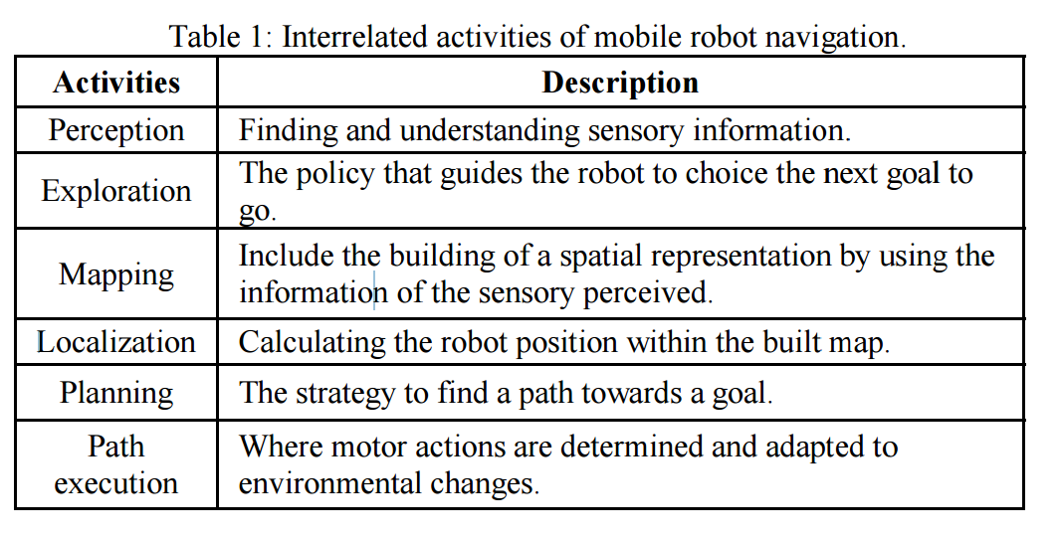
Mobile robots navigation includes different interrelated activities as they are illustrated in Table . We will explain each activate in the Motion Control System part of the propose system.

Slide 4
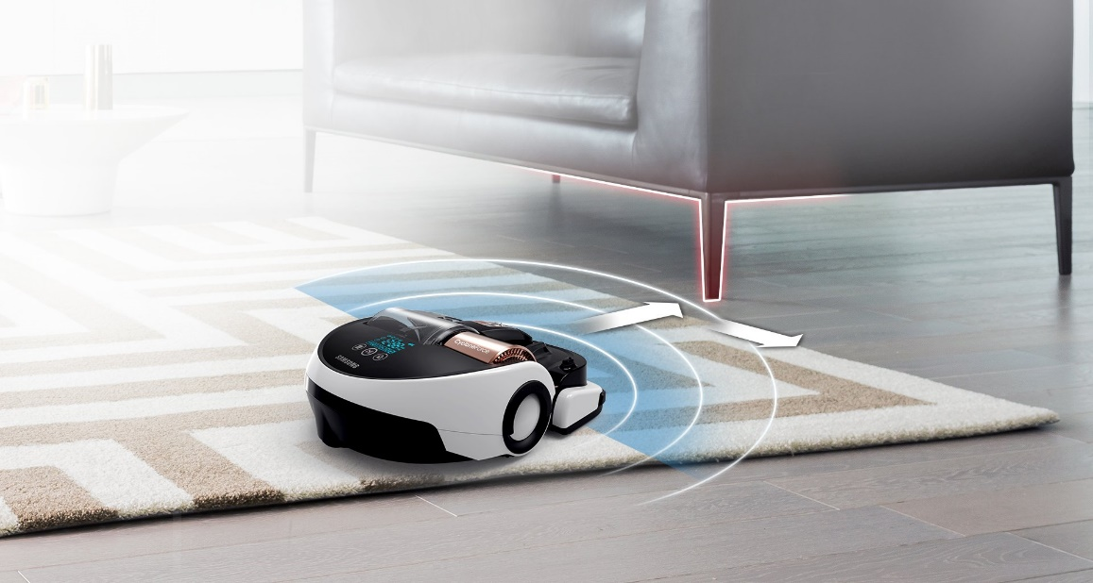
The proposed system is designed to work with PowerBot mobile robot platform, which is developed by Adept Mobile Robots Inc
This system is a non-vision based mobile robot for security patrols in dark environment. This system addresses the difficulty of monitoring a specific area or building in a dark environment.
This is accomplished by using artificial intelligence methods and laser rang sensor and the ultra-sonic. In this system, we fused the laser rang device and the ultra-sonic in order to use in the monitoring and navigation operations.

Slide 5
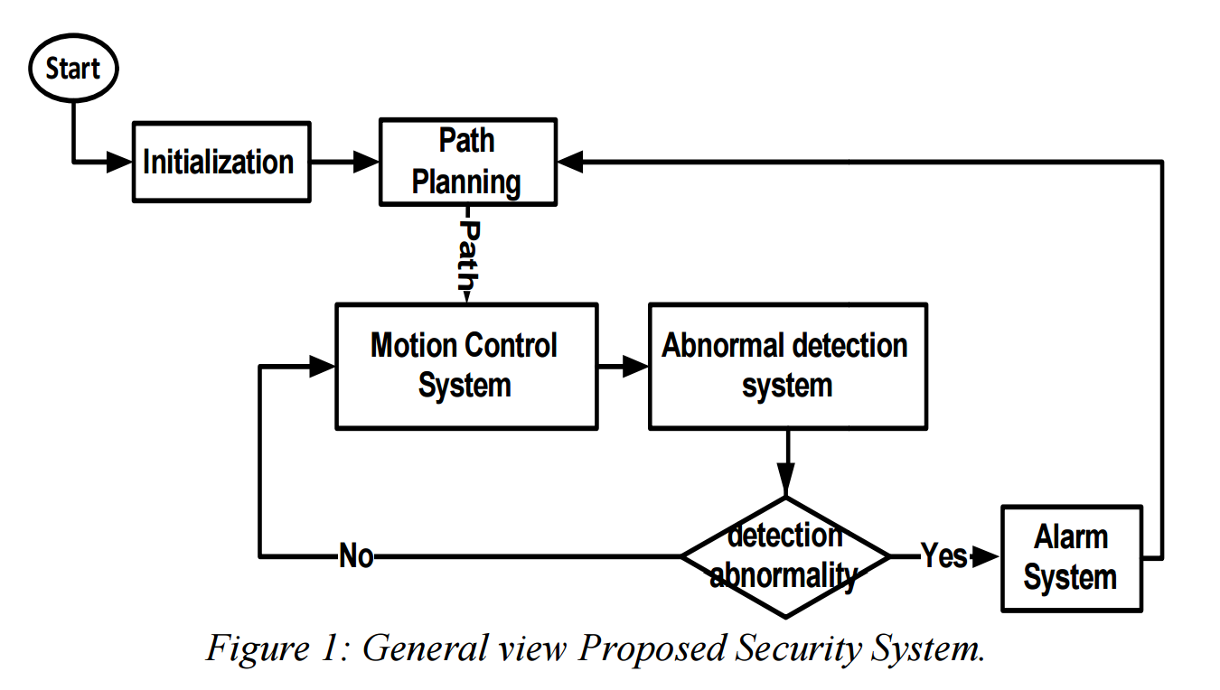

Slide 6
The mobile robot patrol starts its monitoring task by the initialization (turn on the robot, the laser device, and the ultrasonic, determine his location, and many other tasks) and path planning operations.
After that, the control moves to the Motion Control System (MCS). MCS is responsible for the motion operation in the monitoring area. MCS is a behaviour based system and involves four fuzzy logic modules.
During the movement operation, the abnormal detection system monitors the environment.
In case of any abnormal detection, the control switches to the Alarm System (AS), in order to make an alarm and decision.

Slide 7
MOTION CONTROL SYSTEM
MCS is responsible for the navigation operation in the monitoring area.
This system is a behaviour-based system, which involves four fuzzy logic modules.
Based on the situation of the robot one of four models will be used to control the operation of the robot.
The four model are:
Emergency Behaviour (EB)
Obstacles Avoidance Behaviour (OAB)
Robot Setting Behaviour (RSB)
Navigation Behaviour (NB)

Slide 8
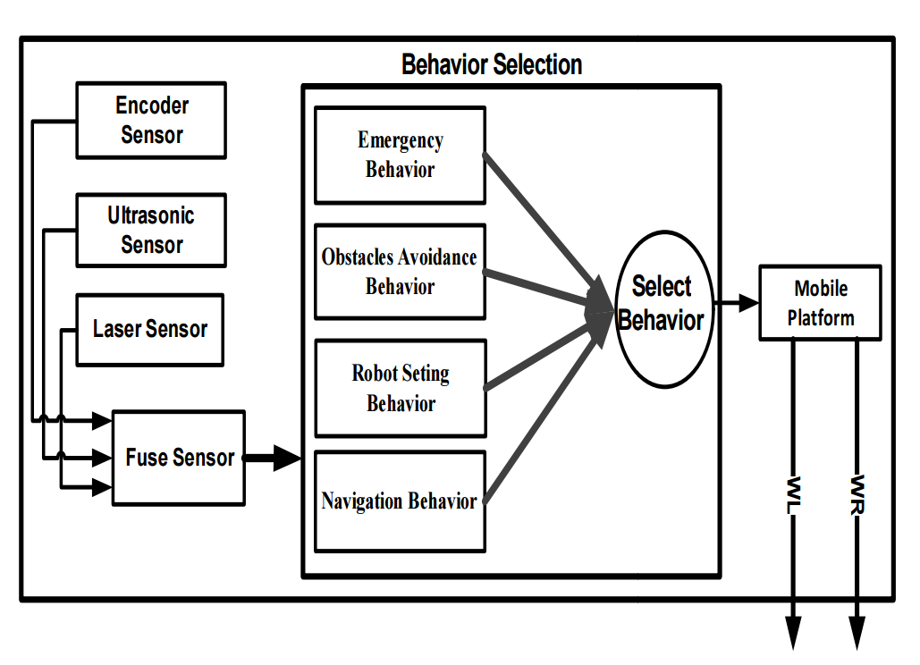
MOTION CONTROL SYSTEM

Slide 9
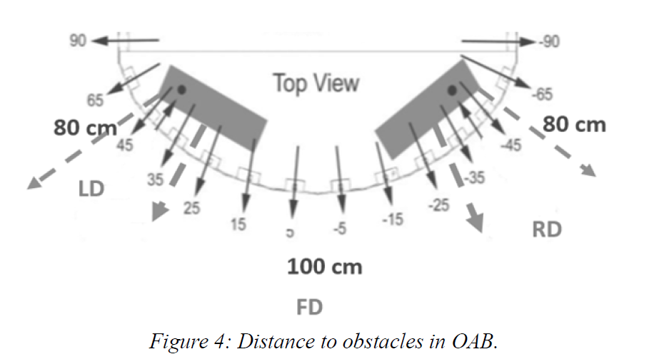
A. Emergency Behaviour (EB)
When the distance between the robot and any obstacle is lase then 30 cm the EB is invoked to control the operation of the mobile robot.
The inputs of EB are the distance between the right, front, and left parts of the robot and the obstacles (RD, FD, and LD).

Slide 10
B. Obstacles Avoidance Behaviour (OAB)
The OAB module is used in avoiding static and dynamic obstacles with a distance between 30 and 100 cm from the robot.
The inputs and output of OAB are similar to the one in EB.
C. Robot Setting Behaviour (RSB)
RSB is used to modify the robot configuration in case of existence of close intermediate points (if the distance between the robot and the point is lase then 50 cm).
The input of RSB is the angle that the robot should rotate (rotate angle). The outputs of the OAB are the velocities of the left LV and the right RV of the motors.

Slide 11
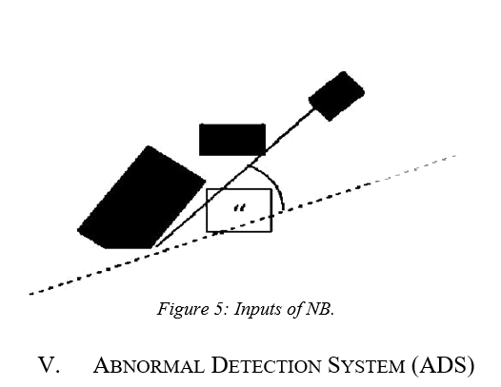
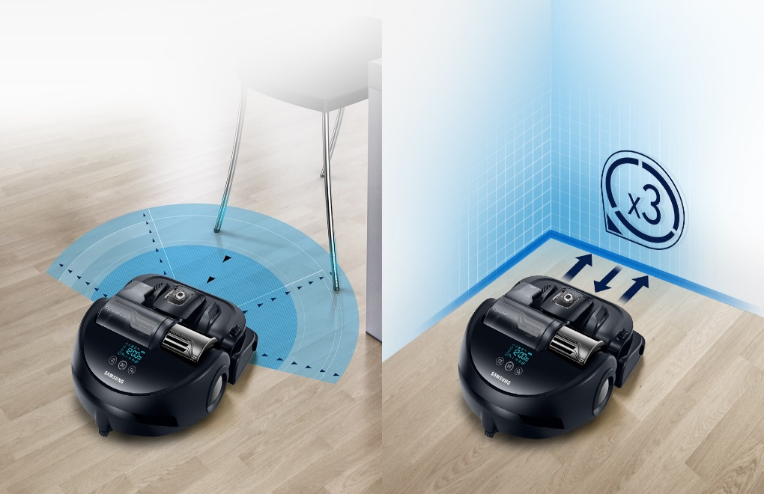
D. Navigation Behaviour (NB)
NB is used to navigate the PowerBot robot in the monitoring area. The inputs of NB are the angle between the direction of the robot to the target and the x-axis (error angle), and the distance between the robot and the target as illustrated in Figure 5. The outputs of NB a re the velocities of the left and right motors.

Slide 12
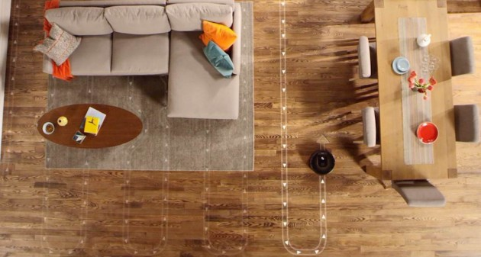
Path navigation

Slide 13
ABNORMAL DETECTION SYSTEM
ADS is responsible for detecting any abnormal situation in the monitoring area.
During the navigation operation of the Robot in the monitoring area, the NN and FL techniques are used in order to determine the abnormal situation in the environment.
The NN and FL use the information coming from the laser rang devise and the ultrasonic sensor, pulse the information stored about the environment, in order to deal with the dark environment (Where it is impossible to use the normal camera).

Slide 14
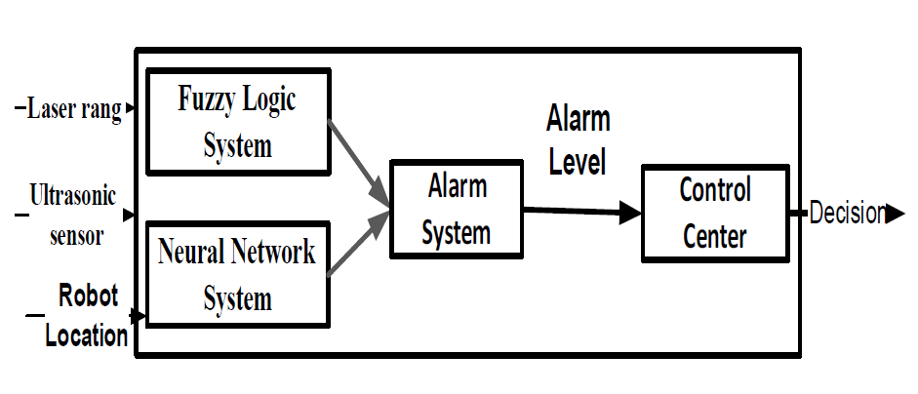
The ADS has many levels depending on the abnormality of the monitoring environment.

Slide 15
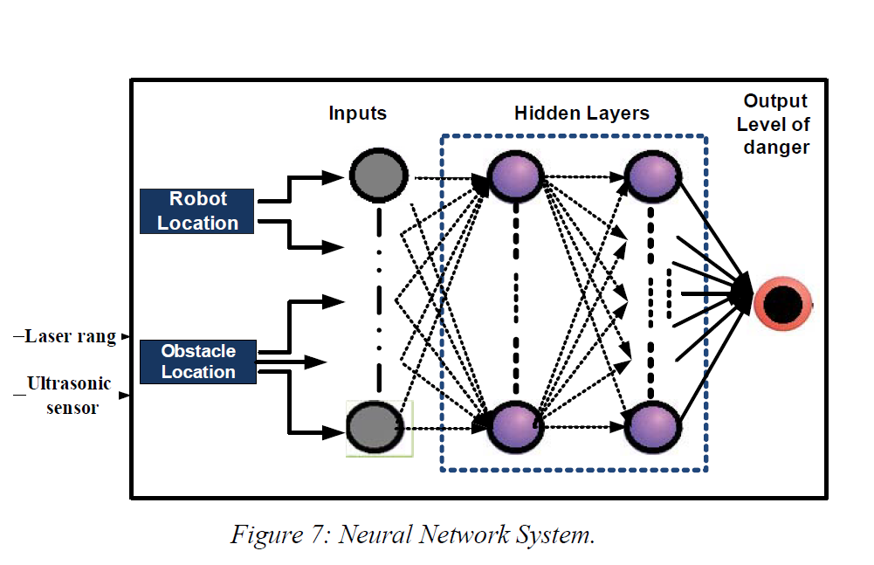
Neural network system

Slide 16
ABNORMAL DETECTION SYSTEM
The path planning, the abnormal detection and the behavior selection system are integrated to form the complete systems as showing in figure.
The path planning and behavior selection systems used the PowerBot mobile robot platform. PowerBot is a wheeled mobile robot from pioneer mobile robots Inc. It is an automated differential drive gu ided vehicle specially designed and equipped for autonomous, intelligent delivery and handling of large payloads.

Slide 17
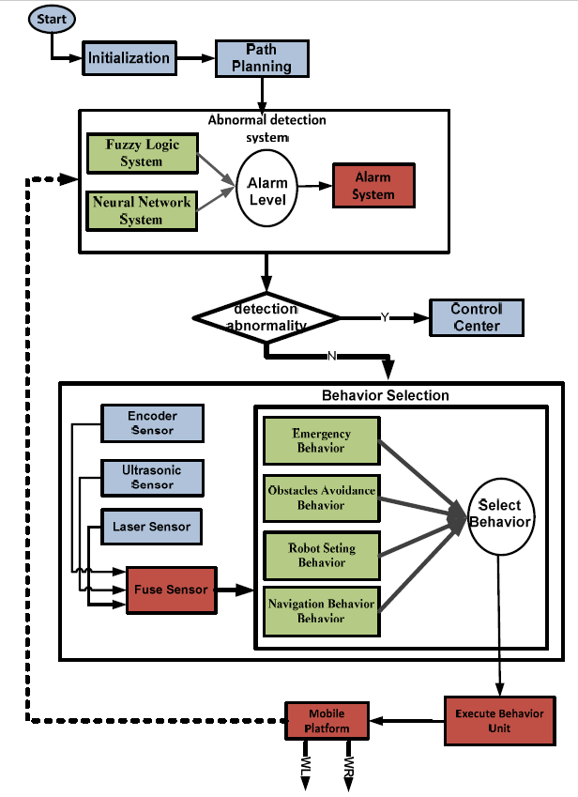

Slide 18
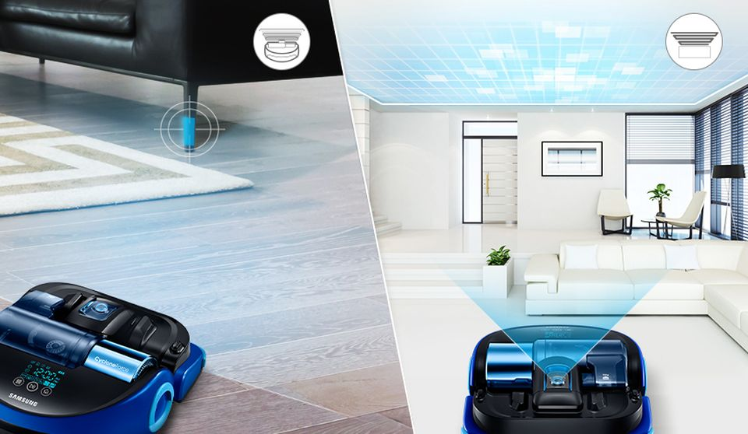
CONCLUSION
We can use fuzzy logic to realize the reactive behaviours for robot navigation.
The method can effectively coordinate conflicts and competitions among multiple reactive behaviours by weighting them and this coordination ability is nearly independent of a dynamic environment due to robustness.

